Slide 1
IN AN ELECTION WAR ROOM
Presented by-
Shreyansh Kesharwani
Suman Das
Sachin Meena

Slide 2
AAM AADMI PARTY
Fastest growing political party in India
4th party after BJP, INC and CPI to have chief ministers in more than 1 states

Slide 3
Politics of Ideology vs Politics of Infrastructure
What makes AAP different from other political parties ?
Why ideology is important ?
How Politics of Infrastructure is beneficial for AAP

Slide 4
Gujarat Politics
Bipolar (BJP and INC)
BJP ruling since past 27 years
While INC has maintained its position as opposition since then

Slide 5
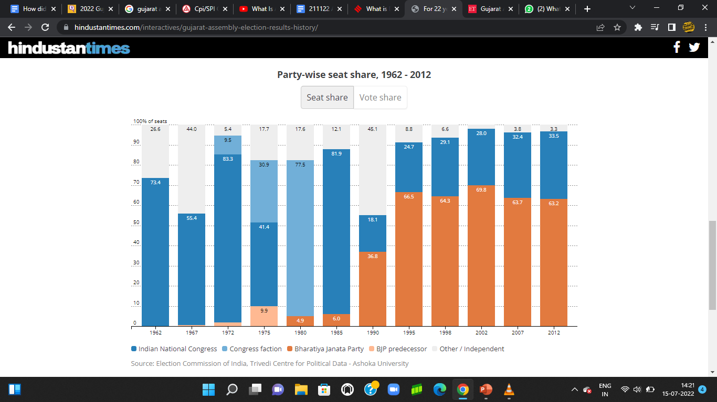

Slide 6
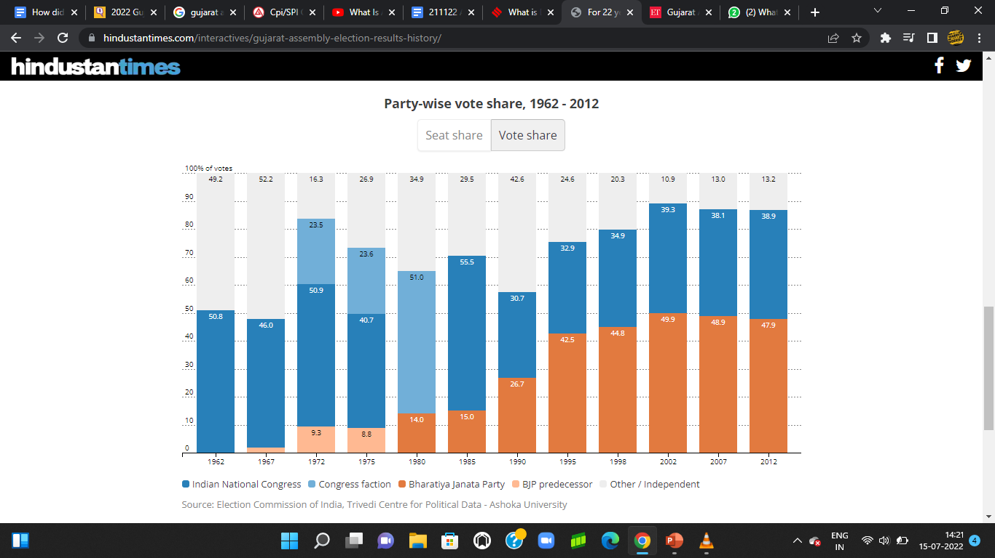

Slide 7
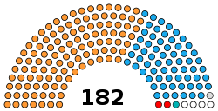
Government (111) BJP (111) Opposition (64) INC (63) IND (1) Others (3) BTP (2) NCP (1) Vacant (4) Vacant (4

Slide 8
BJP’s Steps
PM’s frequent Gujarat visits
Replacing Vijay Rupani by Bhupendra Patel
Dependence on PM Modi’s image
Focus on Tribal belt

Slide 9
INC’s Performance
Lost by a narrow margin of 22 seats in 2017
In 2021 local body polls majority only in one out of 81 municipalities and 18 out of 231 taluka panchayats.
Departure of leaders like Hardik Patel and Alpesh Thakor
Dalits and Adivasis make up a sizeable chunk of Congress' support base in Gujarat

Slide 10
AAP’s Steps
Joined hands with BTP
Reaching out to Patidar community through roadshows and rallies
In 2021 local body polls won 21% of votes in Gandhinagar
Punjab’s sweep gives wings to AAP’s hopes

Slide 11
What should be AAP’s strategy?
Focus on Politics of Infrastructure as they did Delhi and Punjab
Focus on their strong issues i.e. Education and Healthcare
Impactful political rallies, reaching out to people on ground
Targeting the ruling and opposition parties on their failures

Slide 12
Main Agendas
Delhi Model
Employment generation
Corruption
Inflation
Basic necessities ( free water, electricity, wifi etc.)

Slide 13
Target Voters
BJP had around 40% vote share in 2017 assembly elections
Should focus on lower and middle class urban voters
INC’s major support consist of rural voters
Avoiding caste / religion politics

Slide 14
Patidar and Tribal communitry
BTA alliance with AAP
Both BJP and Congress don’t have strong voters support from Patidar community

Slide 15
Points to be taken care by AAP to be the strong opposition by 2029
To collaborate with state parties. Like BJD,TMC etc.
To have a good face for PM who have a high experiences and good personality.
Public leaderships should be generated.
They should have strong local leaders in non Hindi spoken states .
Making solutions for unemployment.
More importance on Human Development Index .

Slide 16
THANK YOU

