Slide 1
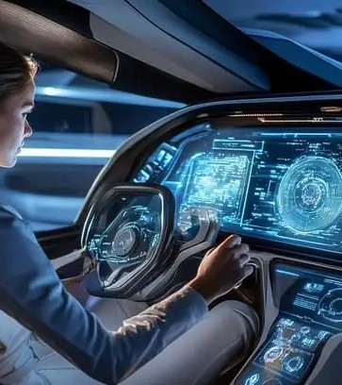




AI-Powered Vehicle Diagnostics & Mileage Integrity Platform
Transforming the automotive ecosystem with AI and blockchain technology
Group Number: 25-26J-396
1/20

Slide 2


Introduction to the Problem
Real-World Challenges
Affected Parties
Vehicle Breakdowns
Unpredictable failures leading to inconvenience and safety concerns
Unpredictable Repair Costs
40% variation across garages creates budgeting difficulties
Mileage Fraud
Affects 30% of used cars in EU, causing financial losses
Drivers
Insurance
Garages
Buyers
30%
Used cars affected by mileage fraud in EU
40%
Variation in repair costs across garages
System Architecture
Data Collection
AI Models
Blockchain
APIs
Users

Slide 3

Fault-Type Classifier
Specialization: Information Technology

Slide 4
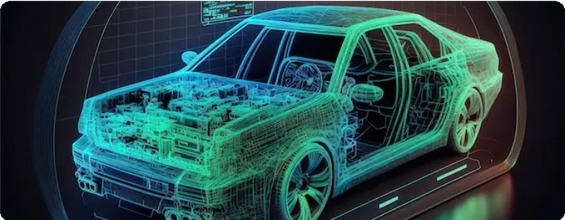
Fault-Type Classifier
The Challenge
How It Works
Current Limitations
Traditional OBD-II tools only provide generic fault codes without intelligent classification
Raw Data Collection
Gather diagnostic data from vehicle
Time-Consuming Process
Current diagnostic process requires extensive manual interpretation by technicians
AI Processing
Machine learning algorithms analyze patterns
Our Solution
AI-Driven Classification
Our system moves beyond simple code reading to identify the root cause of issues
Precise Classification
Fault type identified with high precision
Immediate Diagnosis
Provides accurate and instant identification of vehicle faults

Slide 5
Application of Knowledge - Fault-Type Classifier
Knowledge Domains Data Sources
Machine Learning Automotive Diagnostics
Open-source audio datasets or Frequency datasets
Technologies
User Inputs
Observed symptoms and driving conditions
CNN
Image-based fault processing
Ethical Considerations
Data Privacy
No personal data collection
Random Forest
Tabular data analysis for fault patterns
XGBoost
Advanced tabular data analysis
Only vehicle diagnostic data processed
No user location tracking
Evaluation Metrics
Transparency
Clear explanation of fault classifications
Accuracy
Precision
Recall

Slide 6


Specialization & Validation - Fault-Type Classifier
Validation Approach Specialization Requirements
Data Science
Advanced statistical analysis and machine learning techniques for pattern recognition and classification
Traditional OBD-II
Provides only generic fault codes
Requires manual interpretation
Time-consuming process
AI-Based Classifier
Intelligent fault type detection
VS
AI Development
Expertise in training and optimizing classification models with deep learning frameworks
Identifies root causes
Immediate diagnosis
Automotive Diagnostics
Knowledge of vehicle systems and fault patterns to create relevant training datasets
Real-World Usage Scenario
A driver or mechanic records engine/brake/wheel sounds via a smartphone.
App preprocesses audio and generates spectrograms.
CNN model classifies the type of mechanical fault.
Immediate feedback is provided, allowing early maintenance and preventing vehicle breakdowns.
Validation Strategy
Rigorous testing against diagnostic capabilities of existing OBD-II scanners
90%+

Slide 7
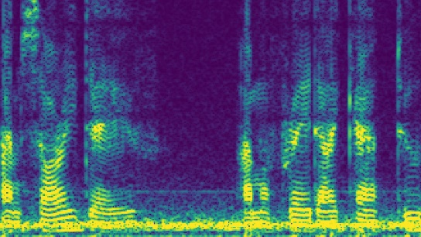
Implementation Details - Fault-Type Classifier
System Workflow
Spectrogram
Real-World Benefits
Drivers can identify root causes instantly
User Input
Symptoms & conditions
Garages can provide immediate diagnoses
Reduces diagnostic time and uncertainty
ML Processing
Fault Label
Random Forest
XGBoost
CNN
6 / 20

Slide 8

Repair Cost Estimater
Specialization: Information Technology

Slide 9
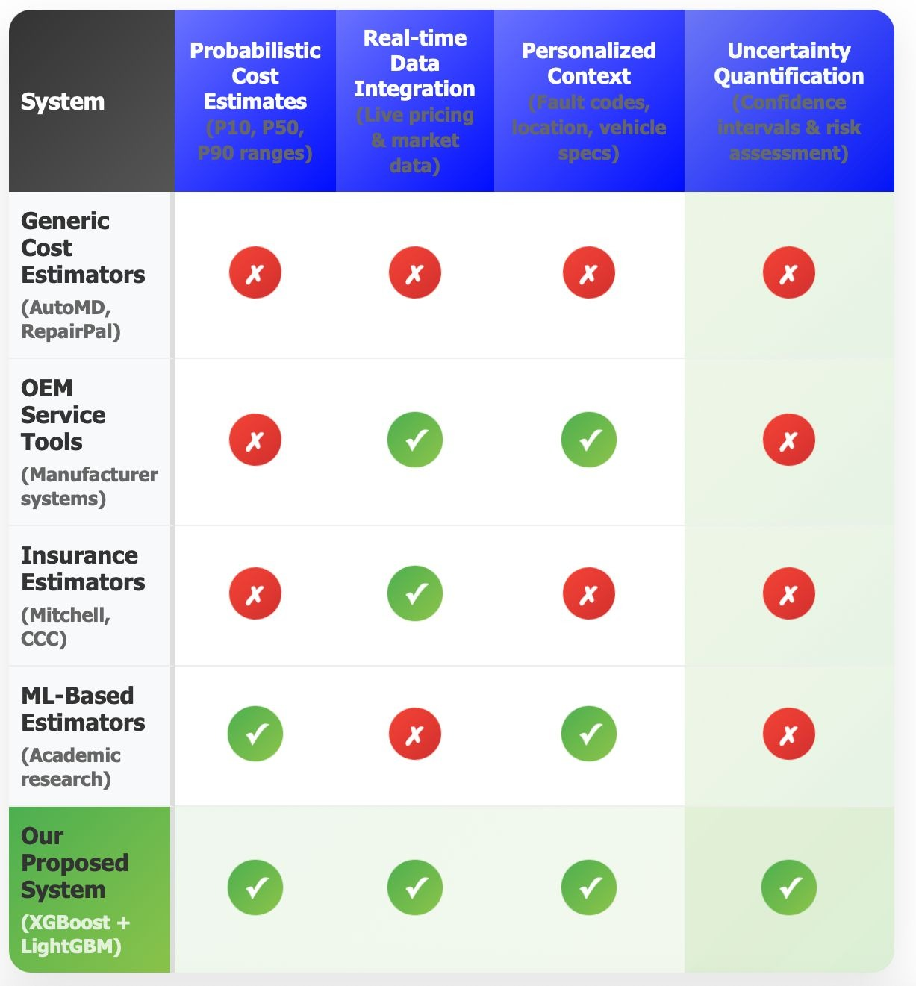
.
Research gap

Slide 10


Repair-Cost Estimator
Predicts repair costs based on spare parts and labor, providing transparent estimates for all stakeholders.
How It Works Cost Uncertainty Visualization
Low
Median
High
Data Collection
Historical repair invoices with parts and labor
Advanced Processing
Regression models and TabNet for cost prediction
P10
P50
P90
Key Benefits
Probabilistic Cost Ranges
P10, P50 (median), and P90 to manage expectations
Budgeting
Drivers can budget with confidence
Trust
Reduces negotiation time
Automation
Streamlines claim processing
Standardization
Clarifies repair expenses

Slide 11

Application of Knowledge - Repair-Cost Estimator
Technical Approach Data Sources
Regression Models
Traditional regression techniques for continuous value prediction, providing a foundation for cost estimation.
Repair Invoices
Historical repair data with detailed breakdowns of parts and labor
Labor Rates
Regional and specialized rates for different repair types
Output: Probabilistic Cost Ranges
TabNet
A deep learning model specifically effective with tabular data, capable of handling complex relationships between repair costs and various factors.
P10
10th Percentile
Lower bound of estimated repair cost
P50
50th Percentile (Median)
Most likely repair cost
Model Training Process
P90
90th Percentile
Upper bound of estimated repair cost
Historical Data
Feature Engineering
Model Training
Cost Prediction

Slide 12
Specialization & Validation - Repair-Cost Estimator
Validation Approach
Financial Modeling Specialization
Data Collection
Historical repair invoices with detailed breakdowns of parts and labor
Part Costs
Detailed analysis of spare part prices across regions
Labor Rates
Regional variations in diagnostic and repair costs
Model Training
Regression models and TabNet deep learning for cost prediction
Cost Range Output
Probabilistic ranges: P10, P50 (median), P90
Geographical Factors
Probabilistic Modeling
Location-based cost variations for parts and services
Handling uncertainty with percentile ranges
Invoice Comparison
Compare predicted costs against actual repair invoice amounts

Slide 13
Implementation Details - Repair-Cost Estimator
System Workflow
Input Data
Repair invoices Labor rates Parts pricing
Regional variations
Advanced Processing
Regression models TabNet deep learning Probabilistic analysis Multi-source data
Output
Probabilistic cost ranges:
Lower estimate
P10
Upper estimate
P50 (Median)
P90
Real-World Applications
Insurance Companies
Automate claim estimates, streamlining processes and improving efficiency. Reduces manual assessment time and provides data-driven repair cost insights.
Drivers
Budget for repairs with greater confidence, mitigating stress from unexpected expenses. Reduces financial uncertainty and helps with vehicle maintenance planning.

Slide 14

AI – Based Garage Recommendation and Repair Time Estimation System with Chatbot in Sri Lanka
Specialization: Information Technology

Slide 15
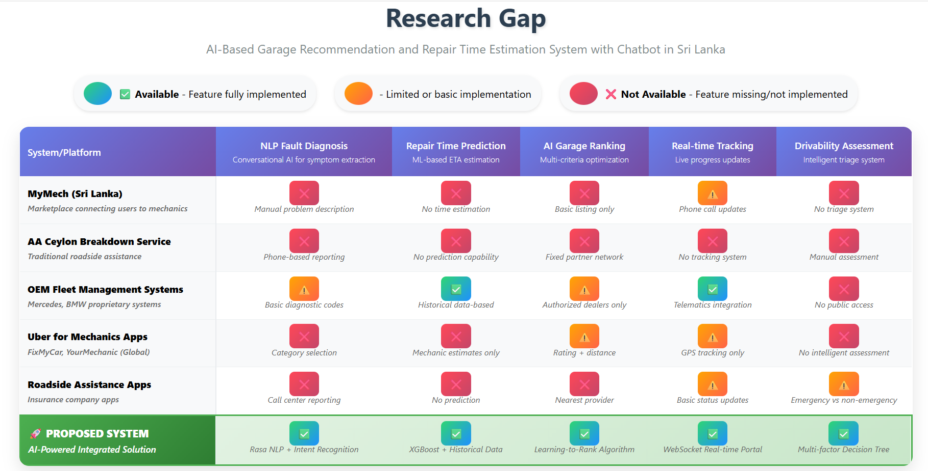

Slide 16


Application of Knowledge
Domains Applied Technologies
NLP (Chatbot)
Extract fault category and fault type from user phrase and asses the drivability
NLP – Chatbot for Fault Capture + Drivable Check : Rasa
ML – ETA Prediction Model : Scikit-learn (Regression)
ML – Garage Ranking Model : Scikit-learn + Weighted Scoring
Database – Job History & Repair Records : MySQL
API – Location & Routing : Google Maps API
Mobile App Framework – User Interface : React Native
Machine Learning
Model 1 : Predict Repair ETA
Model 2 : Rank garages
Required Data
Car Model, Year, Fault Category, Fault Type Needed Parts (from fault type mapping) Historical Repair Times (per car model + fault) Garage Data: employees, job queue, ratings, distance
Data Science
Learn from historical repair/job data
Location-Based Services Get real-time travel & routes through Google Maps API
Key Influencing Factors
Minor vs Serious Faults
Queue Length vs Available Employees
Distance to garage
Predicted Repair Time (ML ETA model)
Garage Ratings (User reviews)
12 / 20

Slide 17
Specialization & Validation
Validation Approach Data Availability and Ethical Clearance
Validation Approach
Data Sources
Compare predicted repair time vs actual repair time logged from garages.
Manually curated dataset (100+ rows demo dataset for training).
Real repair history collected gradually via garages partnered in pilot study.
Publicly available vehicle maintenance datasets (where accessible).
Measure accuracy % (e.g., Mean Absolute Error within ±30 minutes).
Test Garage ranking quality by checking if users mostly choose top recommended garages
Ethical Considerations
Manually curated dataset (100+ rows demo dataset for training).
Real repair history collected gradually via garages partnered in pilot study.
Publicly available vehicle maintenance datasets (where accessible).
Expected Accuracy
ETA Model : 70–80% accuracy in repair time prediction (improves as dataset grows).
Ranking model : At least 75% match between recommended and user-preferred garage.

Slide 18
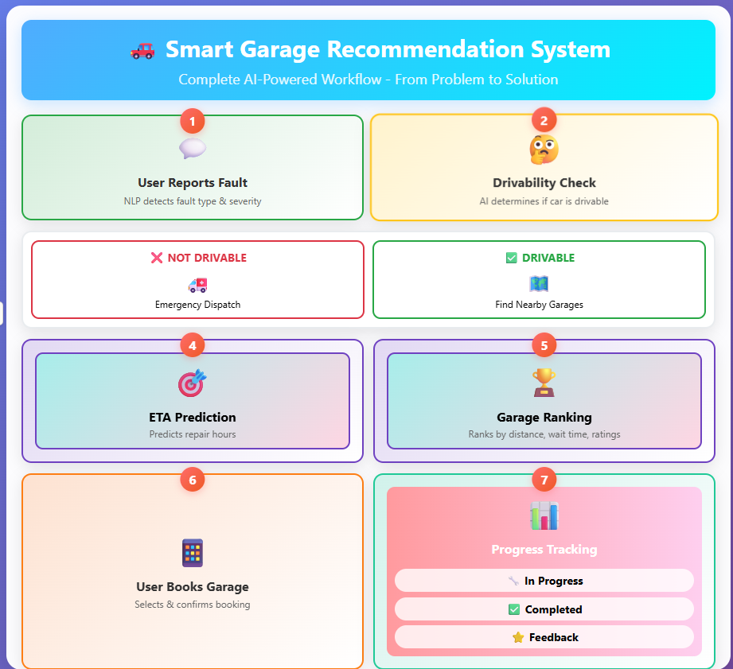
Implementation Details
Special Features
1. AI-powered repair time estimation (Sri Lanka’s first).
2. Real-time garage ranking using multiple factors.
3. Intelligent chatbot interface with NLP.
4. Integrated booking, tracking, and feedback system.
User Benefits 1.Saves time by finding the most suitable garage quickly.
2.Reduces uncertainty with predicted repair duration.
3.Improves trust through progress tracking and ratings.
4.Provides emergency support via mechanic dispatch/towing.

Slide 19

VEHICLE MILEAGE INTEGRITY AND
FRAUD DETECTION SYSTEM
Specialization: Information Technology

Slide 20
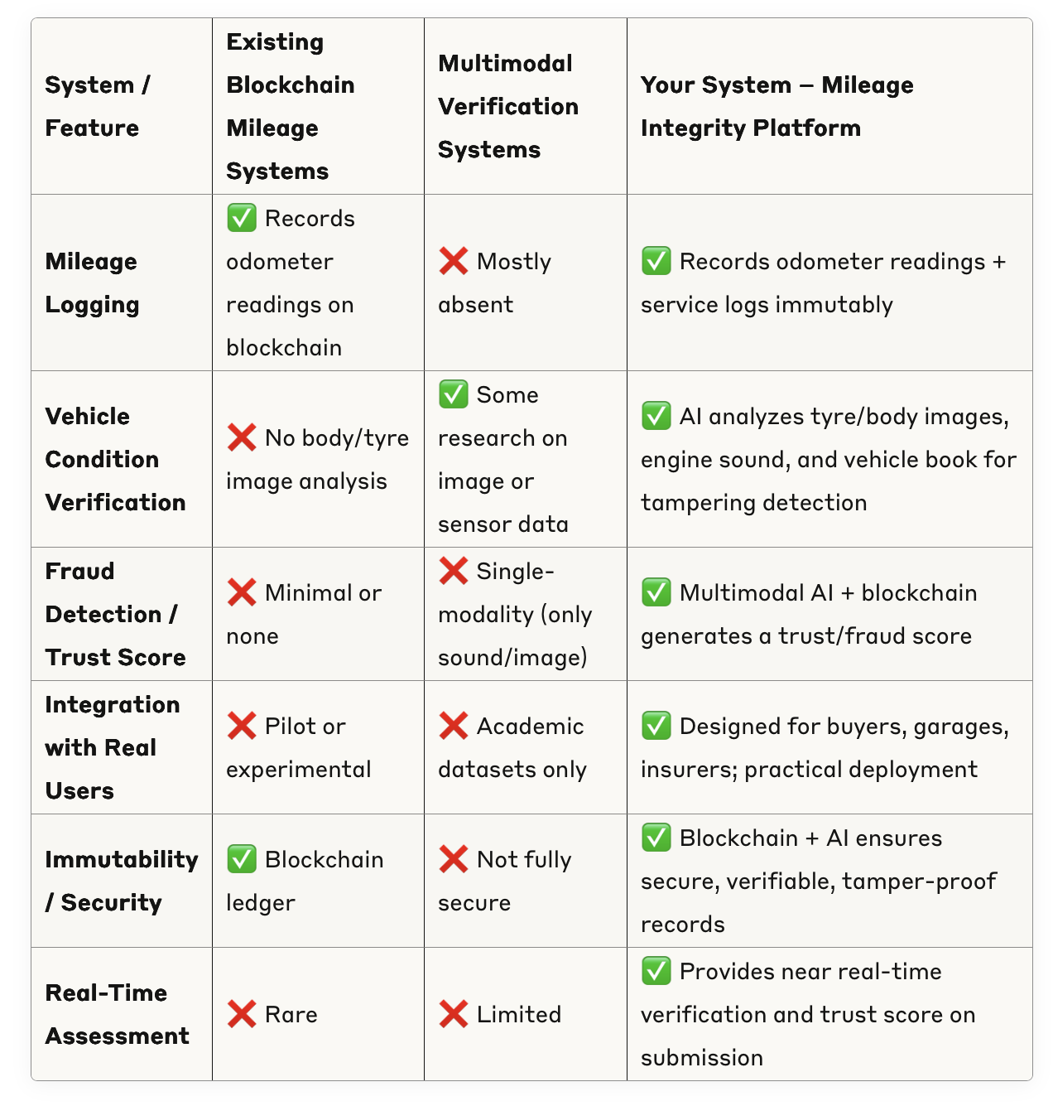
VEHICLE MILEAGE INTEGRITY AND FRAUD DETECTION SYSTEM
Research gap

Slide 21
VEHICLE MILEAGE INTEGRITY AND FRAUD DETECTION SYSTEM
Platform Overview
The Mileage Integrity Platform creates a trusted, transparent, and fraud-proof history for every vehicle, addressing the pervasive issues of mileage tampering and unreliable service records in the automotive marketplace.
Impact: Approximately 30% of used cars in the EU are affected by mileage fraud
Core Technologies
Blockchain Ledger
A permissioned blockchain (Hyperledger or public Polygon) serves as an immutable ledger for recording all validated vehicle events, ensuring data cannot be altered once recorded.
Multimodal AI Fraud Detector
An AI model capable of processing various data types to validate odometer readings, cross-reference repair logs, and analyze sound and visual data for signs of tampering or inconsistencies.
Key Benefits
Fraud Prevention
Identifies and prevents mileage tampering
Immutable Records
Creates unalterable vehicle history
Cross-Verification
Corroborates vehicle condition
Ecosystem Trust
Fosters trust among all stakeholders
Blockchain-Powered Integrity
The platform records validated events as immutable transactions on the blockchain, creating a comprehensive and verifiable vehicle history.

Slide 22


Application of Knowledge - VEHICLE MILEAGE INTEGRITY AND FRAUD DETECTION SYSTEM
Core Technologies Implementation Details
Multi-Layered Validation Process
Odometer Validation
AI cross-references new readings with previous entries, flags inconsistencies
Repair Log Analysis
Validates service records against diagnostic data from repair-cost estimator
Blockchain Ledger
Hyperledger for permissioned network
Polygon for public verification Immutable vehicle event history
Multimodal AI Fraud Detector
Processes multiple data types Validates odometer readings Cross-references repair logs
Multimodal Analysis
Evaluates sound and visual data for signs of tampering or inconsistencies
Immutable Recording
Validated events recorded as transactions on blockchain, creating verifiable history
Ecosystem Impact
Increased Value & Safety
Creates trusted, transparent history increasing value of second-hand transactions
Vehicle Data
AI Analysis
Fraud Detection
Restored Trust
Empowers buyers with accurate information, fostering greater trust among stakeholders

Slide 23



Specialization & Validation - Mileage Integrity Platform
Validation Approach Specialization
Multi-Layered Validation
Cross-references new odometer readings with previous entries
Repair Log Analysis
Corroborates vehicle condition through repair history
Blockchain Ledger
Permissioned blockchain (Hyperledger/Polygon)
Immutable record of all validated vehicle events
Secure transaction history for each vehicle
Proof of ownership transfers and maintenance records
AI Fraud Detector
Multimodal AI capable of processing various data types
Validates odometer readings and repair logs
Analyzes sound and visual inspection data
Identifies inconsistencies suggesting tampering
Multimodal Analysis
Analyzes sound and visual data for signs of tampering
Blockchain Recording
Records validated events as immutable transactions
Expected Accuracy
Validation Process Flow
Fraud Detection Accuracy
Target: >95% accuracy in mileage fraud detection
Data Input
Validation
Processing
Verification
Recording
Data Integrity Guarantee
Immutability of vehicle history records on blockchain

Slide 24

Implementation Details - Mileage Integrity Platform
System Workflow
Data Input
Odometer readings, repair logs
AI Fraud Detection
Cross-references entries, flags inconsistencies
Blockchain Recording
Immutable ledger entry
Verified History
Transparent, tamper-proof record
Implementation Approach
Key Benefits
Multi-Layered Validation
Multimodal AI
Transparent History
Every vehicle event recorded
Cross-references new readings Verifies maintenance records Flags inconsistencies
Processing various data types Analyzes visual data Captures repair history
Fraud Reduction
Prevents mileage tampering
Immutable Ledger
Fraud Prevention
Permissioned blockchain Hyperledger/Polygon Verifiable transactions
Detects mileage tampering Verifies service records Prevents data manipulation
Ecosystem Trust
Increased buyer confidence

Slide 25
Commercialization & Final Project Insights
Business Model
Customer Profile
Multifaceted commercialization strategy leveraging SaaS API model to provide flexible access to advanced functionalities. Platform enables seamless integration into existing systems used by garages, insurance companies, and government agencies.
Tech-Driven Businesses Automotive businesses prioritizing efficiency and cost savings
Informed Drivers
Prioritize trustworthiness in vehicle transactions
Revenue Streams
Value Proposition
Subscription Fees
Tiered models for garages and insurers based on usage
Fraud-proof vehicle history Transparent ecosystem
Cost savings Enhanced trust
Licensing
Proprietary AI models and blockchain framework for enterprises
Intellectual Property
Per-Transaction Charges
Fee for validated entries, ensuring scalable revenue
Core Assets
Proprietary AI models
Blockchain ledger system
Target Market
Garages
Insurance
Buyers

Slide 26
Budget Plan
Description | Estimated Cost | Notes
Server Hosting | LKR 10,000 / Month | To run backend services and host ML models
App Store Hosting | LKR 8,000 (One-Time) | Apple Developer account fees for iOS app
Play Store Hosting | LKR 32,000 / Year | Google Developer account fees for Android app
Cloud Storage (AWS S3) | USD 0.023 per GB / Month | For storing audio data & reports securely
Initial Development & Testing | LKR 250,000 (Approx.) | App development, ML training & pilot testing
Marketing & Outreach | LKR 50,000 (Initial) | Promotional campaigns & partnerships
IOT Sensor Devices | LKR 50,000 – LKR 100,000 | Additional microphones, vibration/accelerometer sensors for real-time recording

Slide 27
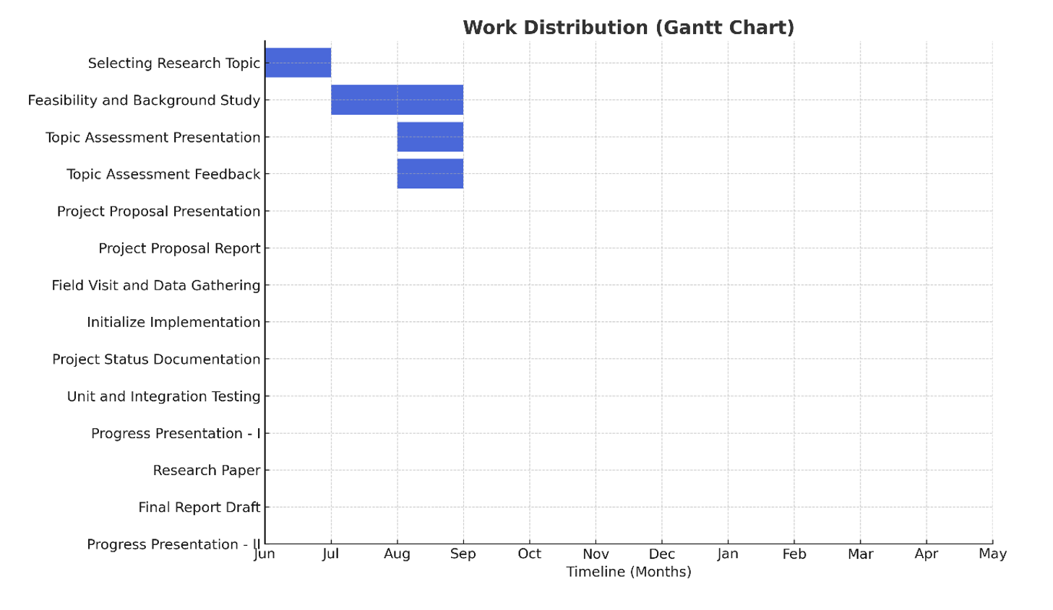
Gantt Chart

Slide 28
Thank You
For Your Attention to the Cllatori Project
Group Number: 25-26J-396
Student 1
IT21330278
Student 2
IT22273994
Student 3
IT22229434
Student 4
IT22552556

