Slide 1
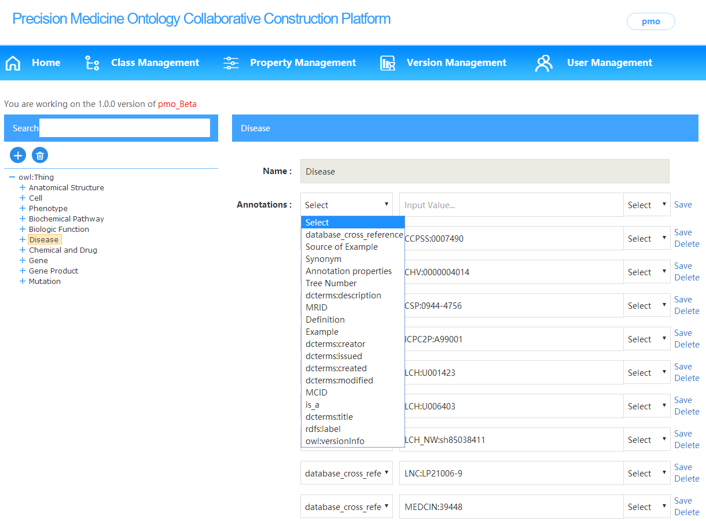

Collaborative Working Platform for Precision Medicine
Ontology Construction
Meng Wu, Jiao Li, Hongyu Kang, Si Zheng, Li Hou
Institute of Medical Information & Library, Chinese Academy of Medical Sciences
Introduction
Results
As large amounts of data accumulate in the field of precision medicine and the semantic relationships between biomedical entities become more and more complex.
The construction of precision medicine ontology needs a lot of collaboration of experts in many areas.
The collaborative working platform we built for precision medicine ontology construction is an interactive online application for collaboratively editing, browsing, and sharing of precision medicine ontology.
The platform has the following functions:
Creating new projects or importing an existing ontology from the local computer.
Distributing different functional roles to users, including administrator, reviewers and processor.
Recording logs which keep track of all changes of a version and only the administrator can generate a new version.
Downloading the ontology in RDF, OWL and XML format.
Methods
System architecture
Conclusions and Future Work
Conclusions:
The collaborative working platform guarantees the comprehensiveness and instantaneity in the process of ontology construction.
The Precision Medicine Ontology (PMO) built upon the collaborative working platform contains 10 top classes in precision medicine domain and 93 semantic relationships between them, which also supports the knowledge base developed based on it.
Future Work:
Extending the function of the system such as ontology mapping, and enhancing the quality control.
Improving the automation of transformation from multi-source non-ontology knowledge resources to ontology.
Contain three layers:
Data Storage and Processing Layer: Storing various data related to the platform, and processing the data from collection to ontology construction.
Management Layer: Managing the functional systems of the back stage.
Application Layer: Providing the bridge between the users and the platform for human computer interaction.
User workflow
References
[1] Huang L, Fernandes H, Zia H, et al. The cancer precision medicine knowledge base for structured clinical-grade mutations and interpretations[J]. Journal of the American Medical Informatics Association Jamia, 2016, 24(3).
Acknowledgments
The authors would like to thank Junlian Li, Xiaoying Li, Yujing Ji, Panpan Deng and Haixia Sun for their contribution to this platform. This work is supported by the National Population and Health Scientific Data Sharing Program of China, and The National Key Research and Development Program of China (Grant No. 2016YFC0901901).
*Email: hou.li@imicams.ac.cn
The processers and reviewers include experts in many areas such as biology, medicine, and ontology construction and so on.
Biocuration 2018. April.

