Slide 1


The 11th International Biocuration Conference
Building a Knowledge Representation Model towards Precision Medicine
Institute of Medical Information & Library
Chinese Academy of Medical Sciences (CAMS&PUMC)
April , 2018

Slide 2
01
Background & Motivation
Knowledge Representation Model
02
Outline
Precision Medical Ontology (PMO)
03
04
Semantic Network
05
Summary

Slide 3
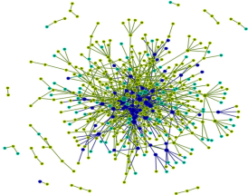










Background and Motivation
The National Key Research and Development Program of China
Precision Medicine Knowledge Base
Knowledge Bbase
Heterogeneous data
Standard
Unstructured text
Standardization
Entity description
Relationships
Unique Identifiers
Application
Text Mining
Data Integration
Knowledge Graph
Biocuration
Information Retrieval
Inference
Biological Information
Knowledge
Knowledge
Representation
Model
Data Integration

Slide 4
What’s kind of knowledge representation model?
Ontology is a recognized tool to manage the heterogeneous data via defining the investigated entities and relationships between them.
Providing identifiers for classes and relations in PM Knowledge Base , thereby enabling integration of biomedical data.
Providing labels for classes and relations, thereby providing a Precision Medicine Vocabulary (PMV).
Providing metadata associated with classes and relations that allows human users to understand their meaning and contribute to consistent use in annotation and other applications.
Facilitating semantic integration of heterogeneous, multimodal data, and enables novel data mining in biomedical literatures.

Slide 5
Precision Medicine Ontology (PMO) principles
Covering all types of terms ,concepts and the relationship between the terms which are urgently needed by the “precision medicine project”.
Providing interoperability with existing international ontology .
All concepts, terms and relations defined in PMO are open access
Interoperable, Re-usable, Machine Readable
Findable, Open Accessible
Providing flexible management tools, supporting any new term merging, and new relationship created
1
2
3
4

Slide 6
PMO construction workflow
I. Define the scope of
the ontology
II. Reuse ontology and taxonomy
III. Collect
Resources (Vocabularies)
VI. Define the properties
of classes
V. Define the classes and the class hierarchy
IV. Design the strategies of term merging
VII. Create instances
Step 7. Create instances

Slide 7
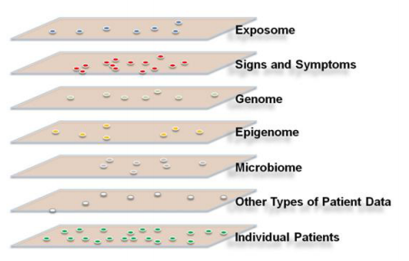
The PMO’s role in the PM Knowledge Base
I. Define the PMO scope
Precision Medicine
The concept of precision medicine — prevention and treatment strategies that take individual variability into account.
Precision medicine: take into account individual variability in genes, environment ,and lifestyle for each other.
Support to identify and integrate gene, disease, drug, mutation, phenotype, pathway, etc. which are the key entries in the PM knowledgebase
National Research Council. Toward precision medicine: building a knowledge network for biomedical research and a new taxonomy of disease. Washington, DC: National Academies Press, 2011
.

Slide 8





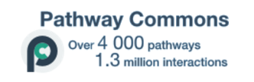


PMO Scope
Anatomical Structure
Biochemical Pathway
PMO
Gene
Biological Function
Gene Product
Chemical and Drug
Mutation
Cell
Disease
Phenotype
Gene

Slide 9
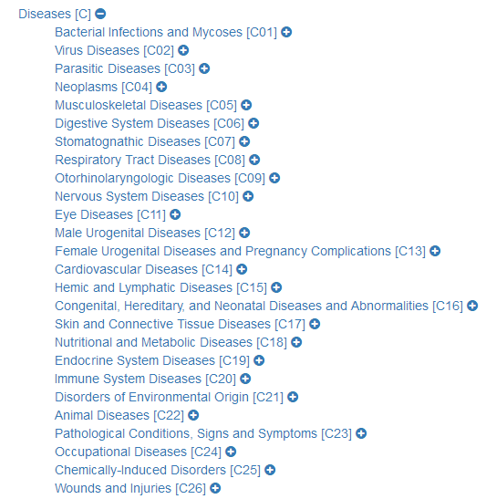
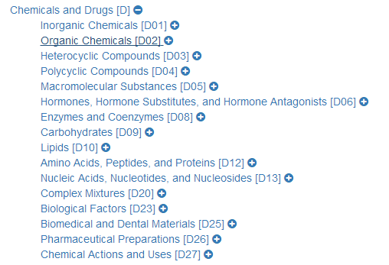


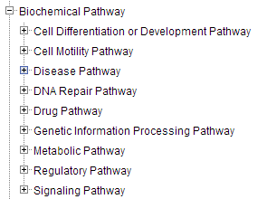
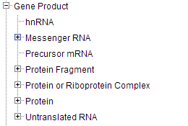
II. Reuse existing ontologies and taxonomy

Slide 10
III. Vocabulary collection and integration
Collecting 58 biomedical vocabularies in precision medicine domain
Gene
Drug
Phenotype
Gene Ontology
HUGO Gene Nomenclature Committee
NCBI Gene
DrugBank
RxNorm Vocabulary
Anatomical Therapeutic Chemical Classification System
Alcohol and Other Drug Thesaurus
Gold Standard Drug Database
FDB MedKnowledge
Veterans Health Administration National Drug File
……
Human Phenotype Ontology
Others
Mutation
MeSH
NCI Thesaurus
SNOMED CT
MedlinePlus Health Topics
Micromedex RED BOOK
University of Washington Digital Anatomist
……
ClinVar
Disease
ICD10
Diagnostic and Statistical Manual of Mental Disorders
ICPC-2 PLUS
……

Slide 11
IV. Term merging strategies
Data process
Data
standardization
Data collection
Data
parser
Data cleaning
Concepts mapping
Exact match
Name match
ID match
Norm match
Normalize the terms before match
Concept match
Match the terms if their concepts match
Manually review
Concepts
integration
Concept addition
Add the non-matching term as a new concept
Concept merge
Merge the matched term to one concept

Slide 12
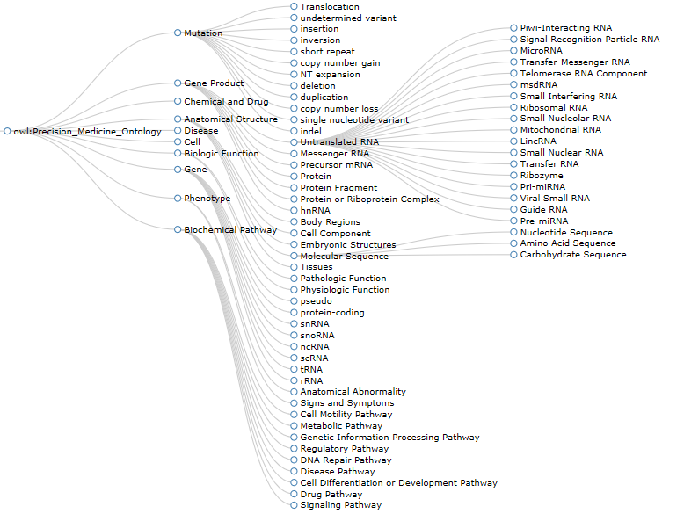
V. Classes and the class hierarchy

Slide 13
VI. Classes Properties
Annotation properties
Annotation property | Definition
MCID | The unique identifier of the resource in PMO
MRID | The unique identifier of the relationship in PMO
Name | The common name of the resource in PMO
Tree Number | The hierarchy of the resource in PMO tree
Definition | The definition of the resource given by experts of PMO
database_cross_reference | The ID of the resource in other databases
Synonym | The synonym of the resource in other databases
is_a | The superclass of the resource
Example | The example of the relationship appearing in biomedical text
Source of Example | The source of the example, usually PubMed

Slide 14

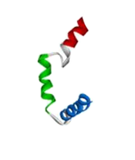
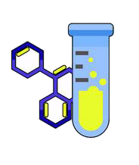
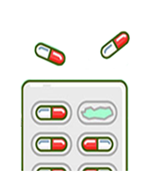

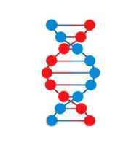
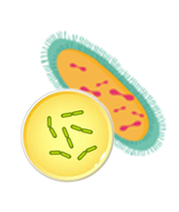
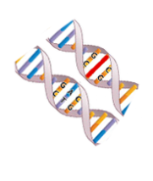
Semantic Network in PMO
regulation
play functional roles in
binding regulation
……
play functional roles-cellular processes in
play functional roles-cellular processes in-expression in
Chemical
Drug
Protein
……
play functional roles in
is associated with
play functional roles-cellular processes in
play functional roles in
……
mutation regulation
play functional roles-cellular processes in
impact of
……
Disease
is biomarker of
Gene
Cell
play functional roles in
is biomarker-efficacy of
play functional roles-cellular processes in
is biomarker-diagnosis of
has mutation
is biomarker-prognosis of
has mutation-somatic
play functional roles-cellular processes in-expression in
has mutation-missense
is associated with
……
play functional roles in
……
……
Mutation

Slide 15
Semantic Relationship Definition
Relationship Statistics: 93 relationship were organized hierarchically.
RID | Relation_Name | Domain | Range | Definition | hierarchy | Example | Source
R00000001 | is biomarker of | Gene | Disease | A gene influences or predicts the incidence of outcome or disease. | First
R00000002 | is biomarker-efficacy of | Gene | Disease | A gene can be used to measure the efficacy of drugs or therapeutic methods in the treatment of a disease. | Second | Human TP53 protein has been used as a biomarker for measuring the efficacy of iloprost in the treatment of lung neoplasm. | Source: GVK Biosciences-NCT00084409
R00000003 | is biomarker-diagnosis of | Gene | Disease | A gene can be used to diagnose a disease. | Second | Human TP53 gene has been used as a biomarker for diagnosis of chronic lymphocytic leukemia. | Source: GVK Biosciences-NCT00923507
R00000006 | is biomarker-unspecified application of | Gene | Disease | A gene is a potential biomarker of a disease-that is, the gene (when mutated or aberrant expressed) is associated with a disease, but the precise function is unclear. | second | Upregulation of human P53 [TP53] protein in nuclei from cells malignant tumor of prostate is associated with prostate cancer in human (Biomarker status: potential biomarker). | PMID: 17145880

Slide 16
Summary
Conclusion
Developing an ontology to support Precision Medicine Knowledge Base construction
Developing a Precision Medicine Ontology (PMO):
Defining 93 semantic relationships (such as is biomarker of, is diagnosis biomarker of ) to connect concepts
Making the PMO open assessable
Undergoing work
Evaluation the PMO usability in the knowledge base construction
Adding new classes such as Cohort and Sample
Enriching instances in PMO from text mining and curation results (feedback)

Slide 17
Thanks！
PPT模板下载：www.1ppt.com/moban/ 行业PPT模板：www.1ppt.com/hangye/
节日PPT模板：www.1ppt.com/jieri/ PPT素材下载：www.1ppt.com/sucai/
PPT背景图片：www.1ppt.com/beijing/ PPT图表下载：www.1ppt.com/tubiao/
优秀PPT下载：www.1ppt.com/xiazai/ PPT教程： www.1ppt.com/powerpoint/
Word教程： www.1ppt.com/word/ Excel教程：www.1ppt.com/excel/
资料下载：www.1ppt.com/ziliao/ PPT课件下载：www.1ppt.com/kejian/
范文下载：www.1ppt.com/fanwen/ 试卷下载：www.1ppt.com/shiti/
教案下载：www.1ppt.com/jiaoan/ PPT论坛：www.1ppt.cn

