Slide 1

Question 1) due to the absence of every workdate, average is unable to calculated.

Slide 2
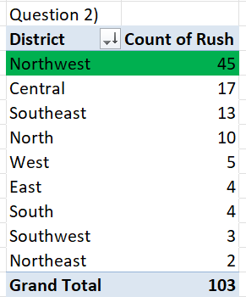
Question 2) Northwest has the highest number of rush jobs.

Slide 3
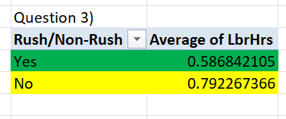
Question 3) Yes, there is a difference between the average of labour hours of Rush and non-rush jobs. Rush-jobs have 0.59 of average labour hours. Non-Rush jobs have 0.79 of average labour hours.

Slide 4
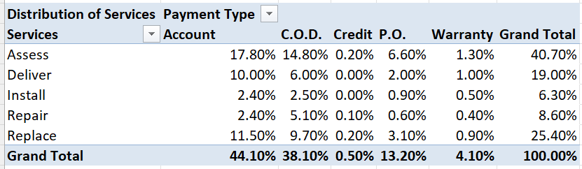
Question 4)
There is distribution of payment type across different services.

Slide 5
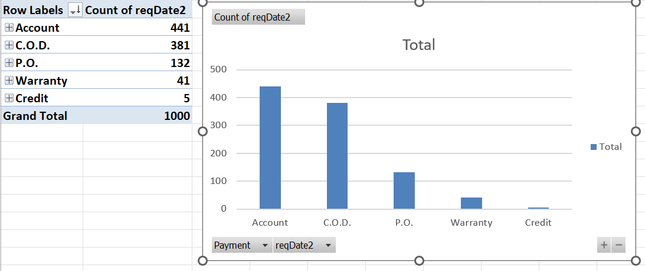
Question 5)

Slide 6
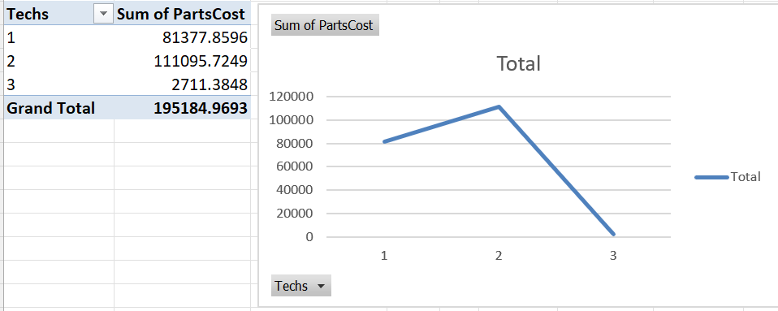
Question 6) No, there is no relationship between the costs of parts and techs.

Slide 7
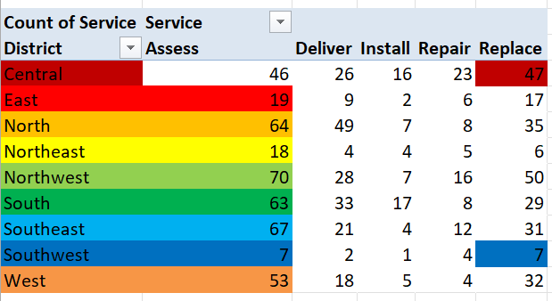
Question 7)
The most common type service requested in each district is coloured respectively.
Most of the district use Assess service.

Slide 8
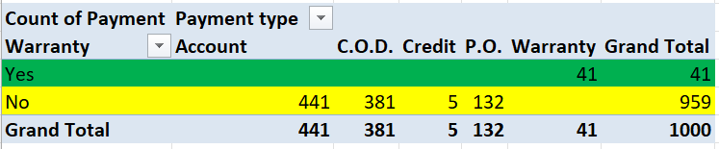
Question 8) Yes, there is difference in payment type with warranty labour and without warranty labour. Warranty labour were payed in warranty payment type. Others were in another types.

Slide 9
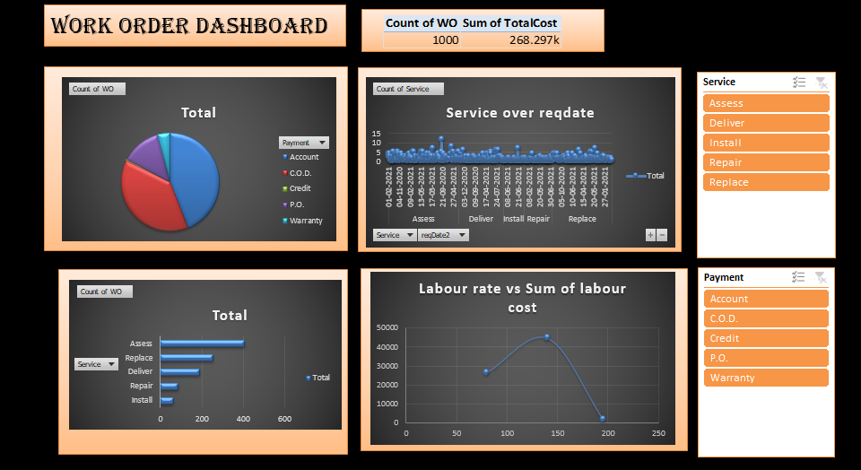
Question 9)
A dashboard for the work order Dataset
A dashboard containing values of segments, service, which access every graph.

