Slide 1
Assessment

Slide 2
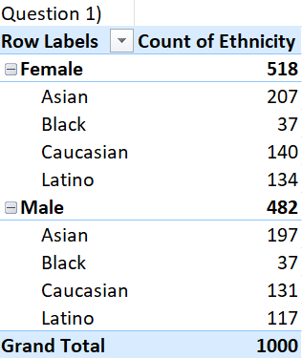
Question 1) Summary of Gender and Ethnicity Distribution

Slide 3
Question 2)

Slide 4
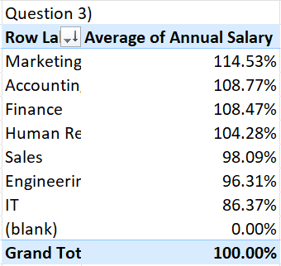
Question 3) Average salaries between different departments

Slide 5
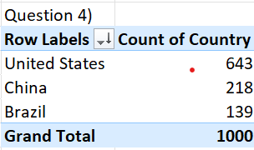
Question 4) Country with highest number of employees

Slide 6
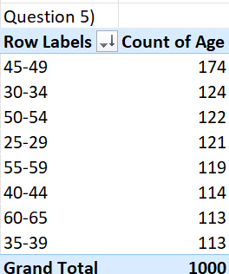
Question 5) Most common age range of employees

Slide 7

Question 6) Average bonus % given to the employees

Slide 8
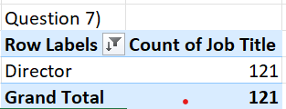
Question 7) Frequently occurred Job Title

Slide 9
Question 8) Primary reasons for employees exit.
No information provided.

Slide 10
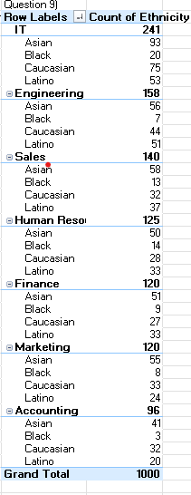
Question9) Departments interms of ethnicity

Slide 11
Question 10) Increase and decrease in hiring

