Slide 1
TITLE: Wide Band Reject Filter
TEAM MEMBER’S:
PRANAV S. 1CR17EC141
DIPRO PRAMANICK 1CR17EC058
PRADEEP L. 1CR17EC1
GUIDED BY: MR. MANOHAR VELLATI

Slide 2
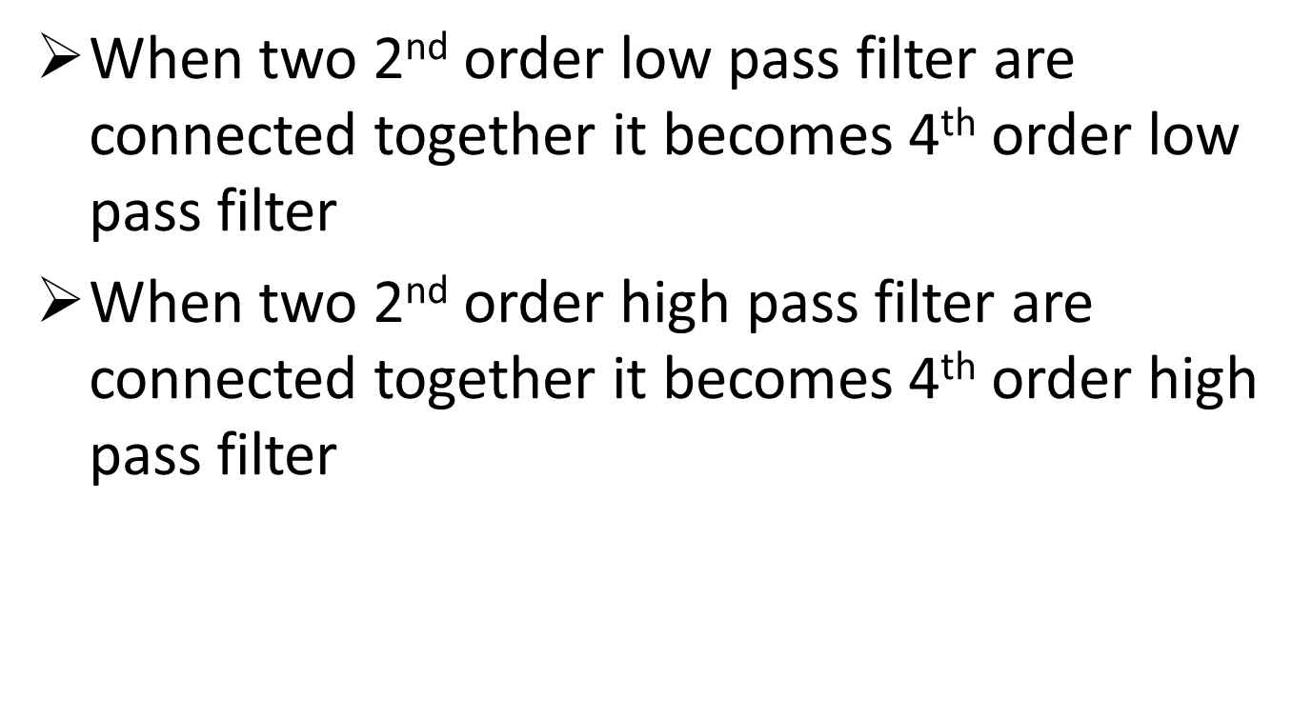
Basic Concept:

Slide 3
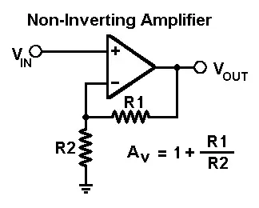
GAIN
BASIC DIAGRAM OF NON-INVERTING AMPLIFIER

Slide 4
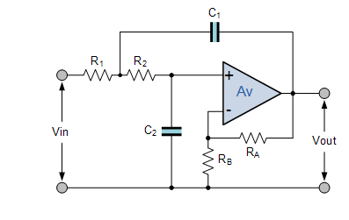
2ND ORDER LOW PASS FILTER
SECOND ORDER FILTER:
IT IS ASLO REFERRED TO AS VCVS FILTERS(VOLTAGE CONTROLLED VOLTAGE SOURCE AMPLIFIER)
FIRST ORDER FILTER CAN BE CONVERTED INTO SEOND ORDER BY ADDING RC NETWROK WITHIN THE INPUT OR THE FEEDBACK PATH.
GENERALLY THEY ARE NAMED AS BUTTEROWRTH,CHEBYSHEV,BESSEL & SALLEN-KEY

Slide 5
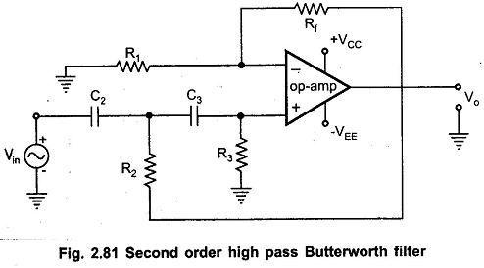
2ND ORDER HIGH PASS FILTER
HIGH PASS FILTER:
1.The above shown diagram is of butterworth filter.
2.The basic operation of an Active High Pass Filter (HPF) is the same as for its equivalent RC passive high pass filter circuit
3.The circuit has an operational amplifier or included within its design providing amplification and gain control.

Slide 6


BLOCK DIAGRAM
Low Pass Filter
Input
Summer
Output
Input
High Pass Filter

Slide 7
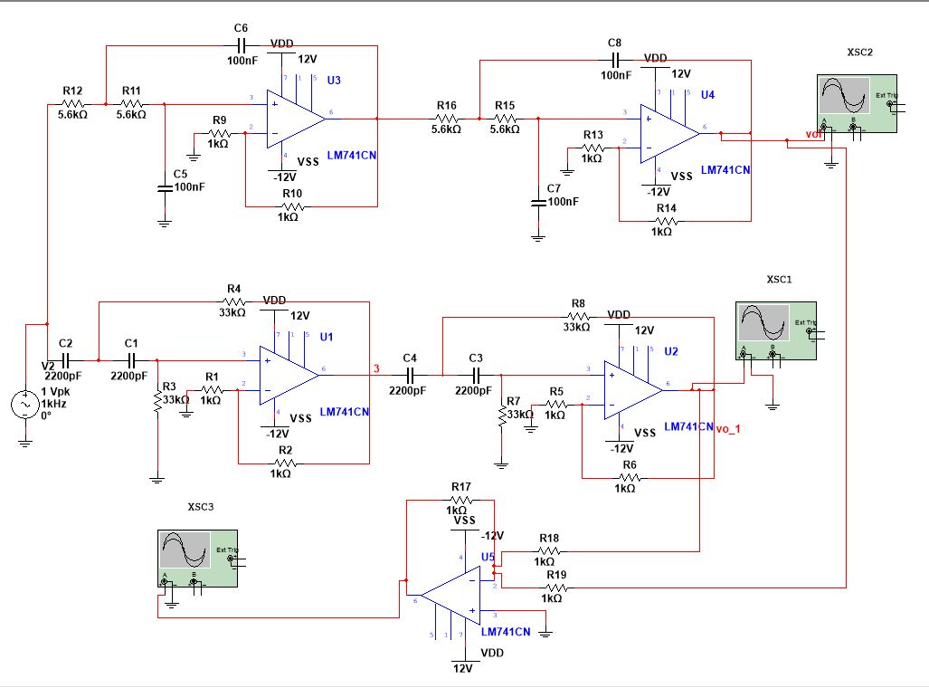
CIRCUIT DIAGRAM

Slide 8
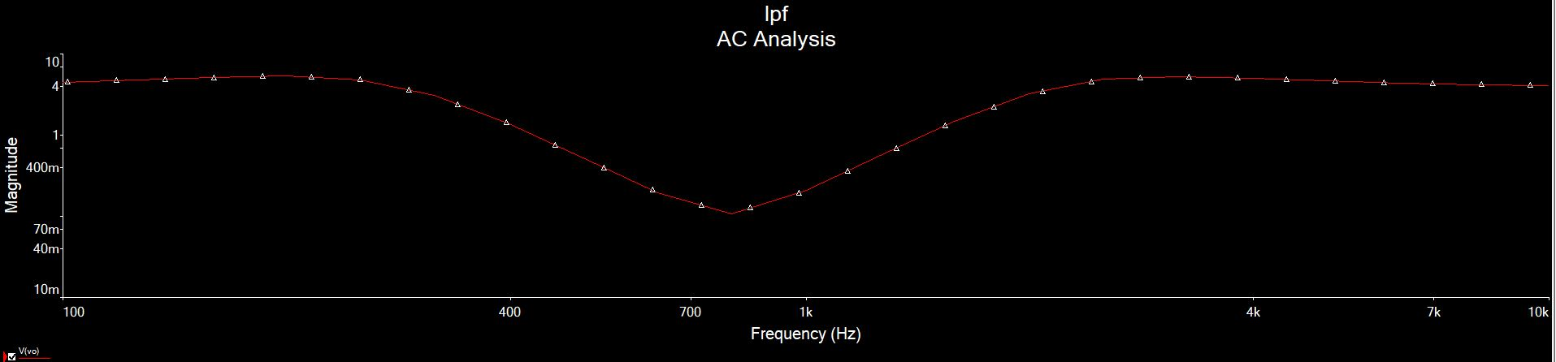
FREQUENCY RESPONSE

Slide 9
Thank You

