Slide 1
Music VP
A musical tour to NYC through MVP’s webpage
- an endeavor by Phillip, Rich, Suraj, Deepali

Slide 2
Elevator pitch
“Music brings people all over the world together .”
“Never before have I seen such a large group of people come together for something so important to them.”

Slide 3
Concept
Project Name
Music Venue Planner
Project Description
Search for the music events and concerts in the New York city and plan your event.
User Story
As a music lover I would like to see music events in New York and plan for the event I am going to attend.

Slide 4
Process
Technologies
(HTML, CSS framework, Jquery, AJAX, APIs, Bootstrap)
Challenges
(meeting virtually and merging codes)
Successes
(Knowing each other’s strengths and completing the project by our internal deadline)
APIs used are
ticketmaster.com
bandsintown.com
openweathermap.com

Slide 5
Breakdown of Tasks and Role
Creating user interface
Researching APIs and getting keys
Coding and building
Testing
Creating demo presentation
Notes:
Every team member performed every single step mentioned on the screen.

Slide 6
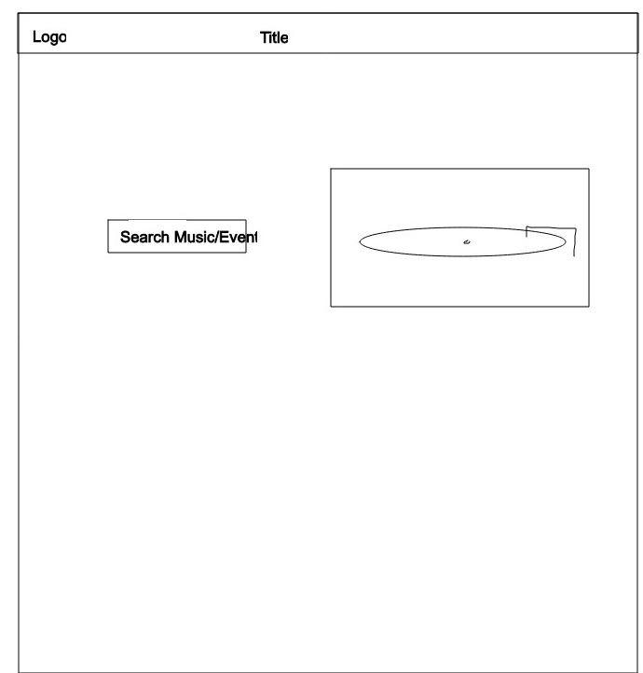

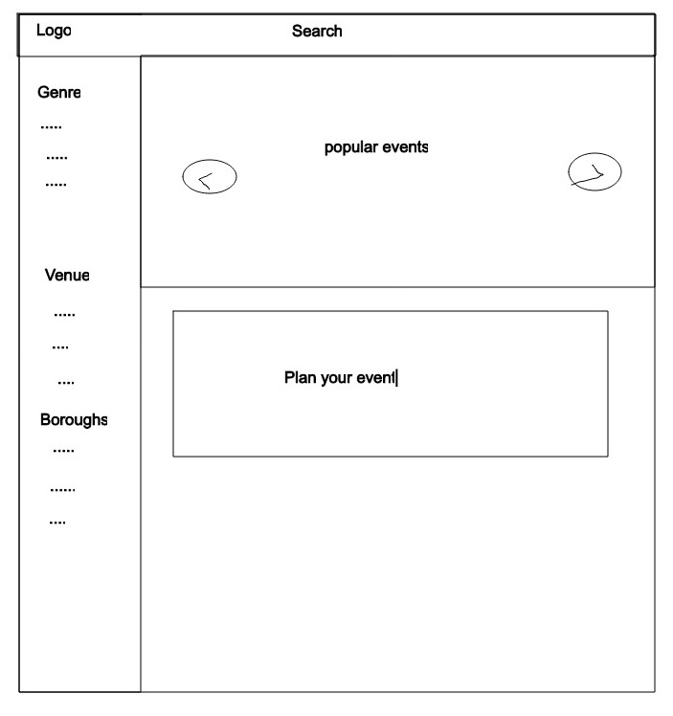
Wireframe

Slide 7
Demo
https://pmanapat.github.io/Music-VP/

Slide 8
Directions for Future Development: Phase 2
Extend our services to tri-state
Direct the Contact Us page to a database and store user information
Enhance the current features such as include advance search
Include hotel booking and flight booking – maybe who knows ☺

Slide 9

Links
Deployed
GitHub repo

Slide 10
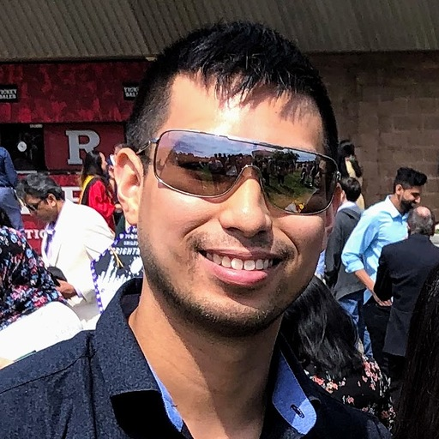
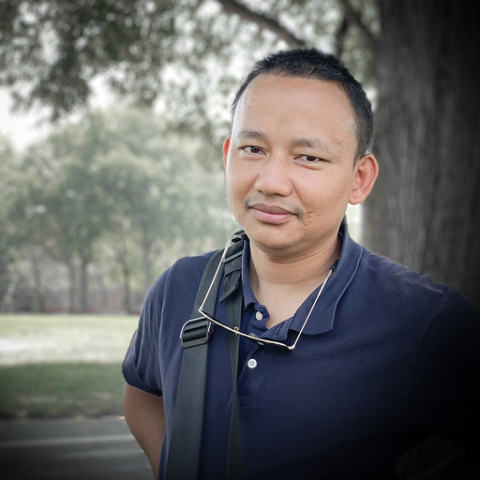
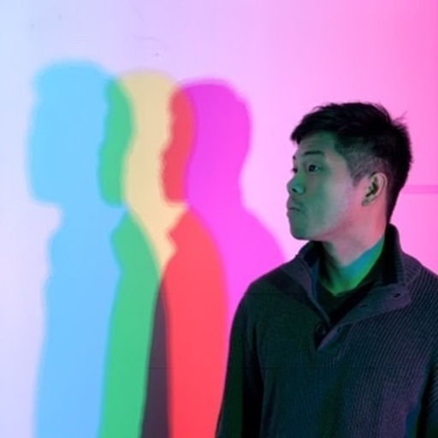
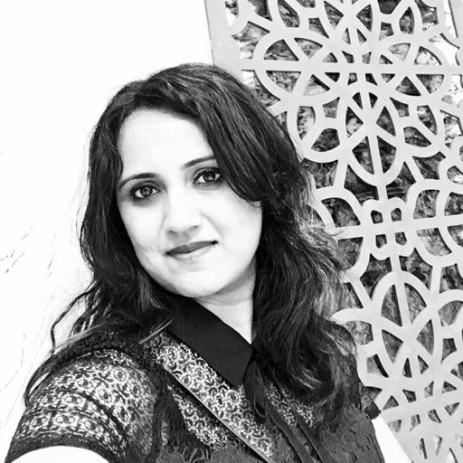
“Thank you!”
Notes:
Opening the session for question and answers

