Slide 1

Portfolio Builder
For Creatives, By Creatives

Slide 2
Elevator Pitch
Kick-start to your career: A good portfolio can potentially earn you many new clients and leads
Project Description: Portfolio builder is an interactive portfolio template that allows you to plug in information and build a cohesive portfolio.
User Story: As a user, I would like to create a portfolio by choosing from an unrivaled set of best-in-class templates and to customize the design to fit my personal style and professional needs.

Slide 3
Processes
Technologies
MERN
Atlas for MongoDB
Challenges
React Application
Collaboration on GitHub
Successes
Creating entire webpage with user inputs
Dynamic, personalized portfolio link for each user

Slide 4
Breakdown of Tasks and Roles
Creating Schemas
Coding and Building
Merging Codes and Testing
Creating Demo
Creating user interface (UI)
Connecting Schemas with UI
Creating Wireframes

Slide 5
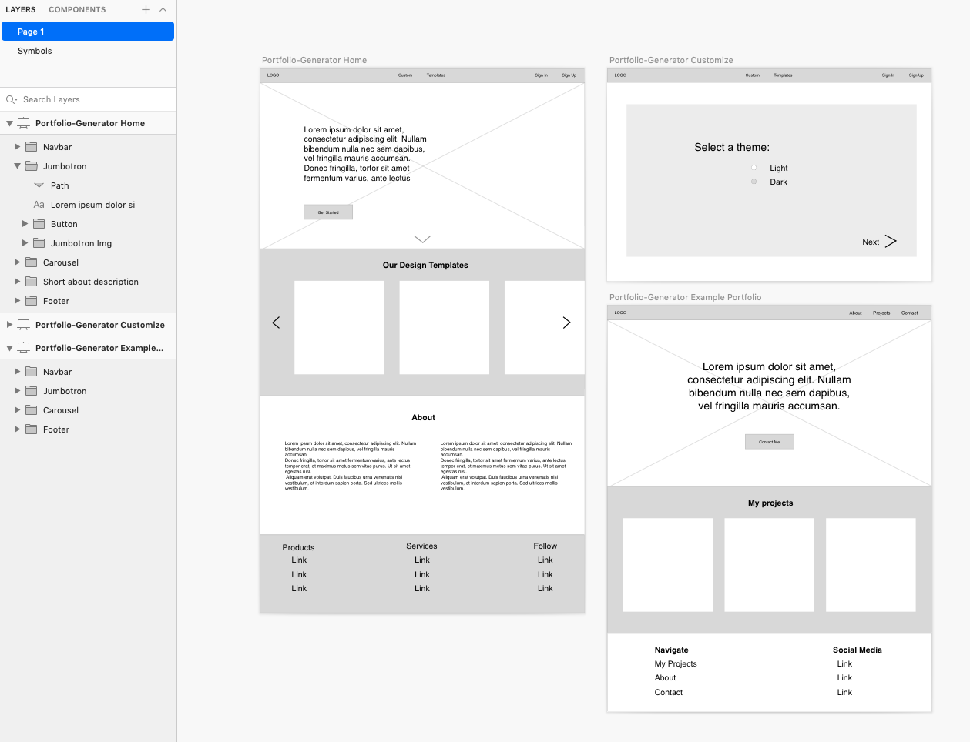
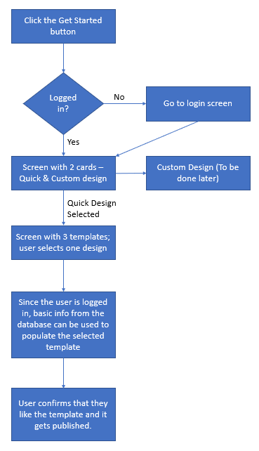
Wireframes

Slide 6
Demo
Deployed links

Slide 7





Thank You!

