Slide 1
Vehicle Report and Information System
Shri Shankaracharya Institute of Professional Management & Technology, Raipur
Minor Project Report on
CSE 7th Semester
Department of Computer Science and Engineering,
Batch 2018-2022
Session July – Dec 2021
Presentation Date:
Project Group Members:
Prakashmani awasthi (303302218104)
Project Guide
Ms. Kaveri Kar
(Assistant Professor, CSE)

Slide 2
Application Area
This project combines the Native full stack android application development with Artificial intelligence to provide a easier approach of reporting vehicle related crime to the authorities, and assist the authorities in investigating these reports by providing the vehicle information directly from the app.
The key area of the project is in public security domain. And it will facilitate information access control to the authorities, and as a result helping them to investigate as soon as possible.
This application will provide different interfaces for the citizen and investigating authorities, as the constitute major portion of the end users of this project.

Slide 3
Project Overview
The title of the project is Vehicle Report and Information System, and it deals with the public security domain. The main aim of the project is to provide ease in reporting vehicle related crime directly from application and provide vehicle information directly to the investigating authorities.
Citizen can report the vehicle by clicking a photo on the app and click on report, the server detects the number plate as ROI and after performing OCR gets the vehicle number to search in the database and places report to nearest police station in the database, the investigating authorities working in the station can access complete information of the vehicle for ease in investigation.
The application is developed using Java/Kotlin, android studio, for hosting the app the APIs are build using PHP and uses MySQL as database, TensorFlow object detection and EasyOCR.

Slide 4
Project Requirements (Developer)
Software’s Required (With Versions duly mentioned)
Android studio version 4.1.2 with Kotlin and java support
Windows 7/8/10.
Any browser.
XAMPP
Jupyter notebook along necessary object detection libraries
Hardware Required
3GB RAM minimum, 8 GB RAM recommended(plus 1 for Android Emulator.)
4GB storage space, 10 series NVIDIA GPU .
Minimum resolution 1280 x 800, and Webcam.
Processor i3 8th gen minimum,
Internet connection.

Slide 5
Project Requirements (End User)
Software’s Required (With Versions duly mentioned)
Android Lollipop or higher (SDK 21 or higher).
Hardware Requirement
Snapdragon 300 series or higher
2GB RAM or higher
3GB Storage or higher
Internet connection

Slide 6
Back End Details
What Back End your project is using?
Ans. For application part: Kotlin, and Java(plugin to convert to kotlin), Volley libraries for requests.
For the data base: MySQL
For API: PHP
For object detection and OCR: TensorFlow and EasyOCR.
How Many Databases?
Ans. The app using a centralized database for storing all the information for both the citizens and authorities.
How Many Tables?
Ans. For authentication there are 2 tables, one for vehicle, one for police station, one table for each police station for affiliated officers, reports table, etc.

Slide 7
Database Details
The app uses a centralised DB named “numauth” which uses the MYSQL DB hosted using XAMPP software.
The DB consists of a total of 9 tables: -
Login_user and Login_admin: - these tables consist of the information required for uthentication of the 2 customer segments.
aUser_info and police_info: - these tables consist of the detailed user information of the customer such as profile image, name, AADHAR number, contact information, etc..
Station_info: - this table stores the information of all the police stations along with there associated Pincode, number of active & solved cases.
Vehicle_info: - this table stores the RVD information of the vehicle regarding the vehicle, its owner, and vendor information.
Imageupload: - it is a cache table to make the image available before report process is complete so that in case the reporter fails to complete the report at least the image can be used for reference.
Reports_user: - this table contains the information related to the report from the reporter centric point of view.
Handle_cases: - this contains the information related to the report from the officer point of view

Slide 8
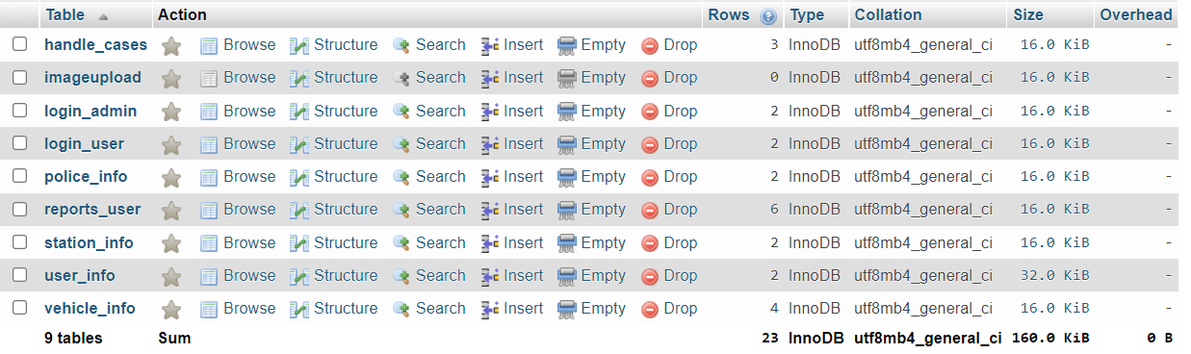
Database Details

Slide 9
Front End Details
How many Interfaces / Screens your Application will have?
Ans. Some of the interfaces in the app are:
1. In app camera view.
2. Image crop and retake view.
3. Interface to place the report.
4. Interface to view the reports in List manner.
5. Interface for descriptive view of vehicle information.
6. Log In and Sign Up interfaces.

Slide 10
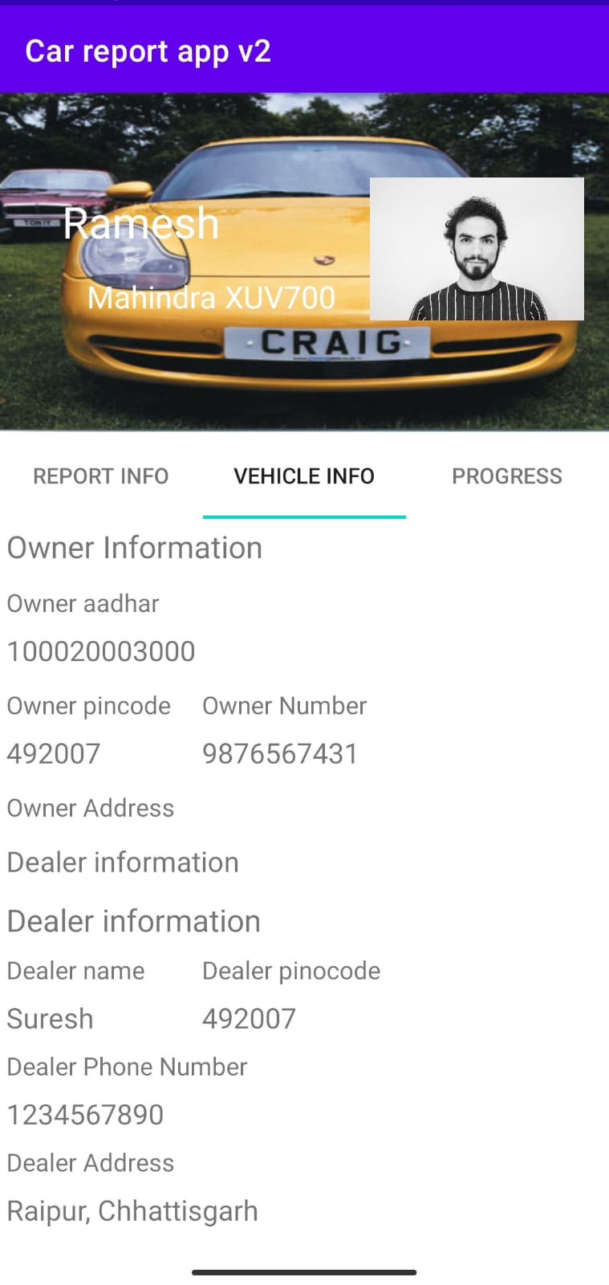
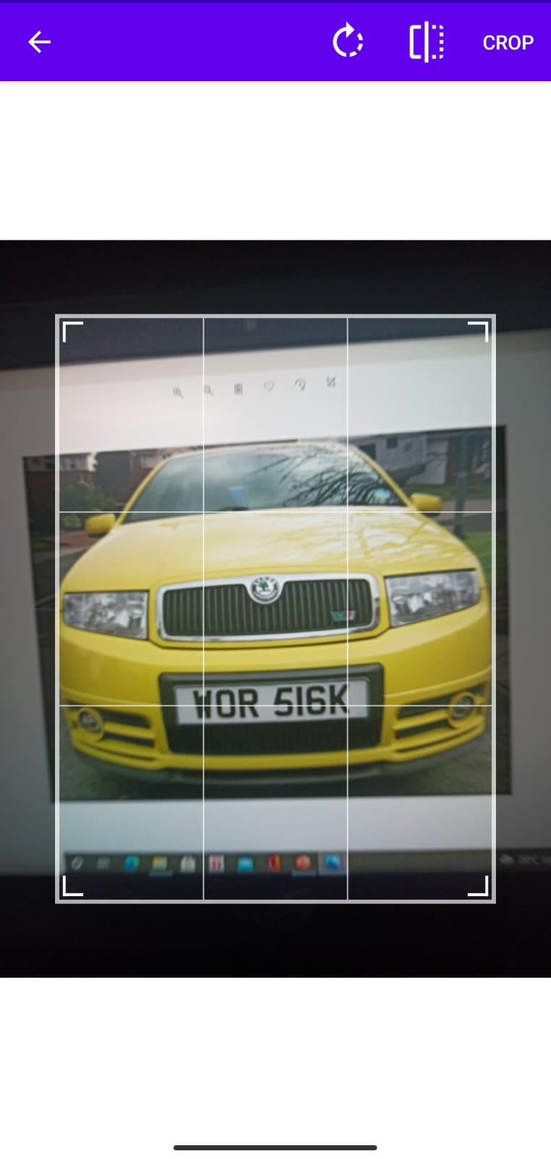
Front End Details
Descriptive Report View
Cropping Interface

Slide 11
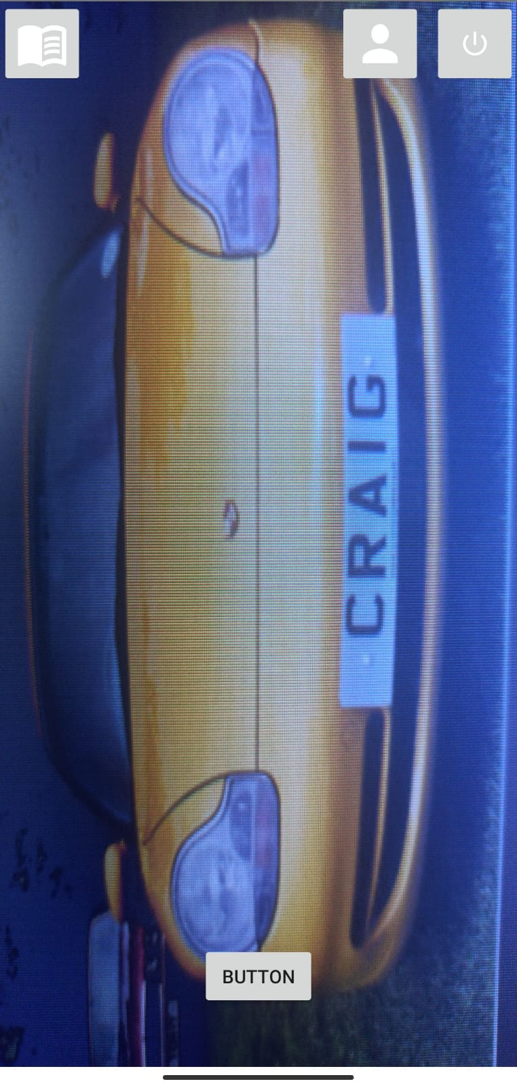
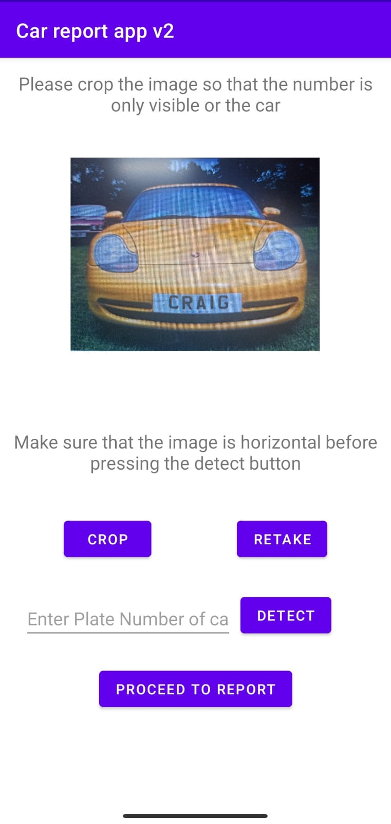
Front End Details
Start Up Screen
Crop image and process

Slide 12
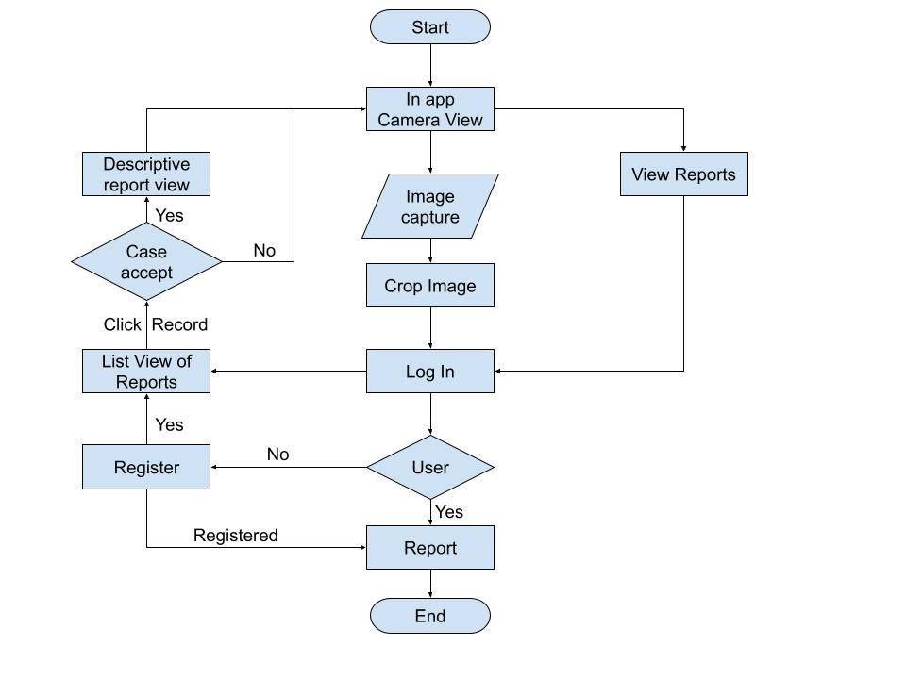
Project Flow Diagram

Slide 13
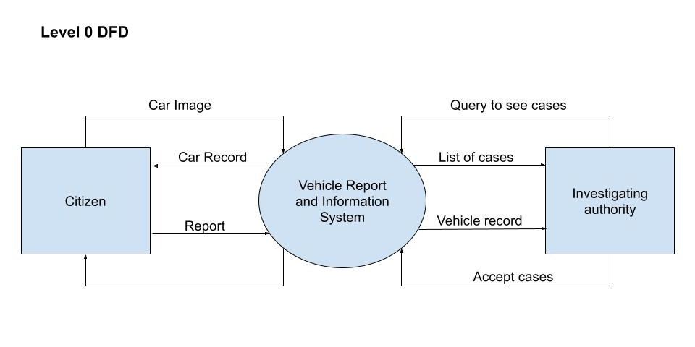
Data Flow Diagram

Slide 14
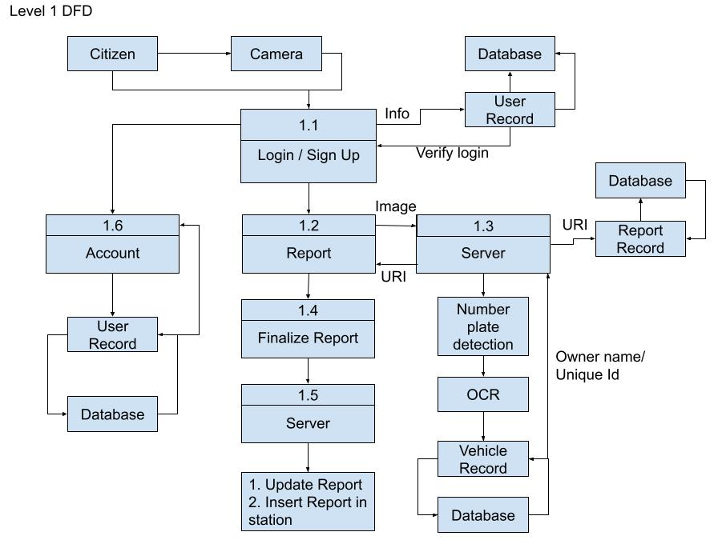
Data Flow Diagram

Slide 15
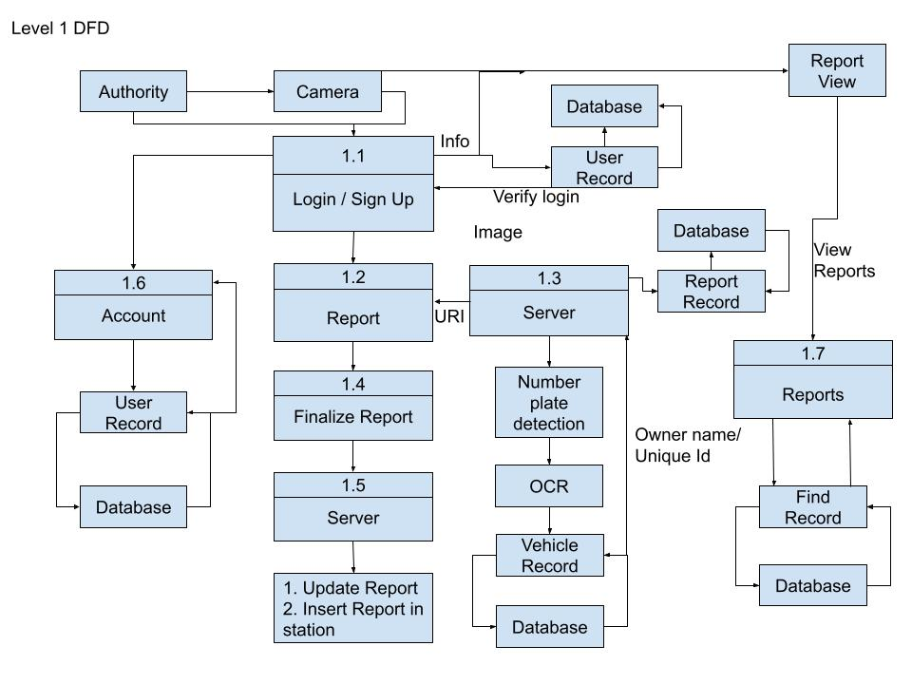
Data Flow Diagram

Slide 16
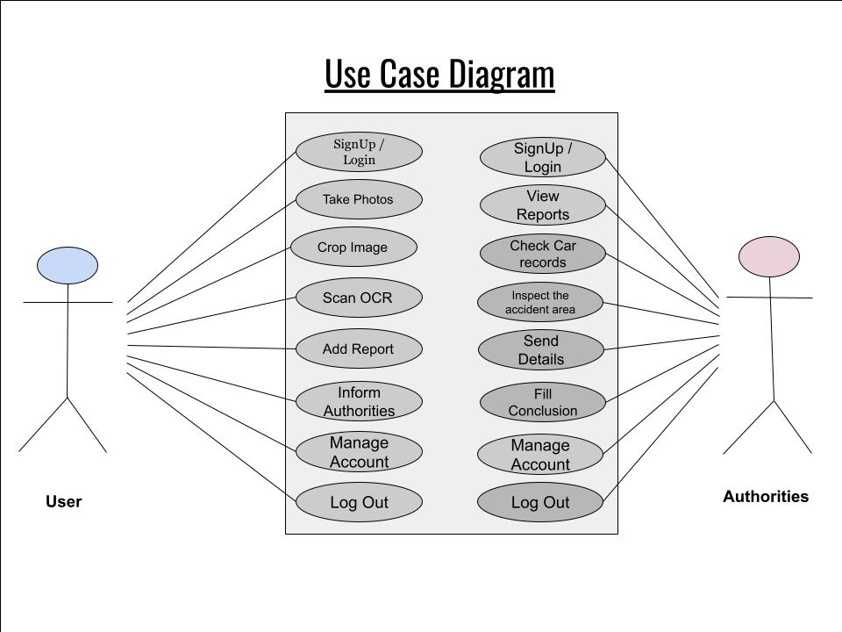
Use Case Diagram

Slide 17
Result & Conclusion
The aim is to make reporting vehicle crime easily and seamless.
Investigation record keeping made easy and interface for tracking the status of investigation.
Implementation of AI to automate the Report generation process.
In society people usually don’t prefer going to the police station to file a report against crime which leads to many missed cases, this app eases up the process without much intervention to make people think that now they can easily report a crime.
Along with it, easy access to vehicle record for authorities to avoid the long application procedure to get access to them and even in a good secure manner so as to avoid the misuse of information.

Slide 18
References
Web Resources
http://www.stackoverflow.com (Last Visited date)
https://youtube.com/
https://www.geeksforgeeks.org/

