Slide 1
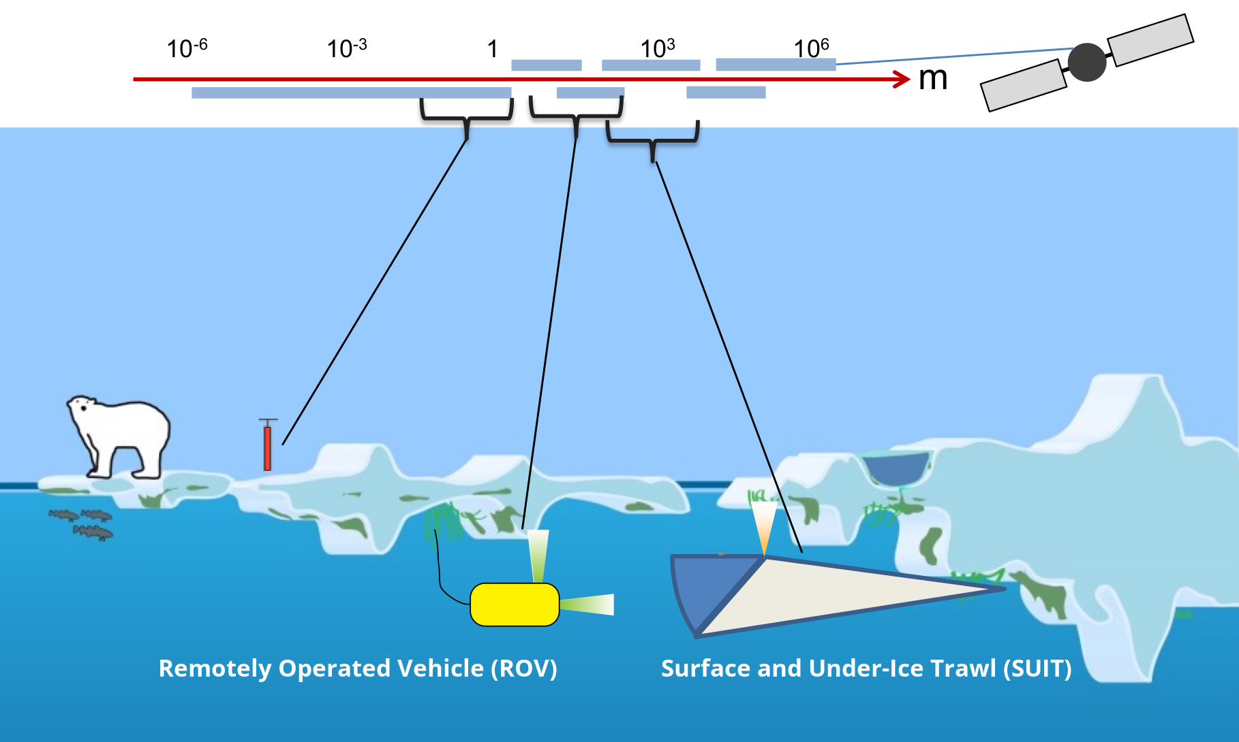
Sensitivity of phytoplankton primary production estimates to available irradiance under heterogeneous sea-ice conditions
Philippe Massicotte, Ilka Peeken, Christian Katlein, Hauke Flores, Yannick Huot, Giulia Castellani, Stefanie Arndt, Benjamin A. Lange, Jean-Éric Tremblay and Marcel Babin

