Slide 1
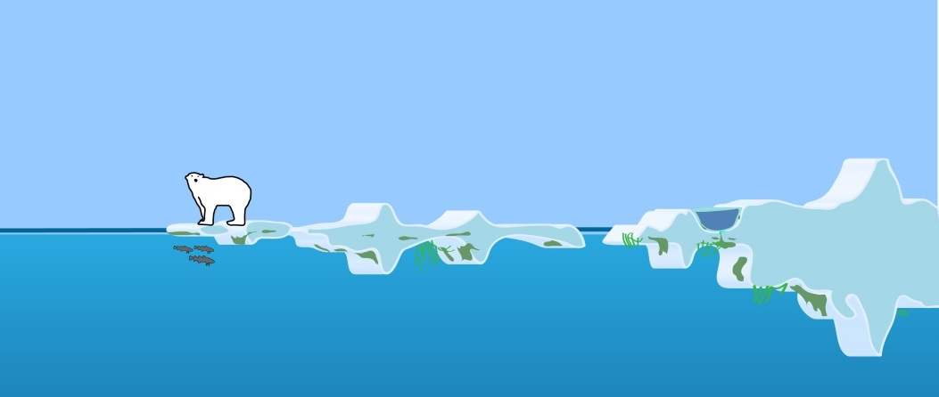
Scales of variability
10⁻⁶
10⁻³
1
10³
10⁶
m
Notes:
Outreach / public media?

Slide 2
Scales of variability
10⁻⁶
10⁻³
1
10³
10⁶
m

