Slide 1
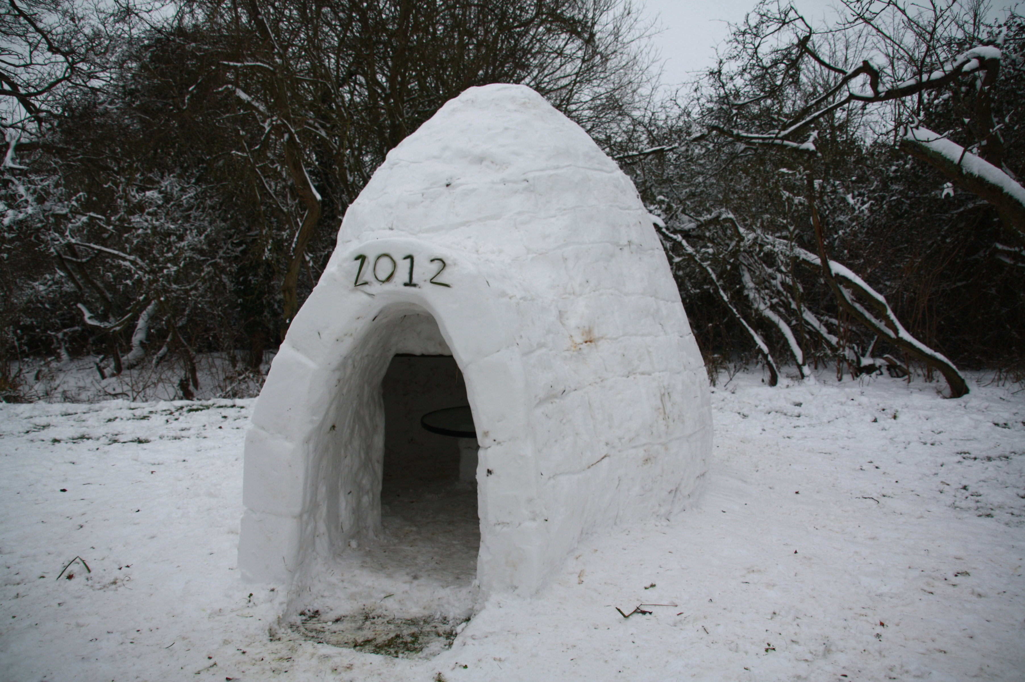
Predicting House Costs in Canada
Pat Maynard
Raymon Ali

Slide 2
Introduction – About Us!
Raymond Ali
Placeholder
Pat Maynard
R&D Software Developer
Full-Stack ERP Developer
Electrical Eng. Tech. Diploma
Computer & Network Technician
Father of two
Lived all over Ontario

Slide 3
Introduction – The Problem
Over the last few decades, we have watched as the housing markets have grown out of control.
We would like to predict what the range of house prices will be in the future and try to narrow down if there is a better year in a decade and a month in a year to purchase a home.
Using historical data, we would like to see how bad it is; or dispel the rumors of a crisis.

Slide 4
Literature Review
Previous Approaches
Linear Regression models
One-Hot-Encoder, breaking out different attributes of the property
Random Forest was popular for training data sets
XGBoost to scale and weigh data
Previous Challenges
Computer efficiency
External Parameters affecting data
Potential Overfitting

Slide 5

Methodology –Gathering Data
Data Sources
Statistics Canada – House Price Index
Stats CREA – MLS Home Price Index

Slide 6
Methodology – Prepare the Data
Problems
Outside factors affecting HPI
Different property characteristics
Overfitting data
Solutions
Pick a specific group of issues to address
One-Hot-Encoder to break out characteristics into Boolean value tables
Not sure yet

Slide 7
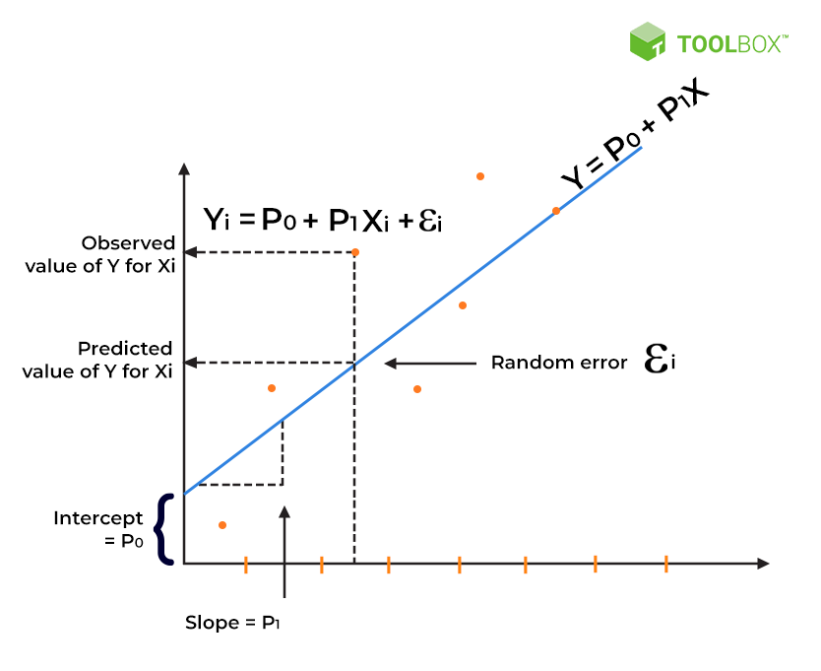
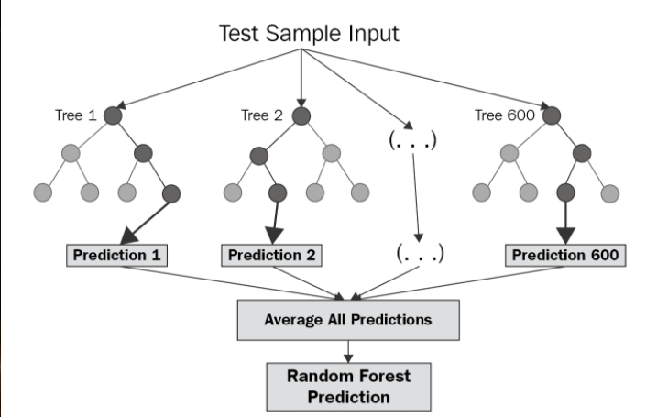
Methodology – Choose a Model
Options based on the Problem
Linear Regression
Decision Tree Regression
Random Forest Regression
Lasso regression

Slide 8



Methodology – Training & Evaluation
Place holder

Slide 9
Methodology – Hyperparameter Tuning
Options
Manual or Automated
Bayesian Optimization
Grid Search
Random Search
Available Tweaks
Learning Rate
Rate Decay
Momentum
Data Sizes
End Goal
To have a more efficient model with more accurate results. And not need a super-computer to process.

Slide 10

Prediction
Without even looking too far into the data we assume that the prices are going to continue to climb.
These prices are linked to larger-scale events such as economic and political events.

