Slide 1
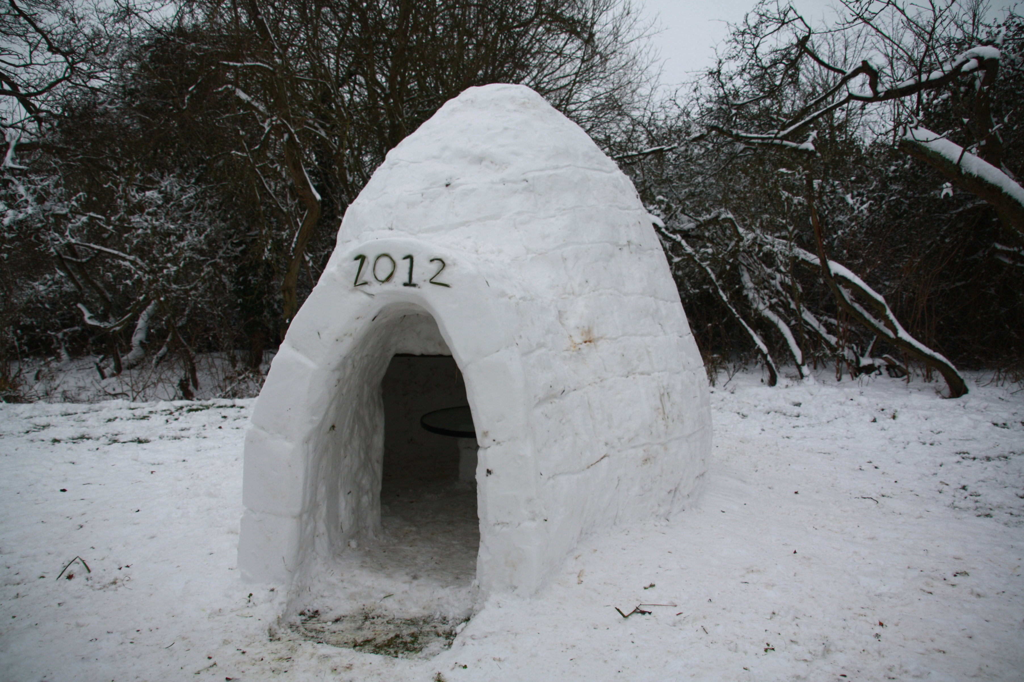
Predicting House Costs in Canada
Pat Maynard
Raymond Ali

Slide 2
Introduction – About Us!
Raymond Ali
Engineering student
Background in Toolmaking
Worked in a variety of machine shops and assembly plants
Very new to this field
Pat Maynard
Full-Stack Software Developer
Electrical Eng. Tech. Diploma
Computer & Network Tech.
Father of two
Lived all over Ontario

Slide 3
Introduction – The Problem
Over the last few decades, we have watched as the housing markets have grown out of control.
We would like to predict the range of house prices (HPI: House Price Index) will be in the future and if possible, try to narrow down if there is a better year in a decade and a month in a year to purchase a home.
Using historical data, we would like to see how bad it is; or dispel the rumors of a crisis.

Slide 4
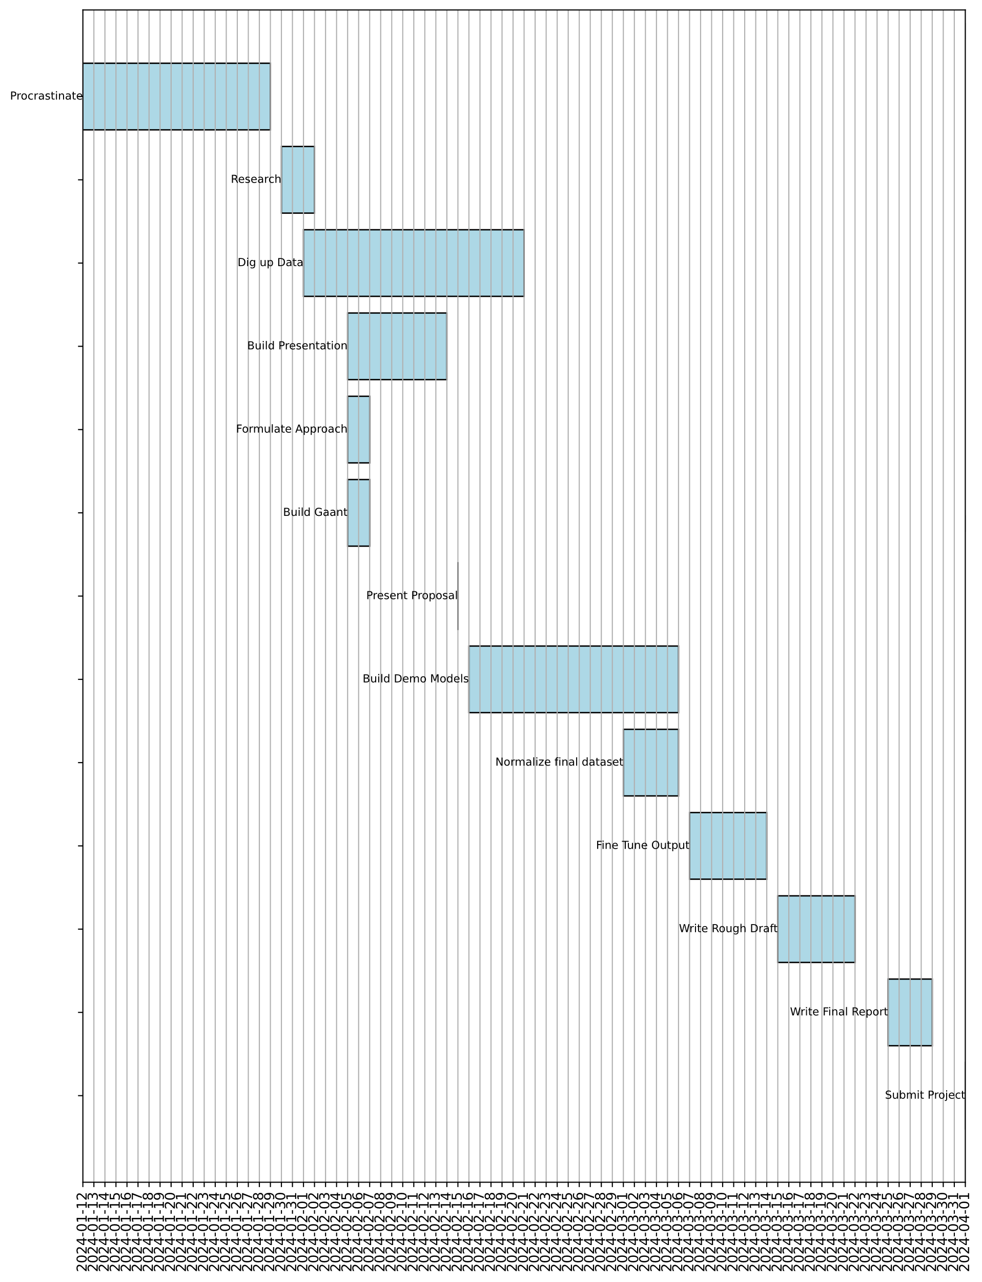
Timeline
Major Factors
Procrastination
Gathering Data
Building a model that works
Fine Tuning

Slide 5
Literature Review
Previous Approaches
Linear Regression models
One-Hot-Encoder, breaking out different attributes of the property
Random Forest was popular for training data sets
XGBoost to scale and weigh data
Previous Challenges
Computer efficiency
External Parameters affecting data
Potential Overfitting

Slide 6

Methodology –Gathering Data
Data Sources
Statistics Canada – House Price Index
Stats CREA – MLS Home Price Index
Statistics Canada – Consumer Price Index (Shelters)
Statistics Canada – Mortgage Interest Rates

Slide 7
Methodology – Prepare the Data
Problems
Outside factors affecting HPI
Different property characteristics
Overfitting data
Weird Data Formats
Solutions
Pick a specific group of issues to address
One-Hot-Encoder to break out characteristics into Boolean value tables
Transpose data to one table
Not sure yet

Slide 8
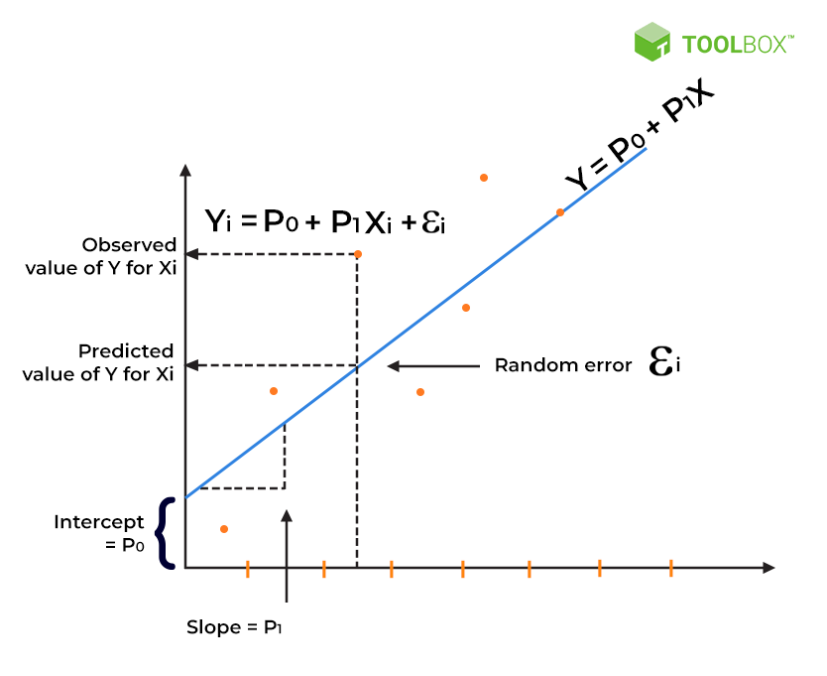
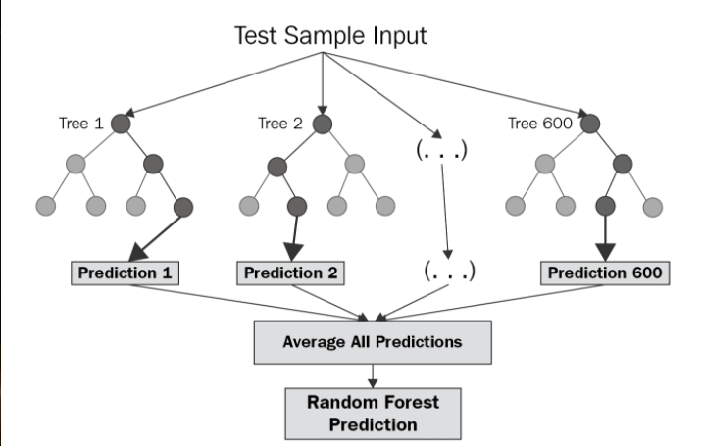

Methodology – Choose a Model
Options based on the Problem
Linear Regression
Decision Tree Regression
Random Forest Regression

Slide 9



Methodology – Training & Evaluation
Training
Break the HPI, CPI, and Interest Rates into features
Divide up the sets into training and test sets
Evaluation
Mean Squared Error – Percent Accuracy
R-Squared Score – Percent of Relationship between Dependant and Independent variables

Slide 10
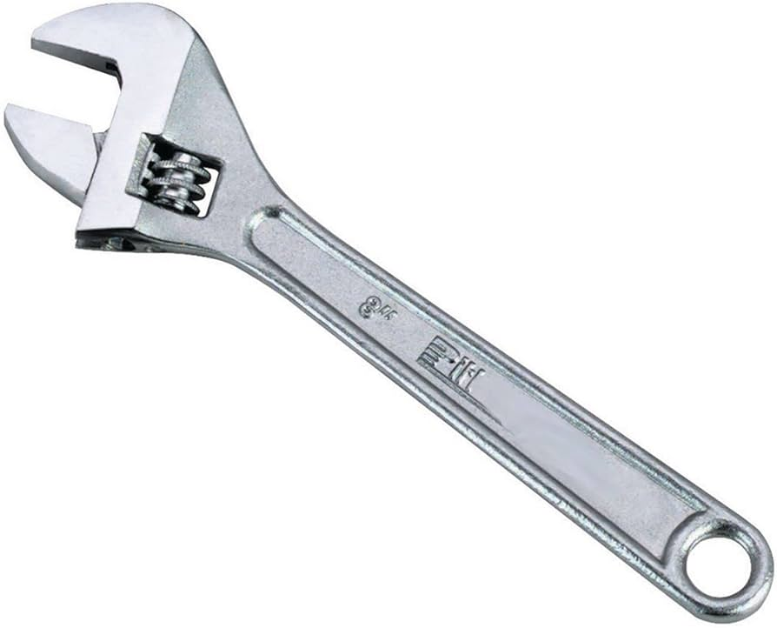
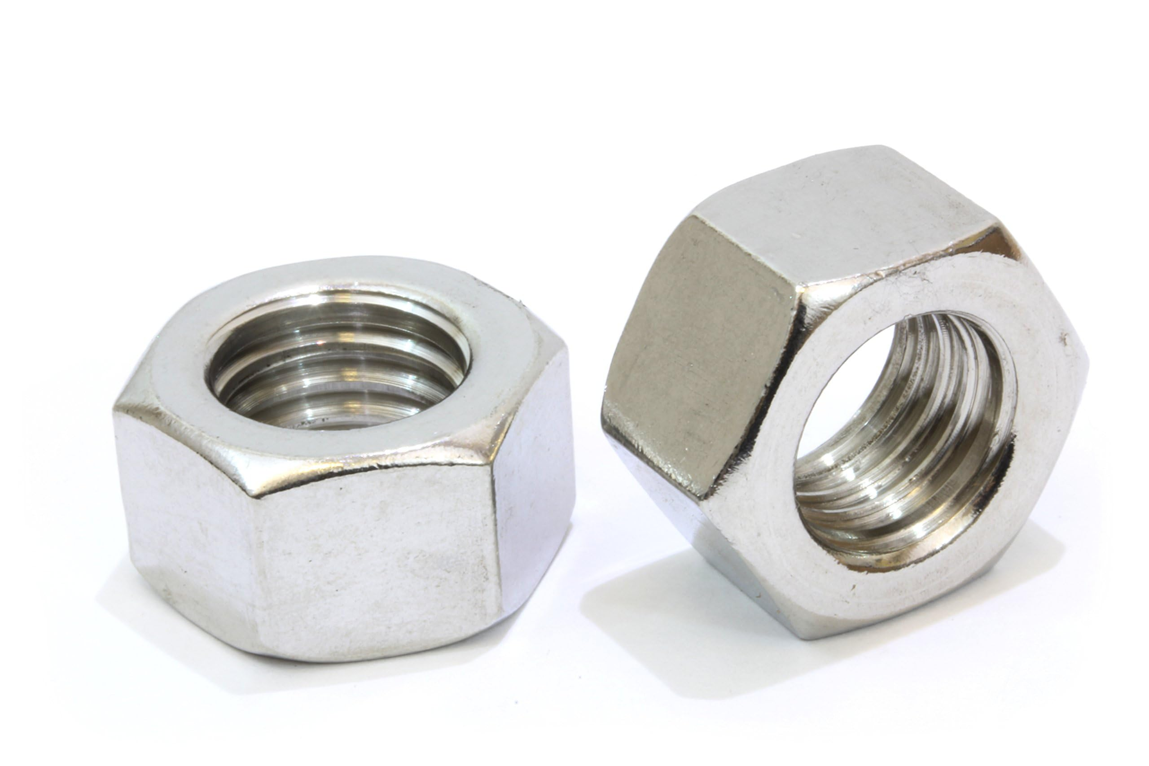
Methodology – Hyperparameter Tuning
Options
Bayesian Optimization - Tries to predict function shape
Grid Search – Cross references the data for optimal combinations
Random Search – Randomly selected cross references from the data pool
Available Tweaks
Learning Rate – Step size
Rate Decay – Reduce learning rate to find local minima
Momentum – Reducing noise by using previous iterations to clean up data
Data Size – How much input data is needed for prediction
End Goal
To have a more efficient model with more accurate results. And not need a super-computer to process.

Slide 11

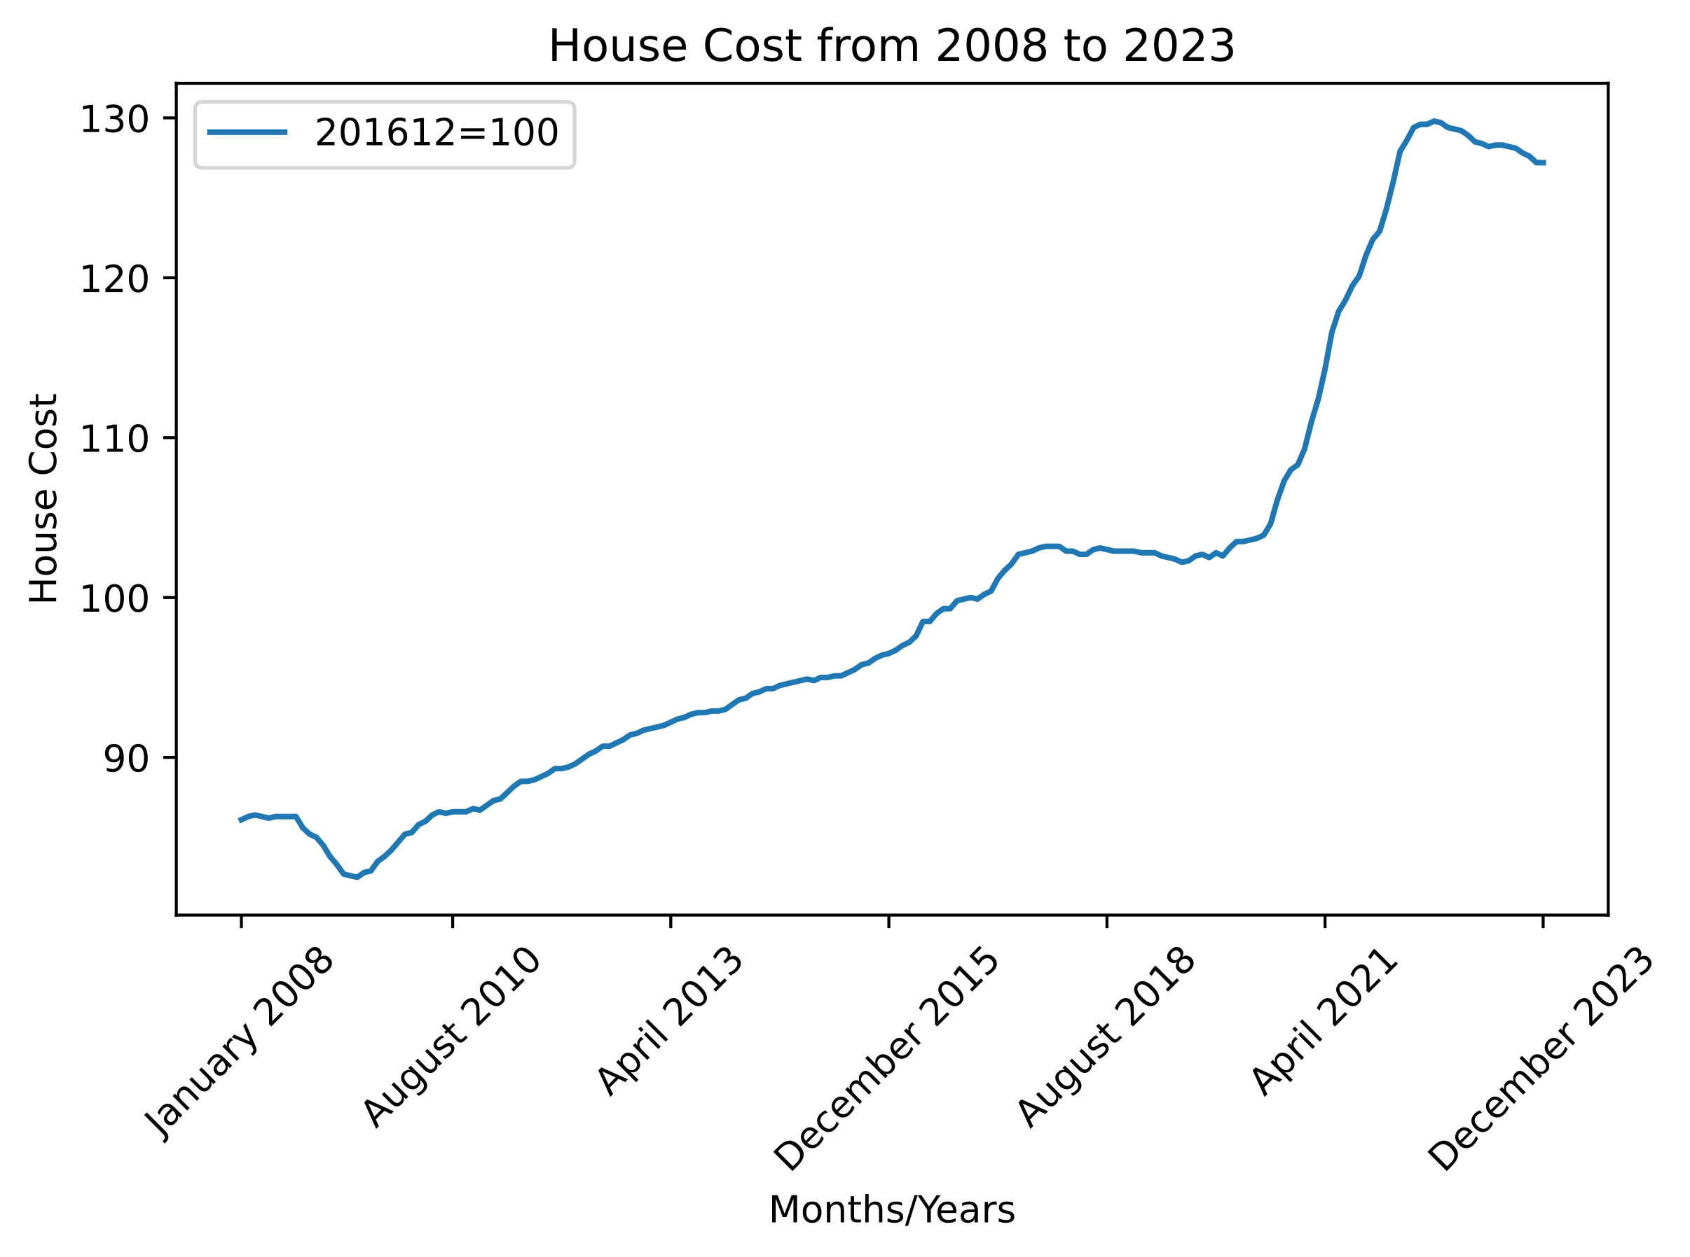
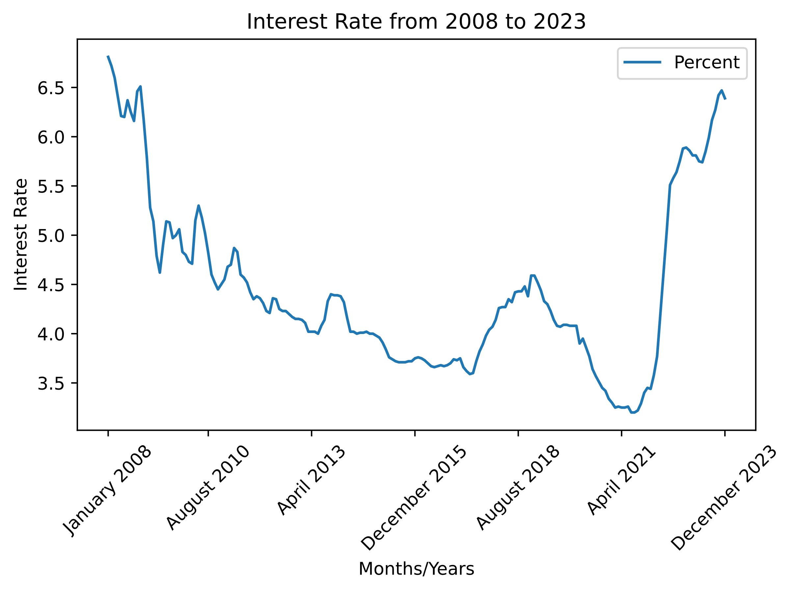
Prediction
Without even looking too far into the data we assume that the prices are going to continue to climb.
These prices are linked to larger-scale events such as economic and political events that are not quantified in the data.

Slide 12
Thank you
Any questions?

