Slide 1
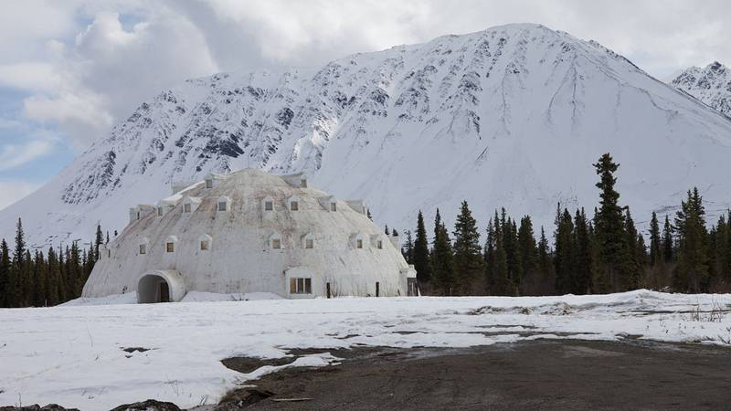
Predicting House Costs in Canada
Pat Maynard
Raymond Ali

Slide 2
Initial Problem

Slide 3

Random Forest Approach in a Nut-Shell

Slide 4
Code Snippets

Slide 5
Issues
Data Set not Large enough
Concatenation of Datasets

Slide 6
Solutions

Slide 7
Hyperparameter Tuning
Grid Search
Random Search
Evaluation of Performance

Slide 8
Outcomes
Conclusions
A more in-depth course on machine learning would need to be taken to tackle such a large problem.

Slide 9
References
Econoscent – Aug 30, 2020 – YouTube – Visual Guide to Random Forest
https://www.youtube.com/watch?v=cIbj0WuK41w&ab_channel=Econoscent

Slide 10
Thank you
Any questions?

