Slide 1
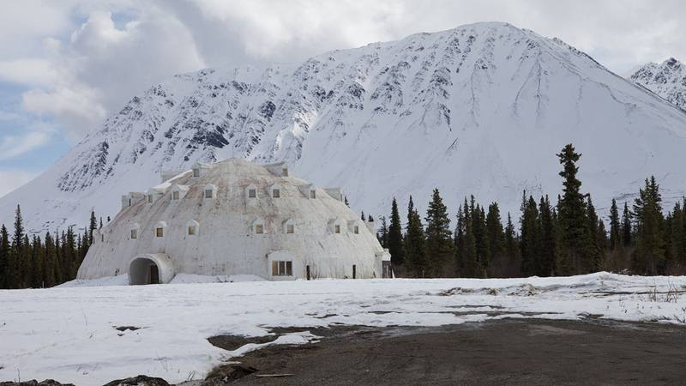
Predicting House Costs in Canada
Pat Maynard
Raymond Ali

Slide 2
Initial Problem

Slide 3

Random Forest Approach in a Nut-Shell

Slide 4
Code Snippets

Slide 5
Issues

Slide 6
Solutions

Slide 7
Outcome

Slide 8
References

Slide 9
Thank you
Any questions?

