Slide 1

Predicting House Costs in Canada
Pat Maynard
Raymond Ali
GitHub: https://github.com/PMcTwist/Machine_Learn_Project

Slide 2
Initial Problem
Initial Problem - To predict housing prices in Canada
New Problem – Need more features to train our model!
New Problem – Need to Hyper Parameter Tune our model!

Slide 3

Random Forest Approach in a Nut-Shell

Slide 4
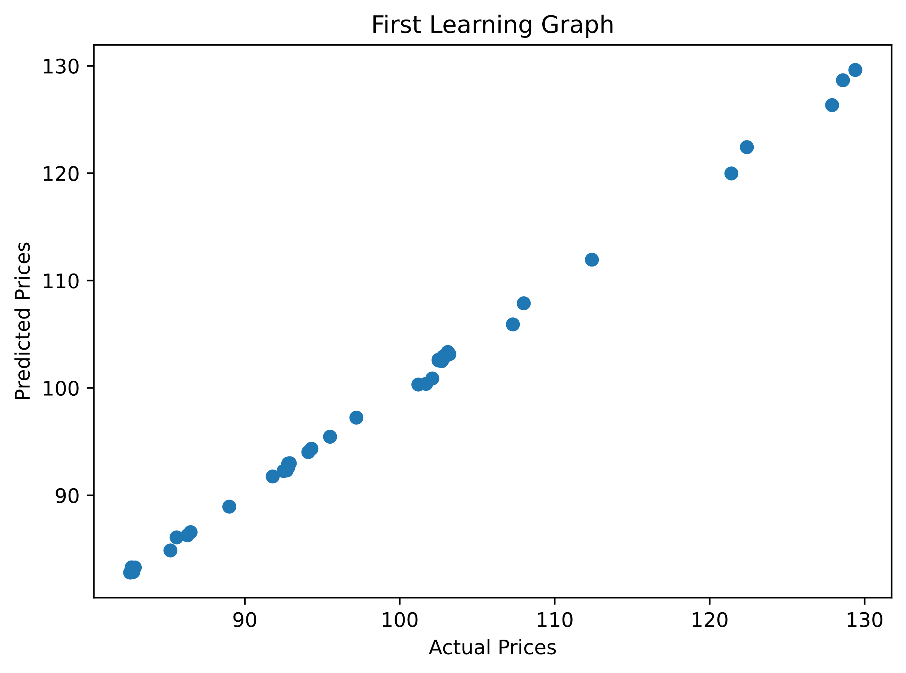
Solutions
Get more features
Hyperparameter tune the output and compare the differences
Get actual dollar values for house costs
Graph an actual prediction and not just compare prediction vs actual HPI

Slide 5
Dataset Issues
Data Set not Large enough
Concatenation of Datasets
Old Data:
New Data:

Slide 6
Feature Code Snippets
# Convert the date strings into datetime objects
dataset['Date'] = pd.to_datetime(dataset['Date']) # Convert Date Features to a number format
dataset['Year'] = dataset['Date'].dt.year
dataset['Month'] = dataset['Date'].dt.month
# Split data into X and y sets
X = dataset[[
'Year',
'Month',
'Composite_HPI',
'Single_Family_Benchmark',
'One_Storey_Benchmark',
'Two_Storey_Benchmark',
'Townhouse_Benchmark',
'Apartment_Benchmark'
]] y = dataset['Composite_Benchmark']

Slide 7

Hyperparameter Tuning
# Define the parameter distribution
param_dist = {
'n_estimators': [50,100,150,200,250,300,
350,400,450,500,550,600,650,700,750]}
# Plant the seeds to grow a forest
forest_model = RandomForestRegressor(random_state=0)
# Initialize the random search
random_search = RandomizedSearchCV(
estimator = forest_model,
param_distributions = param_dist,
n_iter = 15,
cv = 5,
scoring = 'neg_mean_squared_error',
random_state = 0
)
# Store the best selection for later
selected_params = random_search.best_params_
Grid Search
Random Search
Evaluation of Performance
Initial Mean Squared Error: 15446690.869565217
Best Parameters to use: {'n_estimators’: 350}
Hyper Tuned Mean Squared Error: 16103867.163043479
R-Squared Error: 0.9993086327577407

Slide 8
Scaling Code Snippets
# Create an instance of the scaler
scaler = RobustScaler() # Initialize a loop to iterate the train columns
for col in X_train.columns:
col_scaled = scaler.fit_transform(X_train[[col]]) # Append scaled data to empty dataframe
X_train_scaled[col] = col_scaled.flatten() # Transform test column data
col_scaled_test = scaler.transform(X_test[[col]]) # Append scaled data to empty dataframe
X_test_scaled[col] = col_scaled_test.flatten()
scaled_features_for_prediction = scaler.transform(features_for_prediction)

Slide 9
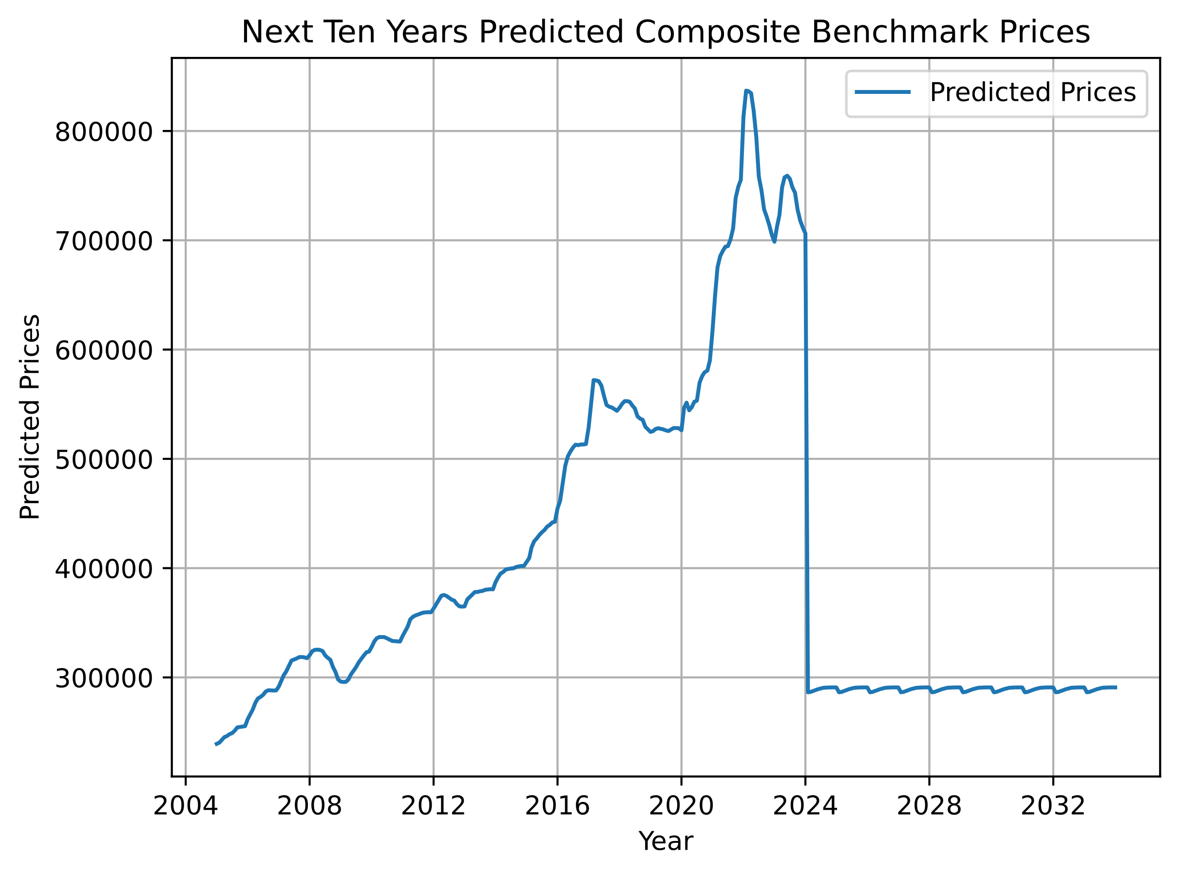
Outcomes

Slide 10
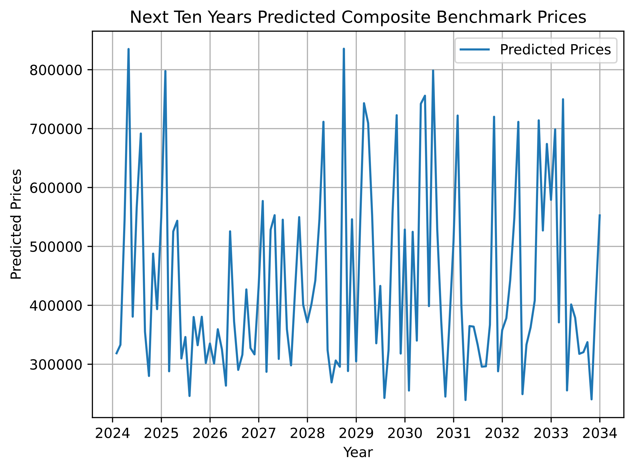
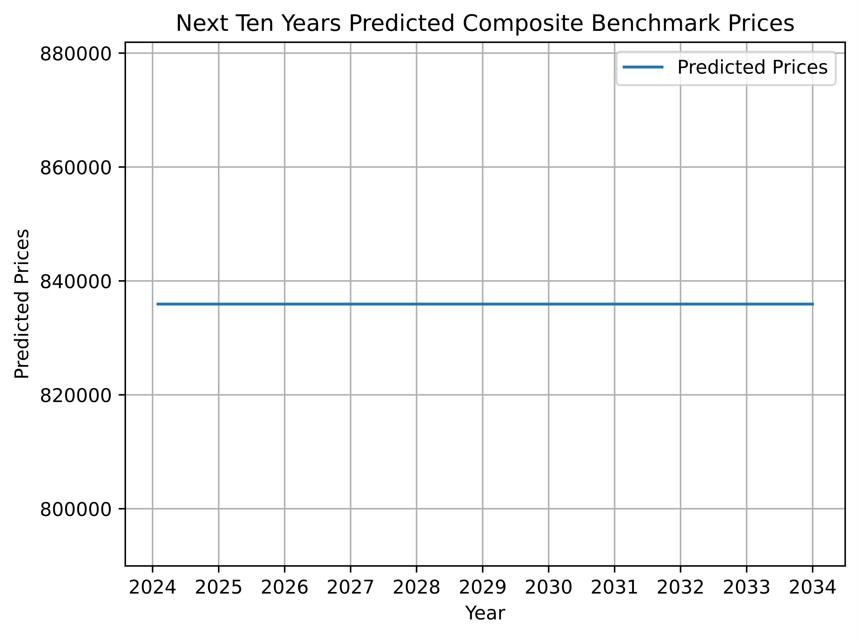
Outcomes

Slide 11
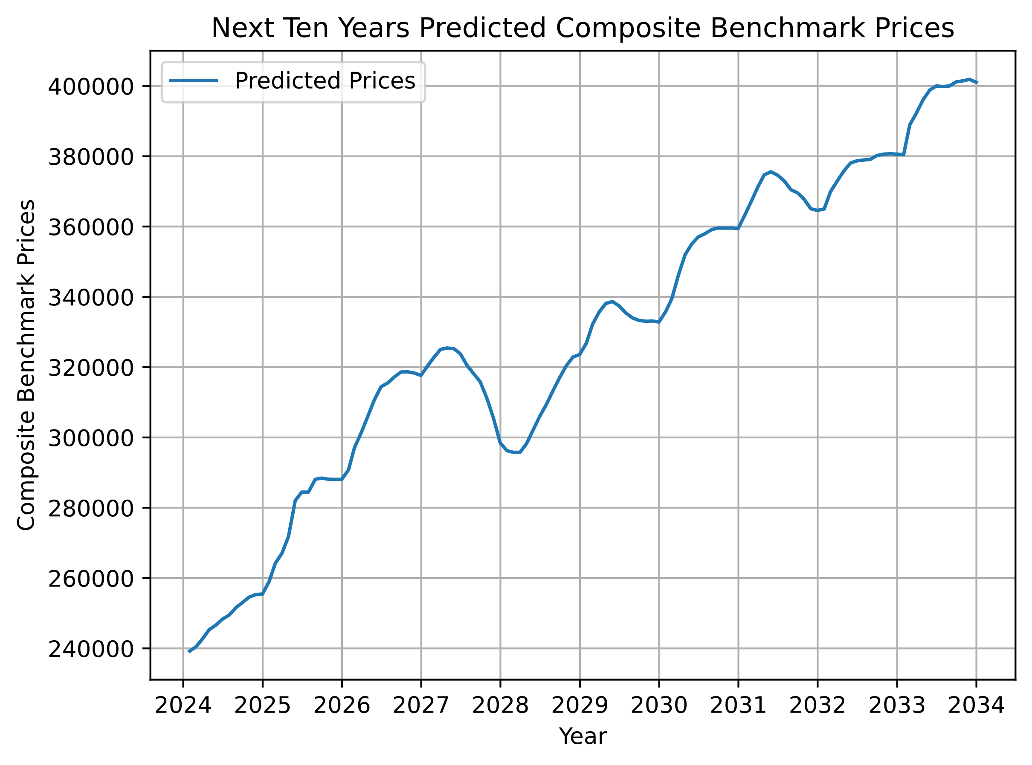
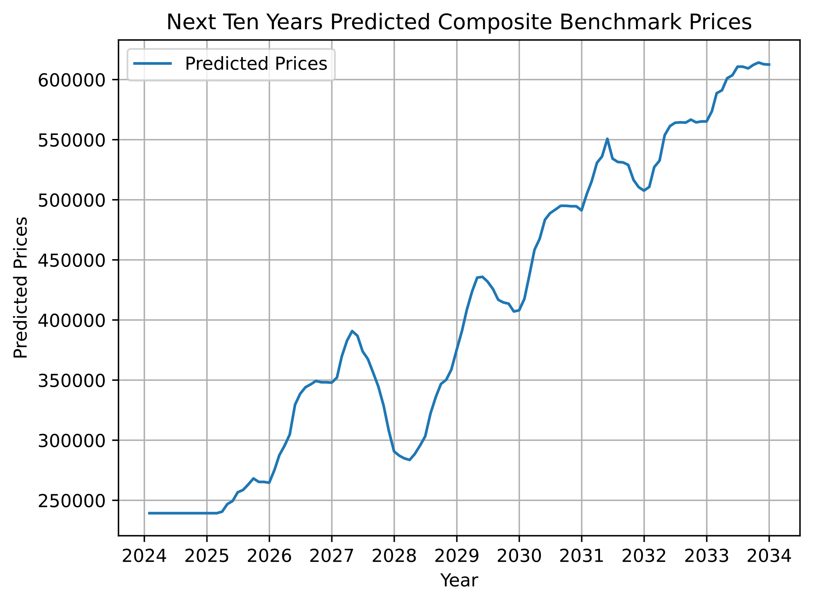
Outcomes
Final Graph

Slide 12

Conclusions
The scale of the output price ranges could be off.
Scale issue could be due to a lower starting point in historical data and the scaler methods used.
Sell Spring of 2027, Buy Winter of 2028!
The same trends of Spring/Winter are shown again in a few places.
SkTime would be a better library to use for future data forecasting when you only have historical data and a future time frame.

Slide 13
References
Econoscent – Aug 30, 2020 – YouTube – Visual Guide to Random Forest
https://www.youtube.com/watch?v=cIbj0WuK41w&ab_channel=Econoscent
Canadian Real Estate Association. (2024) National statistics, February 14 2024 News Release | CREA Statistics. Available at: https://creastats.crea.ca/en-CA/ (Accessed: 11 March 2024).
https://creastats.crea.ca/en-CA/
https://stackoverflow.com/ - Non-stop Forum Searching.
https://scikit-learn.org/stable/user_guide.html - SkLearn Documentation.
(2023, October 24). Full guide to feature scaling in SciKit-Learn - Pierian Training. Pierian Training. https://pieriantraining.com/complete-guide-to-feature-scaling-in-scikit-learn
https://www.sktime.net/en/stable/ - SkTime Documentation.

Slide 14



Thank you
Any questions?

