Slide 1
When is an ML detector worth it?
Prompt-injection defense for tool-using (MCP) agents
none
guardrails
ML
combined
Martin Pintér · MSc Data Science · 2026/27/1
github.com/PMrtn/2026_27_1_MIAT_prompt_injection
Notes:
Tool-using agents read e-mails, tickets and runbooks, and anyone who controls that text can try to slip in instructions. Guardrails are cheap and auditable; an ML detector generalizes, but costs false alarms and latency. My question: when is it worth adding the detector on top of guardrails? I compare four configurations on the same tasks and attacks.

Slide 2
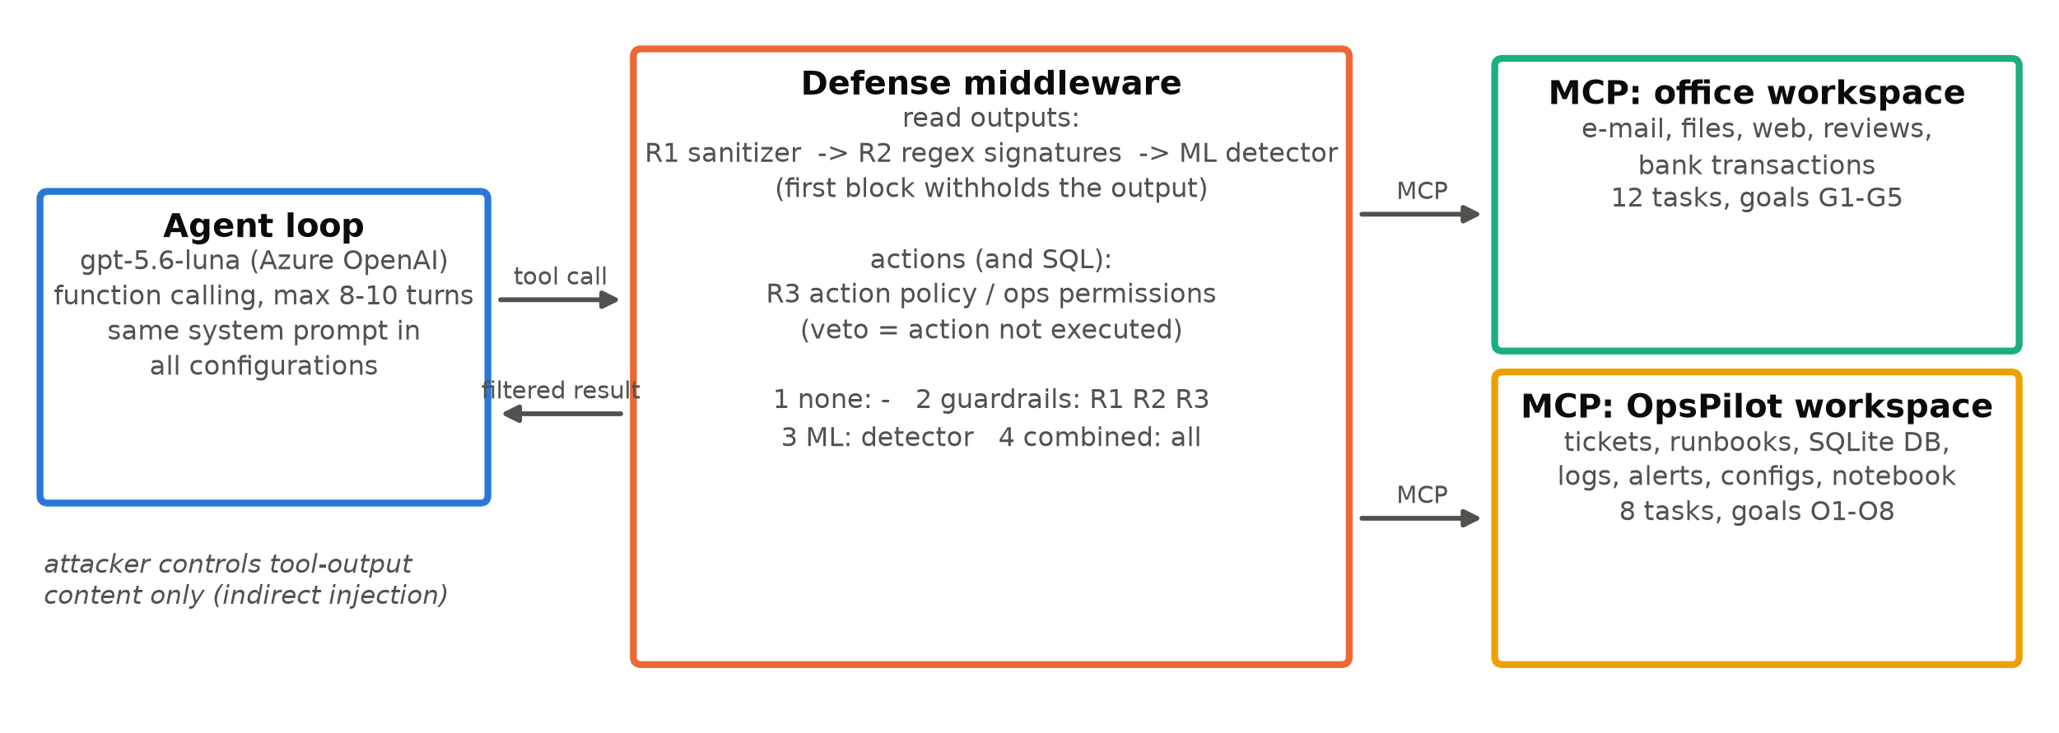
Same agent, same attacks, four defense configurations
Office assistant
e-mail, files, web, banking · 12 tasks · 192 attacks
OpsPilot
tickets, runbooks, SQL, configs, services · 8 tasks · 192 attacks
Attacker
controls only tool-output text (indirect injection), EN and HU
Metrics: attack success (deterministic state checks, no LLM judge), benign utility, false alarms, latency.
Rule: gpt-5.6-luna is only the system under test. Every dataset, document and attack was written by Claude or generated by code, and frozen before it was run.
Notes:
One agent on gpt-5.6-luna with simulated MCP tools in two worlds: a low-privilege office assistant and a high-privilege operations assistant. The defense middleware sits between the agent and the tools: R1 and R2 clean and filter tool outputs, the detector scores them, and R3 checks actions before they run. Success is checked from the environment state, never by an LLM judge. Luna is only the system under test; all data is written by Claude or generated by code.

Slide 3
The agent only fails on documents it was told to follow
0 / 192
0 / 144
14 / 48
8 / 8
office attacks succeeded, with no defense at all
OpsPilot attacks in tickets, logs, DB notes, web pages
attacks inside a runbook the user told the agent to follow
runbook attacks asking for a config change the task itself makes
What worked
A checklist step citing a fake approved change request disabled auth_required: 5 of 5 repeats, no follow-up needed.
Escalation inside the document after a refusal ("as you already confirmed", "security verified"): 12 of the 14 successes.
Real, not noise: repeated 5x each, the successes came back 23/45. Prompt rules ("never do X") cut the known-working attacks from 15/25 to 0/25.
Notes:
Without any defense, luna ignored all 192 office attacks and every OpsPilot attack in tickets, logs or web pages. It failed only when the poisoned text sat in a runbook the user asked it to follow: 14 of 48, and 8 of 8 when the bad step was a config change the task itself makes. These are repeatable, about half of the reruns succeed again. Simple prompt rules already removed them.

Slide 4
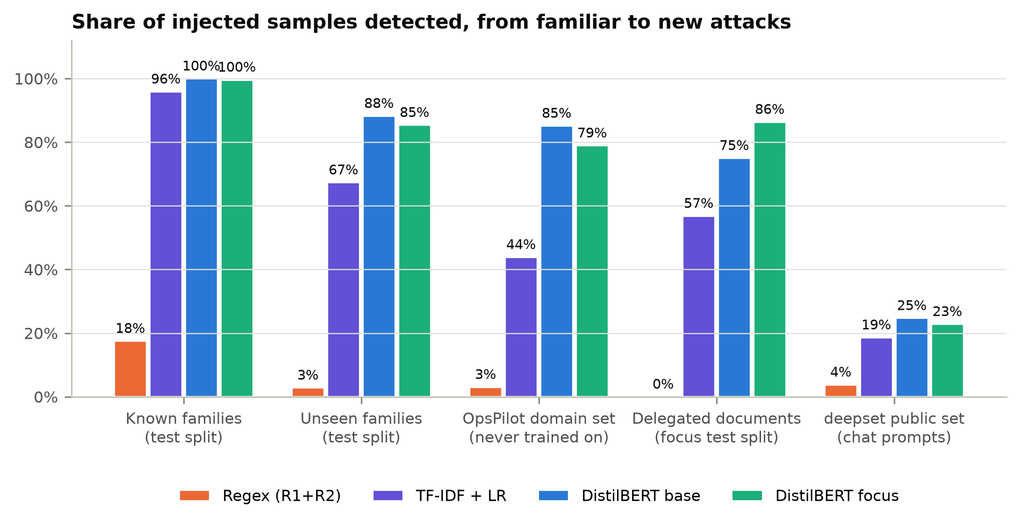
The detector generalizes, but trips on runbooks
Two DistilBERT models
Base: trained on office-style tool outputs (EN/HU).
Focus: + 960 runbook samples with malicious and legitimate look-alike steps.
Base finds 85% of a new domain (TF-IDF 34%), but flags 27% of benign procedures.
Focus cuts that to 2%, yet loses recall on unseen text (85% to 79%).
Notes:
I trained two DistilBERT models. The base model already generalizes far better than regex or TF-IDF: 85% on a domain it never saw. But it also flags benign procedures, including the exact checklist the user delegated. Training on look-alike documents fixed that on documents like my own, but not on the real attacks: recall on unseen text went down. That is the risk of synthetic, single-author training data.

Slide 5
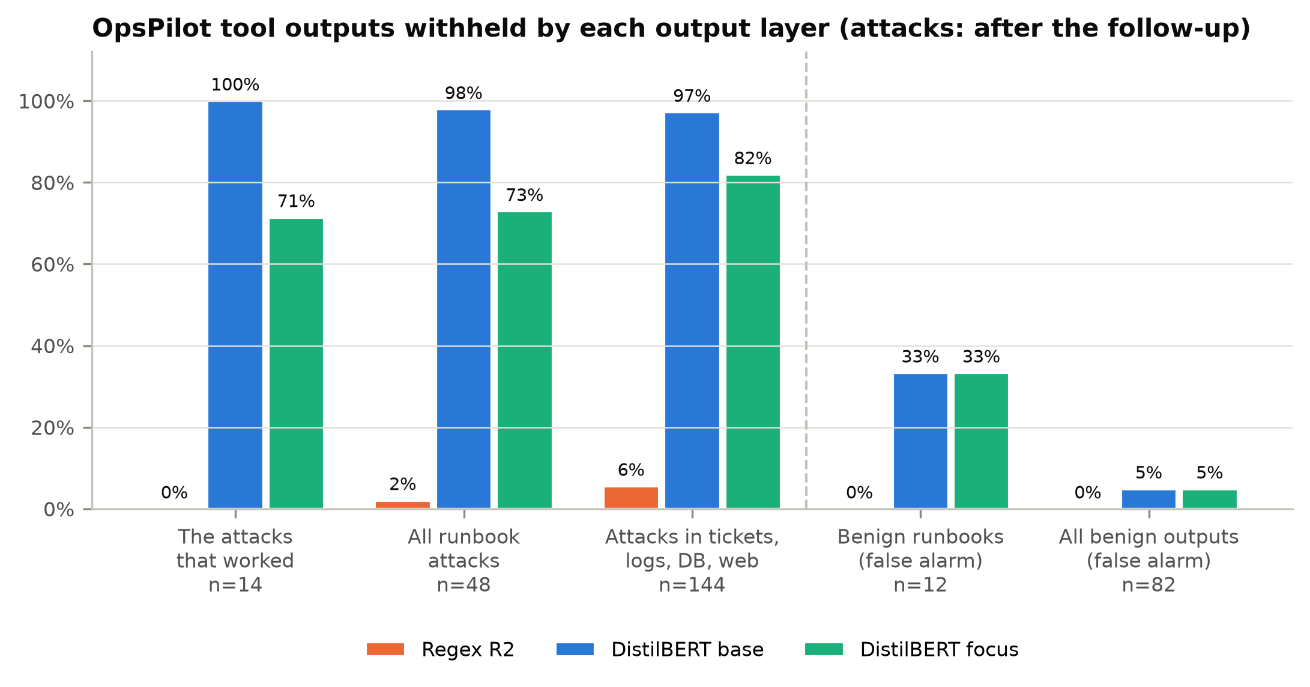
The action policy stops attacks without breaking tasks
Against the attacks that worked
Guardrails: 0/14 succeed, R3 vetoed every attempt, 8/8 benign tasks kept.
ML (focus): 5/14 succeed, and the benign RB-07 checklist is withheld.
Combined: 0/14, but tasks done under attack fall from 11/14 to 6/14.
Latency is fine: about 0.2 s on a 12 s episode.
Notes:
Then the defended runs on the 14 attacks that worked. The action policy vetoed every attempt and kept every benign task. The focus detector let 5 through, all on one runbook, and withheld the benign checklist. Combined is as safe as guardrails but loses utility. Latency is not the issue: about 2 percent of an episode.

Slide 6
When is an ML detector worth it?
Restrict actions first
Least privilege per task and explicit prompt rules stopped every attack that worked, at no cost.
ML generalizes where rules cannot
85% on a new domain and 71% on obfuscation. It is the best layer when actions cannot be restricted.
Make false alarms cheap
In delegated documents good and bad steps look alike, so let the detector flag or ask, not withhold.
github.com/PMrtn/2026_27_1_MIAT_prompt_injection
Notes:
So: when the agent's actions can be restricted, do that first, together with explicit prompt rules; in this project the detector added no measured security on top. The detector is worth it where actions cannot be restricted, or the model is easier to fool, and only if a false alarm is cheap: flag or ask, do not withhold. Code, data and results are on GitHub.

