Slide 1
SDA Project
Exploratory data analysis and Modelling

Slide 2
Members
Cherukuri Nikhilesh - S20180010040
Kore Nithish Kumar - S20180010086
Pulla Nagendra Babu - S20180010138
Rishabh Tripathi - S20180010147

Slide 3
Methodology
Loading the Dataset
Univariate analysis
Checking for Null Values
Checking the Normality of Data
Exploring data trends
Detection and removal of influential points
Checking for correlation
Principal component analysis for feature selection
Factor Analysis
Splitting data into train and test data and Applying Multi linear regression
Test of Hypothesis
Test of assumptions(Linearity, Homoscedasticity, Normality of errors, etc.)

Slide 4
About Dataset
Independent Variables
Large B/P
Large ROE
Large S/P
Large Return rate in last quarter
Large Market Value
Small Systematic risk
Dependent Variables
Annual Return
Excess Return
Systematic Risk
Total Risk
Absolute Win rate
Relative Win rate
Given data of 4 different quarters from 1990-2010 and one with combined data of all quarters.

Slide 5
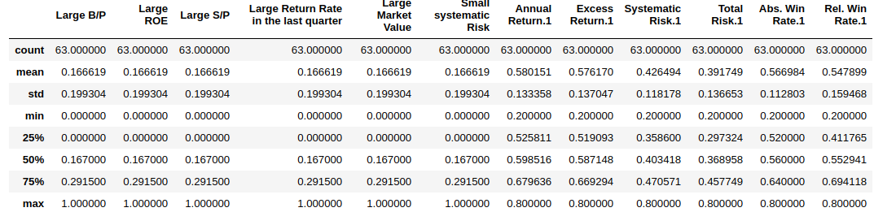
Dataset Summary

Slide 6
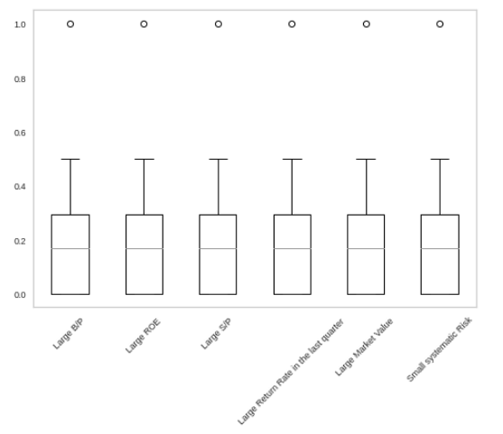
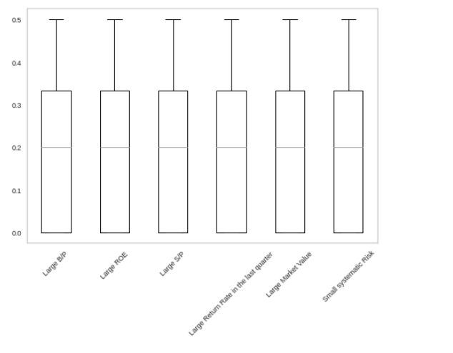
Detection of Outliers
Before removing Outliers After removing Outliers
Outliers affect the regression line badly.
Also affect determination coefficient.

Slide 7
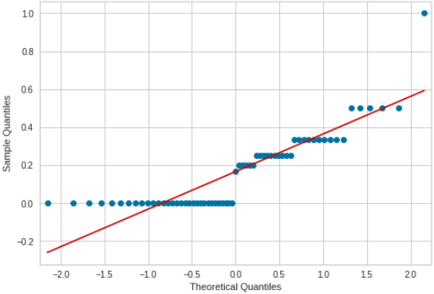
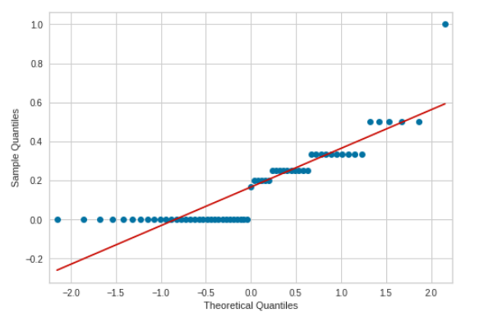
Normality of data
Independent variables are not normal as they are deviating from straight line.

Slide 8
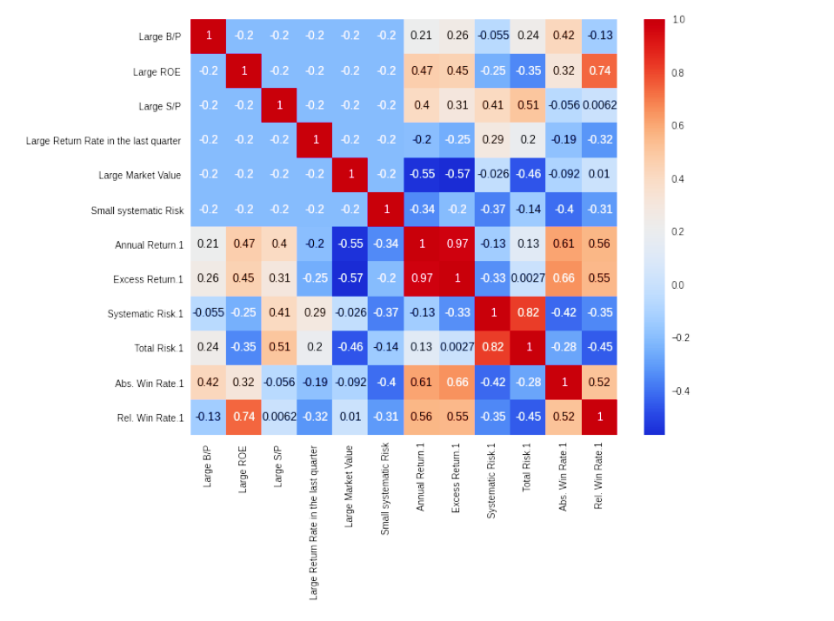
Correlation
Some of the features are correlated and some are uncorrelated.
Values ranging from [-1, 1].

Slide 9
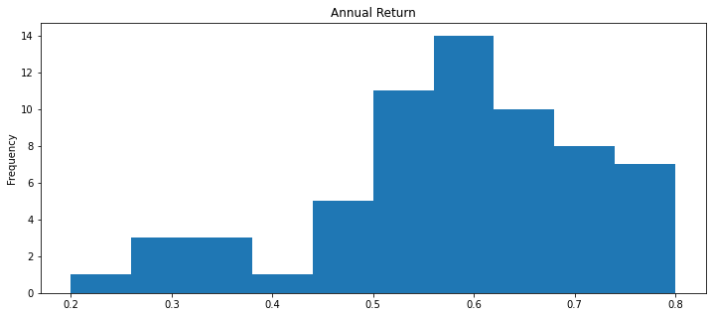
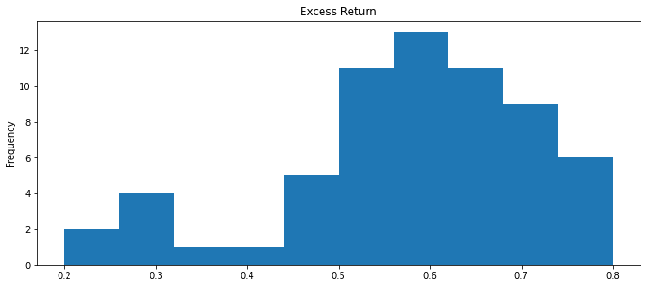
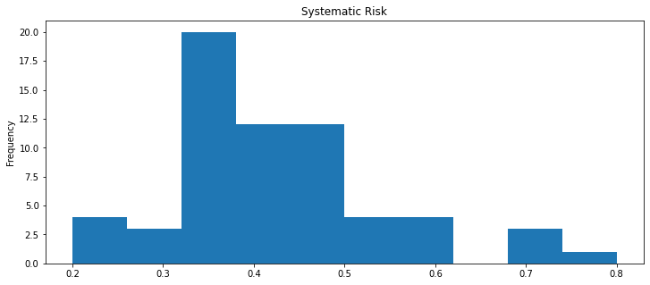
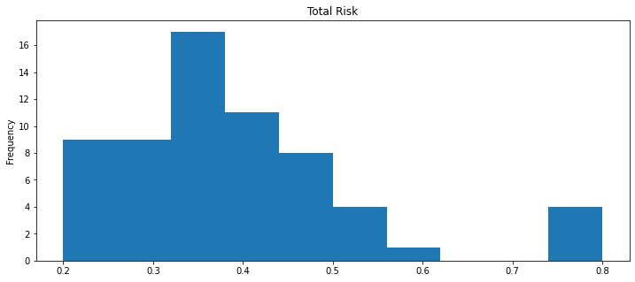
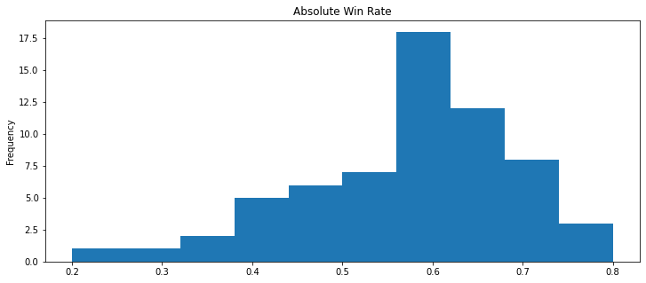
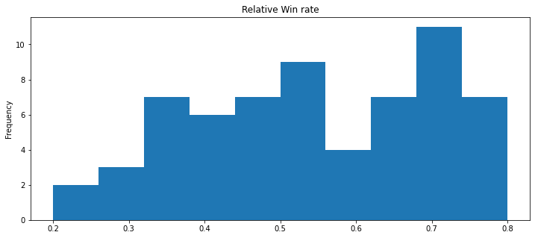
Normality of dependent variables

Slide 10
Inference: The above graph show the distribution of normal variables.We can say that they are Normal because they resemble bell shaped curves.

Slide 11
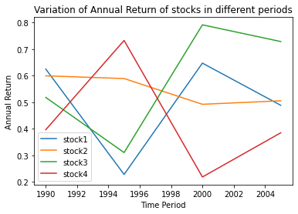
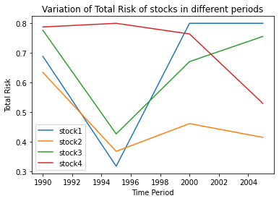
Stocks in different periods
Variation of Annual Return and Total Risk.
Inference : From period to period we can observe that values of stocks varies accordingly, stock value may increase or decrease as time passes, here for the first four stocks the change in the Annual return is shown, also total risk involved in different periods is shown.

Slide 12
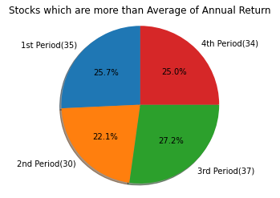
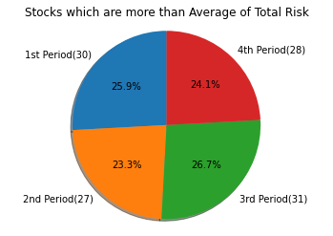
Performance of stocks
Number of stocks performing more than average is an important statistic to classify the stocks.
Inference : The above graphs shows us the count of stocks which performed more than average
performance in each period. We can say that in the 3rd period(2000-2005) most of the stocks performed well and gained a reasonable annual income, in 2nd period(1995-2000) less number of stocks involved in risk.

Slide 13
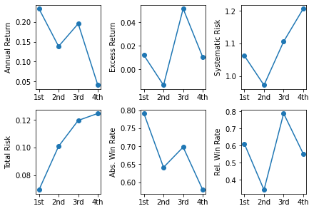
Change in Target Variable
Inference: The above plots shows how the average of each target variable changes over each quarter.We can observe the trend of various attributes over different quarters.

Slide 14
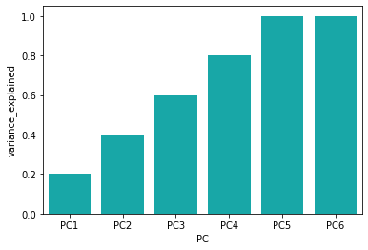
Principal Component Analysis
Variance Explained: [0.19999994 0.39999988 0.59999981 0.79999975 0.99999969 1.]
Inference: We can see that 100% variance of data is explained after considering the 6th principle component.Even though 6th PC explains only little variance we considered it because number of features are less and also to explain 100% variance of the data.

Slide 15
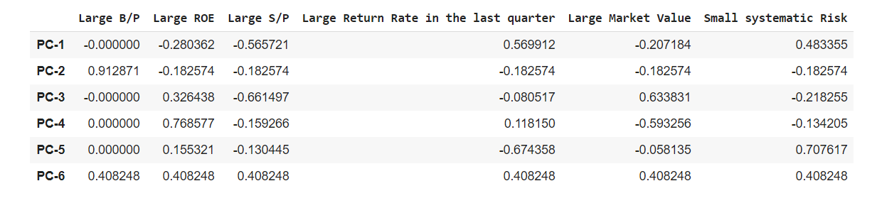
PC1 - Large return rate in last quarter PC2 - Large B/P PC3 - Large S/P PC4 - Large ROE PC5 - Small Systematic Risk PC6 - Large Market Value

Slide 16
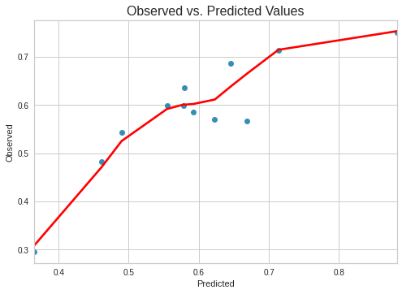
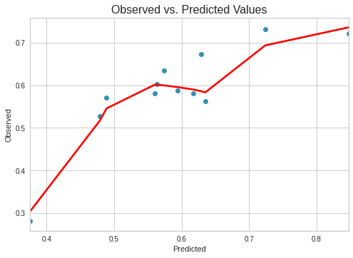
Regression Model
Annual Return: Excess Return:
Variance Score: 0.70194 Variance Score: 0.671 R-Squared: 0.99 R-Squared: 0.986

Slide 17
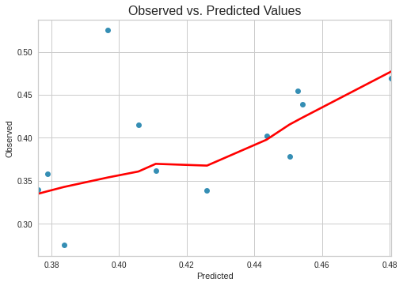
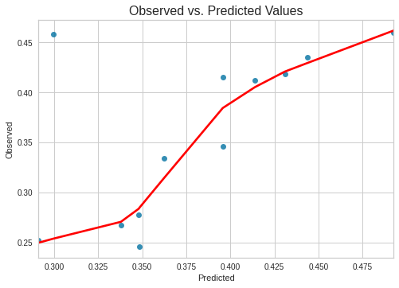
Systematic Risk: Total Risk:
Variance Score: 0.081 Variance Score: 0.30 R-Squared: 0.966 R-Squared: 0.967

Slide 18
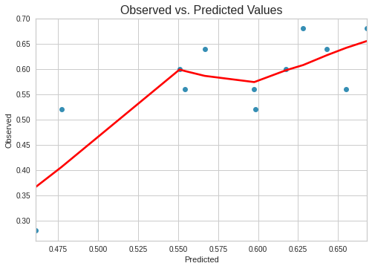
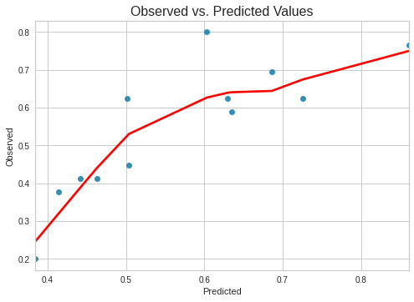
Absolute Win rate: Relative Win rate:
Variance Score: 0.504 Variance Score: 0.662 R-Squared: 0.983 R-Squared: 0.979
Inference: As we can see the r-square values for the models of all the dependent variable are high (above 0.96) so we can say that the error in our modeling is low,So our model performs well..

Slide 19
Ols regression results
R²-values :
Y1 - 0.9900
Y2 - 0.986
Y3 - 0.966
Y4 - 0.967
Y5 - 0.983
Y6 - 0.979
Adj - R²-values :
Y1 - 0.988
Y2 - 0.984
Y3 - 0.961
Y4 - 0.962
Y5 - 0.980
Y6 - 0.975
DW - values
Y1 - 2.099
Y2 - 2.016
Y3 - 2.020
Y4 - 2.038
Y5 - 1.902
Y6 - 1.945
Here, R²-values are high, so we can use our data directly for the prediction.
For the 1st four dependent variables Durbin-Watson values are >2, so they are negatively correlated, where as for 5th and 6th dependent variables DW-values are <2, so they are positively correlated .

Slide 20
TEST OF ASSUMPTIONS

Slide 21
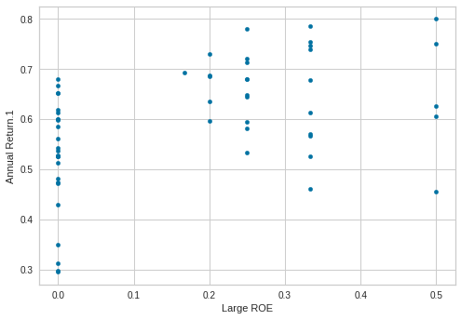
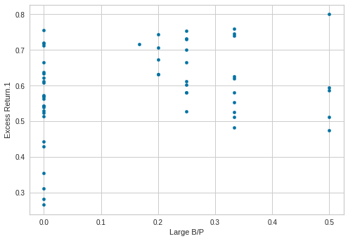
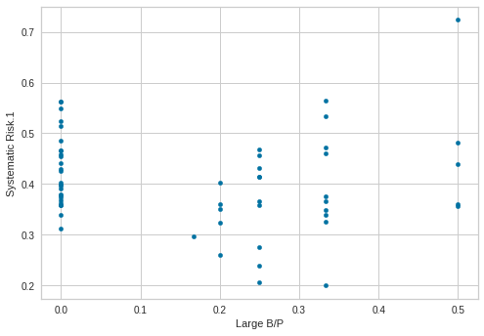
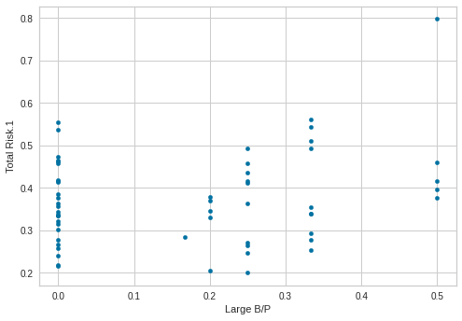
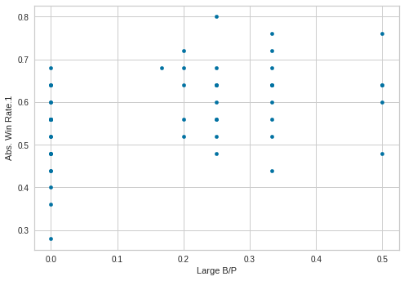
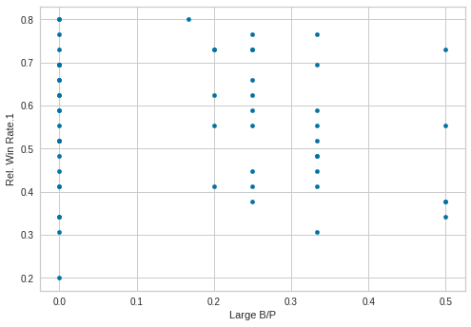
Linearity

Slide 22
Inference: The above graph show the plot between independent variable and dependent variable.By observing the graphs we can say that all the points are scattered which are not completely linear.So we can say that linearity condition is not completely satisfied.

Slide 23
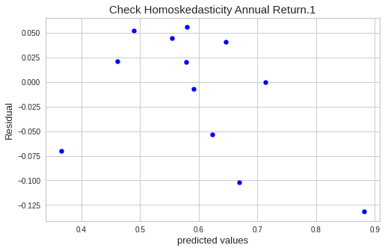
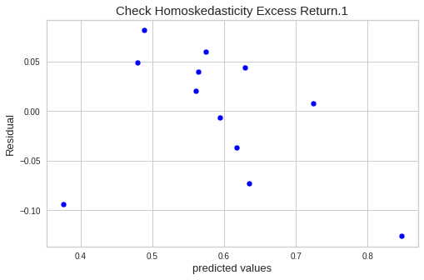
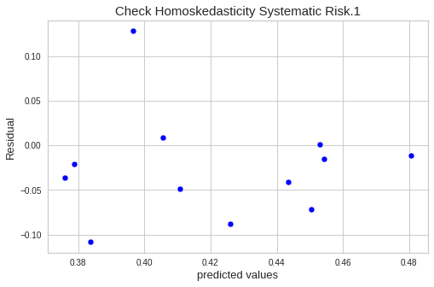
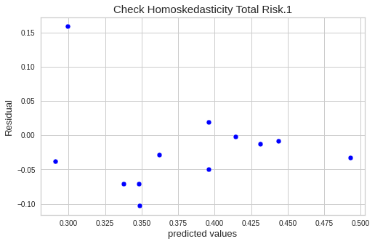
Homoscedasticity

Slide 24
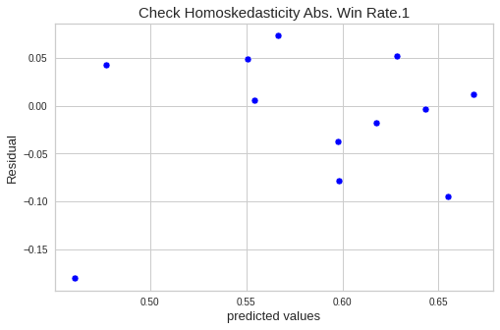
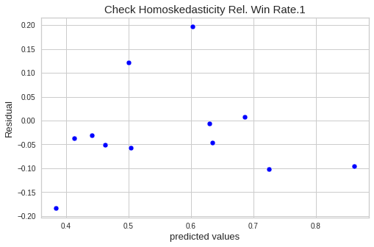
Inference: The above graph shows the plot between Residuals and predicted values.The points are random with no funnel shape which confirms that Homoscedasticity is true.

Slide 25
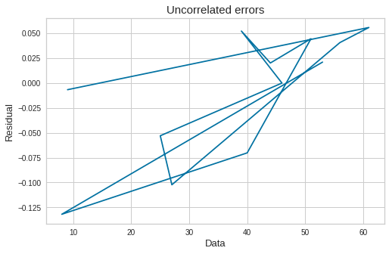
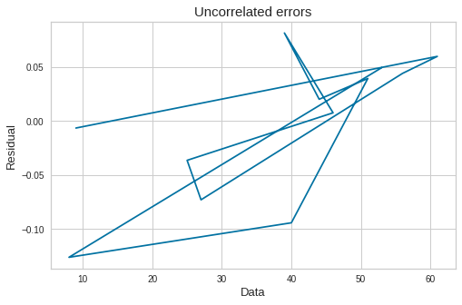
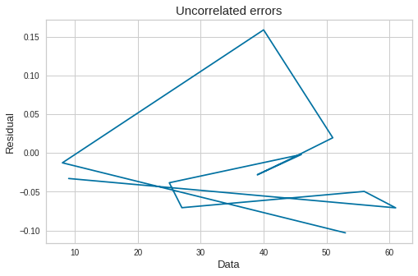
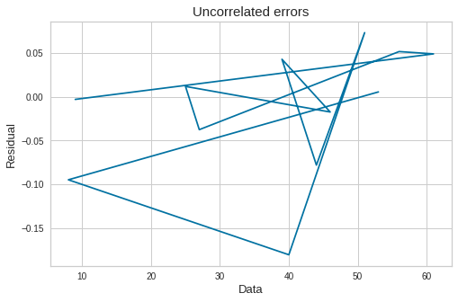
Uncorrelated Errors
Annual Return
Excess Return
Total Risk
Abs. Win rate

Slide 26
Inference : For the above plots, we can see some correlation or pattern between the errors, which means there are correlation errors.
We can also check this correlations by performing durbin watson test.
If Dw = 2, we can say there is no correlation
If Dw < 2, we can say the errors are positively correlated.
If Dw > 2, we can say the errors are negatively correlated.
In the given dataset 4 dependent variables are positively correlated and 2 dependent variables are negatively correlated

Slide 27
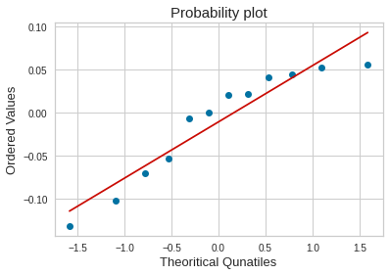
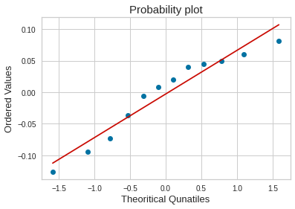
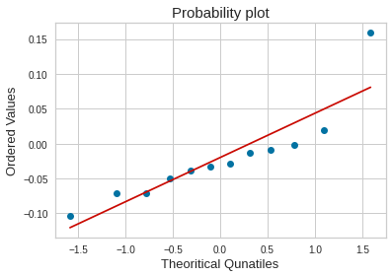
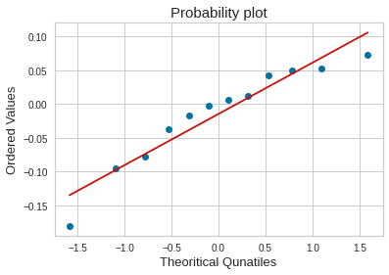
Normality of error terms
Annual Return
Excess return
Total Risk
Abs. Win Rate

Slide 28
The above plots are between theoretical quantiles of standard normal variables and ordered values of sample quantiles.
Inference : If we observe the plots for the errors, we can conclude that errors follow normal distribution, because the plot shows the fluctuation around the line and there is not much deviation, from this inference we can say that graphs are linear.

Slide 29
Conclusion
After performing Linear Regression and checking the test of assumptions we can say that the goodness of model judged based on R-squared value is High.We can achieve higher r-square and less error if Linearity condition between dependent and independent variables holds.

Slide 30
THANK YOU

