Slide 1

Facebook 2.0
WEB 2022A Group-4

Slide 2
01
The database structure
02
Demo features in application
CONTENT
03
What we have learnt
What we should improve
04
What trainer team should improve
05

Slide 3
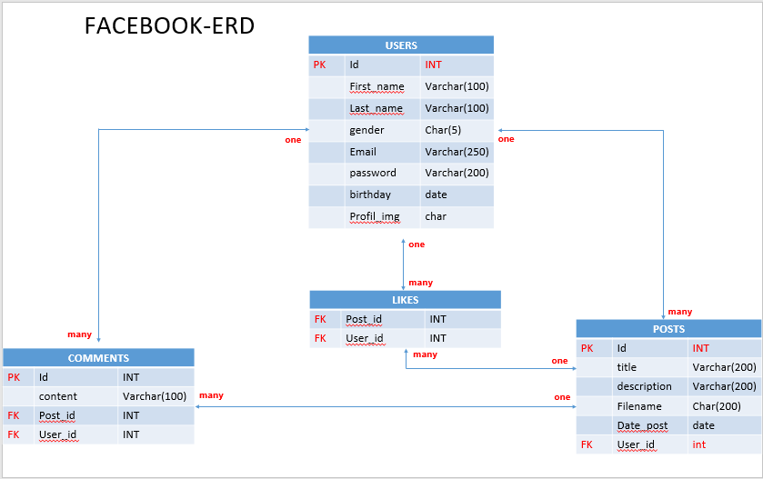
The database structure

Slide 4
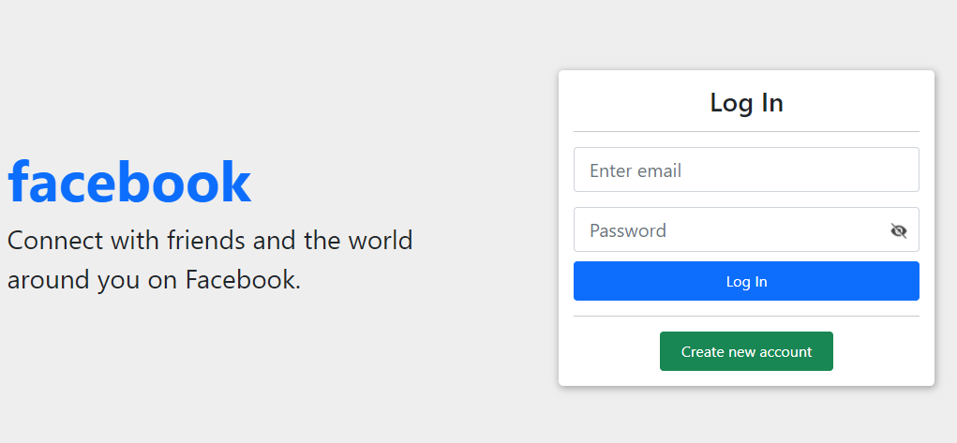
Demo features in application
Link: http://localhost:3000/pages.php

Slide 5
What we have leant during this project
Soft skill
Technical skill
Time management
Task management
Work as teamwork
Critical thinking
$_SESSION
Making security user login
Clear about CRUD
Get data from Database
Display images

Slide 6
What we should improve
Researching skill
Make code clean and clear for each functional
Time and task management
Work smart more than work hard
Make smoothly process of coding

Slide 7
What trainer team should improve
Provide more time for each project
Give the best strategies

Slide 8





Thank you !
www.passerellesnumeriques.org

