Slide 1

Facebook 2.0
WEB 2022A Group-4

Slide 2
01
The database structure
02
Demo features in application
CONTENT
03
What we have learnt
What we should improve
04
What trainer team should improve
05

Slide 3
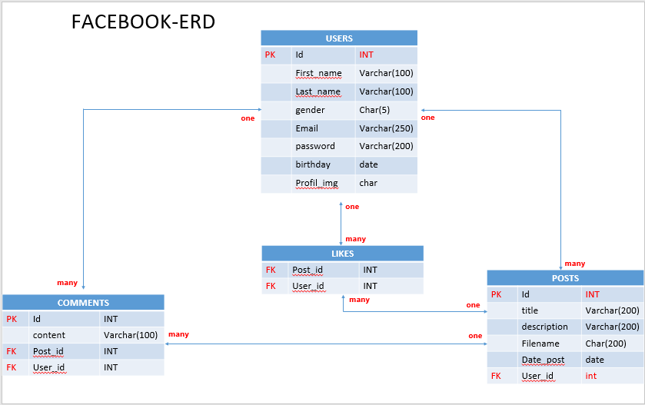
Tim
The database structure (ERD)

Slide 4
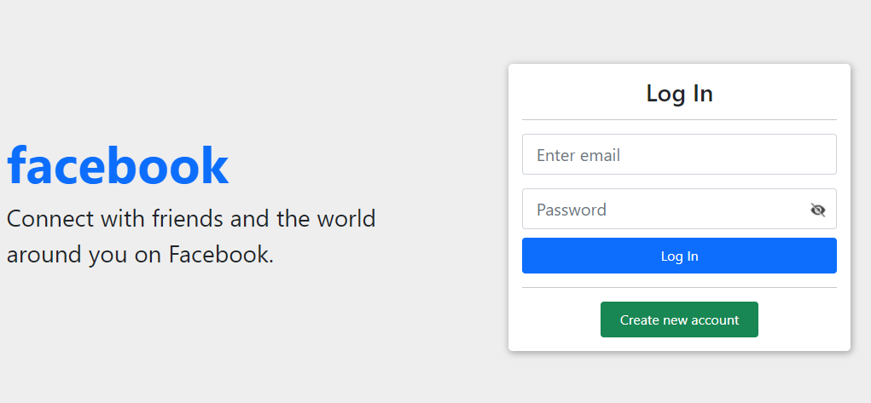
Tim
Demo features in application
Link: http://localhost:3000/pages.php

Slide 5
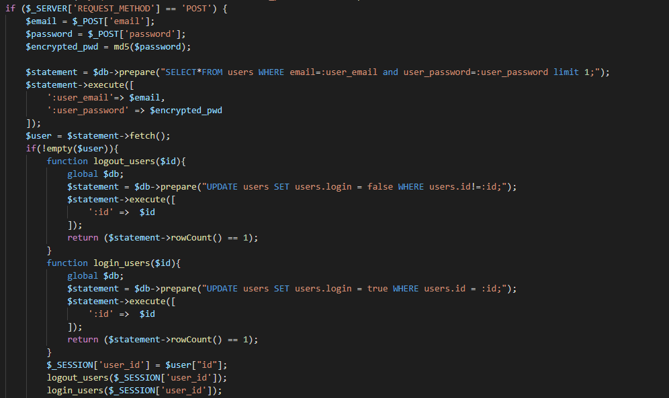
PHP Structure
Tim

Slide 6
Sauth
What we have leant during this project
Soft skill
Technical skill
Time management
Task management
Work as teamwork
Critical thinking
$_SESSION
Making security user login
Clear about CRUD
Get data from Database
Display images

Slide 7
Sauth
What we should improve
Researching skill
Make code clean and clear for each functional
Time and task management
Work smart more than work hard
Make smoothly process of coding
Design quality template

Slide 8
Sauth
What trainer team should improve
Provide more time for each project
Give the best strategies

Slide 9





Thank you !
www.passerellesnumeriques.org

