Slide 1
Assistive Technology
blind people

Slide 2
INTRODUCTION
Assistive technology helps blind and visually impaired people perform daily activities independently.
It improves mobility, safety, communication, and accessibility.
Smart devices use sensors and microcontrollers to detect obstacles and provide alerts.
Voice guidance and buzzer or vibration alerts help users move safely.
These technologies reduce dependence on others and increase confidence.

Slide 3
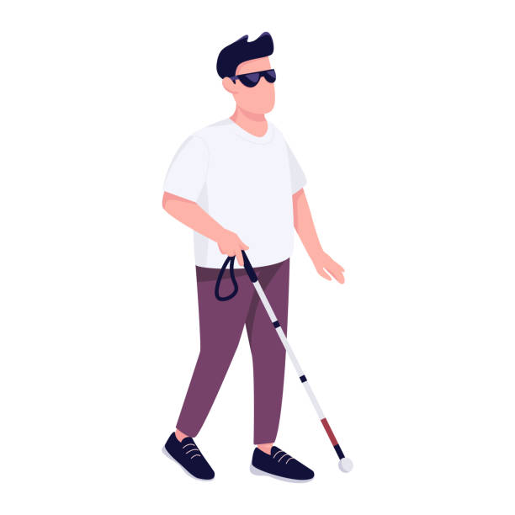
Problem faced by blind people
Difficulty detecting obstacles while walking.
Higher risk of accidents and falls.
Challenges in navigating unfamiliar places.
Inability to read printed text without assistance.
Difficulty recognizing objects, people, and currency.
Dependence on others for daily activities.
Limited access to affordable assistive technology.

Slide 4
Objective of assistive technology for blind people
To help blind people move
safely and independently.
To improve their ability to perform daily activities without depending on others.
To provide easy access to information through audio, Braille, and voice-based technologies.
To enhance communication using screen readers, voice assistants, and accessible devices.
To support education by making books, notes, and learning materials accessible.

Slide 5
Components used
Arduino Uno
The main controller that processes sensor data and controls the buzzer.
Ultrasonic Sensor
Detects obstacles by measuring the distance between the sensor and nearby objects.
Buzzer
Produces a warning sound when an obstacle is detected.
Jumper Wires
Connect the Arduino, sensor, and buzzer.
Breadboard (Optional)
Used for making temporary connections without soldering.
9V Battery (or Power Bank)
Supplies power to the Arduino for portable use.
USB Programming Cable
Uploads the Arduino program and can also power the board during testing.

Slide 6
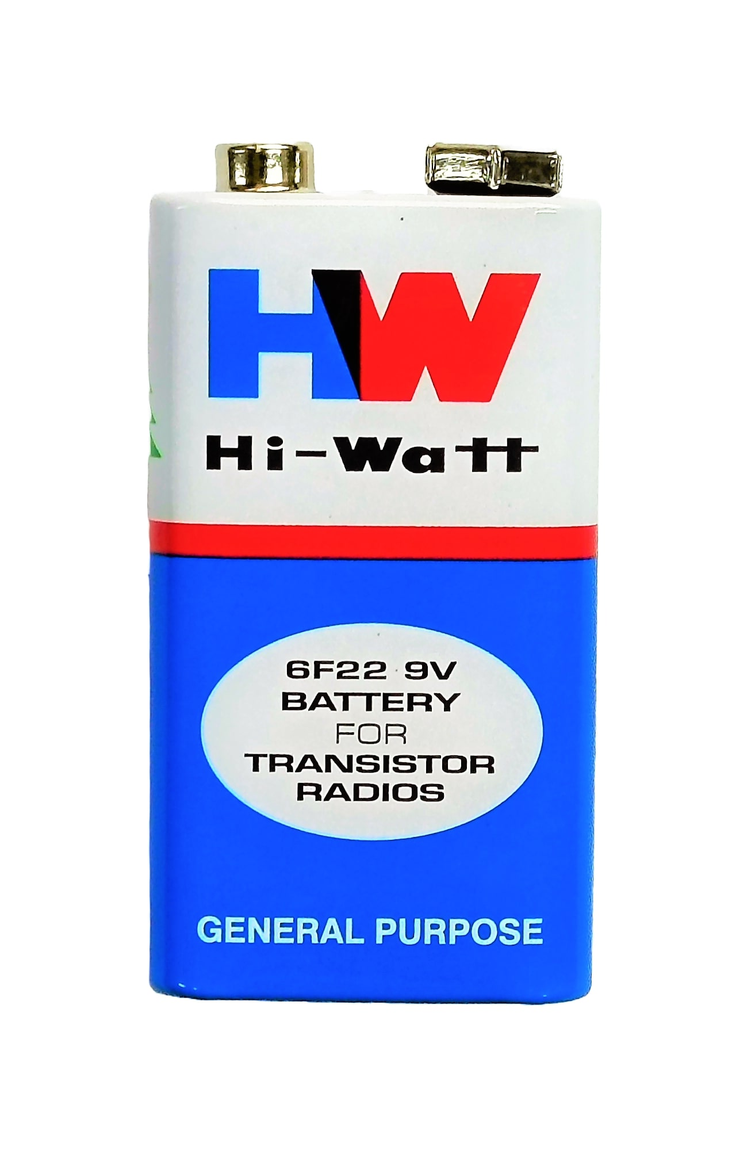
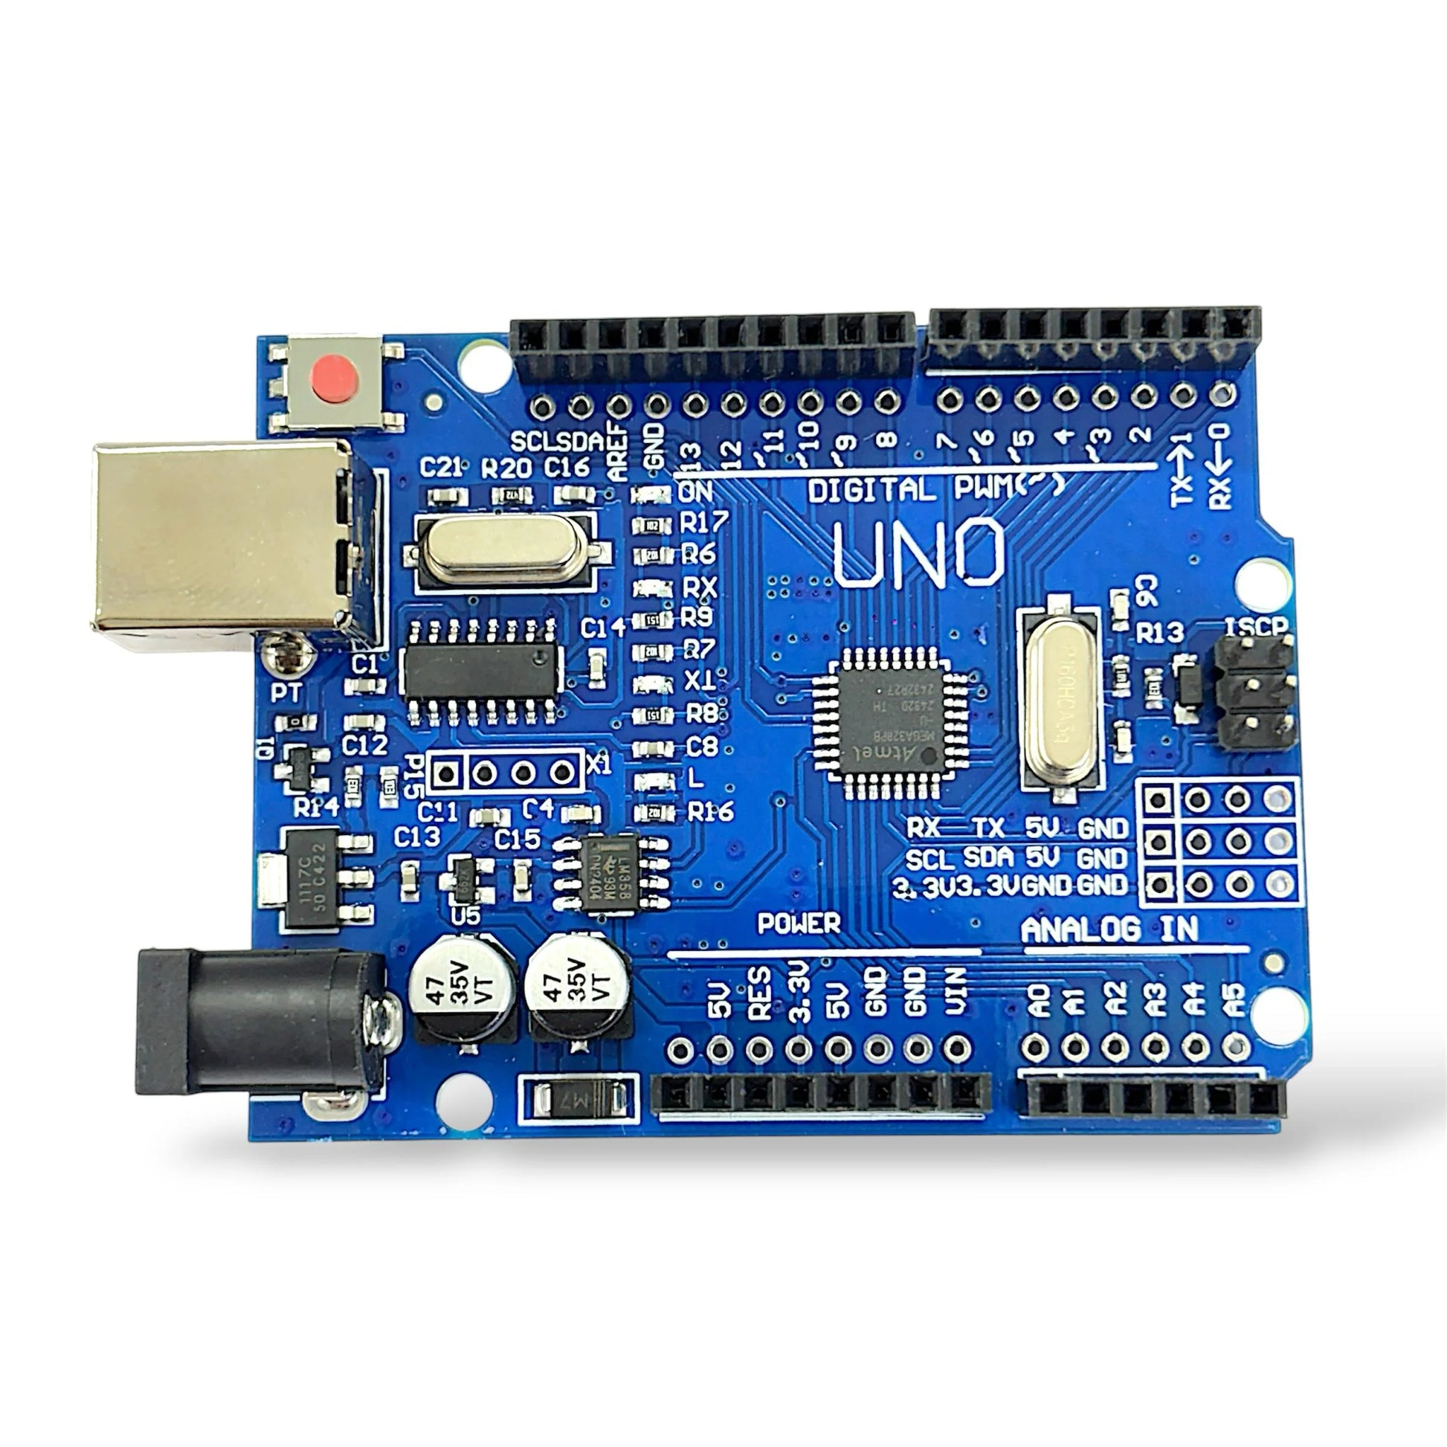
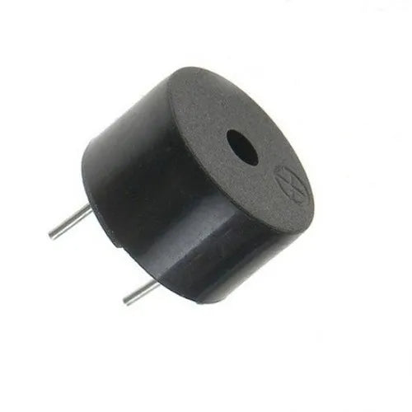
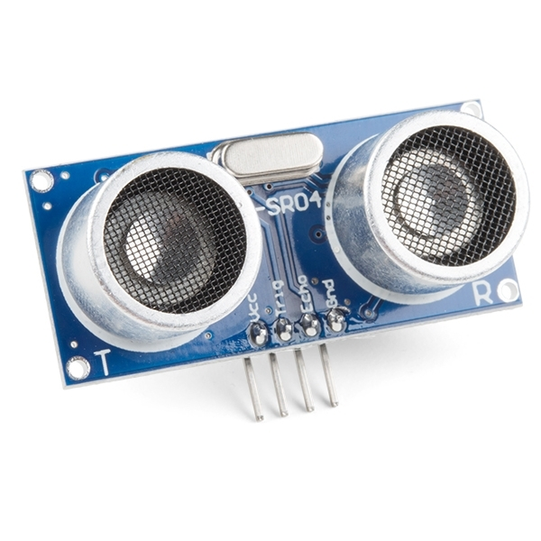
Working principle
🔋 Battery
↓
🧠 Arduino Uno
↓
📡 Ultrasonic Sensor
↓
Obstacle Detected?
↓ Yes
🔊 Buzzer ON
↓
🚶 User Avoids Obstacle

Slide 7
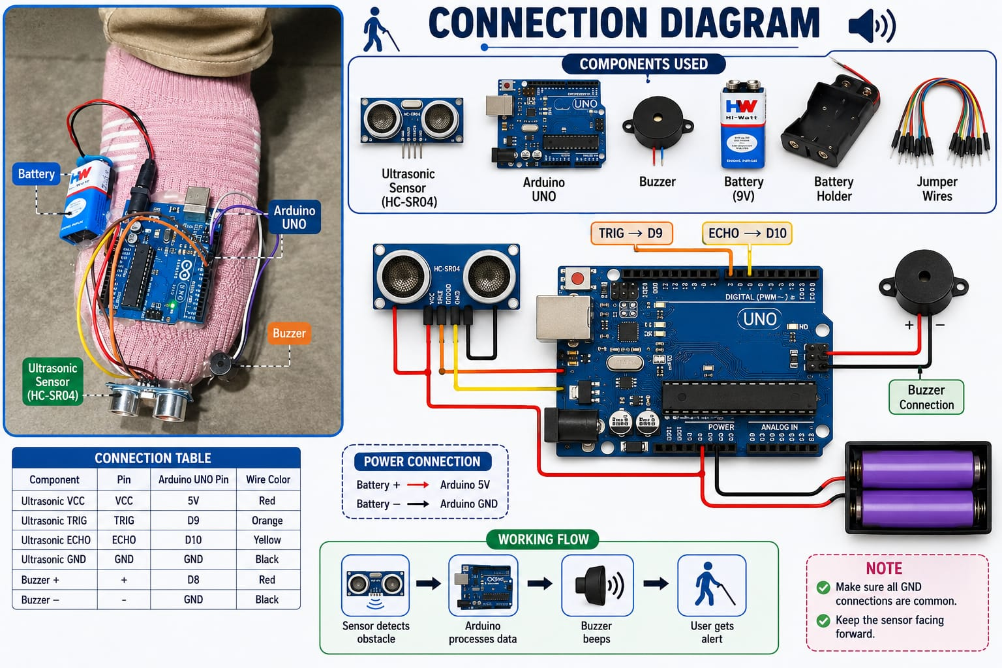
CONNECTION

Slide 8
Programming/coding
const int trigPin = 9; const int echoPin = 8; const int buzzerPin = 11; const int safetyDistance = 7; void setup() { pinMode(trigPin, OUTPUT); pinMode(echoPin, INPUT); pinMode(buzzerPin, OUTPUT); Serial.begin(9600);}void loop() { digitalWrite(trigPin, LOW); delayMicroseconds(2); digitalWrite(trigPin, HIGH); delayMicroseconds(10); digitalWrite(trigPin, LOW); long duration = pulseIn(echoPin, HIGH); int distance = duration * 0.034 / 2; Serial.print("Distance: "); Serial.print(distance); Serial.println(" cm"); if (distance > 0 && distance <= safetyDistance) { digitalWrite(buzzerPin, HIGH); } else { digitalWrite(buzzerPin, LOW); } delay(100);}

Slide 9
Advantages & applications
Helps visually impaired people detect obstacles easily.
Reduces the risk of accidents and falls
Low-cost and easy to build.
Portable and lightweight design.
Battery-operated, making it easy to use anywhere.
Improves independent and safe movement.
Used by visually impaired people for safe navigation.
Useful in homes, schools, hospitals, and public places.
Helps avoid obstacles while walking.Can be used for indoor and outdoor movement.

Slide 10
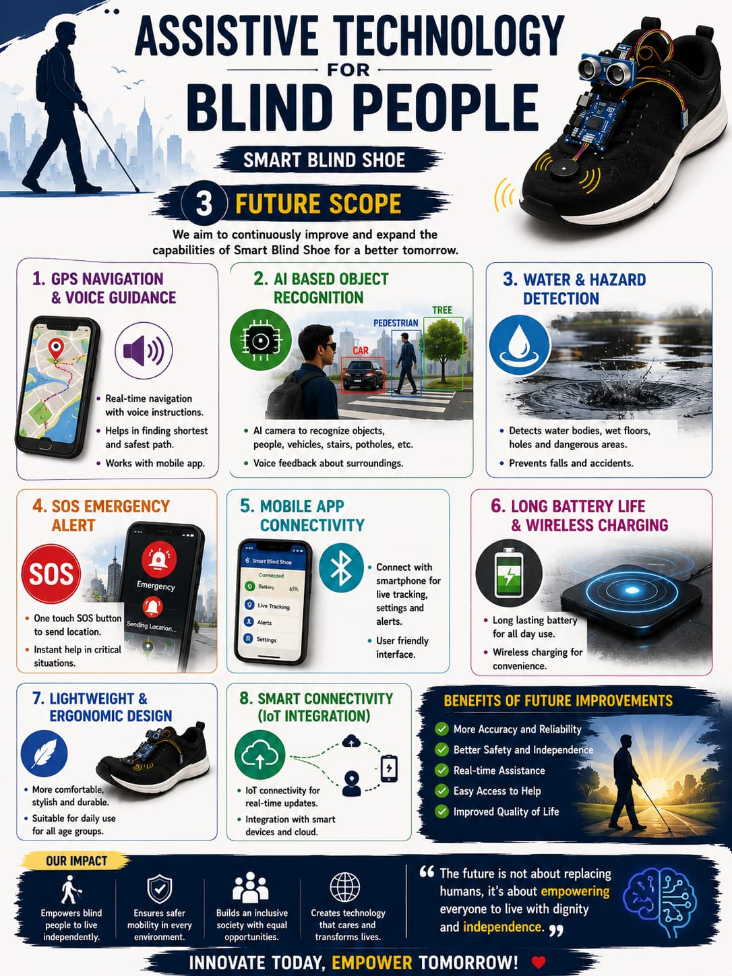
Future scope
Add a vibration motor for silent alerts.
Integrate GPS for live location tracking.
Add GSM or mobile app support for emergency alerts.
Use AI to recognize different objects.
Make the device smaller and lighter.
Rechargeable battery can improve usability.
Add voice guidance for better navigation.

Slide 11
conclusion
The Smart Assistive Shoe is a simple and affordable solution for visually impaired people. It uses an ultrasonic sensor to detect nearby obstacles and alerts the user through a buzzer. This project improves safety, supports independent movement, and demonstrates how technology can make everyday life easier for people with visual disabilities.

Slide 12
Thank you for your time and attention.I hope you found my presentation informative and interesting.
Presented by:shaheena Rai
Project:Assestive Technology for blind people

