Slide 1
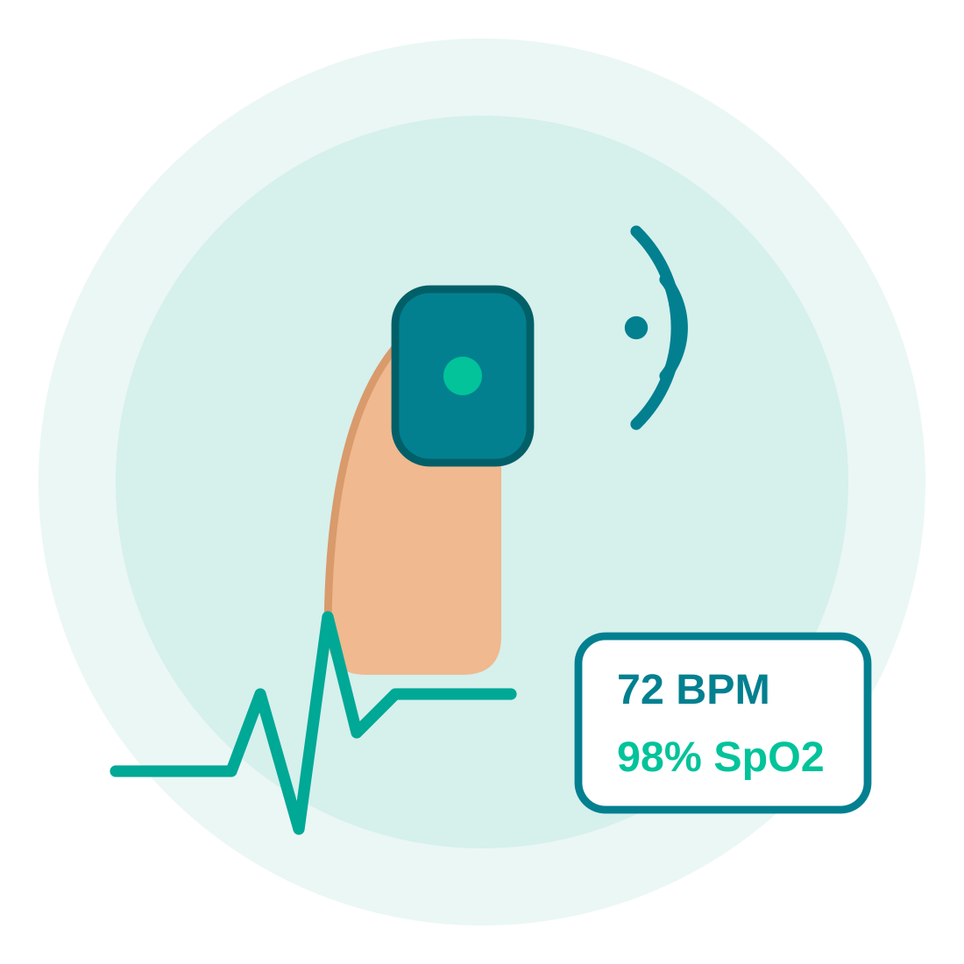
TINKERING PROJECT
VASC Age
Smart Health Monitoring System
School: Annasaheb Dhamane Madhyamik Ashram School, Kaman
Team Size: 5 Students

Slide 2


WHY THIS PROJECT
The Problem
Many elderly people and patients need regular health monitoring, but checking vital signs frequently can be difficult without visiting a hospital or clinic.
Continuous
Frequent hospital visits are time-consuming and costly
health monitoring shouldn't need
a hospital visit every time
Elderly and chronically ill patients need continuous tracking
Manual checkups can't be done round the clock at home
VASC Age | Smart Health Monitoring System
2

Slide 3




OUR AIM
Project Objectives
To design an affordable, portable device that continuously tracks vital signs — helping people monitor their health quickly and accurately, without frequent hospital visits.
Accurate Monitoring
Portability
Quick Checkups
Affordability
Deliver reliable heart rate and SpO₂ readings in real time.
Build a compact device usable at home, school, or camps.
Cut down time spent on routine hospital visits.
Use low-cost components for wide accessibility.
VASC Age | Smart Health Monitoring System
3

Slide 4



OUR SOLUTION
VASC Age – Smart Health Monitoring System
Real-time Heart Rate
Blood Oxygen (SpO₂)
Instant Data Display
Portable & Wireless
Continuously measures pulse (BPM) using an optical sensor.
Tracks blood oxygen saturation levels instantly.
Shows readings clearly on a connected display.
Compact, easy-to-use design for monitoring anywhere.
VASC Age | Smart Health Monitoring System
4

Slide 5


SYSTEM WORKING
How It Works
1
2
3
4
Finger placed on
MAX30102 sensor
Sensor measures
heart rate & SpO₂
ESP8266 (ESP-01)
processes the data
Data sent wirelessly /
shown on display
The final health readings help users track their vitals quickly, accurately, and without visiting a clinic.
VASC Age | Smart Health Monitoring System
5

Slide 6
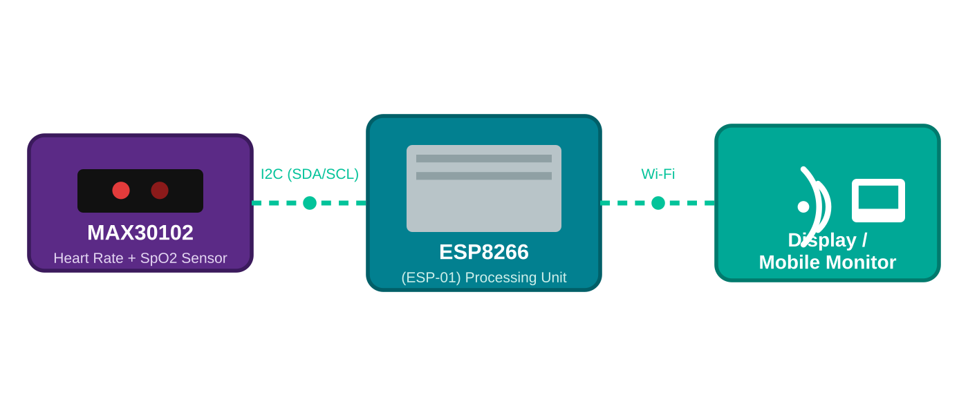
BLOCK DIAGRAM
Circuit Connection Overview
VASC Age | Smart Health Monitoring System
6

Slide 7
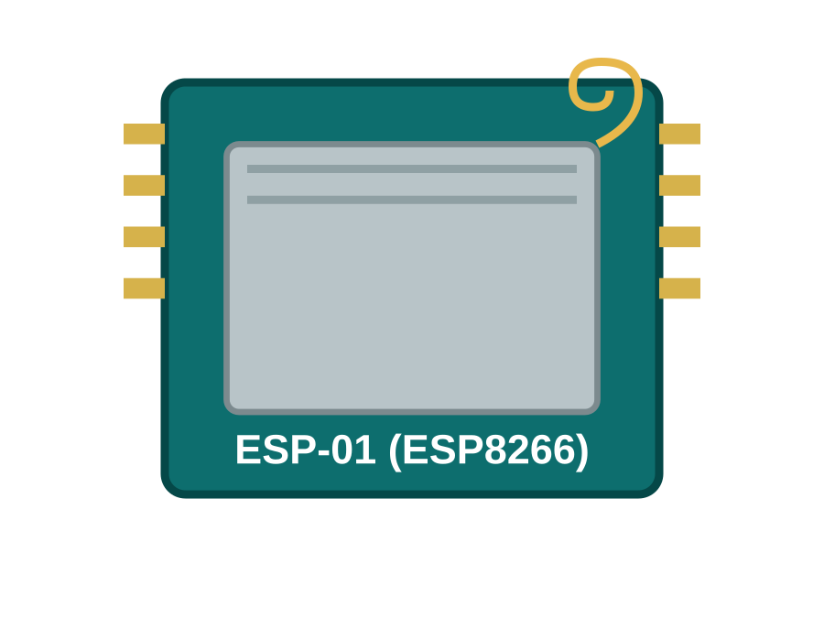
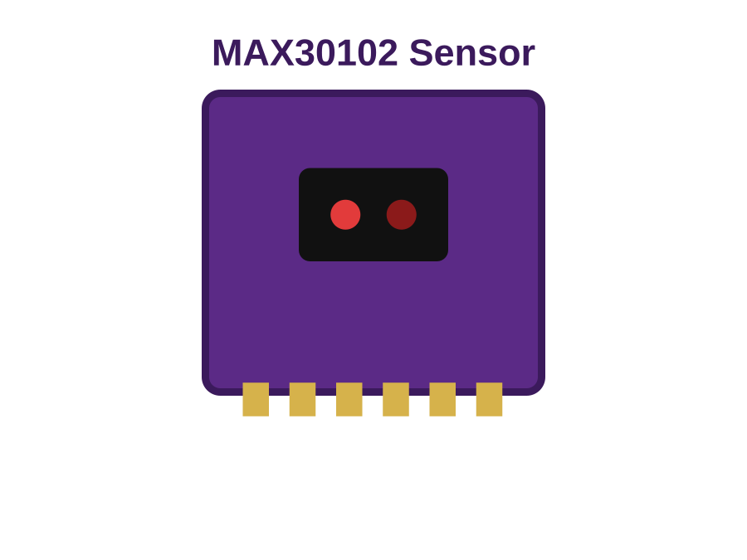
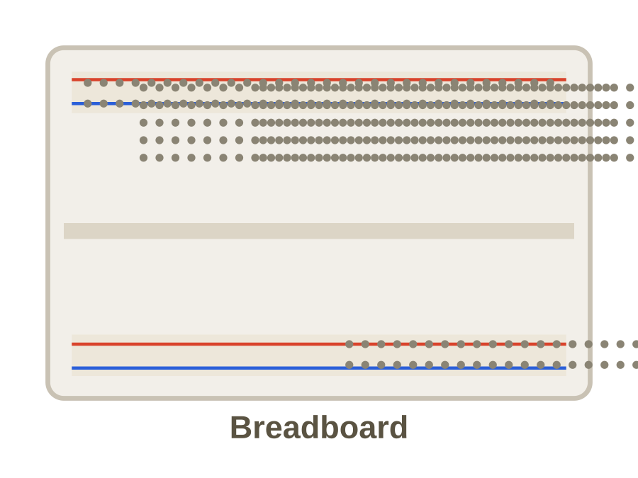
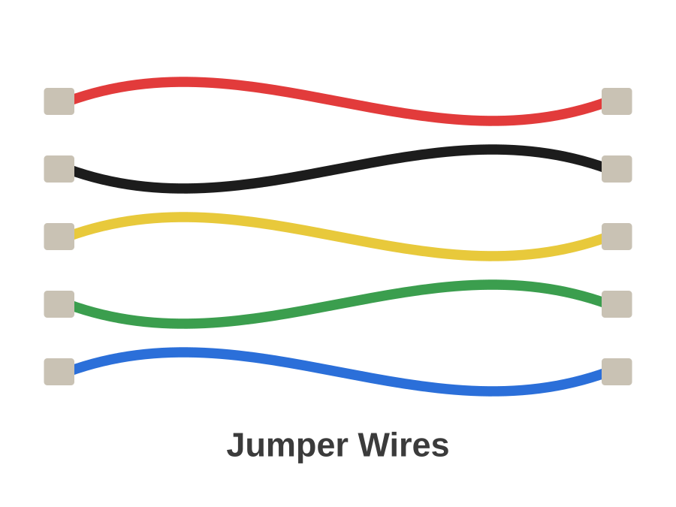
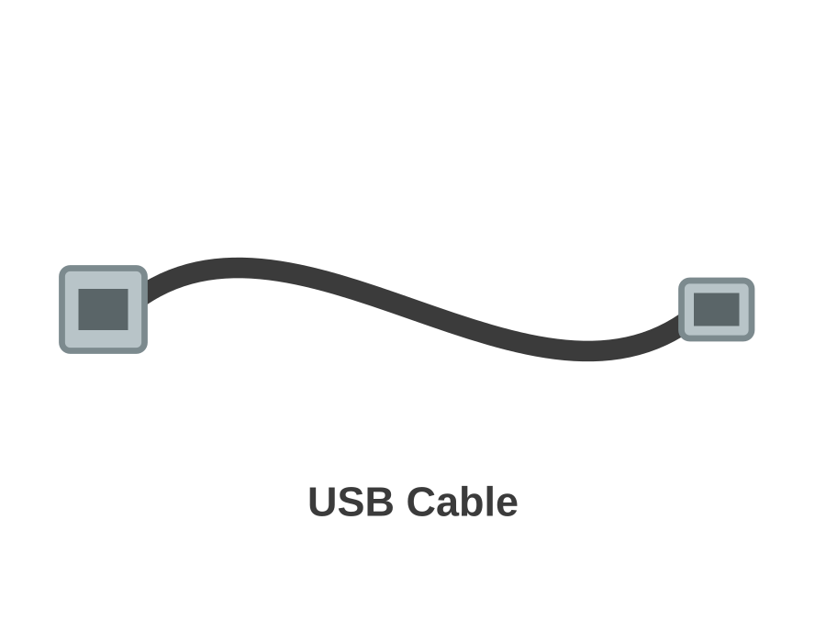
HARDWARE
Components Used
ESP-01 ESP8266 Wi-Fi Module
MAX30102 Heart Rate & SpO₂ Sensor
Breadboard
Processes sensor data & enables wireless connectivity
Measures pulse rate and blood oxygen level
Solderless board to build the circuit prototype
Jumper Wires
USB Cable
Connects components on the breadboard
Powers the circuit and enables programming
VASC Age | Smart Health Monitoring System
7

Slide 8

WHY IT MATTERS
Advantages
Provides quick and accurate health readings
Portable and easy to use
Helps in early health monitoring
Cost-effective solution
Suitable for home and healthcare use
VASC Age | Smart Health Monitoring System
8

Slide 9






APPLICATIONS
Real-Life Uses
Hospitals
Clinics
Homes
Health Camps
Elderly Care Centers
Schools for Health Check-ups
VASC Age | Smart Health Monitoring System
9

Slide 10
Thank You
VASC Age — Smart Health Monitoring System
Annasaheb Dhamane Madhyamik Ashram School, Kaman

