Slide 1
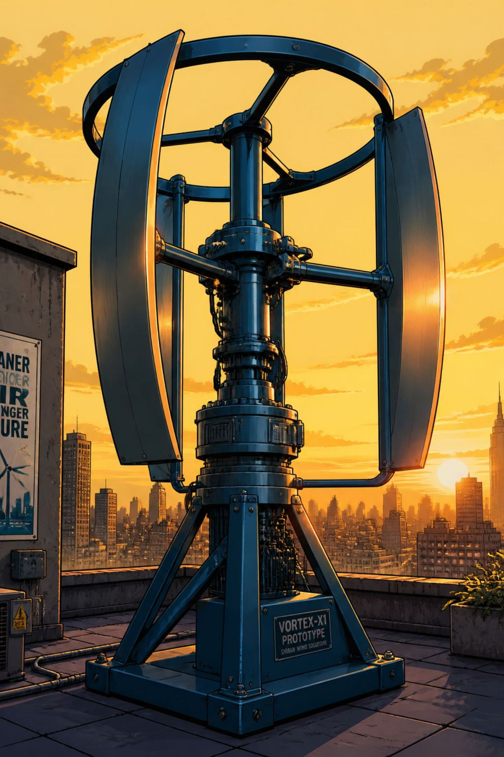
Vertical Axis Wind Turbine:
A compact, urban-ready wind energy prototype that converts variable wind into usable electricity. This project demonstrates a practical, low-maintenance solution for decentralised power.

Slide 2
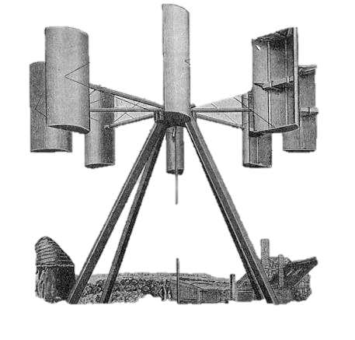
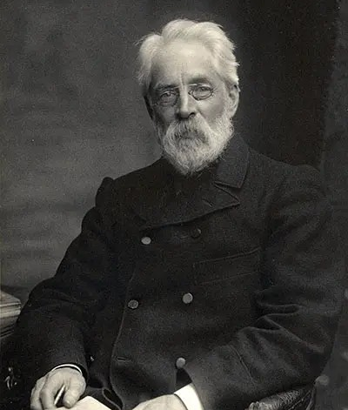
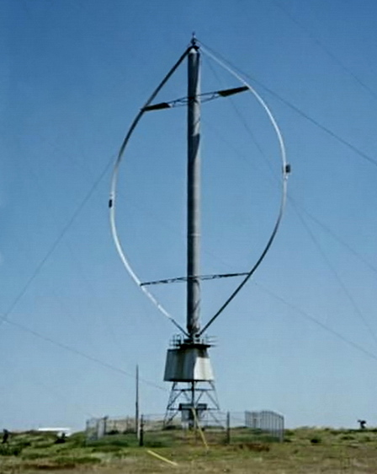
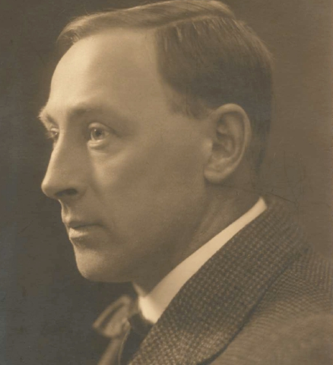
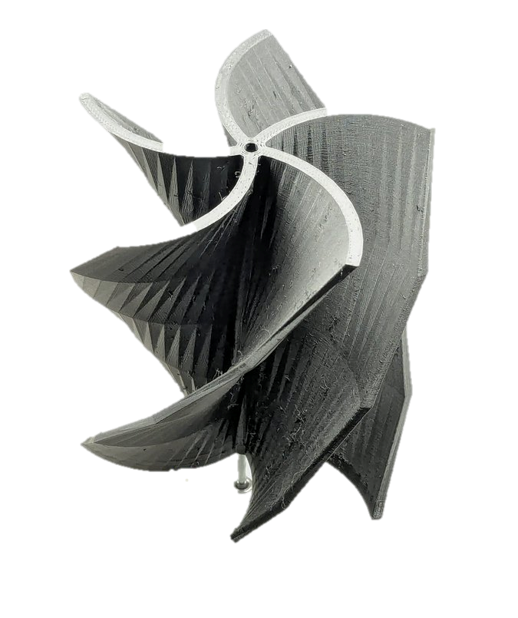
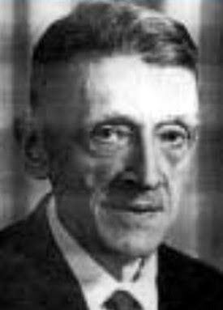
1.BACKGROUND OF VAWT
1887 — James Blyth (Scotland): Built the world’s first electricity-generating VAWT to power his cottage.
1922 — Sigurd Johannes (Finland): Invented the drag-based S-shaped Savonius turbine, which spins easily in low-speed wind.​
1931 — Georges Jean Marie (France): Patented the lift-based Darrieus ("eggbeater") turbine, establishing the aerofoil design used in modern high-efficiency VAWTs.

Slide 3

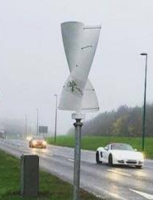
The Highway Divider Concept & Real-World Testing
2010–2012 (Scientific Proof): University researchers in India and the US published studies proving that cars moving in opposite directions create a continuous, concentrated wind vortex over median dividers.​​
2017 (First Successful Commercial Trial): Kadir Yürüten (Devecitech) successfully deployed smart ENLIL turbines on Istanbul's highway dividers (Turkey) to power local sensors and streetlights.

Slide 4

COMMUNITY PROBLEM
Electricity consumption exceed production on global stage and we are not capable to utilize it efficiently.
Rising household consumption increases costs and carbon emissions.

Slide 5
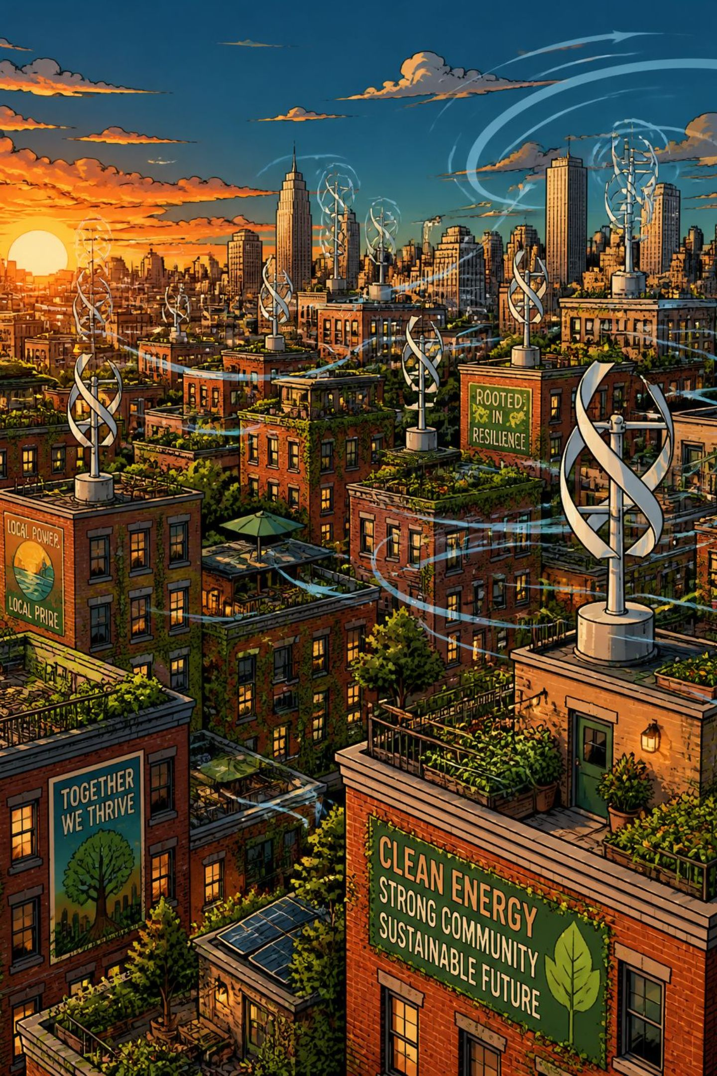
The Solution: Harnessing the Power of VAWT
Vertical Axis Wind Turbines capture wind from any direction, making them ideal for turbulent, variable urban flows. Their compact footprint, simplified mounting and reduced maintenance make VAWTs well suited for residential and community-scale deployments.
Omnidirectional
Compact
Low Maintenance
Smaller form factor fits rooftops and small plots.
mechanism — captures wind from any direction.
Few moving parts and simpler bearings reduce upkeep.

Slide 6
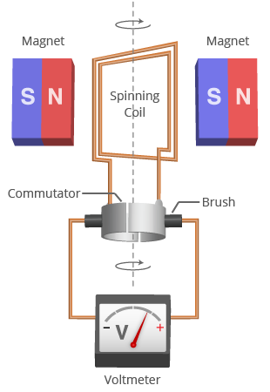
HOW DYNAMO WORKS
A dynamo converts mechanical energy into electrical energy using electromagnetic induction.
As a mechanical force rotates a coil of copper wire within a stationary magnetic field, the movement forces electrons in the wire to flow, creating an electric current.

Slide 7

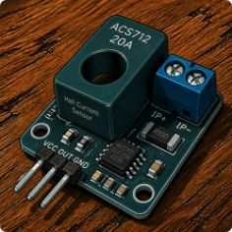

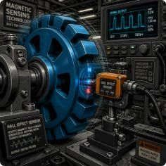
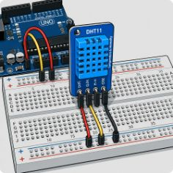



Project Components: The Anatomy of the Turbine
Arduino Uno
Current Sensor
Voltage Sensor
Hall Effect Sensor
Central controller for data acquisition, signal processing and control logic.
Monitors output current from the dynamo for power calculations and safety.
Measures generated voltage by dynamo
Detects RPM by reading magnets on the rotating shaft — essential for performance metrics.
DHT11 Sensor
Breadboard
LED Indicators
Dynamo Motor
L temperature and humidity to correlate environmental conditions with output.
Prototyping platform for sensor connections and temporary circuits.
Visual status signals .(streetlight)
Primary generator converting rotational motion into electrical energy; wired through rectification and regulation stages.

Slide 8

How It Works: The Technical Process
Arduino Monitors
Wind Catches
Rotor Spins
Dynamo Generates
electricity
Airflow produces torque on the blades; the rotor spins the dynamo producing alternating current. Power is rectified and conditioned; Arduino reads voltage, current and RPM and logs data for management or storage.

Slide 9
Results: Powering Small‑Scale Needs
Prototype testing converted wind into measurable electrical output, demonstrating stable operation across variable wind speeds. Readings showed dependable voltage and current traceable to RPM and environmental conditions — validating the monitoring architecture.
Proof
Scalable
Proof of Concept
Scalable
Operational prototype
Modular design suitable for small arrays or rooftop deployments.

Slide 10
Advantages for a Greener Future
Decentralised Power
Lower Emissions
Quiet & Safe
Reduces dependence on distant generation; lowers transmission losses.
Clean electricity locally reduces carbon footprint for homes and communities.
Reduced noise and safer operation compared with large horizontal-axis turbines.

Slide 11
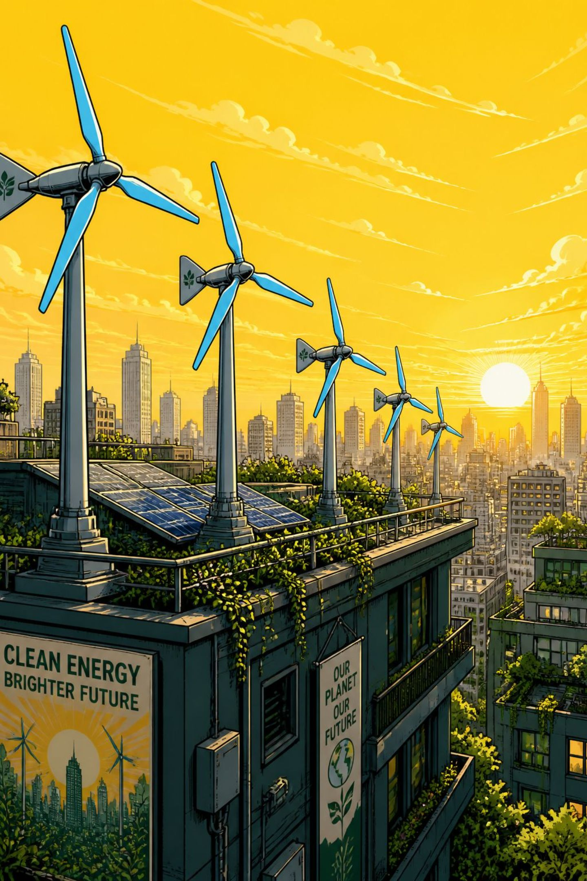
Conclusion: The Winds of Change
This VAWT project illustrates a practical path to localised, sustainable electricity. With reliable sensing and simple control, small turbines can support off‑grid power and reduce pressure on central grids.

Slide 12
THANK YOU

Slide 13
PRESENTED BY:
Siddharth Yadav
Yash sawardekar

