Slide 1
DeconMSn – Supplementary Information
Anoop Mayampurath

Slide 2
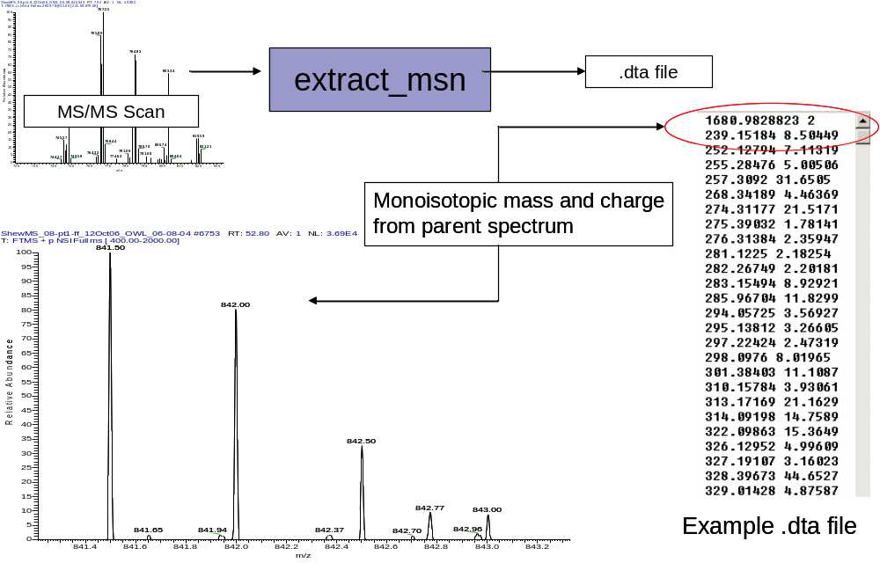
Tandem Mass Spectrometry-based Proteomics
MS/MS fragmentation results are used in conjunction with parent mass and charge to identify peptides.
Thermo Fisher Mass Spectrometer

Slide 3
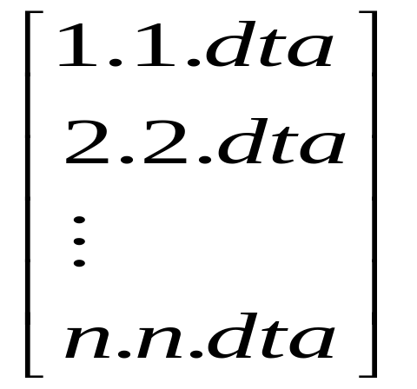
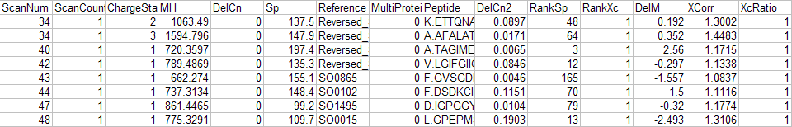
All *.dtas
SEQUEST
_fht file

Slide 4
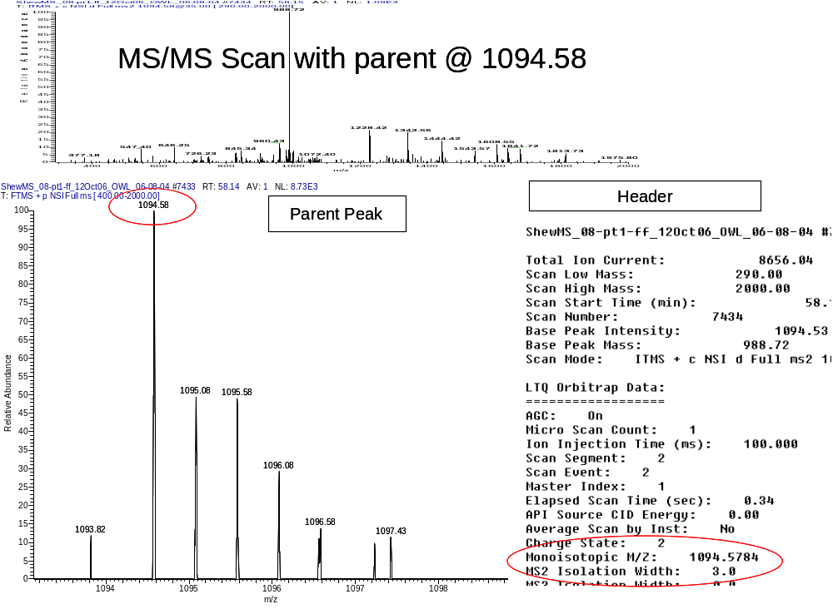
Every MS/MS scan includes the parent information (mono m/z, charge etc.) in its header, which is written by the instrument’s acquisition software.

Slide 5
The acquisition software gets the right monoisotopic mass only if the ‘monoisotopic precursor select’ option is enabled in the instrument, in which case the number of dtas that are generated and number of filter-passing peptides identified are reduced.
Dataset SEQUEST Jobs | Number of .dtas | Filter Passing Identifications
231575_NMIP_fht (not enabled) | 25189 | 3861
231576_NMIP_fht (not enabled) | 25290 | 3368
231579_fht (enabled) | 7153 | 2301
231580_fht (enabled) | 6678 | 1615
Filters –
  1+ Xcorr >= 1.9
  2+ Xcorr >= 2.2
  3+ and higher Xcorr >= 3.5
  DelCn2 >= 0.1
  Only Partially or fully tryptic

Slide 6
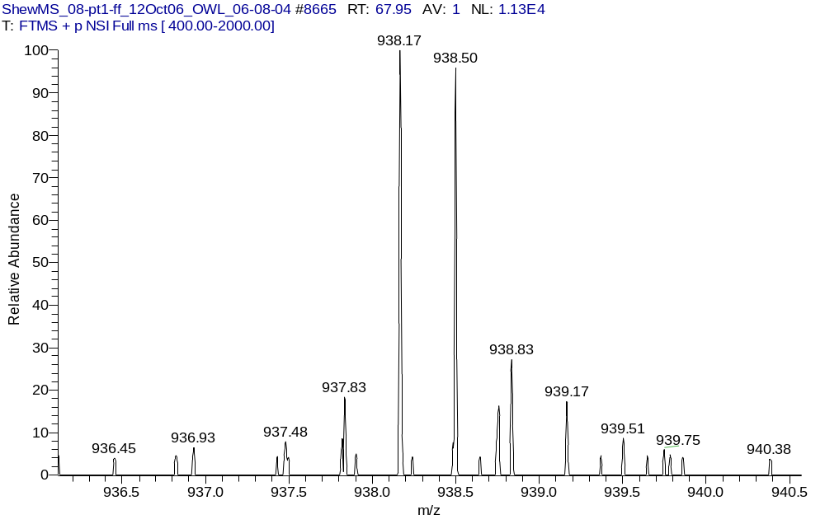
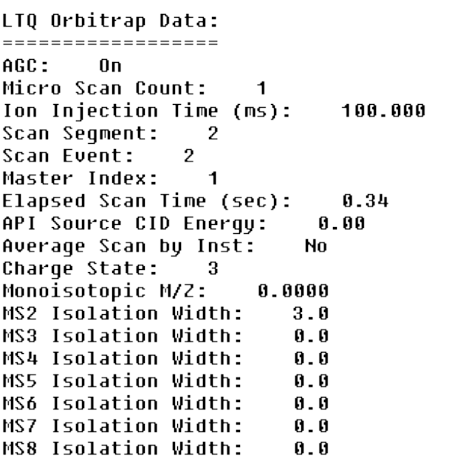
If the ‘monoisotopic precursor selection’ is not enabled, either a 0 is written to the header…
Parent Peak
Header

Slide 7
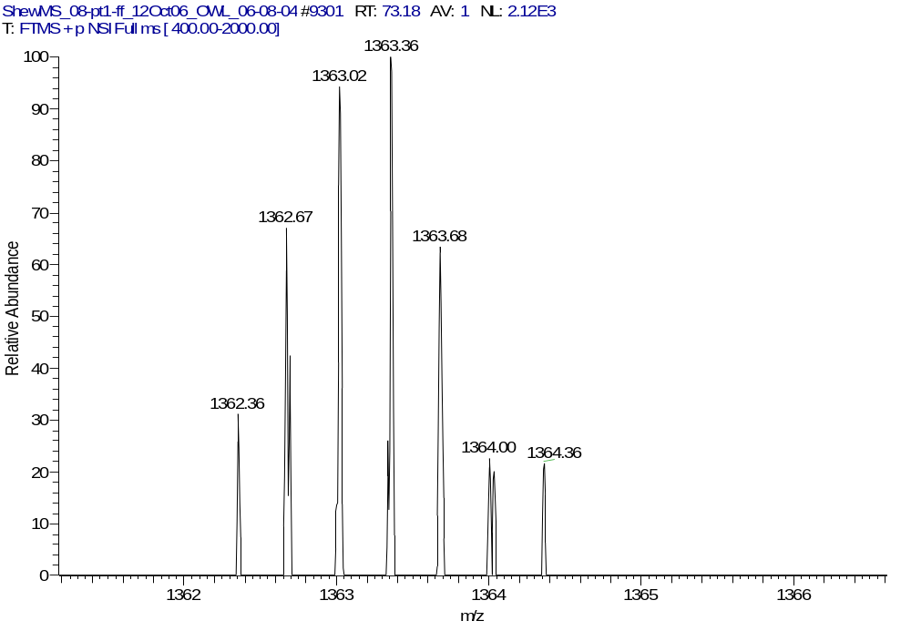
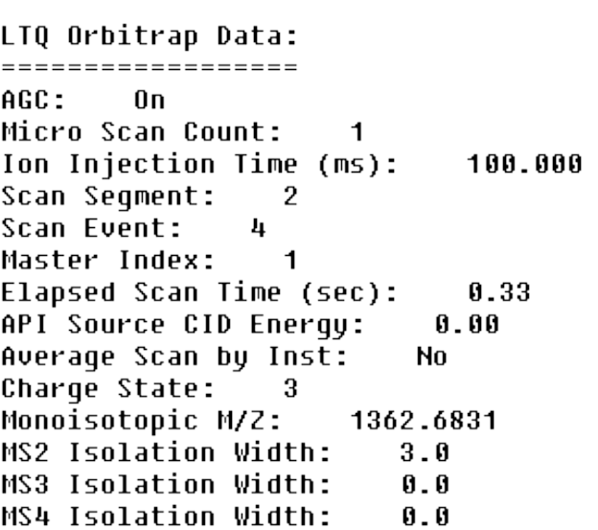
…or, the wrong monoisotopic mass is determined.
Parent Peak
Header

Slide 8
Here’s how extract_msn works…
Start
ParentPeak,
Mono m/z,
CS
Mono m/z != 0
Y
Deisotope with
Mono m/z and CS
.dta
N
CS != 0
Deisotope with
ParentPeak and
CS = +2/+3
N
Y
Deisotope with
ParentPeak and CS
.dta
.dta
Stop

Slide 9
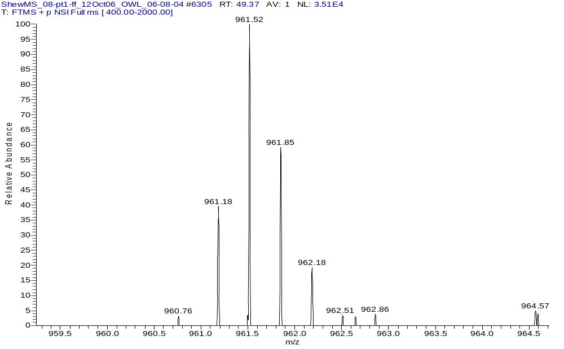
Example: Case where extract_msn got it wrong
Parent Peak : 961.52
Mono m/z in header : 0
CS : 3
Extract_msn protonated mass: 2882.533
Sequest hit : 2881.542
Xcorr : 7.931
Sequence: K.GLLTKDHELIEPTSGNTGIALAYVAAAR.G

Slide 10
Our solution: Use a combination of THRASH and charge state based peak finding routines to correctly deisotope the parent isotopic distribution

Slide 11
Overview of THRASH algorithm
A window is set +/- 5 Da around the ParentPeak
The most abundant peak in the window is selected.
The approximate molecular weight of the distribution (i.e. average mass) is computed using the observed m/z and the predicted charge value of the selected peak.
The Averagine algorithm is used to guess the molecular formula of the detected compound based on the mass and composition of the average amino acid (or DNA or RNA) determined from the Protein Informatics Resource (PIR) database.
The Mercury algorithm is used to generate theoretical spectrum of the detected compound from the predicted molecular formula.
The theoretical and experimental isotopic distribution are compared to calculate an isotopic fit value. The fit value is the least square error between the theoretical data and the experimental data. The peak that gives the lowest (best) isotopic fit value is assumed to be the correct monoisotopic peak.
Remove that peak and go back to Step 2

Slide 12
DeconMSn Algorithm (for one MS2 scan)
Start
Get
ParentPeak
from header
Get ParentMz
from spectrum
Guess charge based
on peak spacing
(FindPeak)
THRASH
FindPeak
success?
N
.dta
CS = +2/+3
THRASH
success?
N
Sum Spectra
across retention
time and THRASH
Y
.dta
MonoMass/CS
from FindPeak
Y
THRASH
success?
Y
.dta
MonoMass/CS
from THRASH
N

Slide 13
Notes
The FindPeak() algorithm determines charge state by simply looking for peaks that are 1/CS away from the parent peak. It looks for the monoisotopic peak using this method.
Summing of spectra occurs only if THRASH fails for a particular distribution. Summing is not set as the default option to avoid errors due to overlapping peptides, especially when one begins to elute where the other ends. The summing would clump these as part of one scan and might lead to wrong deisotoping.
Also, summing across the elution peak profile is computationally complex as the elution profile for each peptide has to be determined prior to deisotoping. Nevertheless, it is our intention to incorporate this as part of our future releases of DeconMSn.
Summing of spectra is done across a window of +/-2 scans from the parent
First preference is given to the result from THRASH if both the THRASH result and the FindPeak() result give the same charge. If however, both methods return different charge states, separate .dta’s are created.

Slide 14
Parameter values
DeconMSn uses the following parameters (with corresponding values) for deisotoping.The values have been empirically chosen
Parameters for Peak-Picking
  Peak-Fit type
    Sets the type of peak-fitting to be performed
    Options are
      Apex (Chooses the most intense point in the peak profile)
      Lorentzian (Does a Lorentzian fit to the entire peak profile)
      Quadratic (Does a three-point quadratic-fit to the peak top)
    Default value – quadratic

Slide 15
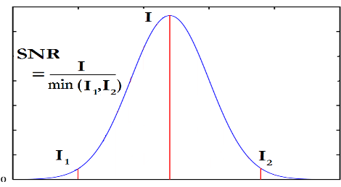
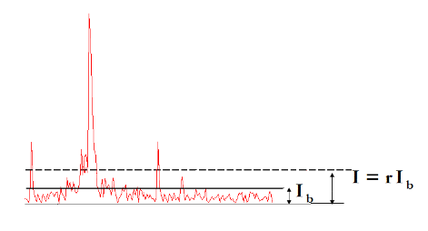
Peak-Picking (contd.)
  Minimum S/N
    sets the signal-to-noise ratio using the given formula
    default value - 3
  Minimum Background Ratio (r )
    sets the maximum intensity level to be considered as background
    default value - 5

Slide 16
Horn Transform parameters
  Charge Mass (mass of charge carrier) – 1.00782
  Maximum mass to consider – 10000
  Maximum charge – 10
  Set THRASH – If set, scores each isotopic profile in stops of +/-1 Da for fit to data, exits and returns if new_score > current_score (set to true)
  Set Complete Fit – If set, works same as THRASH except the best fit from a series of fits is returned (set to true)
  Set Sum All Spectra/Sum Across Scan range – options to sum by default (set to false)
  Type of distribution-fit
    Sets the method of fitting theoretical and observed distributions
    Options are peak, area and chi-sq
    Default set to AREA
  Allowable shoulder (n)
    Sets the number of allowable shoulders as the number of non-decreasing peaks preceding a minima for it to be considered a shoulder
    Default – 1
  Max Fit
    Range 0 -1, measures the fit between observed and theoretical
    Default set to 0.25

Slide 17
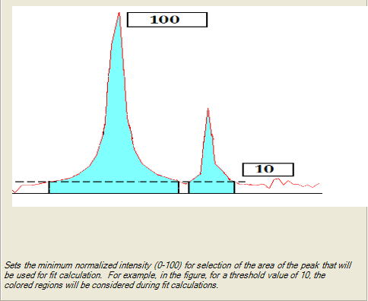
Horn Transform (contd.)
Threshold intensity for score
  Default 10

Slide 18
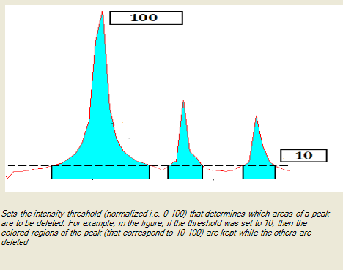
Horn Transform (contd.)
Threshold Intensity for Deletion
  Default : 10

Slide 19
For low resolution MSn scan (extract_msn)
The acquisition software recognizes a +1 based on MS2 fragmentation pattern, and writes it to the header
Else writes out CS 0
Start
ParentPeak,
CS
CS = 1?
.dta
.dta
CS 1
.dta
CS 2/3
Stop

Slide 20
DeconMSn handles low resolution as follows:
  A set of features based on [1] are calculated for every fragmentation spectrum.
  The features are given to a trained Support-Vector-Machine (SVM) that tries to assign a charge state based on the feature values.
  Deisotope using ParentPeak and the CS that the SVM returns
  [1] “Peptide charge state determination for low-resolution tandem mass spectra” A. Klammer et al. , “Proceedings of 2005 IEEE Computational Systems Bioinformatics Conference”

Slide 21
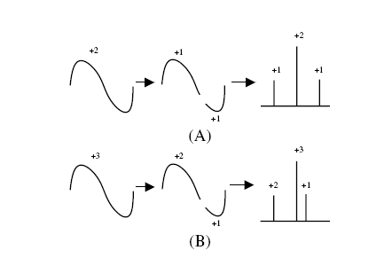
Features
Xscore2, Xscore3 from [1]
Parent
Fragments
Parent
Fragments
Schematic depicting nature of fragmentation for multiply charged peptides [1]

Slide 22
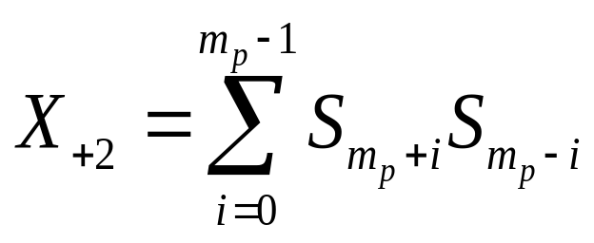
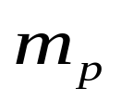
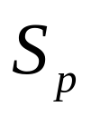



Xscore2
where,
- Parent mz
- Sum of all peak intensities +/- 0.5 of p

Slide 23
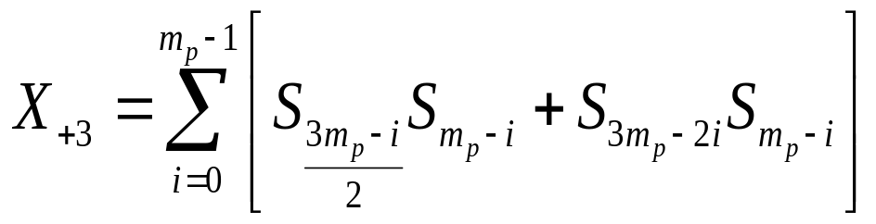
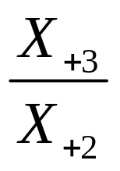
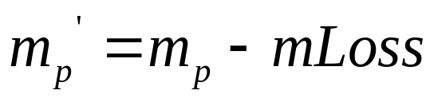
Xscore3
Xratio
Xscore2_{mLoss}, Xscore3_{mLoss}
mLoss = mass of (CO/NH3/ H₂O)

Slide 24
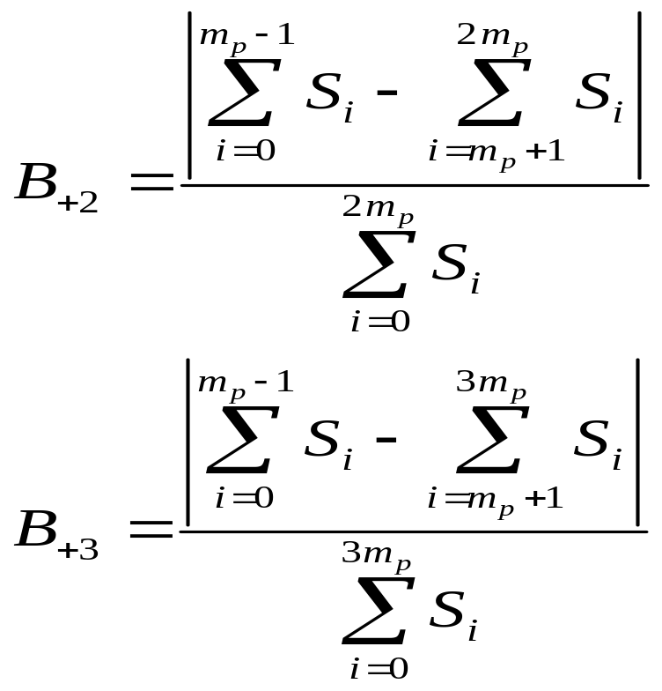
Bscore2, Bscore3

Slide 25
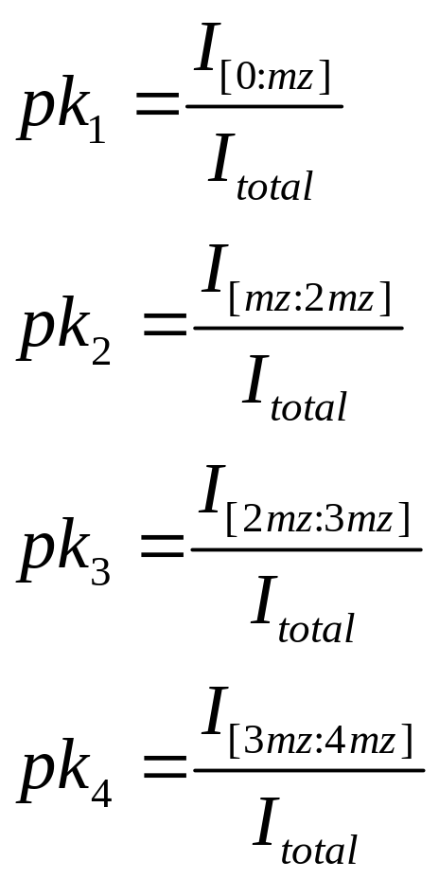
Peak Distribution
Where,
I_{[interval]} – Peak count in interval
I_{total} : Peak count in entire scan

Slide 26
Fscore2, Fscore3
  Linear discrminant analysis of charge +2 and charge +3 fragmentation spectra
  A test charge +2 will have a high Fscore2 and a low Fscore3, whereas a test charge+3 will have a higher Fscore3 than its Fscore2
Scan
Parent m/z

Slide 27
Training Set
9 high-resolution MS/MS datasets (from LTQ_FT and LTQ_Orbitrap) were processed with DeconMSn (2 Human_Lipid_Rafts, 2 QC_Standards, 2 S_typhimurium, 3 Shewanella)
DTAs were created for only those spectra that was THRASHed
From each dta, we get scan, charge, parent_mz, mz_list and intensity_list
Features space was created using all the spectra (CS =1, 2, 3 and 4)
5000 spectra was chosen from the feature space (keeping distribution of CS intact)
Train SVM using these 5000 spectra
All the above steps were done in MATLAB, and thus is external to DeconMSn. Future versions of DeconMSn will incorporate the ability to retrain the SVM based on instrument-specific settings.

Slide 28
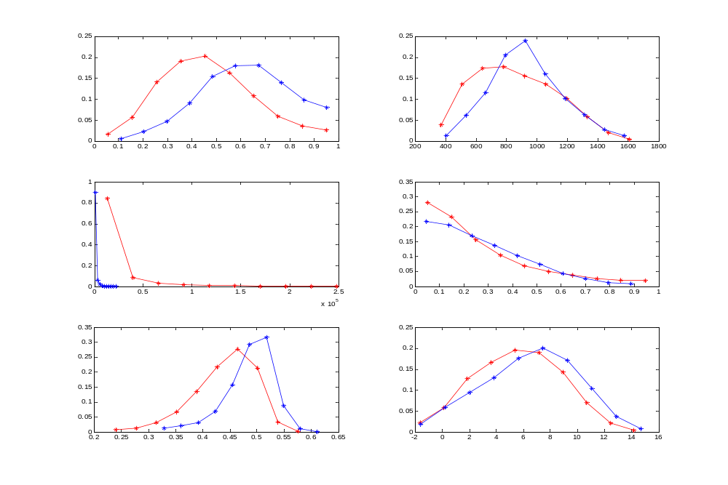
Example distributions of features
Scan
Parent m/z
Xscore2
Bscore2
pk₂
Fscore2

Slide 29
DeconMSn algorithm (low–resolution)
Start
ParentPeak
Fragmentation
spectrum
Next
Spectra
CS = 1?
Y
.dta
CS 1
N
Calculate
features, add to
feature space
Last
Spectra?
N
Y
A

Slide 30
A
Normalize feature
space
Determine charge
of every entry in
feature space
.dta
.dta
Stop

Slide 31
The value of discriminant score between two classes is either positive or negative
Say for e.g., that for a +2/+3 discrimination, +ve indicates +2 and –ve indicates +3
The more positive the score is, the more certain the SVM is of the feature being +2. Likewise, the more negative, the more chances are that the feature is +3
Ambiguous spectra were given both +2 and +3 charge states.

Slide 32
Results

Slide 33
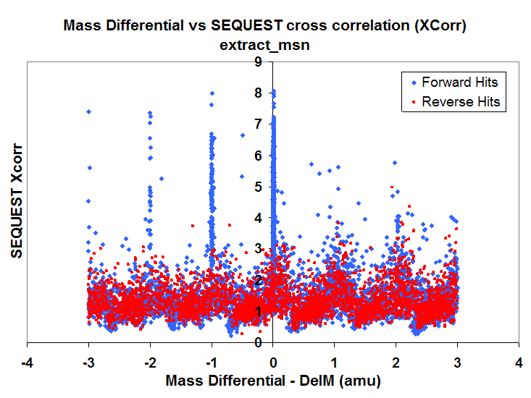
Dataset1

Slide 34
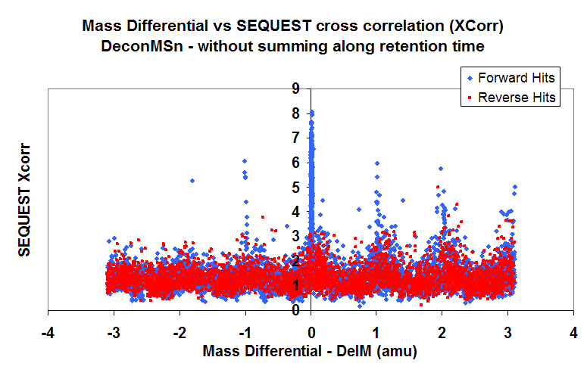

Slide 35
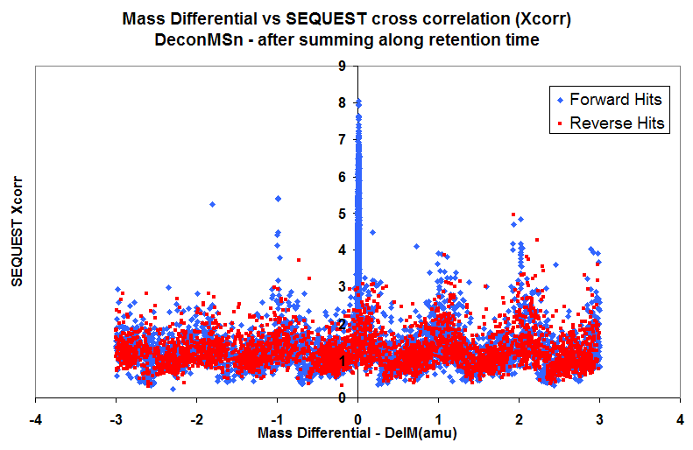

Slide 36
Observations
extract_msn choosing the wrong mass as being monoisotopic leads to DelM values of -1, -2 etc…
DeconMSn chooses the right mono mass leading to DelM values of 0
Summing along retention time, in the event that THRASH fails for a single scan, leads to improvement in quality of distribution and thus more peptides with DelM as 0 are achieved
If the following filters are applied
    Choose only DelCn2 >=0.1
    For 1+ peptides, choose only peptides with Xcorr >=1.9
    For 2+ peptides, choose only peptides with Xcorr >=2.2
    For all peptides >=3+, choose only peptides with Xcorr >= 3.2
then…

Slide 37
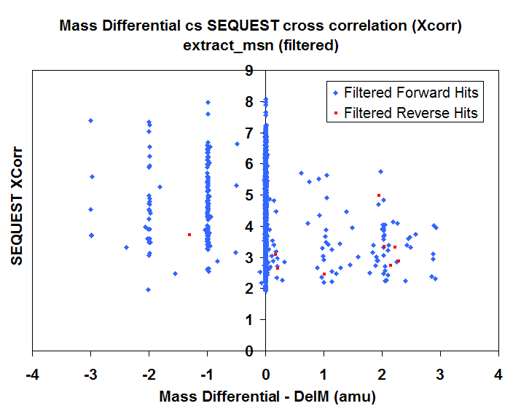

Slide 38
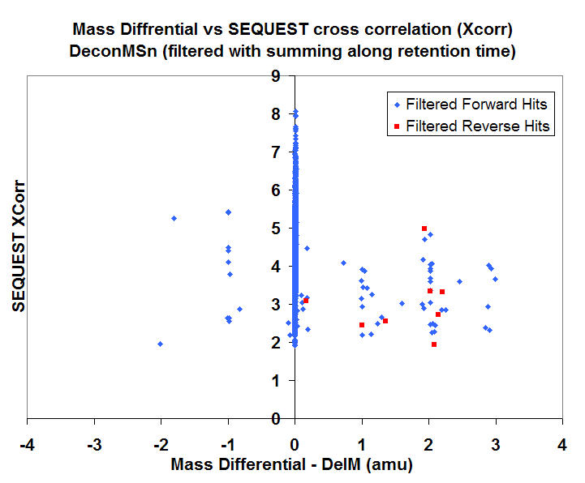

Slide 39
Some reasons for remaining DelM offsets
Bad spectra or low-abundant species – when peaks were below the noise threshold and were missed.
Overlapping peptide isotopic distributions - cases where parent isotopic distribution overlapped with other parent distribution. THRASH returned the distribution for the parent peak chosen for fragmentation but SEQUEST thought it was the other peptide due to possibly better match of fragmentation pattern.
Summing spectra in the event of unsuccessful THRASH on a single spectra would lead sometimes to overlapping distributions which when THRASHed would give wrong results. This is one reason why summing is not performed on default.
In rare cases, SEQUEST did give erroneous results.
If THRASH failed for both single and summed spectra, and FindPeak() found a single peak that happened to be 1/CS away from the parent, then that peak is returned in error. The algorithm has been designed such that the occurrence of these cases are minimal.

Slide 40
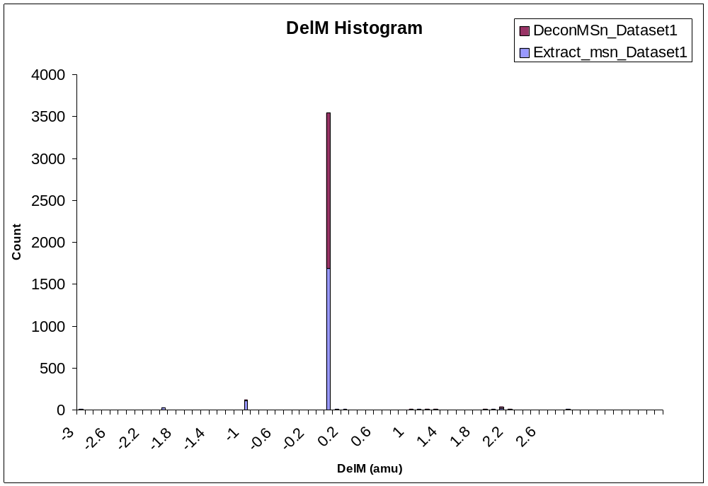

Slide 41
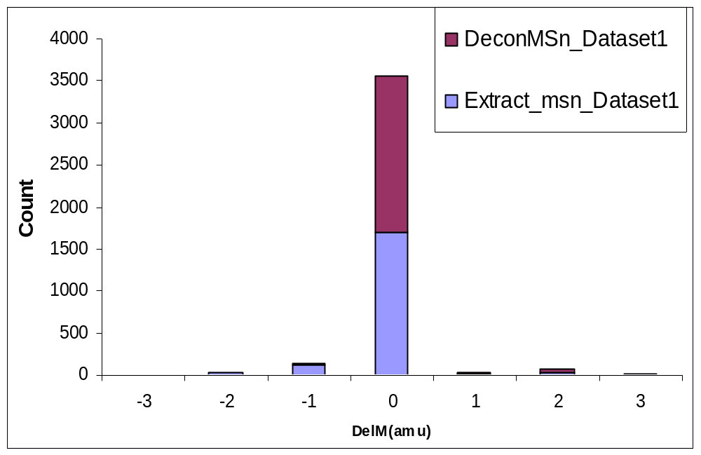

Slide 42
Distribution of DelM values for filtered peptides
 | DelM < -0.5 | -0.5 < DelM < 0.5 | DelM > 0.5
Extract_msn | 154 | 1702 | 77
DeconMSn | 12 | 1839 | 64

Slide 43

Example:
DeconMSn got it right and extract_msn got it wrong
Parent Peak (fragmentation) – 1363.02
Extract_msn MonoH - 4086.00510
DeconMSn
  THRASH (MonoH -4085.05968035)
Sequest gave a hit at 4085.05

Slide 44
Other datasets

Slide 45
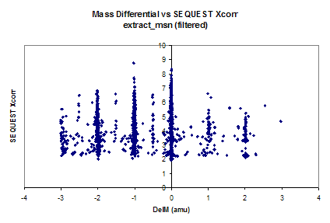
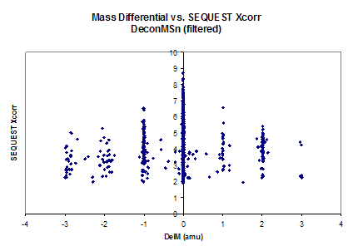
Dataset2

Slide 46
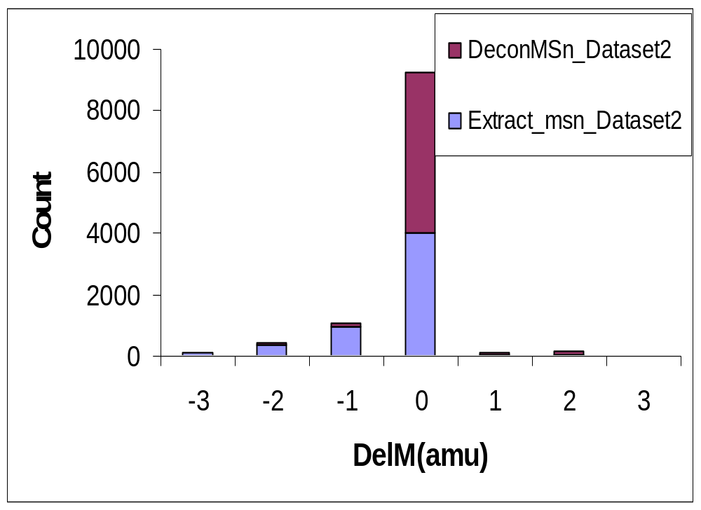

Slide 47
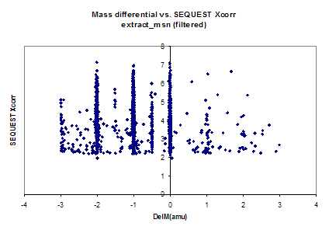
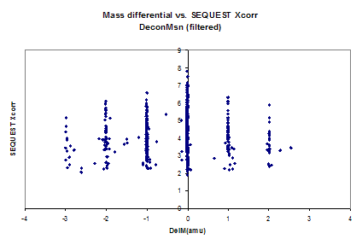
Dataset 3

Slide 48
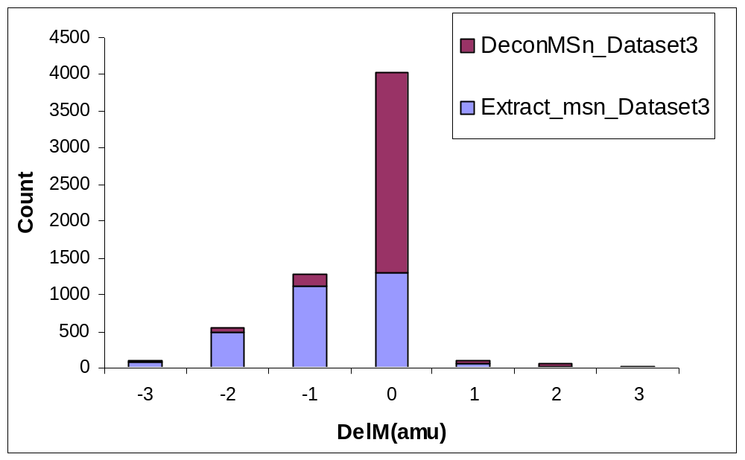

Slide 49
Some notes for Dataset 3
The threshold for the ion intensity to be selected for fragmentation was set to a very low value the result being low-intensity ions near a peptide distribution were chosen for fragmentation.
Extract_msn gave default charge states of +2 and +3
DeconMSn was not able to return a THRASH result for a single spectrum, but was able to find a good isotopic distribution for a summed spectrum, and thus returned the correct monoisotopic mass
However, summing all the time is a bad idea as noise peaks get added on to the isotopic distribution which when THRASHed would result in +DelMs. The same is true for overlapping distributions too.

Slide 50
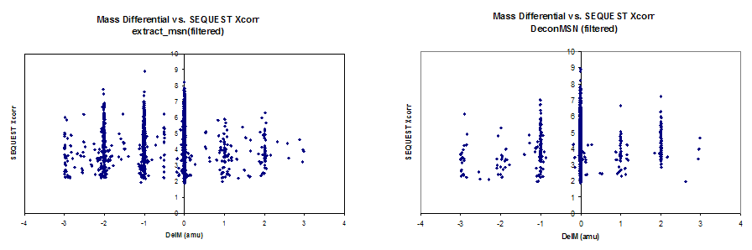

Dataset 4

Slide 51
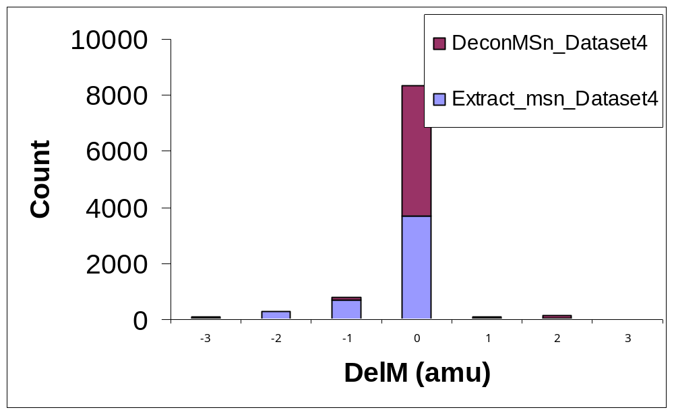

Slide 52
For low resolution
Extract_MSN gave 24,631 dta
DeconMSn gave 21,569 dtas
After filtering using DelCn2 and Xcorr
  Charge 1+: Xcorr >=1.9, DelCn2>=0.10, Partially or fully Tryptic
  Charge 2+: Xcorr >=2.2, DelCn2>=0.10, Partially or fully Tryptic
  Charge >=3+: Xcorr >=3.2, DelCn2>=0.10, Partially or fully Tryptic
  Number of hits found by extract_msn that we didn't find : 47/2816 hits which is about 1.7%
  Number of hits found by DeconMSn that extract_msn didn’t find :49 (this, on further examination are unique to DeconMSn only due to lack of grouping)
  Number of reverse hits in extract_msn : 17
  Number of reverse hits in DeconMSn : 19
In short, we found ~98% of all the good hits, with ~12% reduction in number of dtas, leading to lesser search time, with equivalent false positive rates.

Slide 53
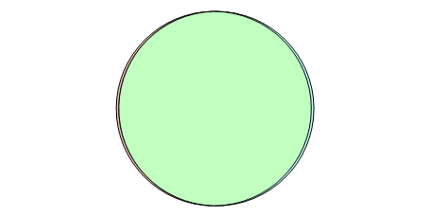
Low-resolution data results
47 filtered hits
unique to
extract_msn
2816 filtered
hits common
49 filtered hits unique
to DeconMSn

Slide 54
Sample MS/MS analysis results
178 S_typhimurium mutants samples run on LTQ_Orbitrap
Monoisotopic decoy (forward + reverse sequences) searches using SEQUEST
 | Mono_DeconMSn_Decoy | Mono_Extract_Decoy
Reverse SEQUEST hits | 193 | 315
All hits | 753046 | 709682
All hits (0.1 Da mass tol) | 712927 | 668992

Slide 55
Implementation
Command line
Input
  .RAW files
  .mzXML files
Output
  .dta files
  .MGF
Options for setting
  Scan range
  Mass Range
  Minimum Ion Count for MS/MS spectra consideration
  Force charge on all parent ions
  Choice of output directory if different from input directory
  Parameter file to be considered

Slide 56
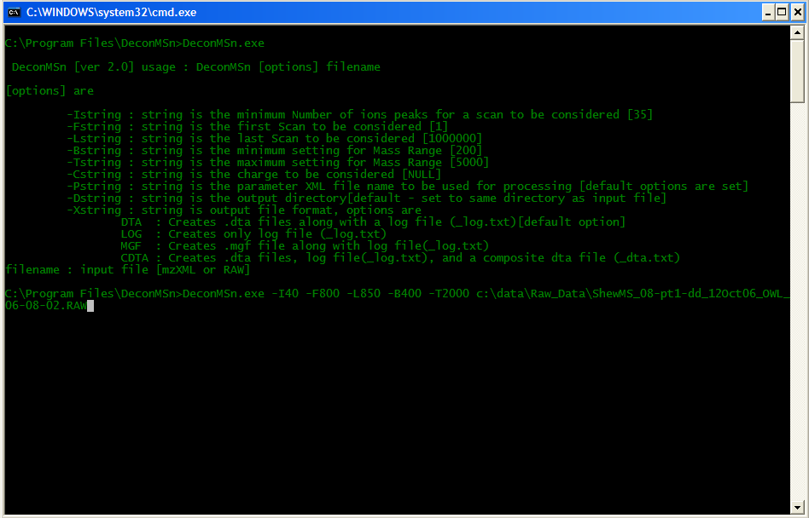
Screenshot

Slide 57
Summary
  DeconMSn accurately detects the monoisotopic mass and charge of high resolution mass spectra
  Shows improvements in narrow mass tolerance Sequest searches
  Good implementation of SVM to handle low resolution tandem mass spectra
  Incorporated and currently used as part of the Data Management System for our Accurate Mass and Time (AMT) Tag pipeline.

Slide 58
Acknowledgments
Navdeep Jaitly
Samuel Purvine
Ken Auberry
Matthew Monroe
Joshua Adkins
Richard Smith
Other acknowledgements
NIH National Center for Research Resources
National Institute of Allergy and Infectious Diseases
Environmental and Molecular Sciences Laboratory (EMSL)

