Slide 1

Evaluating Decon2LS
Analysis Parameters
Matthew Monroe

Slide 2
Data Analysis Pipeline
Complex
Protein
Mixture
AMT Tag Database Generation to Enable High Throughput Analysis
Downstream
Data Analysis
LC-MS/MS
Measurements
LC-MS/MS
Datasets
Peptide
Identification
Peptide
IDs
Peptide
Filter
Tryptic
Digestion
DAnTE
Normalization
SEQUEST
X!Tandem
MASIC
DeconMSn
Extensive
Fractionation
Predicted
Proteins
AMT Tag
Database
Peptide
Mixture
Protein
Rollup
Diagnostic
Plots
Select
Appropriate
Path
High Throughput Proteomics Analysis
WARP net alignment/
mass calibration
LC-MS
Measurements
LC-MS
Datasets
Peak Lists
Masses
and NETs
Peak
Matching
MultiAlign
Alignment
across
samples
Deisotope
Find
Features
Detected
Peptides
Target
unidentified
features
QA/QC
trends
Decon2LS
VIPER
SMART

Slide 3
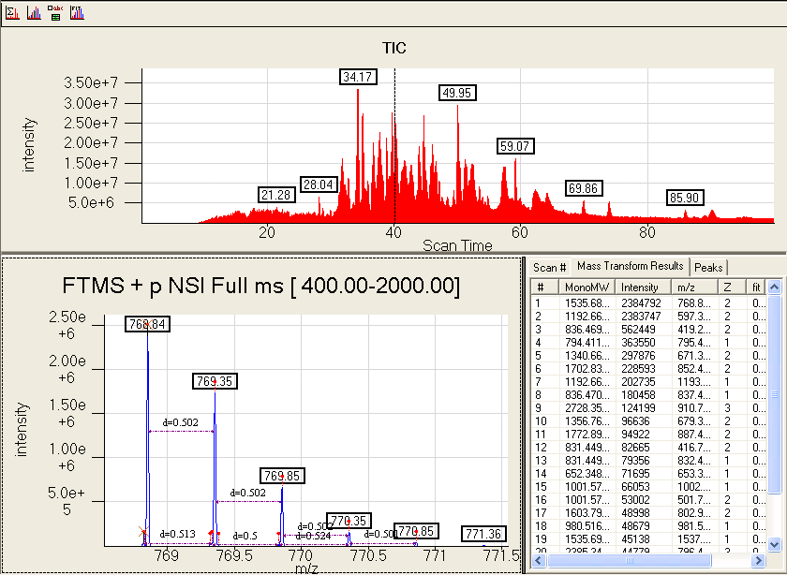
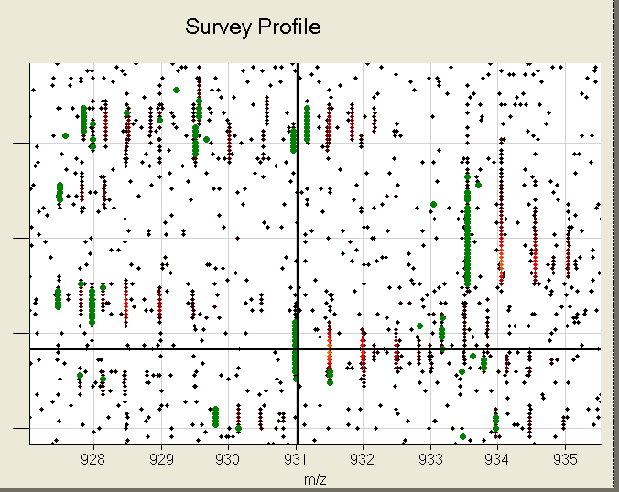


Decon2LS
Deisotopes high resolution LC-MS data
  Uses enhanced THRASH deisotoping algorithm to determine abundance, charge state, and monoisotopic masses of MS features

Slide 4
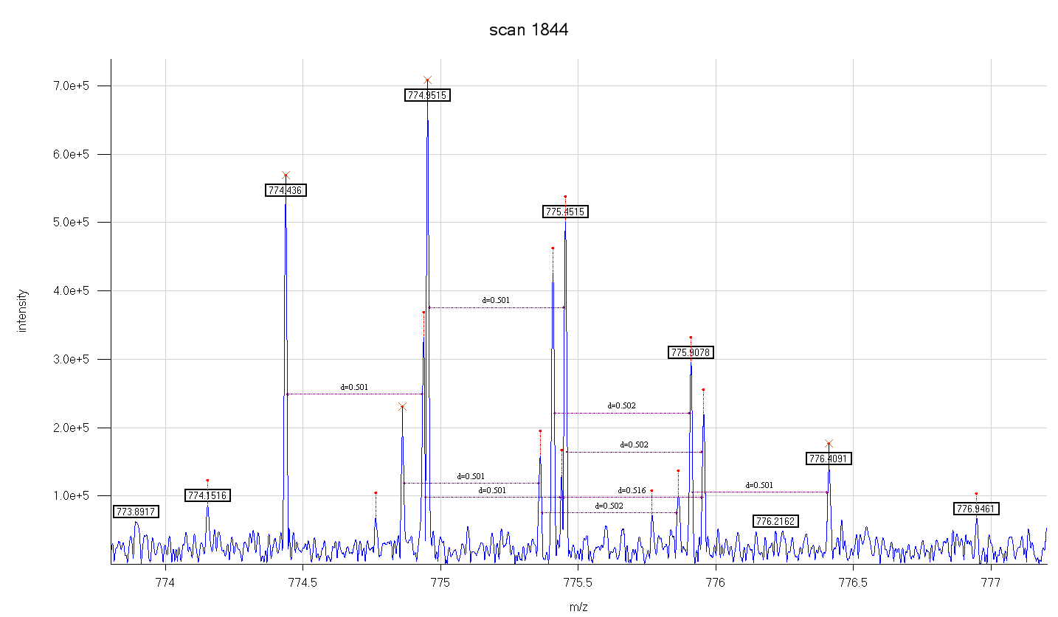
Decon2LS
Deisotoping features
  Process of converting a mass spectrum (m/z, intensity) into a list of species (mass, abundance, charge)
Deisotoping a mass spectrum of 4 overlapping species
Charge
Monoisotopic MW
Abundance
2
1546.8566
533467
2
1547.7050
194607
2
1547.8877
671947
2
1548.7996
426939
intensity
m/z

Slide 5
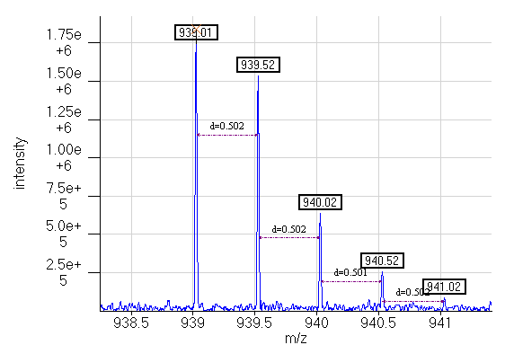
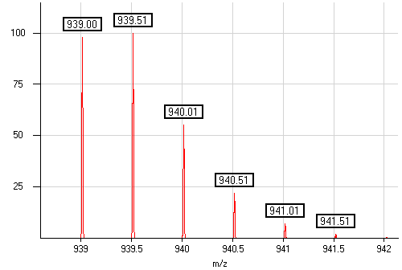
Deisotoping an Isotopic Distribution
Decon2LS deisotoping algorithm compares theoretical isotopic patterns with observed patterns
Observed spectrum
Theoretical spectrum
Fitness value
Charge
detection
algorithm
estimated empirical formula:
C₈₃ H₁₂₄ N₂₃ O₂₅ S₁
charge = 2
Averagine
Mercury
avg. mass = 1876.02

Slide 6


¹⁶O/¹⁸O Mixtures
Overlapping isotope patterns are separated by 4 Da
  Example: 1311.680 Da peptide appearing as 2+ peptide ions
Unlabeled peptide
656.84
1.25e+6
¹⁸O labeled peptide
1.00e+6
intensity
658.85
7.5e+5
657.34
657.84
5.0e+5
d=0.502
659.35
d=0.501
658.35
d=0.501
2.5e+5
d=0.501
659.85
d=0.501
660.35
657
658
m/z
659
660
Notes:
Used same example as Matt scan 3034 (feature scans are from 3010 to 3070) MW 1279 to 1291; Peptide is LGNQEPGGQTALK
\\proto-4\QC_LTQ_FT\QC_Process_Exp002_DS010_LTQ_FT_O18\QC_Process_Exp002_DS010_LTQ_FT_O18.RAW
Decon2LS Processing options:
Horn Transform: O16/O18 labelled mixture is checked, sum across scan range is disabled
Horn Transform: Threshold settings: Max fit 0.15, Threshold for deletion 1, Threshold intensity for score 10

Slide 7
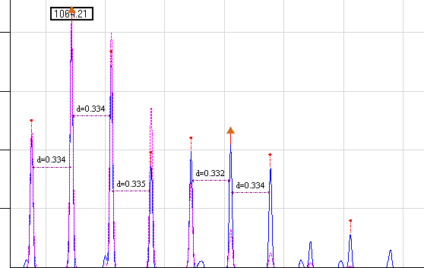
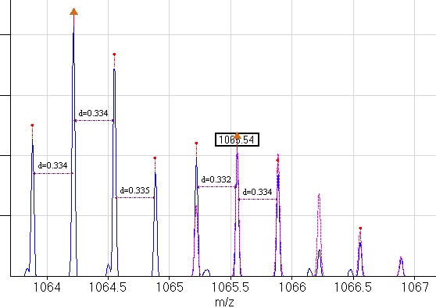
¹⁶O/¹⁸O Mixtures
  Heavier peptides (which appear as higher charge states) create challenges for deisotoping and quantitation
  Example: 3188.617 Da peptide
  appearing as 3+ species
Theoretical distribution
for unlabeled peptide
Unlabeled peptide
1064.21
2.00e+5
¹⁸O labeled peptide
1.50e+5
d=0.334
1065.54
Theoretical distribution
for ¹⁸O labeled peptide
1.00e+5
d=0.334
d=0.335
d=0.332
d=0.334
5.0e+4
1066.55
1064
1064.5
1065
m/z
1065.5
1066
1066.5
1067
Notes:
Scan 7742; peptide is GTEAAAVPEVELSDQPENTFLHPIIQIDR
\\proto-4\QC_LTQ_FT\QC_Process_Exp002_DS010_LTQ_FT_O18\QC_Process_Exp002_DS010_LTQ_FT_O18.RAW
Decon2LS Processing options:
Horn Transform: O16/O18 labelled mixture is checked, sum across scan range is disabled
Horn Transform: Threshold settings: Max fit 0.15, Threshold for deletion 1, Threshold intensity for score 10
Theoretical 16O empirical formula: C142 H232 N39 O42 S1.073
Theoretical 18O empirical formula: C142 H236 N39 O42 S1.135

Slide 8
Identifying LC-MS Features
Deisotoping collapses original raw MS data into data lists
scan num | charge | abundance | mz | fit | average mw | monoiso mw | most abu. mw | fwhm | signal noise
1500 | 1 | 2772933 | 759.0649 | 0.0716 | 758.5222 | 758.0576 | 758.0576 | 0.0106 | 718.83
1500 | 1 | 2614913 | 1103.033 | 0.1111 | 1102.698 | 1102.026 | 1102.026 | 0.0222 | 74.04
1500 | 1 | 2422829 | 864.4919 | 0.0156 | 864.0073 | 863.4846 | 863.4846 | 0.0137 | 74.75
1500 | 2 | 2297822 | 563.3253 | 0.012 | 1125.322 | 1124.636 | 1124.636 | 0.006 | 77.94
1500 | 1 | 1213607 | 943.9815 | 0.1025 | 943.5518 | 942.9742 | 942.9742 | 0.0165 | 120.36
1500 | 3 | 988761 | 675.0246 | 0.02 | 2023.375 | 2022.052 | 2023.0549 | 0.0086 | 79.22
1500 | 2 | 734070 | 688.392 | 0.0384 | 1375.694 | 1374.77 | 1374.7695 | 0.009 | 92.09
1500 | 2 | 663954 | 642.3243 | 0.0253 | 1283.417 | 1282.634 | 1282.6341 | 0.0076 | 109.01
1500 | 1 | 661477 | 730.1117 | 0.024 | 729.5461 | 729.1045 | 729.1045 | 0.0096 | 39.06
1500 | 2 | 630657 | 689.3645 | 0.0446 | 1377.64 | 1376.715 | 1376.7145 | 0.0088 | 57.52
1500 | 2 | 569896 | 591.8343 | 0.0198 | 1182.379 | 1181.654 | 1181.6541 | 0.0065 | 111.2
1500 | 2 | 503993 | 757.8854 | 0.0706 | 1513.762 | 1512.753 | 1512.7533 | 0.0105 | 80.4
1500 | 2 | 451007 | 936.9389 | 0.0296 | 1873.091 | 1871.863 | 1872.8662 | 0.0156 | 46.74
Ultimate Goal: Given series of deisotoped mass spectra, group related data across LC elution time, then match to AMT tags
  Look for repeated monoisotopic mass values in sequential spectra, allowing for missing data

Slide 9
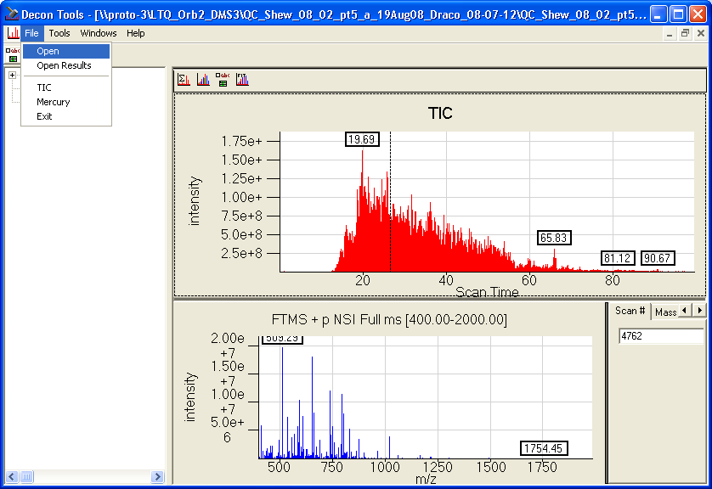
Decon2LS GUI
Use File menu to open binary data files (e.g. Finnigan .Raw file)
  Once open, can browse chromatogram, view spectra, and manually deisotope
  Press Left/Right arrow to step through TIC
  Press Backspace to zoom out one level

Slide 10
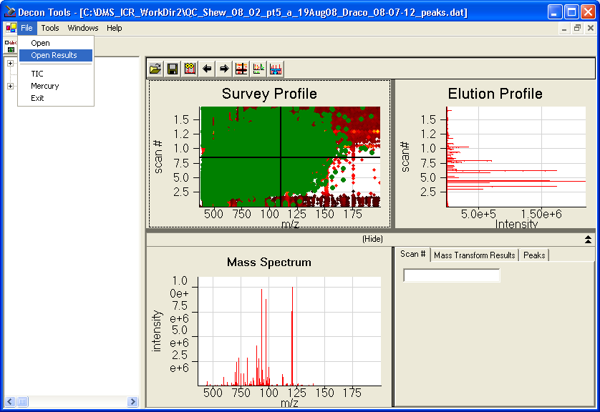
Decon2LS GUI
Can also open saved .Dat files created via auto-processing
  Shows 2D view of m/z vs. time with abundance color coded
  Can be a memory hog, and keyboard shortcuts are not available for stepping through scans

Slide 11
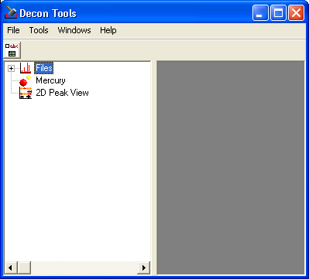
Decon2LS GUI
Set global options using "config" button below File menu
  These options will affect automated processing
  They also affect any files you open after tweaking these options

Slide 12
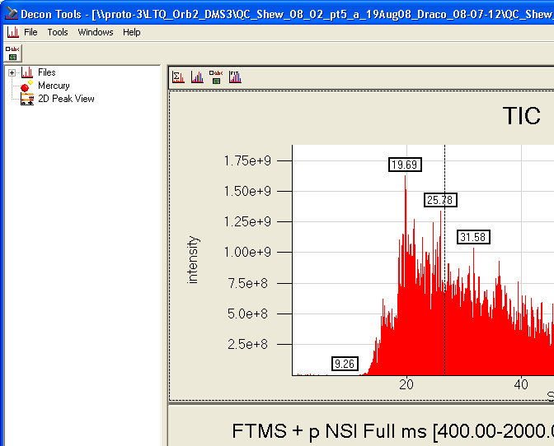
Decon2LS GUI
After opening a file
  Set options using the option button above the TIC
  These options are independent of the global options

Slide 13
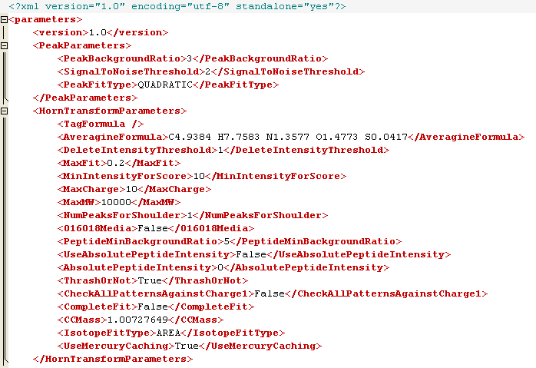
Decon2LS Deisotoping Parameters
Several thresholds affect which peaks get deisotoped, and how far into the noise the data is examined
  Key thresholds:

Slide 14
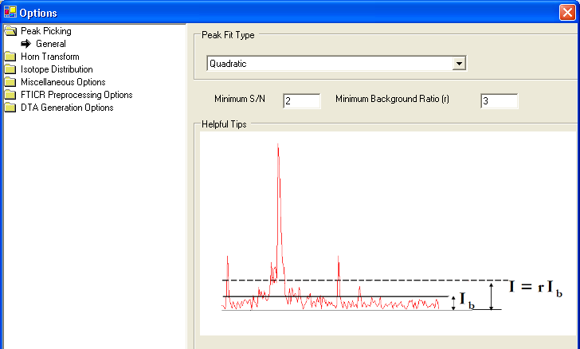
Decon2LS Deisotoping Parameters
Minimum Background Ratio (PeakBackgroundRatio)
  Used to determine which spectral points are "peaks" and therefore should be deisotoped
  Peak intensity must be ≥ r times the background level (I_{b})

Slide 15
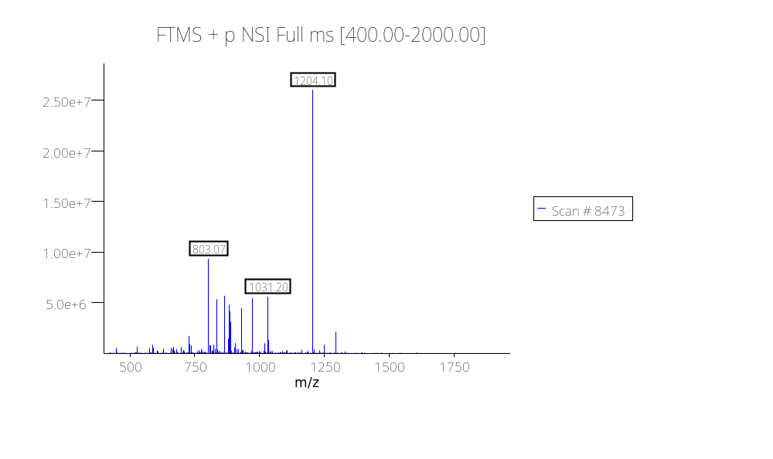
Decon2LS Deisotoping Parameters
Computation of the background level; example 1
  Compute the average of all points in a spectrum
  Compute the standard deviation (σ) of all points
  Compute the mean of all data within +/- 5 σ of the average
  Example: QC_Shew_08_02_pt5_a_19Aug08 on LTQ_Orb2
Count | 31,051
Average | 5.6E+04
StDev | 4.6E+05
StDev*5 | 2.3E+06
Threshold_Max | 2.4E+06
Threshold_Min | -2.2E+06
Avg of points below Threshold_Max | 34,700
(Includes all but the top 124 points)
Thus, I_{b} = 34,700
Notes:
Scan 8473 in \\proto-3\LTQ_Orb2_DMS3\QC_Shew_08_02_pt5_a_19Aug08_Draco_08-07-12\
See file QC_Shew_08_02_pt5_a_19Aug08_SummedSpectra.pxp

Slide 16
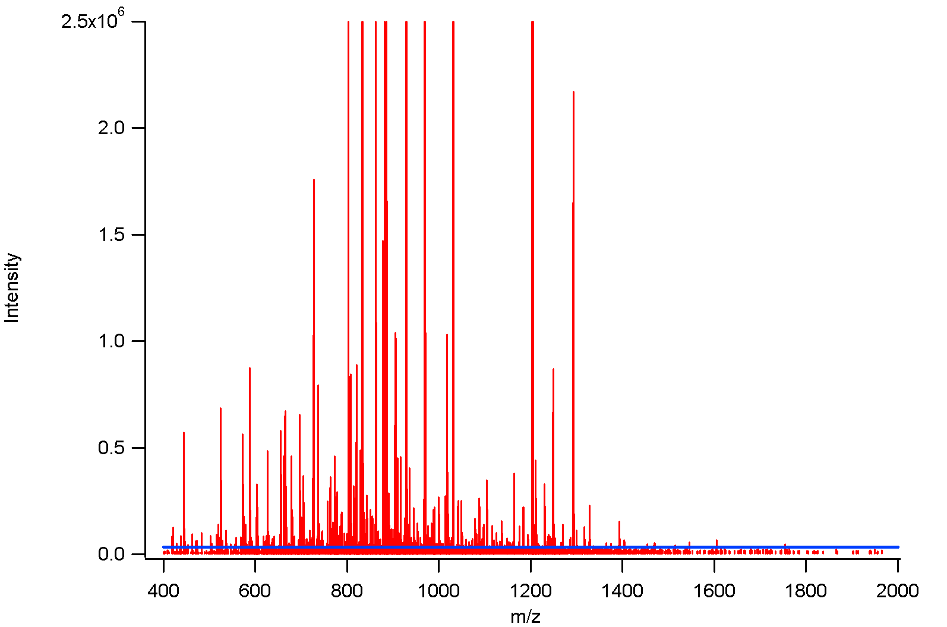
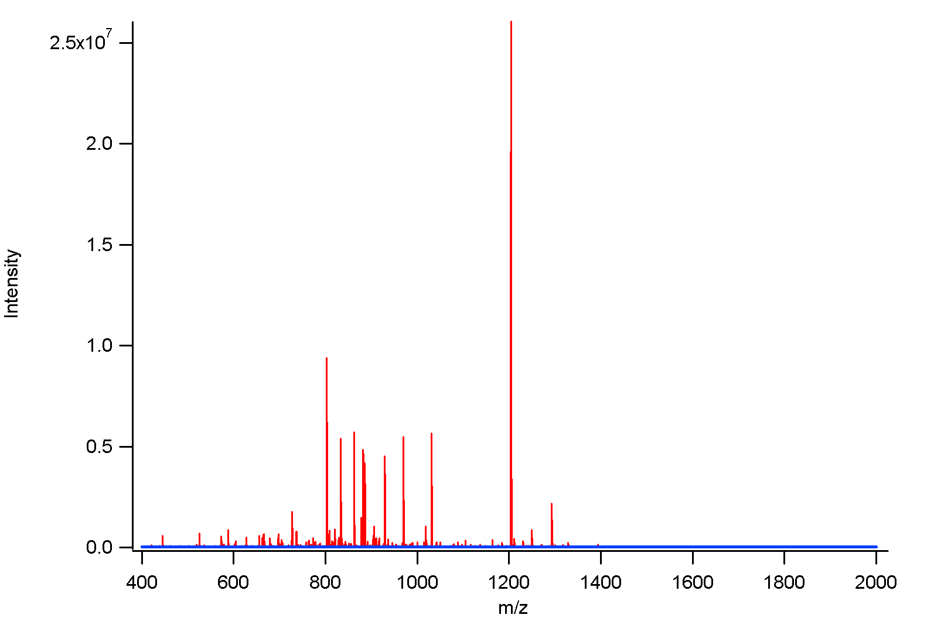
Decon2LS Deisotoping Parameters
Computation of the background level; example 1
  I_{b} = 34,700
Zoomed Y-axis view
Blue line indicates I_{b}
Notes:
Scan 8473 in \\proto-3\LTQ_Orb2_DMS3\QC_Shew_08_02_pt5_a_19Aug08_Draco_08-07-12\
File QC_Shew_08_02_pt5_a_19Aug08_SignalToNoise.pxp: Scan8473_Full and Scan8473_Zoomed
Copy using Edit->Export Graphics, change Format to PNG Image, use 2x resolution, keep the size "Same". Now paste in Powerpoint and scale down

Slide 17
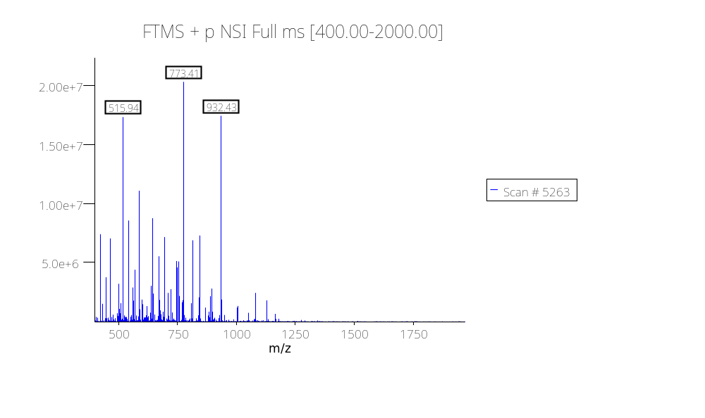
Decon2LS Deisotoping Parameters
Computation of the background level; example 2
  Compute the average of all points in a spectrum
  Compute the standard deviation (σ) of all points
  Compute the mean of all data within +/- 5 σ of the average
  Example: QC_Shew_08_02_pt5_a_19Aug08 on LTQ_Orb2
Count | 26,898
Average | 1.1E+05
StDev | 6.0E+05
StDev*5 | 3.0E+06
Threshold_Max | 3.1E+06
Threshold_Min | -2.9E+06
Avg of points below Threshold_Max = I_{b} | 71,000
(Includes all but the top 140 points)
Notes:
Scan 5263 in \\proto-3\LTQ_Orb2_DMS3\QC_Shew_08_02_pt5_a_19Aug08_Draco_08-07-12\
See file QC_Shew_08_02_pt5_a_19Aug08_SummedSpectra.pxp

Slide 18
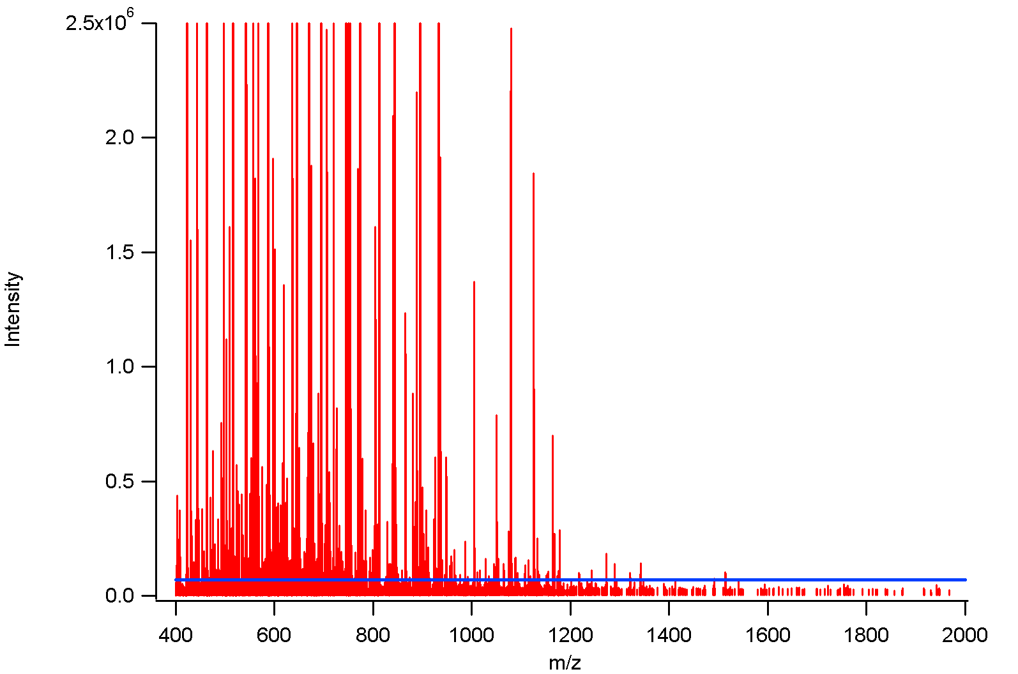
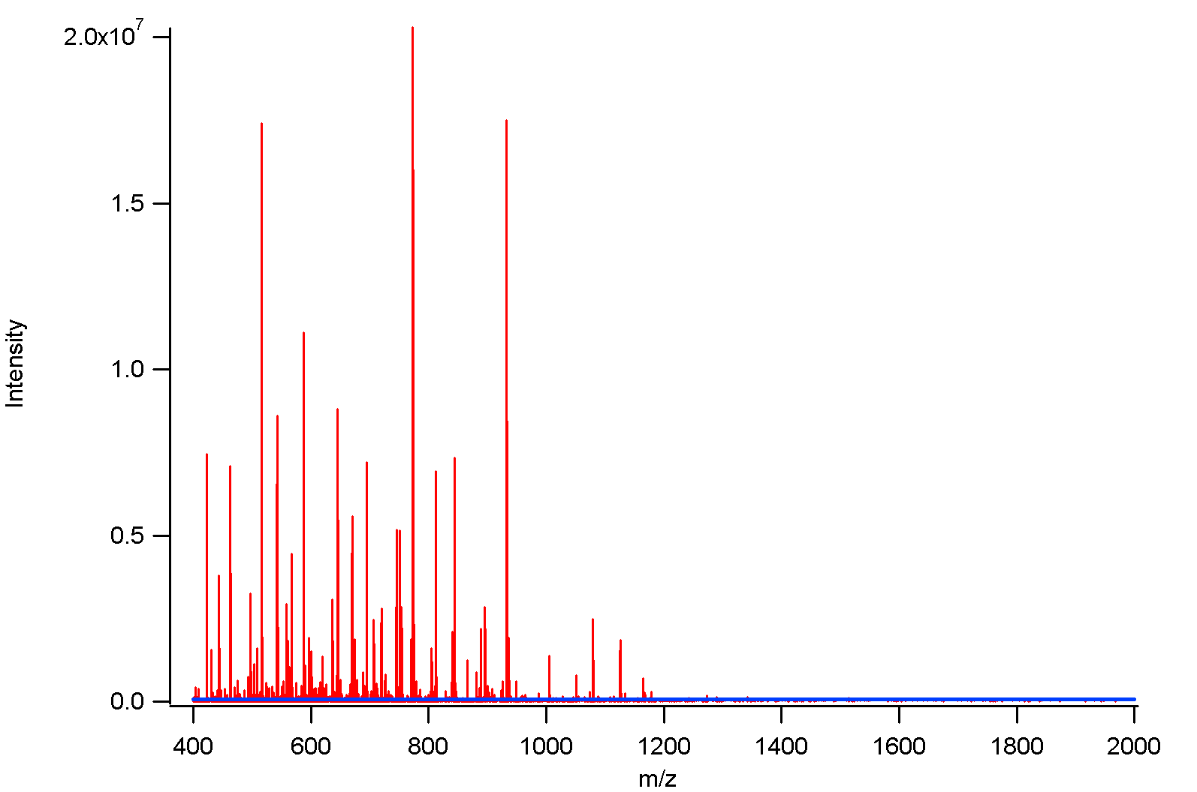
Decon2LS Deisotoping Parameters
Computation of the background level; example 2
  I_{b} = 71,000
Zoomed Y-axis view
Blue line indicates I_{b}
Notes:
Scan 5263 in \\proto-3\LTQ_Orb2_DMS3\QC_Shew_08_02_pt5_a_19Aug08_Draco_08-07-12\
File QC_Shew_08_02_pt5_a_19Aug08_SignalToNoise.pxp: Scan5263 _Full and Scan5263 _Zoomed

Slide 19
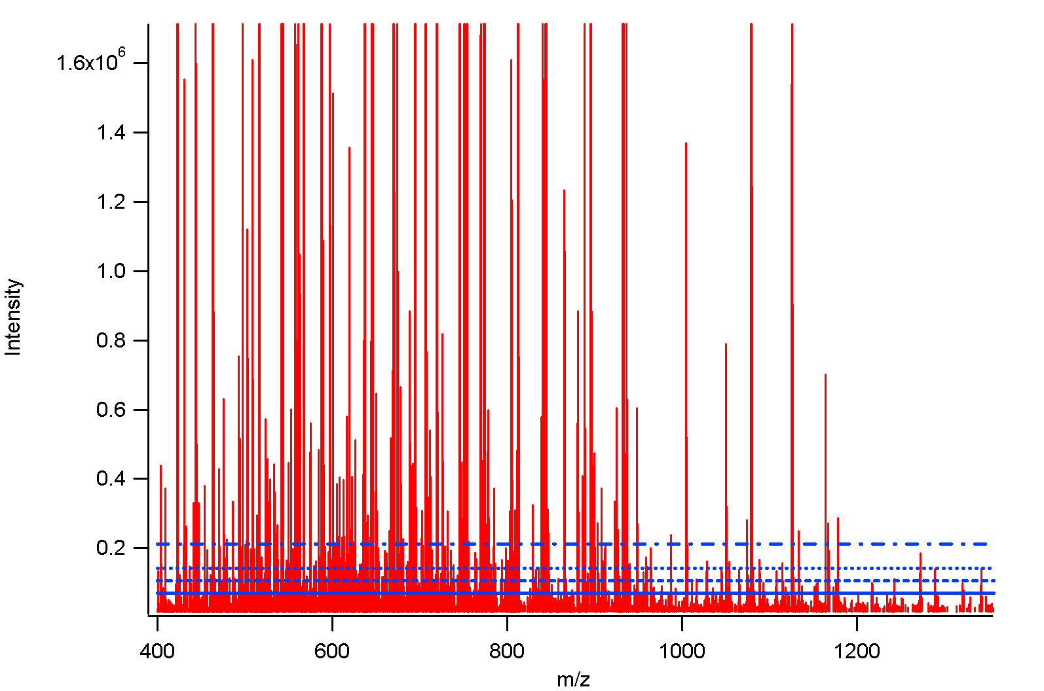
Decon2LS Deisotoping Parameters
Thresholds at various multiples of I_{b} = 71,000
3x
2x
1.5x
I_{b}
Notes:
Scan 5263 in \\proto-3\LTQ_Orb2_DMS3\QC_Shew_08_02_pt5_a_19Aug08_Draco_08-07-12\
File QC_Shew_08_02_pt5_a_19Aug08_SignalToNoise.pxp: Scan5263_VariousIb

Slide 20
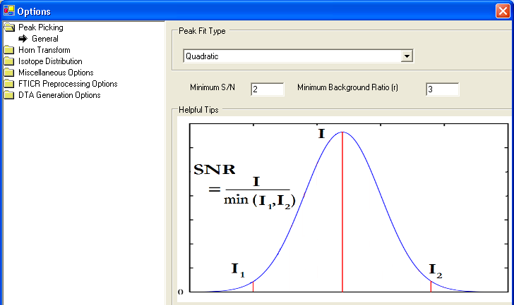
Decon2LS Deisotoping Parameters
Minimum S/N (SignalToNoiseThreshold)
  Also used to determine which spectral points are "peaks" and therefore should be deisotoped
  Require that ratio of peak's max intensity to average of the peak's 2 valleys is ≥ the S/N threshold

Slide 21
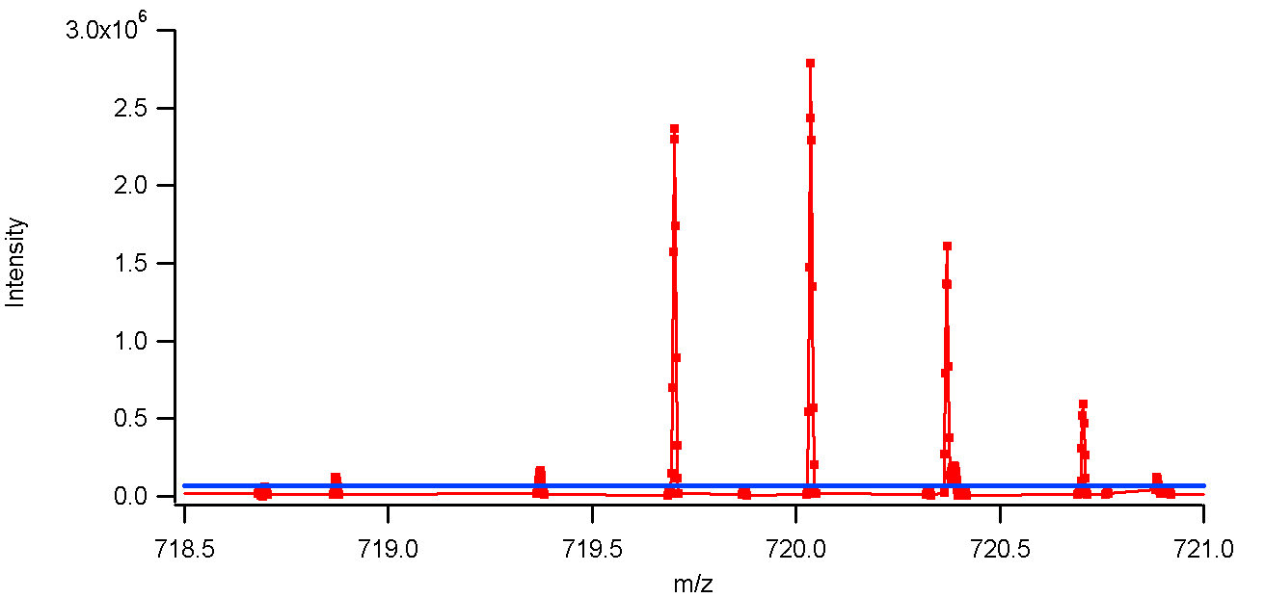
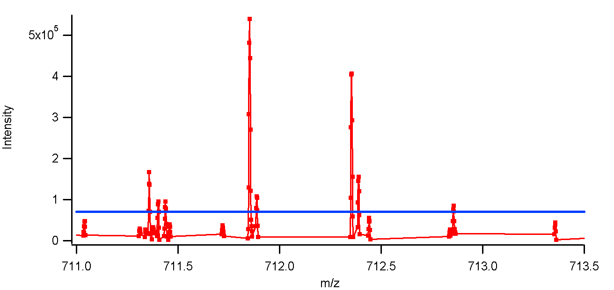
Minimum S/N (SignalToNoiseThreshold)
Hard to compute
localized S/N on
orbitraps since
data is
thresholded
prior to saving
to disk
S/N=176
S/N=61
S/N=22
S/N=47
S/N=6
S/N=4
Blue line indicates I_{b}
Notes:
File QC_Shew_08_02_pt5_a_19Aug08_SignalToNoise.pxp: Scan5263_LocalizedSN and Scan5263_LocalizedSN_2

Slide 22
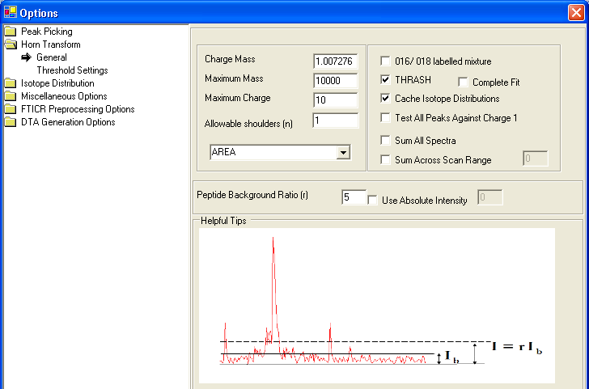
Decon2LS Deisotoping
Peptide Background Ratio (PeptideMinBackgroundRatio)
  Determines which points are considered when deisotoping a specific peak
  Only use if point's intensity ≥ r times I_{b}

Slide 23
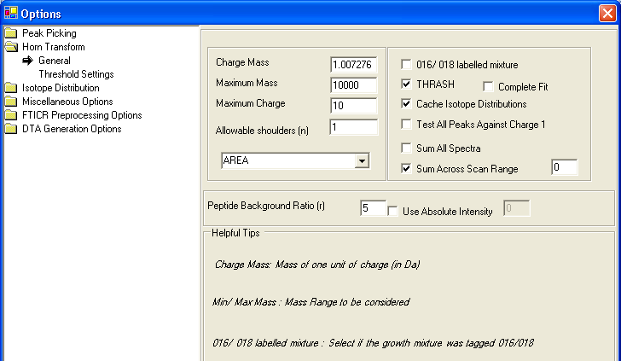
Decon2LS Deisotoping
Summing across adjacent scans can also affect results
  "0" means to sum 3 spectra (current, previous, and next)
  "1" means to sum 5 spectra (current, -2, -1, +1, and +2)

Slide 24
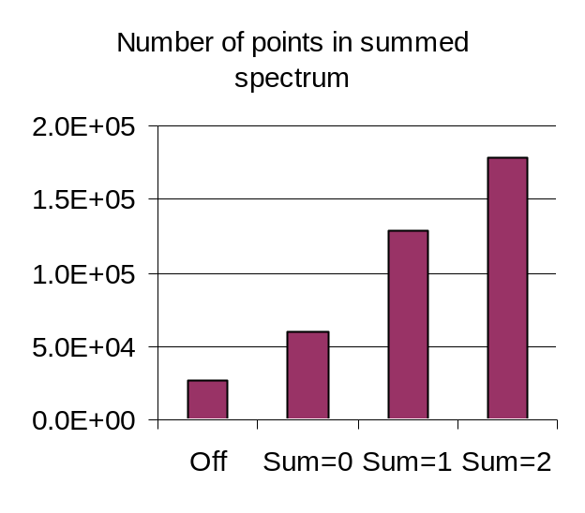
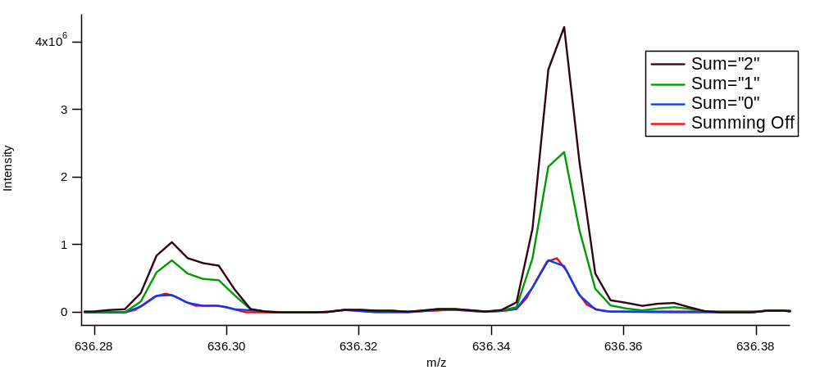
Decon2LS Deisotoping
Summing across adjacent scans can also affect results
  Enabling summing slows down the processing (by 2x or more)
  It is currently used by DeconMSn, but is not used by predefined Decon2LS parameter files
  Summing example:
Notes:
See file I_B_Computation.xls
Plot is in QC_Shew_08_02_pt5_a_19Aug08_SummedSpectra.pxp: SumComparison1

Slide 25
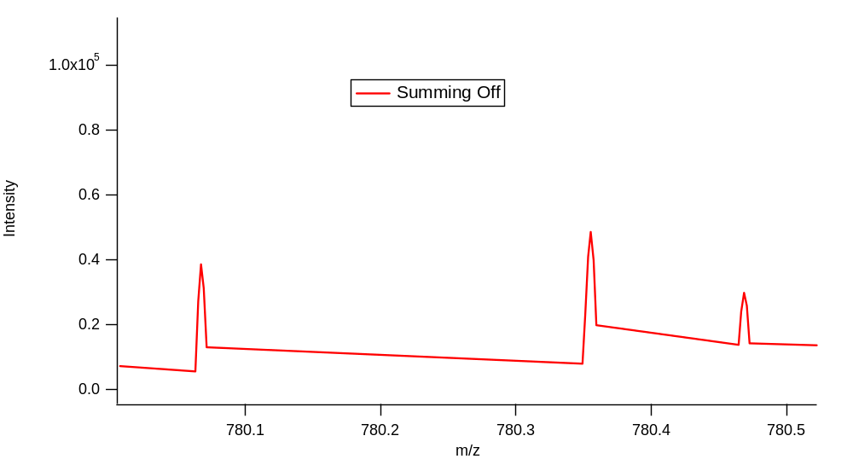
Decon2LS Deisotoping
Summing across adjacent scans can also affect results
  Beneficial at low intensities, but artifacts are added if too many scans are summed
Notes:
Plot is in QC_Shew_08_02_pt5_a_19Aug08_SummedSpectra.pxp: SumComparison2

Slide 26
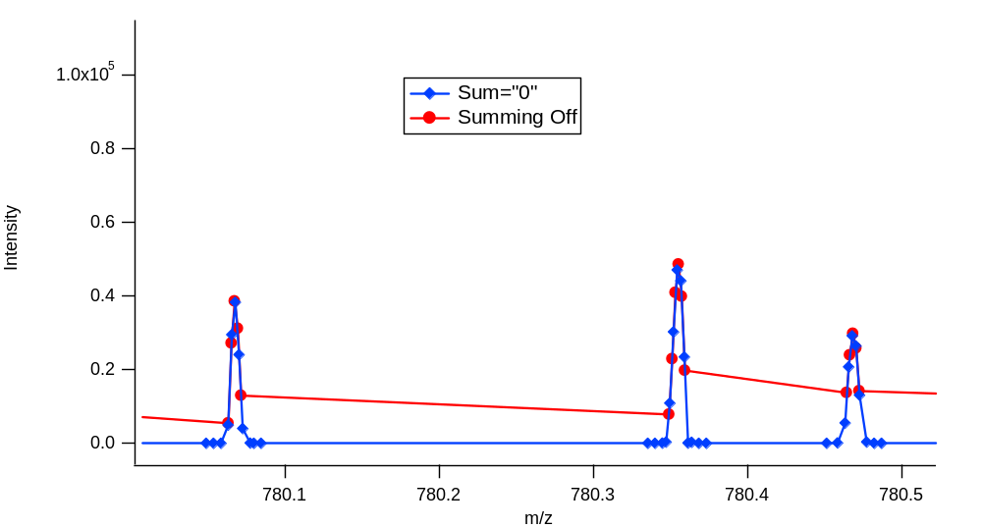
Decon2LS Deisotoping
Summing across adjacent scans can also affect results
  Beneficial at low intensities, but artifacts are added if too many scans are summed
Notes:
Plot is in QC_Shew_08_02_pt5_a_19Aug08_SummedSpectra.pxp: SumComparison2

Slide 27
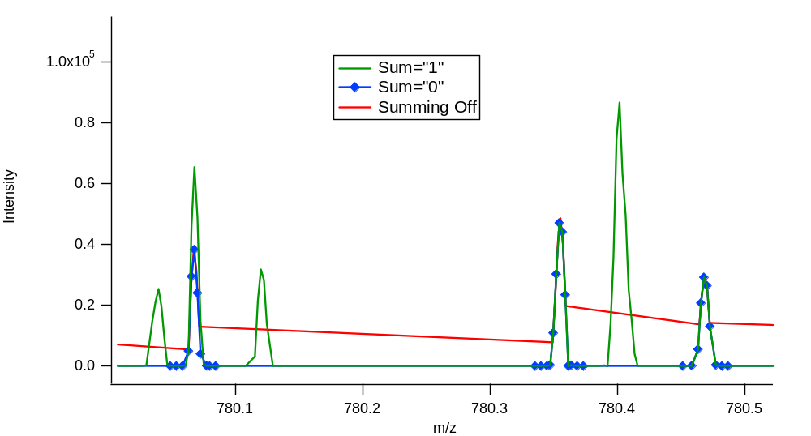
Decon2LS Deisotoping
Summing across adjacent scans can also affect results
  Beneficial at low intensities, but artifacts are added if too many scans are summed
Notes:
Plot is in QC_Shew_08_02_pt5_a_19Aug08_SummedSpectra.pxp: SumComparison2

Slide 28
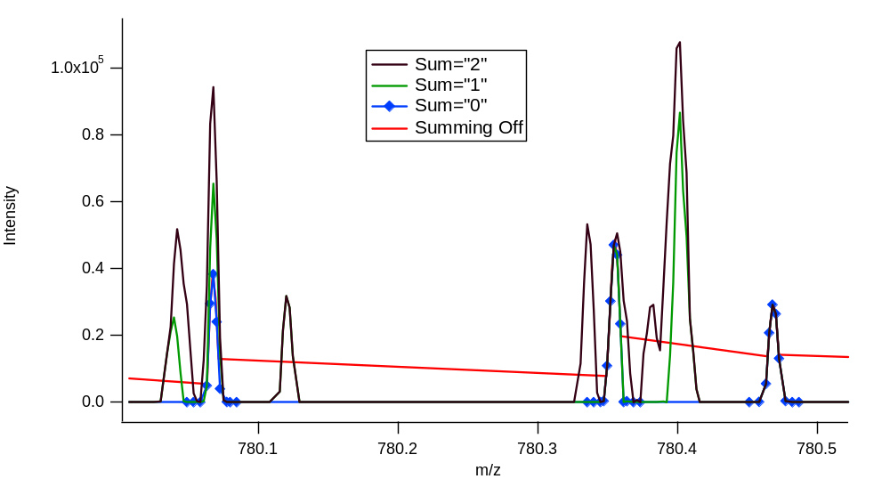
Decon2LS Deisotoping
Summing across adjacent scans can also affect results
  Beneficial at low intensities, but artifacts are added if too many scans are summed
Notes:
Plot is in QC_Shew_08_02_pt5_a_19Aug08_SummedSpectra.pxp: SumComparison2

Slide 29
Evaluating Decon2LS Thresholds
Weijun suggested that the thresholds were set too high for Orbitrap and LTQ-FT data processing
To check this, I analyzed the same dataset multiple times, varying these Decon2LS Thresholds:
  S/N
  Peak background ratio
  Peptide background ratio
Metrics for Comparison
  Processing time
  LC-MS Feature (UMC) Count
  AMT tag count identified
  FDR using 11 Da shift

Slide 30
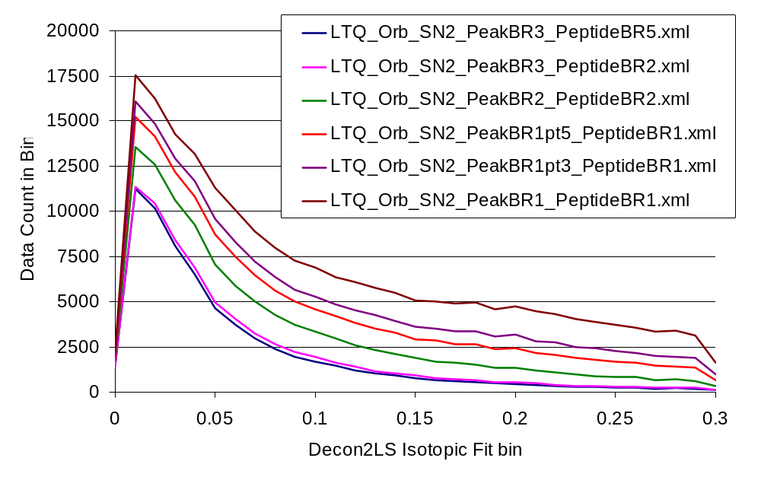
QC_Shew on LTQ_Orb_3
The new parameter files have Max Isotopic Fit of 0.3 instead of 0.2
  Histrogram of isotopic fit value distribution for each analysis
QC_Shew_08_02_pt1-c_18Aug08_Sphinx_08-07-27
Notes:
QC_Shew_08_02_pt1-c_18Aug08_Sphinx_08-07-27 on Orb_3, vs. MT_Shewanella_ProdTest_P352 on Porky
See file Decon2LS_Thresholds_Orb3_QC.xls

Slide 31
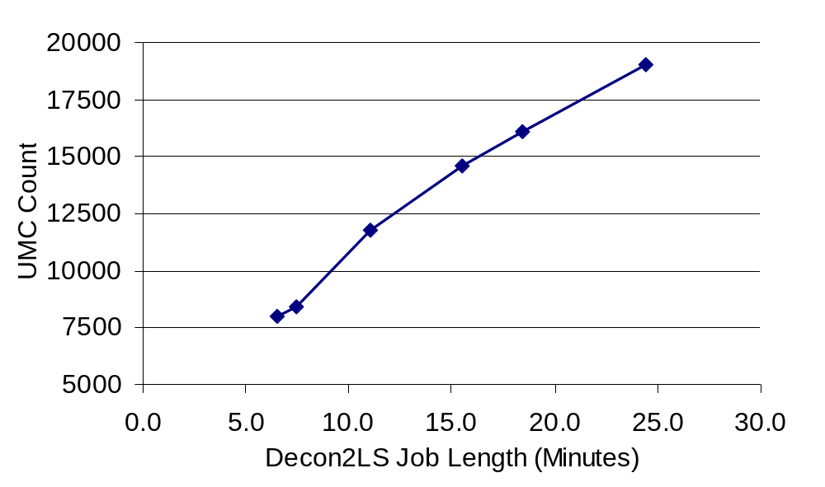
QC_Shew on LTQ_Orb_3
S/N | Peak Background Ratio | Peptide Background Ratio | Job | Task ID | Job Length (Minutes) | LC-MS Feature (UMC) Count
2 | 3 | 5 | 330193 | 3887 | 6.5 | 8,012
2 | 3 | 2 | 333270 | 3892 | 7.5 | 8,423
2 | 2 | 2 | 330194 | 3888 | 11.0 | 11,781
2 | 1.5 | 1 | 330195 | 3889 | 15.5 | 14,616
2 | 1.3 | 1 | 330196 | 3890 | 18.4 | 16,099
2 | 1 | 1 | 330197 | 3891 | 24.4 | 19,045
1.5 | 1.5 | 1 | 333271 | 3893 | 12.8 | 12,870
Notes:
QC_Shew_08_02_pt1-c_18Aug08_Sphinx_08-07-27 on Orb_3, vs. MT_Shewanella_ProdTest_P352 on Porky
See file Decon2LS_Thresholds_Orb3_QC.xls

Slide 32
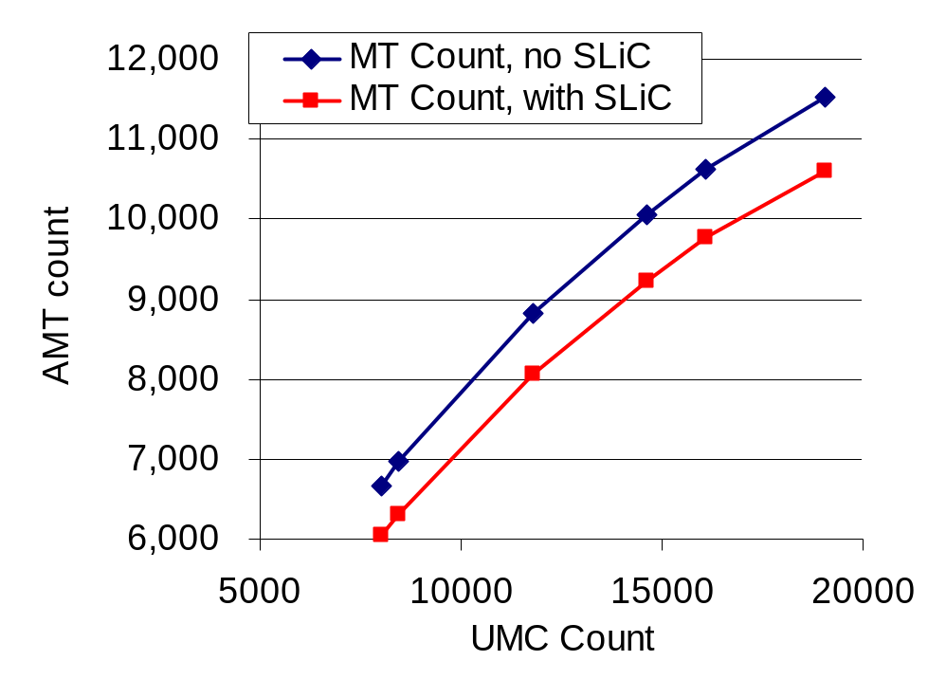
QC_Shew on LTQ_Orb_3
S/N | Peak BR | Pep. BR | Job Length | UMC Count | MT Count ID'd, no SLiC | MT Count ID'd, SLiC Filtered
2 | 3 | 5 | 6.5 | 8,012 | 6,674 | 6,046
2 | 3 | 2 | 7.5 | 8,423 | 6,969 | 6,316
2 | 2 | 2 | 11.0 | 11,781 | 8,825 | 8,065
2 | 1.5 | 1 | 15.5 | 14,616 | 10,057 | 9,222
2 | 1.3 | 1 | 18.4 | 16,099 | 10,620 | 9,759
2 | 1 | 1 | 24.4 | 19,045 | 11,528 | 10,597
1.5 | 1.5 | 1 | 12.8 | 12,870 | 9,300 | 8,505
Notes:
QC_Shew_08_02_pt1-c_18Aug08_Sphinx_08-07-27 on Orb_3, vs. MT_Shewanella_ProdTest_P352 on Porky
See file Decon2LS_Thresholds_Orb3_QC.xls

Slide 33
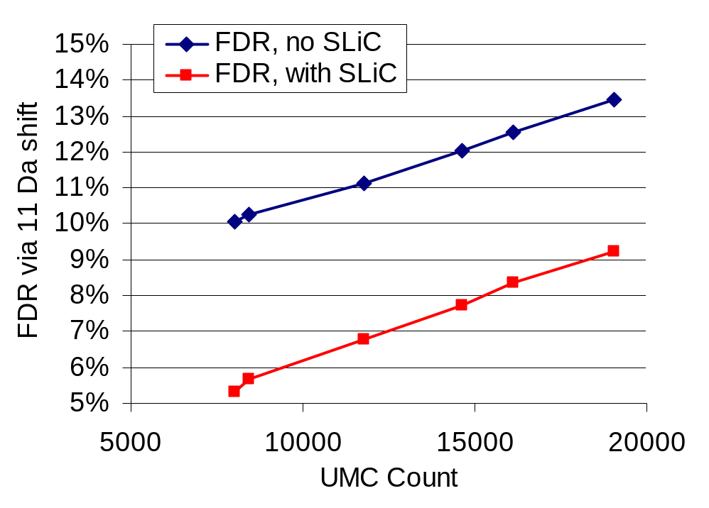
QC_Shew on LTQ_Orb_3
S/N | Peak BR | Pep. BR | Job Length | UMC Count | MT Count ID'd, no SLiC | MT Count ID'd, SLiC Filtered | FDR via 11 Da shift (No SLiC) | FDR via 11 Da shift (With SLiC)
2 | 3 | 5 | 6.5 | 8,012 | 6,674 | 6,046 | 10% | 5%
2 | 3 | 2 | 7.5 | 8,423 | 6,969 | 6,316 | 10% | 6%
2 | 2 | 2 | 11.0 | 11,781 | 8,825 | 8,065 | 11% | 7%
2 | 1.5 | 1 | 15.5 | 14,616 | 10,057 | 9,222 | 12% | 8%
2 | 1.3 | 1 | 18.4 | 16,099 | 10,620 | 9,759 | 13% | 8%
2 | 1 | 1 | 24.4 | 19,045 | 11,528 | 10,597 | 13% | 9%
1.5 | 1.5 | 1 | 12.8 | 12,870 | 9,300 | 8,505 | 11% | 7%
Notes:
QC_Shew_08_02_pt1-c_18Aug08_Sphinx_08-07-27 on Orb_3, vs. MT_Shewanella_ProdTest_P352 on Porky
See file Decon2LS_Thresholds_Orb3_QC.xls

Slide 34
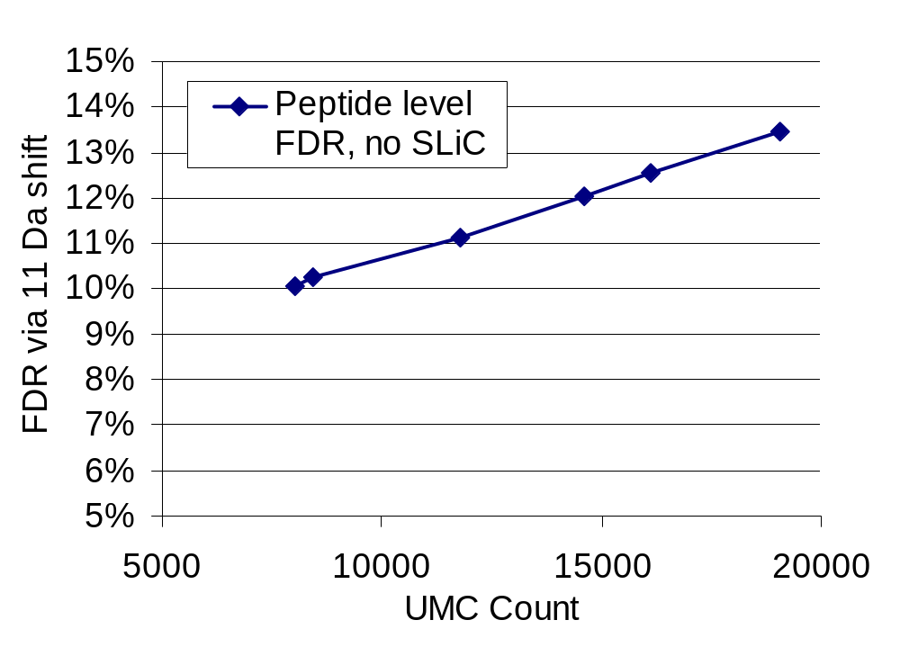
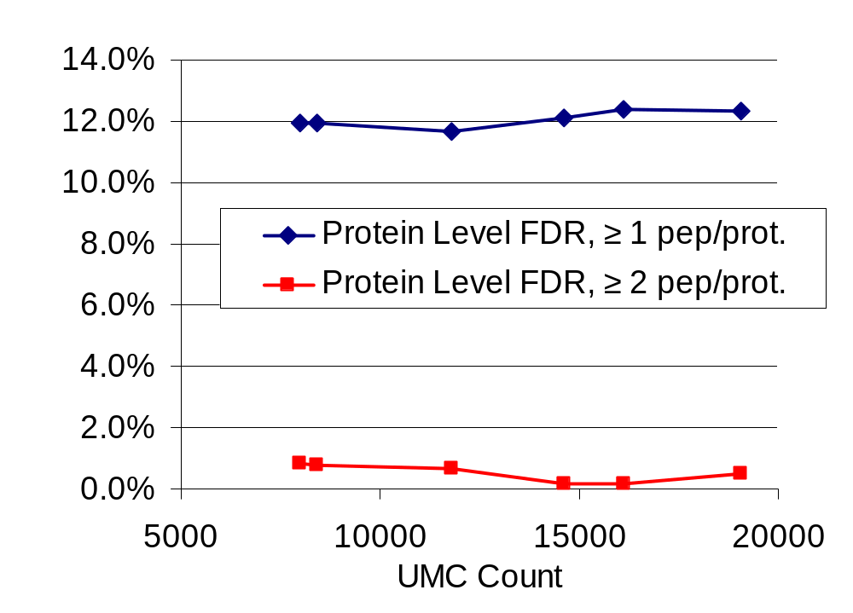
QC_Shew on LTQ_Orb_3
S/N | Peak BR | Pep. BR | UMC Count | MT Count ID'd, SLiC Filtered | FDR via 11 Da shift (With SLiC) | Protein Level FDR, ≥ 1 pep/prot. | Protein Level FDR, ≥ 2 pep/prot. | Protein Level FDR, ≥ 3 pep/protein
2 | 3 | 5 | 8,012 | 6,046 | 5% | 12.0% | 0.8% | 0.0%
2 | 3 | 2 | 8,423 | 6,316 | 6% | 12.0% | 0.8% | 0.0%
2 | 2 | 2 | 11,781 | 8,065 | 7% | 11.6% | 0.6% | 0.0%
2 | 1.5 | 1 | 14,616 | 9,222 | 8% | 12.1% | 0.2% | 0.0%
2 | 1.3 | 1 | 16,099 | 9,759 | 8% | 12.4% | 0.2% | 0.0%
2 | 1 | 1 | 19,045 | 10,597 | 9% | 12.3% | 0.5% | 0.0%
1.5 | 1.5 | 1 | 12,870 | 8,505 | 7% | 11.6% | 0.6% | 0.0%
Notes:
QC_Shew_08_02_pt1-c_18Aug08_Sphinx_08-07-27 on Orb_3, vs. MT_Shewanella_ProdTest_P352 on Porky
See file Decon2LS_Thresholds_Orb3_QC.xls

Slide 35
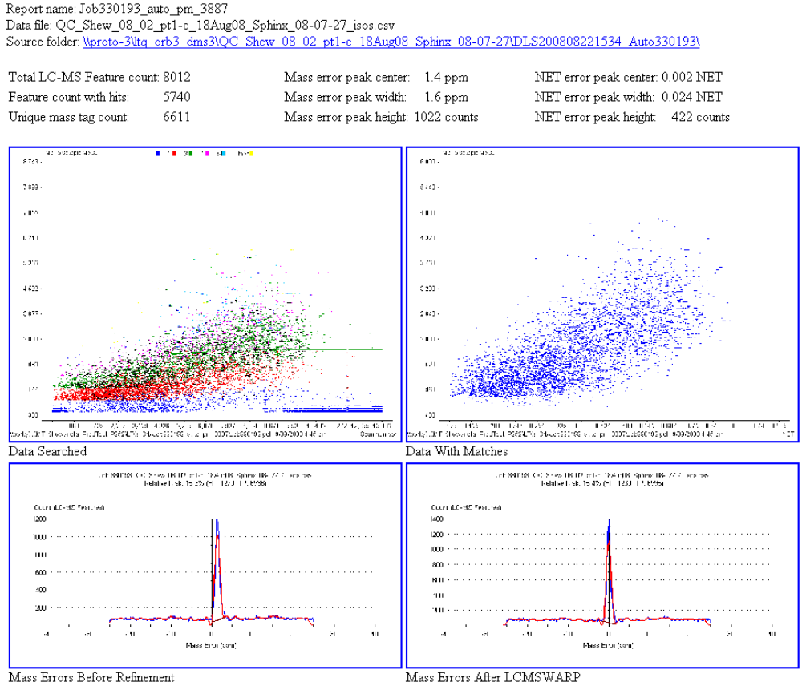
QC_Shew on LTQ_Orb_3
S/N=2
Peak BR=3
Pep BR=5
Notes:
QC_Shew_08_02_pt1-c_18Aug08_Sphinx_08-07-27 on Orb_3, vs. MT_Shewanella_ProdTest_P352 on Porky
See file Decon2LS_Thresholds_Orb3_QC.xls

Slide 36
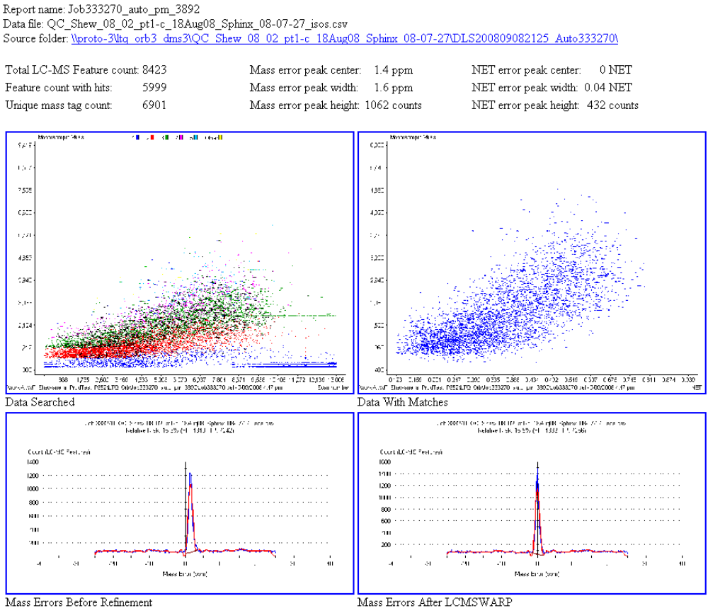
QC_Shew on LTQ_Orb_3
S/N=2
Peak BR=3
Pep BR=2
Notes:
QC_Shew_08_02_pt1-c_18Aug08_Sphinx_08-07-27 on Orb_3, vs. MT_Shewanella_ProdTest_P352 on Porky
See file Decon2LS_Thresholds_Orb3_QC.xls

Slide 37
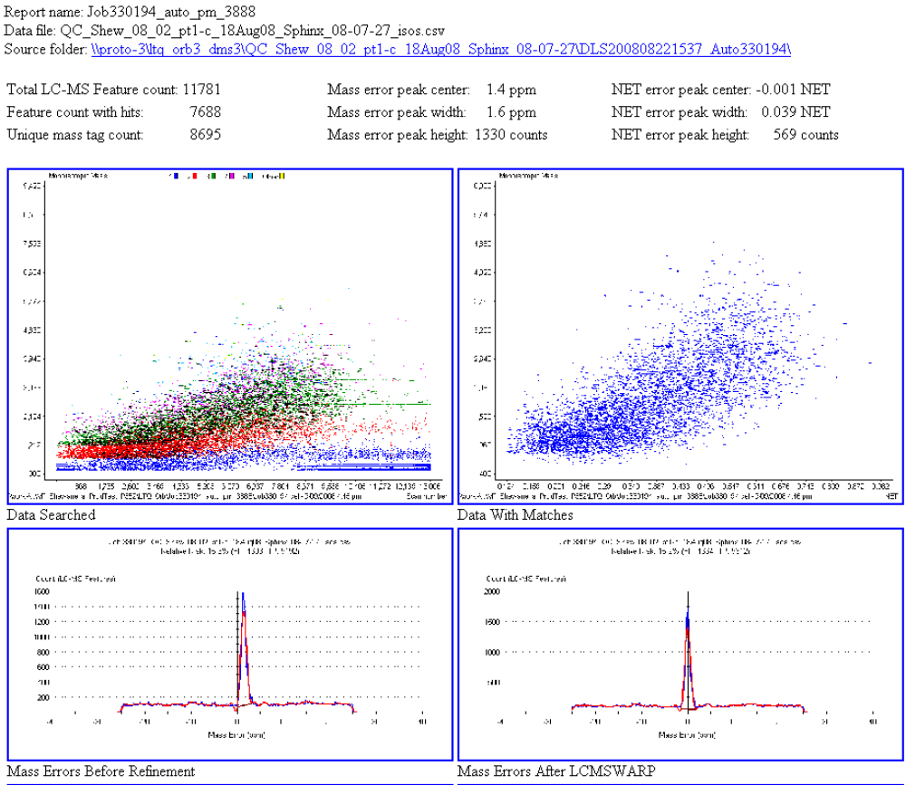
QC_Shew on LTQ_Orb_3
S/N=2
Peak BR=2
Pep BR=2
Notes:
QC_Shew_08_02_pt1-c_18Aug08_Sphinx_08-07-27 on Orb_3, vs. MT_Shewanella_ProdTest_P352 on Porky
See file Decon2LS_Thresholds_Orb3_QC.xls

Slide 38
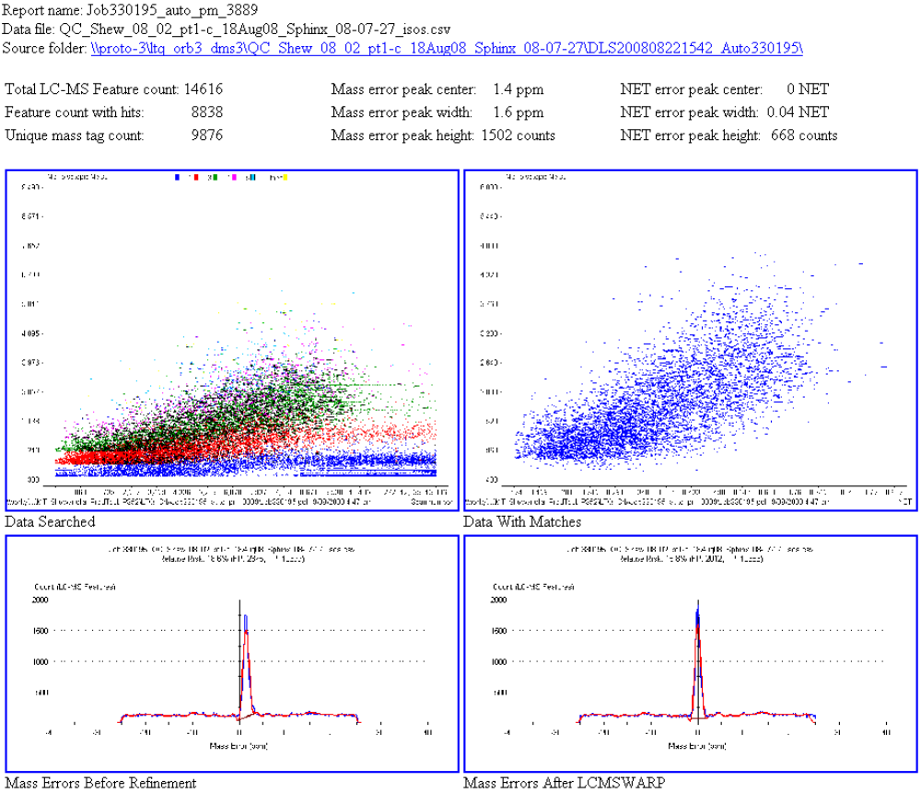
QC_Shew on LTQ_Orb_3
S/N=2
Peak BR=1.5
Pep BR=1
Notes:
QC_Shew_08_02_pt1-c_18Aug08_Sphinx_08-07-27 on Orb_3, vs. MT_Shewanella_ProdTest_P352 on Porky
See file Decon2LS_Thresholds_Orb3_QC.xls

Slide 39
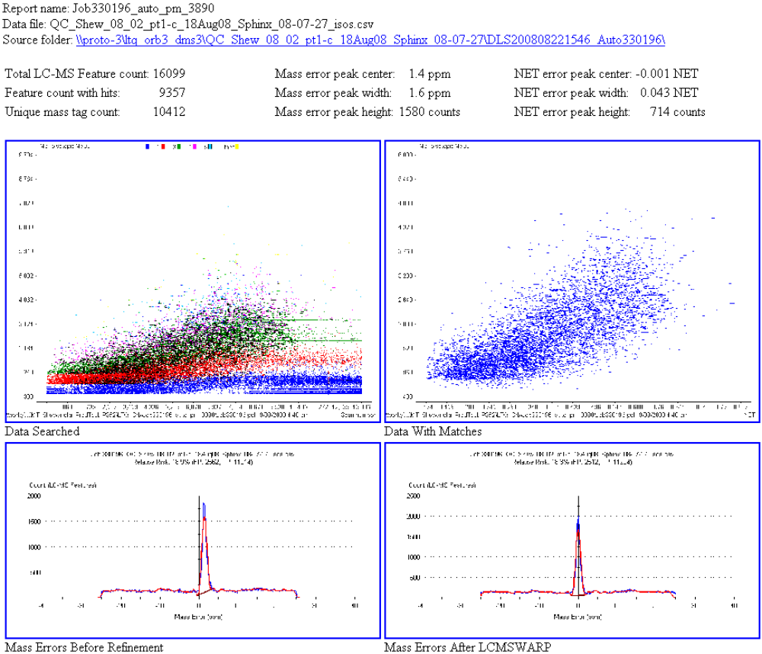
QC_Shew on LTQ_Orb_3
S/N=2
Peak BR=1.3
Pep BR=1
Notes:
QC_Shew_08_02_pt1-c_18Aug08_Sphinx_08-07-27 on Orb_3, vs. MT_Shewanella_ProdTest_P352 on Porky
See file Decon2LS_Thresholds_Orb3_QC.xls

Slide 40
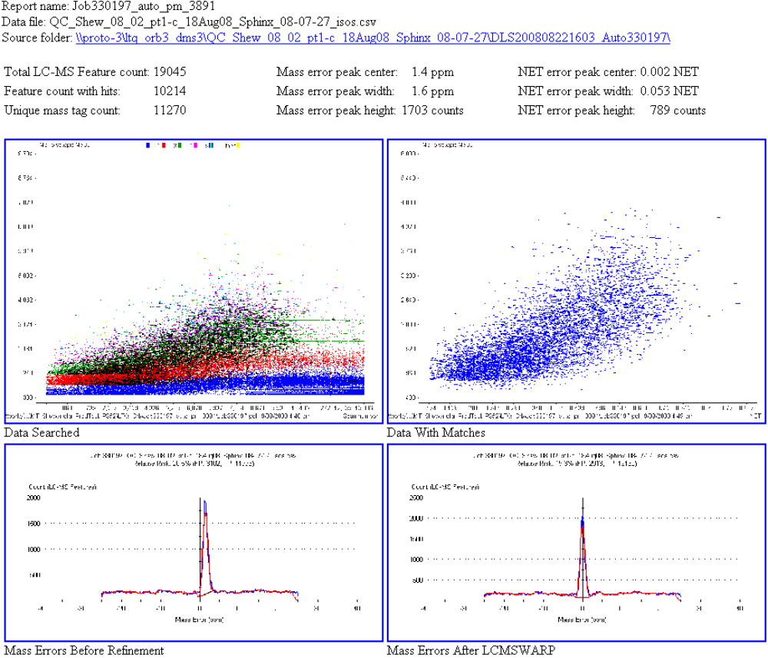
QC_Shew on LTQ_Orb_3
S/N=2
Peak BR=1
Pep BR=1
Notes:
QC_Shew_08_02_pt1-c_18Aug08_Sphinx_08-07-27 on Orb_3, vs. MT_Shewanella_ProdTest_P352 on Porky
See file Decon2LS_Thresholds_Orb3_QC.xls

Slide 41
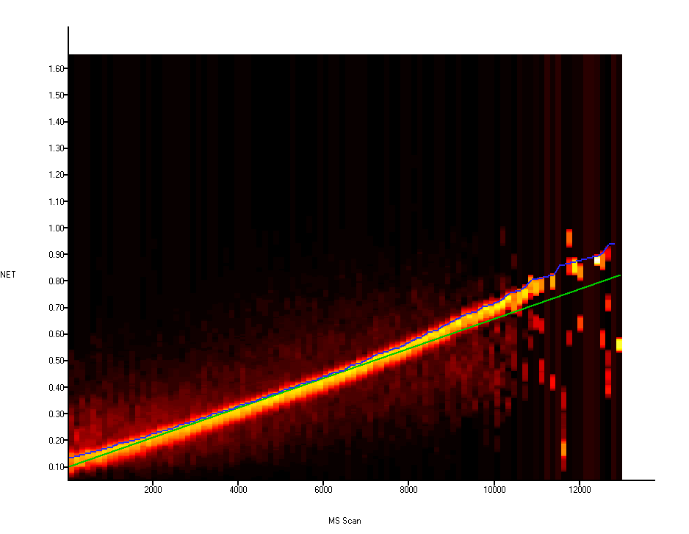
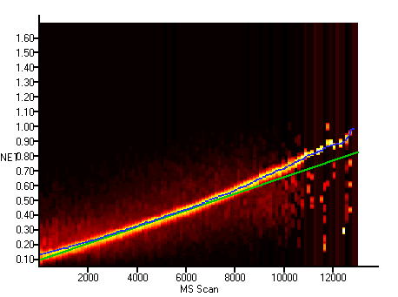
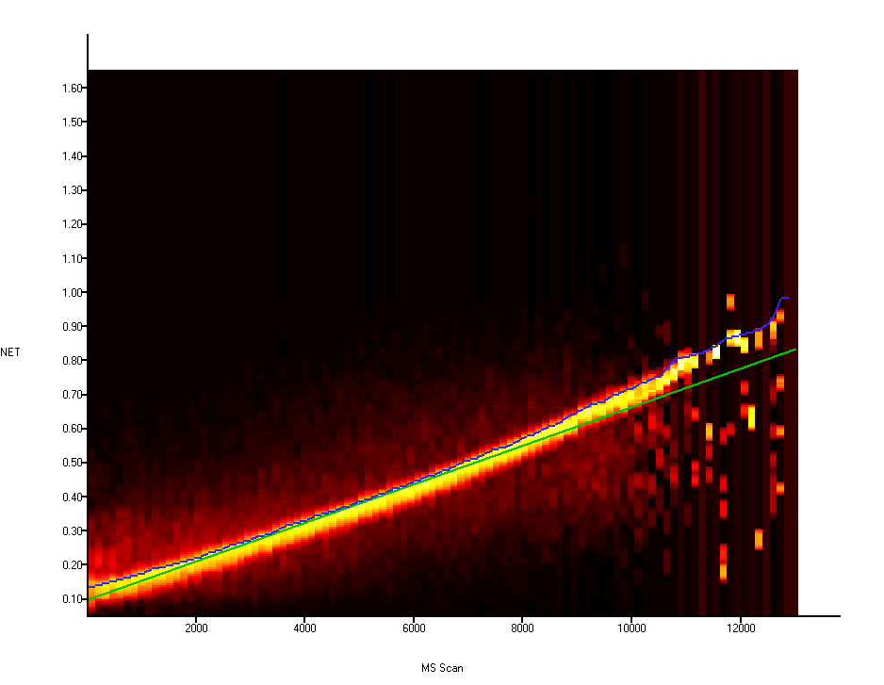
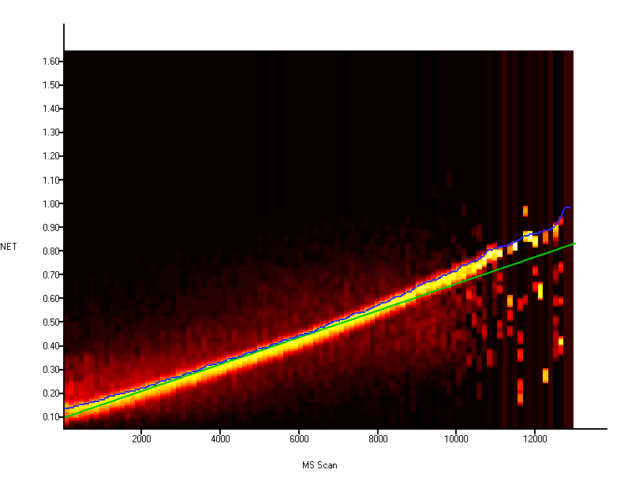
QC_Shew on LTQ_Orb_3
S/N=2
Peak BR=3
Pep BR=5
S/N=2
Peak BR=2
Pep BR=2
S/N=2
Peak BR=1.3
Pep BR=1
S/N=2
Peak BR=1
Pep BR=1
Notes:
QC_Shew_08_02_pt1-c_18Aug08_Sphinx_08-07-27 on Orb_3, vs. MT_Shewanella_ProdTest_P352 on Porky

Slide 42
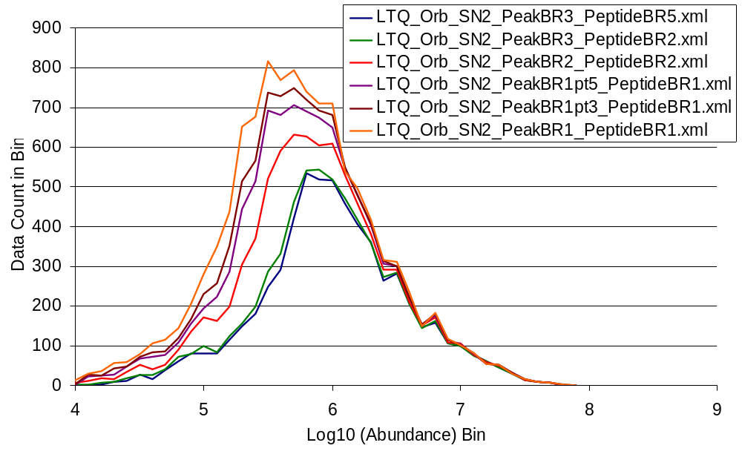
QC_Shew on LTQ_Orb_3
Examine abundance distribution for identified features
Lower Decon2LS thresholds allow more low abundance peptides to be identified
QC_Shew_08_02_pt1-c_18Aug08_Sphinx_08-07-27
Notes:
QC_Shew_08_02_pt1-c_18Aug08_Sphinx_08-07-27 on Orb_3, vs. MT_Shewanella_ProdTest_P352 on Porky
See file Decon2LS_Thresholds_Orb3_QC.xls

Slide 43
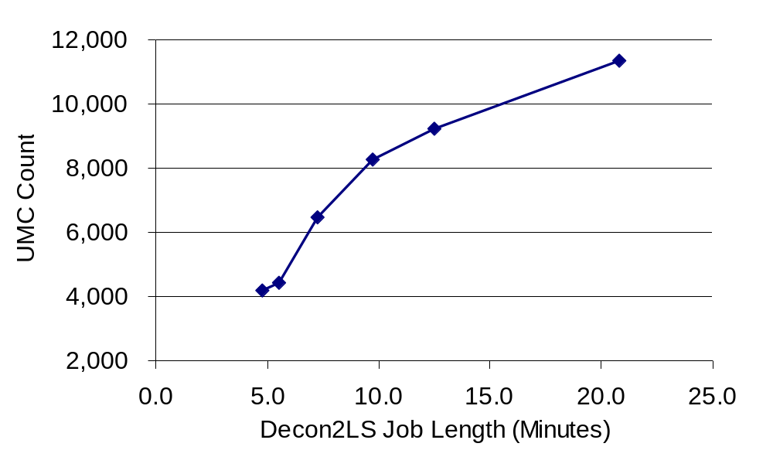
GG_MO_Trauma on LTQ_Orb_3
S/N | Peak Background Ratio | Peptide Background Ratio | Job | Task ID | Job Length (Minutes) | UMC Count
2 | 3 | 5 | 330198 | 707 | 4.8 | 4,200
2 | 3 | 2 | 333265 | 708 | 5.5 | 4,432
2 | 2 | 2 | 330199 | 709 | 7.3 | 6,467
2 | 1.5 | 1 | 330200 | 710 | 9.7 | 8,268
2 | 1.3 | 1 | 330201 | 711 | 12.5 | 9,257
2 | 1 | 1 | 330202 | 712 | 20.8 | 11,362
1.5 | 1.5 | 1 | 333269 | 713 | 9.1 | 7,082
Notes:
GG_MO_Trauma_235329_14Aug08_Sphinx_08-07-28 on Orb_3, vs. MT_Human_P342 on Pogo
See file Decon2LS_Thresholds_Orb3_GG_MO_Trauma.xls

Slide 44
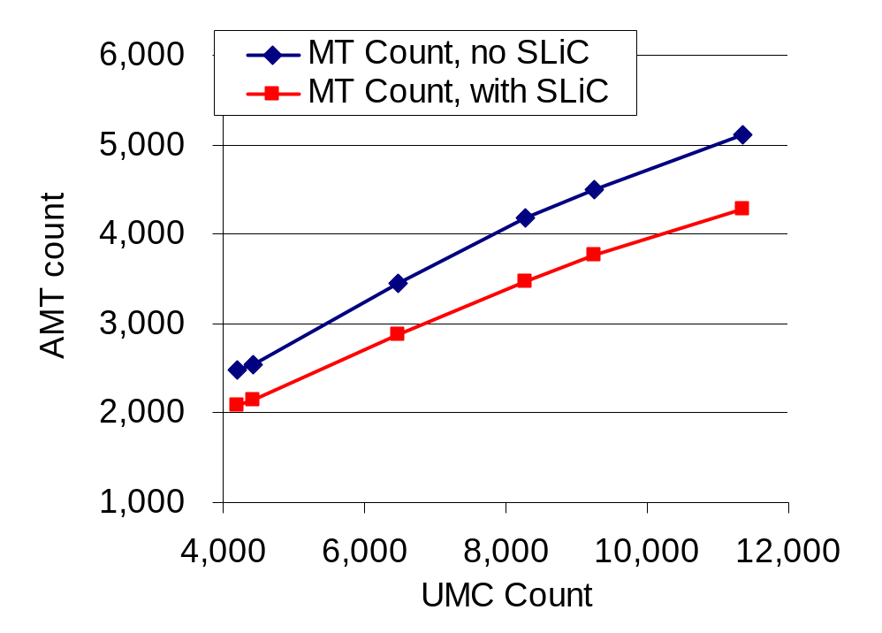

GG_MO_Trauma on LTQ_Orb_3
S/N | Peak BR | Pep. BR | Job Length | UMC Count | MT Count ID'd, no SLiC | MT Count ID'd, SLiC Filtered | Pair Count ID'd, No SLiC | Pair Count ID'd, With SLiC
2 | 3 | 5 | 4.8 | 4,200 | 2,486 | 2,085 | 539 | 527
2 | 3 | 2 | 5.5 | 4,432 | 2,547 | 2,152 | 557 | 544
2 | 2 | 2 | 7.3 | 6,467 | 3,454 | 2,886 | 745 | 732
2 | 1.5 | 1 | 9.7 | 8,268 | 4,179 | 3,476 | 876 | 858
2 | 1.3 | 1 | 12.5 | 9,257 | 4,504 | 3,767 | 935 | 912
2 | 1 | 1 | 20.8 | 11,362 | 5,101 | 4,279 | 1,048 | 1,020
1.5 | 1.5 | 1 | 9.1 | 7,082 | 3,820 | 3,147 | 792 | 776
Notes:
GG_MO_Trauma_235329_14Aug08_Sphinx_08-07-28 on Orb_3, vs. MT_Human_P342 on Pogo
See file Decon2LS_Thresholds_Orb3_GG_MO_Trauma.xls

Slide 45

GG_MO_Trauma on LTQ_Orb_3
S/N | Peak BR | Pep. BR | Job Length | UMC Count | MT Count ID'd, no SLiC | MT Count ID'd, SLiC Filtered | FDR via 11 Da shift (No SLiC) | FDR via 11 Da shift (With SLiC)
2 | 3 | 5 | 4.8 | 4,200 | 2,486 | 2,085 | 16% | 11%
2 | 3 | 2 | 5.5 | 4,432 | 2,547 | 2,152 | 15% | 11%
2 | 2 | 2 | 7.3 | 6,467 | 3,454 | 2,886 | 17% | 11%
2 | 1.5 | 1 | 9.7 | 8,268 | 4,179 | 3,476 | 18% | 12%
2 | 1.3 | 1 | 12.5 | 9,257 | 4,504 | 3,767 | 18% | 13%
2 | 1 | 1 | 20.8 | 11,362 | 5,101 | 4,279 | 19% | 15%
1.5 | 1.5 | 1 | 9.1 | 7,082 | 3,820 | 3,147 | 17% | 11%
Notes:
GG_MO_Trauma_235329_14Aug08_Sphinx_08-07-28 on Orb_3, vs. MT_Human_P342 on Pogo
See file Decon2LS_Thresholds_Orb3_GG_MO_Trauma.xls

Slide 46


GG_MO_Trauma on LTQ_Orb_3
S/N | Peak BR | Pep. BR | UMC Count | MT Count ID'd, SLiC Filtered | FDR via 11 Da shift (With SLiC) | Protein Level FDR, ≥ 1 pep/prot. | Protein Level FDR, ≥ 2 pep/prot. | Protein Level FDR, ≥ 3 pep/protein
2 | 3 | 5 | 8,012 | 6,046 | 5% | 22% | 0.0% | 0.0%
2 | 3 | 2 | 8,423 | 6,316 | 6% | 21% | 0.5% | 0.0%
2 | 2 | 2 | 11,781 | 8,065 | 7% | 19% | 0.3% | 0.0%
2 | 1.5 | 1 | 14,616 | 9,222 | 8% | 19% | 0.3% | 0.0%
2 | 1.3 | 1 | 16,099 | 9,759 | 8% | 19% | 1.4% | 0.0%
2 | 1 | 1 | 19,045 | 10,597 | 9% | 20% | 1.1% | 0.0%
1.5 | 1.5 | 1 | 12,870 | 8,505 | 7% | 19% | 0.4% | 0.0%
Notes:
GG_MO_Trauma_235329_14Aug08_Sphinx_08-07-28 on Orb_3, vs. MT_Human_P342 on Pogo
See file Decon2LS_Thresholds_Orb3_GG_MO_Trauma.xls

Slide 47

GG_MO_Trauma on LTQ_Orb_3
S/N=2
Peak BR=3
Pep BR=5
Notes:
GG_MO_Trauma_235329_14Aug08_Sphinx_08-07-28 on Orb_3, vs. MT_Human_P342 on Pogo
See file Decon2LS_Thresholds_Orb3_GG_MO_Trauma.xls

Slide 48

GG_MO_Trauma on LTQ_Orb_3
S/N=2
Peak BR=3
Pep BR=2
Notes:
GG_MO_Trauma_235329_14Aug08_Sphinx_08-07-28 on Orb_3, vs. MT_Human_P342 on Pogo
See file Decon2LS_Thresholds_Orb3_GG_MO_Trauma.xls

Slide 49

GG_MO_Trauma on LTQ_Orb_3
S/N=2
Peak BR=2
Pep BR=2
Notes:
GG_MO_Trauma_235329_14Aug08_Sphinx_08-07-28 on Orb_3, vs. MT_Human_P342 on Pogo
See file Decon2LS_Thresholds_Orb3_GG_MO_Trauma.xls

Slide 50

GG_MO_Trauma on LTQ_Orb_3
S/N=2
Peak BR=1.5
Pep BR=1
Notes:
GG_MO_Trauma_235329_14Aug08_Sphinx_08-07-28 on Orb_3, vs. MT_Human_P342 on Pogo
See file Decon2LS_Thresholds_Orb3_GG_MO_Trauma.xls

Slide 51

GG_MO_Trauma on LTQ_Orb_3
S/N=2
Peak BR=1.3
Pep BR=1
Notes:
GG_MO_Trauma_235329_14Aug08_Sphinx_08-07-28 on Orb_3, vs. MT_Human_P342 on Pogo
See file Decon2LS_Thresholds_Orb3_GG_MO_Trauma.xls

Slide 52

GG_MO_Trauma on LTQ_Orb_3
S/N=2
Peak BR=1
Pep BR=1
Notes:
GG_MO_Trauma_235329_14Aug08_Sphinx_08-07-28 on Orb_3, vs. MT_Human_P342 on Pogo
See file Decon2LS_Thresholds_Orb3_GG_MO_Trauma.xls

Slide 53




GG_MO_Trauma on LTQ_Orb_3
S/N=2
Peak BR=3
Pep BR=5
S/N=2
Peak BR=2
Pep BR=2
S/N=2
Peak BR=1.3
Pep BR=1
S/N=2
Peak BR=1
Pep BR=1
Notes:
GG_MO_Trauma_235329_14Aug08_Sphinx_08-07-28 on Orb_3, vs. MT_Human_P342 on Pogo
\\pogo\mtd_Peak_Matching\results\MT_Human_P342\LTQ_Orb\Job330198_auto_pm_707\Job330198_NETandMassAlignmentSurface.png
\\pogo\mtd_Peak_Matching\results\MT_Human_P342\LTQ_Orb\Job330201_auto_pm_711\Job330201_NETandMassAlignmentSurface.png

Slide 54

GG_MO_Trauma on LTQ_Orb_3
Examine abundance distribution for identified features
  All identified peptides
Lower Decon2LS thresholds allow more low abundance peptides to be identified
GG_MO_Trauma_235329_14Aug08_Sphinx_08-07-28
Notes:
GG_MO_Trauma_235329_14Aug08_Sphinx_08-07-28 on Orb_3, vs. MT_Human_P342 on Pogo
See file Decon2LS_Thresholds_Orb3_GG_MO_Trauma.xls

Slide 55

GG_MO_Trauma on LTQ_Orb_3
Examine abundance distribution for identified features
  Only peptides identified from paired LC-MS Features (UMCs)
Still see more low abundance peptides, but curves are not skewed toward lower abundance
GG_MO_Trauma_235329_14Aug08_Sphinx_08-07-28
Notes:
GG_MO_Trauma_235329_14Aug08_Sphinx_08-07-28 on Orb_3, vs. MT_Human_P342 on Pogo
See file Decon2LS_Thresholds_Orb3_GG_MO_Trauma.xls

Slide 56
Comparison Between Instruments
Statistics for recent, typical QC_Shew datasets on several instruments
Instrument | Date | S/N | Peak BR | Pep. BR | Job | Task ID | Job Length (Minutes) | Mass Tol. (ppm) | NET Tol.
11T | 7/29/2008 | 2 | 3 | 5 | 323886 | 3907 | 158 | 2.7 | 0.022
9T | 2/27/2008 | 2 | 3 | 5 | 286207 | 3906 | 192 | 5.0 | 0.022
LTQ_FT | 4/19/2008 | 2 | 3 | 5 | 333644 | 3902 | 9 | 2.6 | 0.022
LTQ_FT | 4/19/2008 | 2 | 1 | 1 | 333647 | 3905 | 31 | 3.1 | 0.023
Orb_2 | 8/20/2008 | 2 | 3 | 5 | 329814 | 3745 | 21 | 1.9 | 0.024
Orb_2 | 8/20/2008 | 2 | 1 | 1 | 329952 | 3748 | 119 | 2.1 | 0.024
Orb_3 | 8/19/2008 | 2 | 3 | 5 | 330193 | 3887 | 6 | 1.5 | 0.025
Orb_3 | 8/19/2008 | 2 | 1 | 1 | 330197 | 3891 | 24 | 1.8 | 0.025
Note: tolerances are auto-determined by VIPER using the mass error and NET error histograms

Slide 57
Comparison Between Instruments
Statistics for recent, typical QC_Shew datasets on several instruments
Instrument | S/N | Peak BR | Pep. BR | Job Length (Min.) | Mass Tol. (ppm) | MT Count ID'd, no SLiC | MT Count ID'd, SLiC Filtered | FDR via 11 Da shift (No SLiC) | FDR via 11 Da shift (With SLiC)
11T | 2 | 3 | 5 | 158 | 2.7 | 13,082 | 11,918 | 18% | 12%
9T | 2 | 3 | 5 | 192 | 5.0 | 17,192 | 15,124 | 31% | 22%
LTQ_FT | 2 | 3 | 5 | 9 | 2.6 | 6,758 | 6,055 | 12% | 6%
LTQ_FT | 2 | 1 | 1 | 31 | 3.1 | 12,073 | 10,836 | 17% | 11%
Orb_2 | 2 | 3 | 5 | 21 | 1.9 | 13,779 | 12,725 | 13% | 7%
Orb_2 | 2 | 1 | 1 | 119 | 2.1 | 18,260 | 16,910 | 18% | 13%
Orb_3 | 2 | 3 | 5 | 6 | 1.5 | 6,674 | 6,046 | 10% | 5%
Orb_3 | 2 | 1 | 1 | 24 | 1.8 | 11,528 | 10,597 | 13% | 9%

Slide 58

Comparison Between Instruments
Statistics for recent, typical QC_Shew datasets on several instruments
11T
9T
LTQ_FT
LTQ_Orb_2
LTQ_Orb_3

Slide 59

Comparison Between Instruments
Statistics for recent, typical QC_Shew datasets on several instruments
11T
9T
LTQ_FT
LTQ_Orb_2
LTQ_Orb_3

Slide 60


LC-MS Feature Count Trends
Examine average number of LC-MS Features (UMCs), by week, by instrument, for QC_Shew datasets
  This is not identified features, just raw number of LC-MS features

Slide 61


QC_Shew on 11T in July 2008

Slide 62


QC_Shew on 9T in February 2008

Slide 63


QC_Shew on LTQ_FT in April 2008

Slide 64


QC_Shew on Orb_2 in August 2008

Slide 65

QC_Shew on Orb_3 in August 2008

Slide 66
Conclusions
Consider lowering the Decon2LS thresholds used for processing LTQ-FT and LTQ-Orbitrap datasets
  Keep S/N at 2
  Lower Peak Background Ratio from 3 to 1
  Lower Peptide Background Ratio from 5 to 1
  Raise Max Isotopic Fit from 0.2 to 0.3
  Raise VIPER Max Isotopic Fit from 0.15 to 0.3
Upside is more true positives, particularly low abundance peptides
Downside is more false positives, and thus higher FDR
Implementation of SMART into VIPER and MultiAlign will allow FDR to be fine-tuned
Slides are at: \\pnl\projects\MSSHARE\MonroeM

