Slide 1
DeconTools_Autoprocessor & DeconConsole.exe
This document contains information on:
DeconTools_Autoprocessor
DeconConsole.exe
The DeconTools parameter file.
Contact:
Gordon Slysz
gordon.slysz@pnl.gov

Slide 2
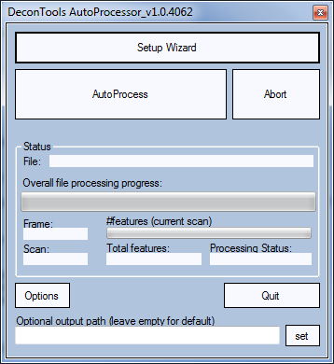
DeconTools_Autoprocessor & DeconConsole.exe
DeconTools_Autoprocessor:
User interface
Supports batch processing of files
DeconConsole.exe
Console-based automated processing
Useful for insertion into multi-step, multi-application workflows

Slide 3
DeconTools_Autoprocessor
For automated MS Feature finding (deconvolution)
Click ‘Setup Wizard’

Slide 4
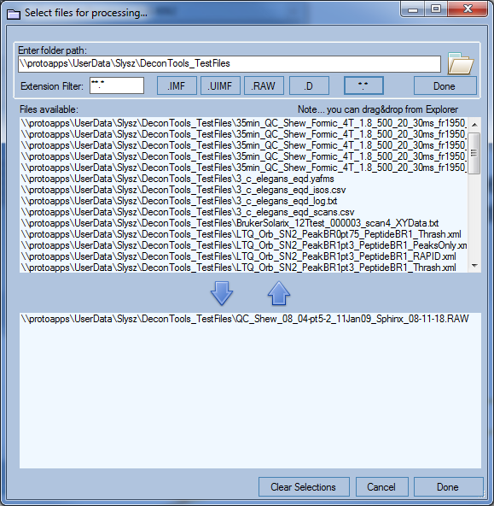
DeconTools_Autoprocessor: selecting the target MS datafile
Click ‘Setup Wizard’
Navigate to the folder that contains the target MS datafile.

Slide 5
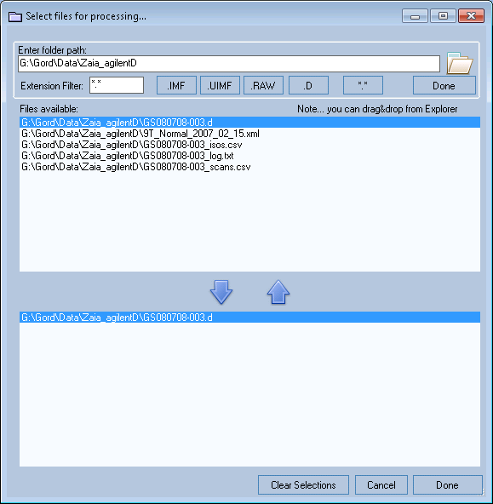
DeconTools_Autoprocessor: selecting the target MS datafile
Click ‘Setup Wizard’
Navigate to the folder that contains the target MS datafile.
Select the file/folder and click ‘Done’

Slide 6
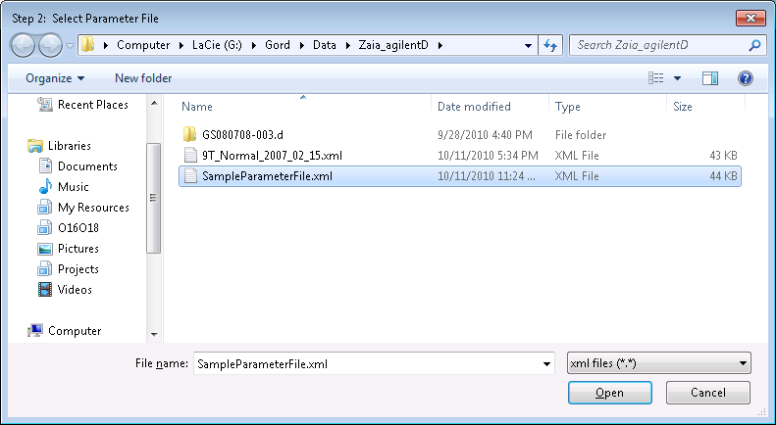
DeconTools_Autoprocessor: selecting the parameter file
Select a .XML parameter file. This parameter file is the same one used in earlier versions of DeconTools.
**Note: A sample parameter file is provided (same folder as DeconToolsAutoprocessor.exe)

Slide 7
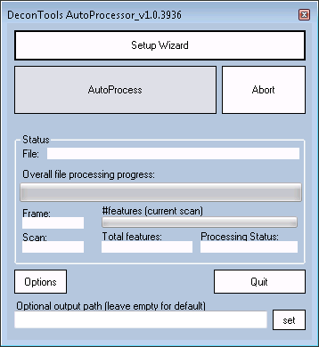
DeconTools_Autoprocessor
Select a .XML parameter file. This parameter file is the same one used in earlier versions of DeconTools.
Click ‘AutoProcess’

Slide 8
DeconTools_Autoprocessor
Things to note:
Three files are created in the same folder as the original MS datafile folder:
the _isos.txt file
the _scan.txt file
the _log.txt file

Slide 9
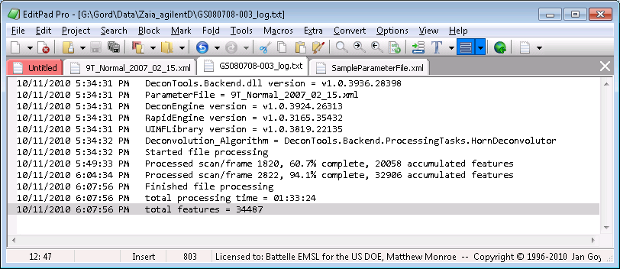
DeconTools_Autoprocessor
Log file is created in the same folder as the raw data file. This can be opened unobtrusively. The log file is updated every 15 minutes, so this is another way of monitoring progress.

Slide 10

DeconConsole.exe
DeconConsole.exe is console-based means of automating MS_feature extraction.
requires two arguments:
filename
DeconTools parameter file (.xml). This is the same parameter file used in previous versions of DeconTools.
Sample command, entered at a DOS prompt:
DeconConsole.exe BSA_TOF4.d SampleParameterFile_Scans10-12.xml

Slide 11
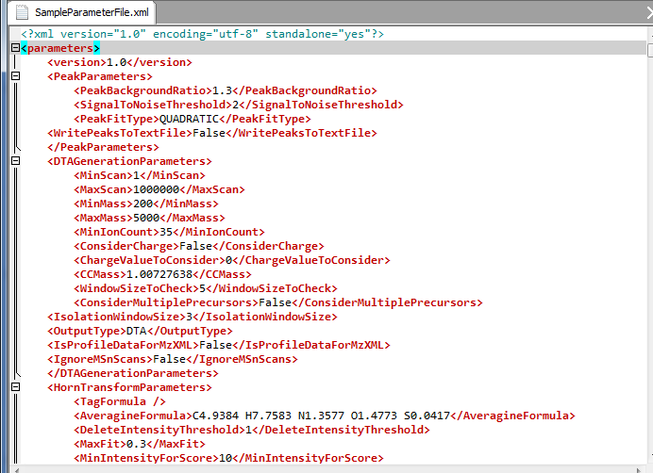
DeconTools Parameter file information
The peak parameters. The PeakBackgroundRatio is a key parameter. A low value will result in many peaks being detected. Too many peaks greatly slow down deconvolution (THRASH)
Set this to ‘TRUE’ to export all detected peaks. Look for a _peaks.txt file.
The DTAGenerationParameters are not currently used.
Deconvolution parameters. HornTransform = THRASH.

Slide 12
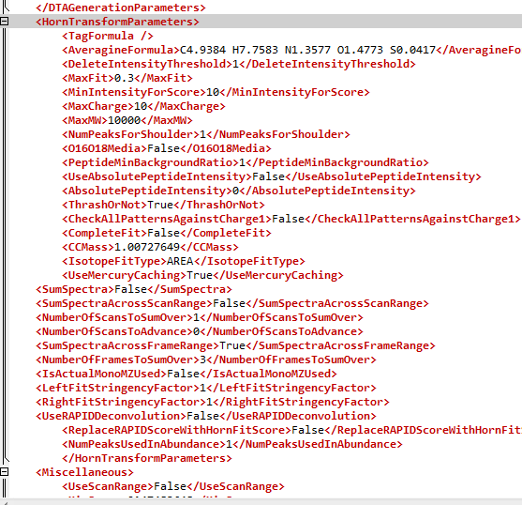
DeconTools Parameter file information
THRASH deconvolution parameters
Summing parameters. Set SumSpectraAcrossScanRange to ‘TRUE’ to sum across scans. NumberOfScansToSumOver represents the +/- number of scans to sum.

Slide 13
DeconTools Parameter file information
RAPID deconvolution. See Park et al (2008). Set this to ‘True’ to override THRASH deconvolution.
Miscellaneous section.

Slide 14
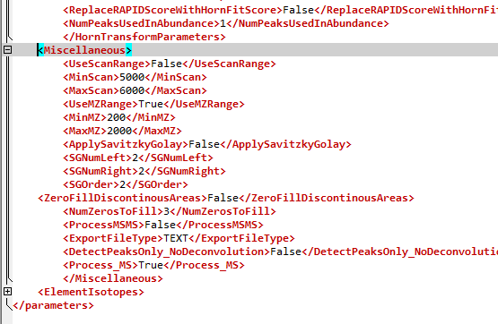
DeconTools Parameter file information
Set ‘UseScanRange’ to ‘True’ if you want to restrict processing to a certain region of the MS data file. Then set the boundaries “MinScan” and “MaxScan” .
Setting this to ‘TRUE’ means that the mass spectrum will be Savitzky-Golay smoothed.
Setting this to ‘TRUE’ will result in zero-filling. Good to use for sparse raw data (e.g. TOF-MS).
Setting this to ‘TRUE’ means that only peaks will be detected and no deconvolution will be performed. Ensure that you set the ‘WritePeaksToTextFile’ set to ‘True

