Slide 1
DAnTE
Data Analysis Tool Extension
Ashoka Polpitiya

Slide 2

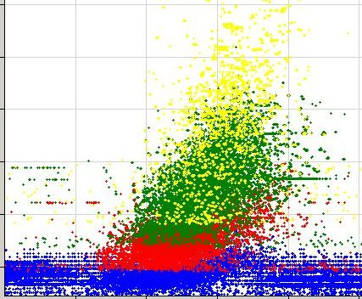
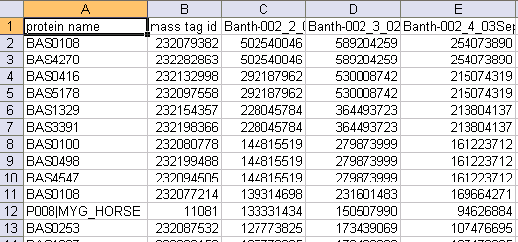
Where does DAnTE fit in?
Normalize raw abundances and rollup to proteins using RRollup, QRollup, and ZRollup
AMT Pipeline
(LC-MS)
Biological Conclusions
Multialign
DAnTE
QRollup
Other CSV
files
(microarray)

Slide 3
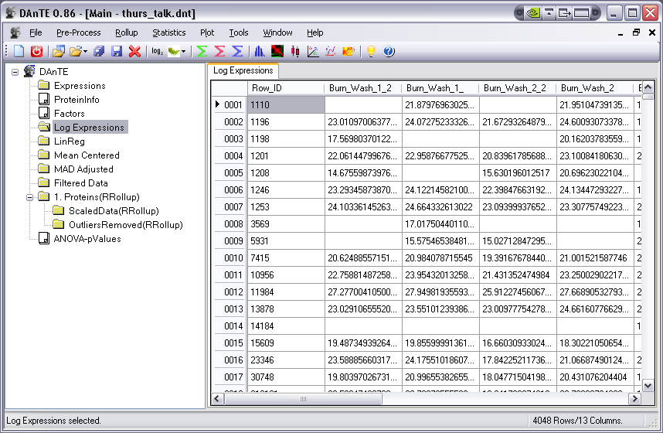
DAnTE

Slide 4
Analysis Flow in DAnTE
Statistical Tests
ANOVA
Mix Models
Data Loading
  Peptide abundance
  Peptide-Protein relations
  Factors
Rollup
  RRollup
  ZRollup
  QRollup
  Rollup Plots
Misc Analytical Methods
PCA
PLS
Heatmaps (kmeans, hierachical)
Variance Stabilization
  log2 or log10
  Bias (additive/multiplicative)
Global Normalization
  Central tendency
  Median absolute Deviation (MAD)
Impute Missing
Substitute
Average
KNNimpute
SVDimpute etc.
Investigative Plots
  Histograms
  Boxplots
  Correlation diagrams
  MA Plots
Replicate Normalization
  Linear Regression
  Loess
  Quantile
Other Features
Filter ANOVA results
Save session

Slide 5
Goals of a downstream tool in Proteomics
Identify problematic datasets
Normalize
  Remove systematic bias and variation due to technical artifacts
Rolling up to proteins
Hypothesis testing and feature discovery
  Fixed effects (treatment)
  Random effects (different LC columns, Batch)
  Unbalanced data (due to missing)
  PCA / PLS
  Clustering (Hierarchical / K-means)

Slide 6
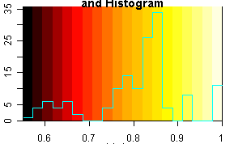
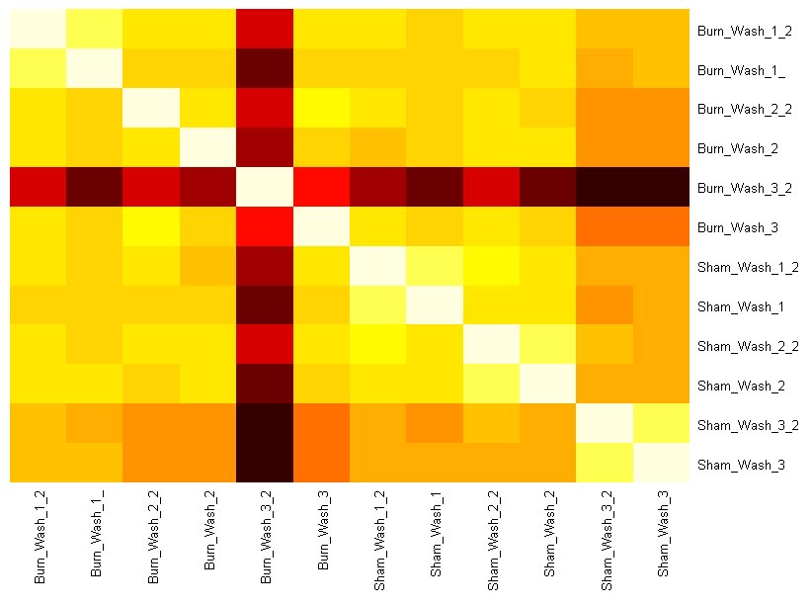
Goals of a downstream tool in Proteomics
Identify problematic datasets
  Correlation Plots
Outlier dataset
Color legend with overlaid histogram of correlation values
Dataset Names
Dataset Names

Slide 7
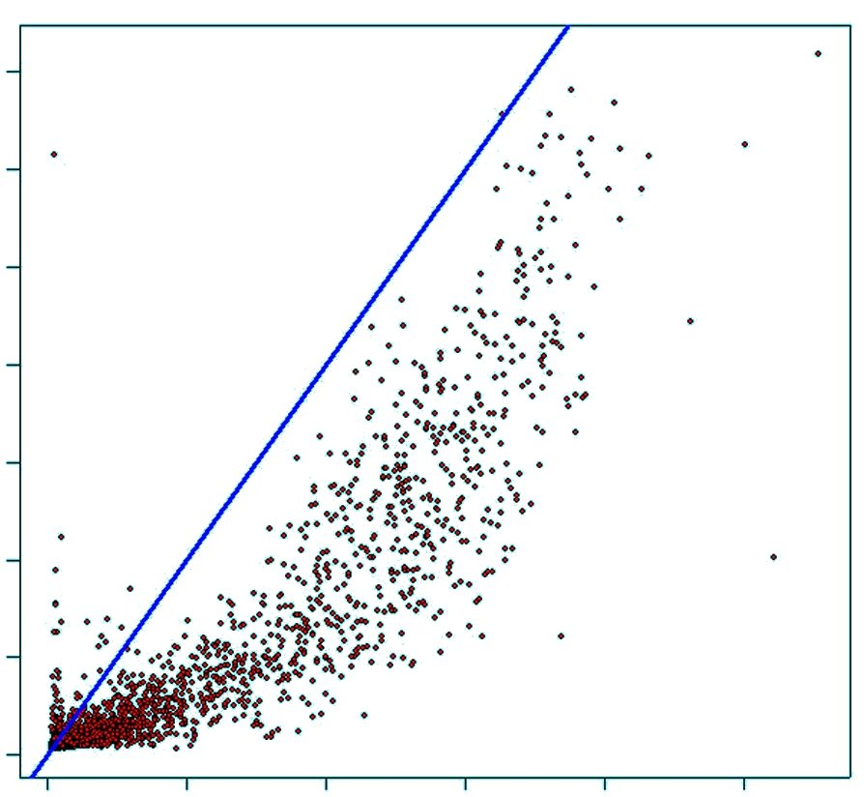
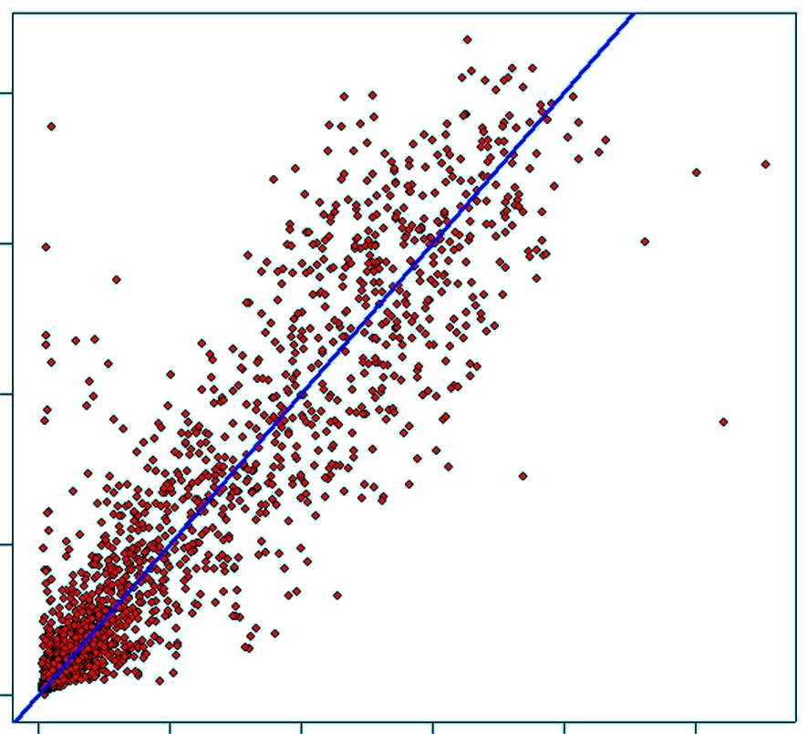
Goals of a downstream tool in Proteomics
Identify problematic datasets
Normalize
  Remove systematic bias and variation due to technical artifacts
Dataset 2
Raw
Normalized
Dataset 1
Dataset 1

Slide 8
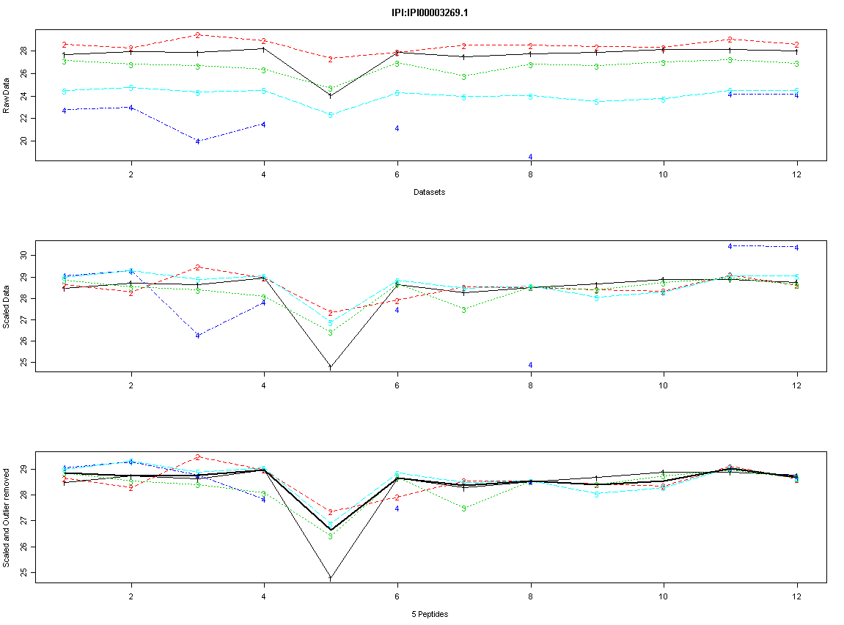
Goals of a downstream tool in Proteomics
Identify problematic datasets
Normalize
  Remove systematic bias and variation due to technical artifacts
Rolling up to proteins
Raw
Scaled
Datasets

Slide 9
Example dataset
3 Burn (human) samples and 3 Control samples.
Each sample was run in duplicates, therefore 12 datasets.
Burn
Sham
(control)

Slide 10
Example dataset
Group datasets using “Factors”
  Gender
  Sample type
  Technical replicate
  Biological Replicate
Factors for Burn data
  Condition: Burn / Sham
  Replicates: 1,1,2,2,3,3,4,4,5,5,6,6
Burn
Sham
(control)
1
1
2
2
3
3
4
4
5
5
6
6
6
6

Slide 11
Outline of the Analysis of Data
Load data
Initial diagnosis with plots
Define factors
Normalize
  Within a Factor
    Linear regression
    Loess
    Quantile
  Global
    MAD
    Mean Centering
Rollup
ANOVA

Slide 12
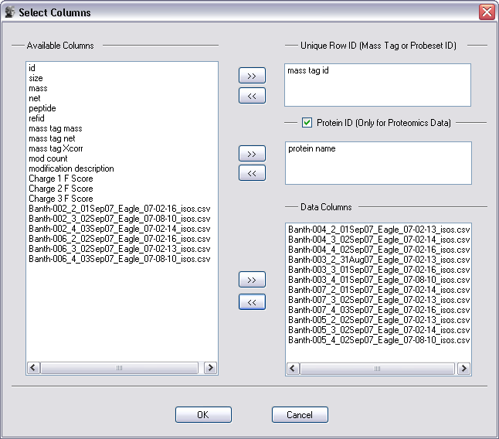
Data loading example

Slide 13
Correlations
Outlier dataset
Color legend with overlaid histogram of correlation values
Dataset Names
Dataset Names

Slide 14
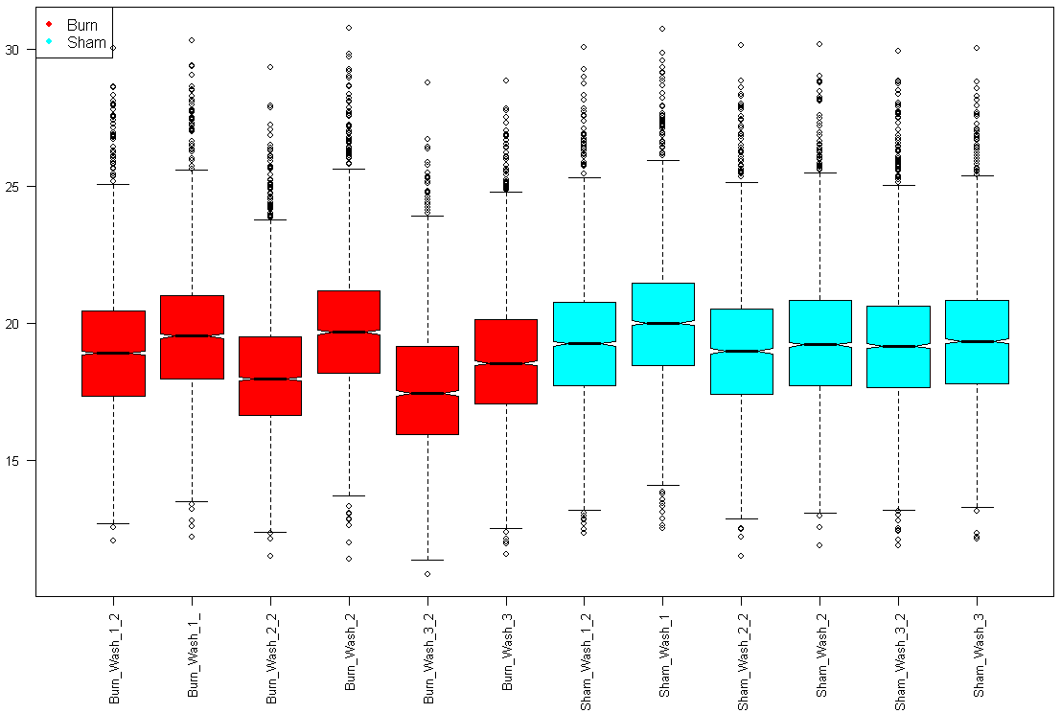
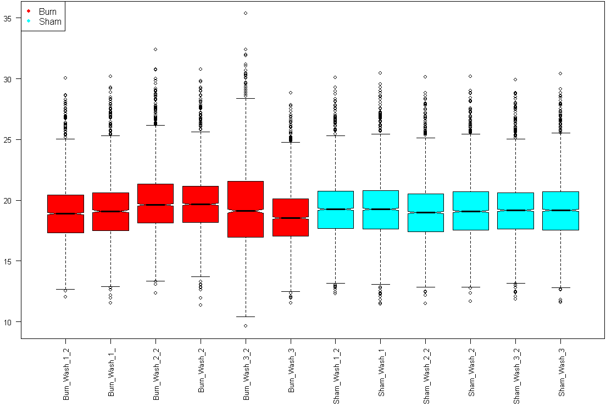
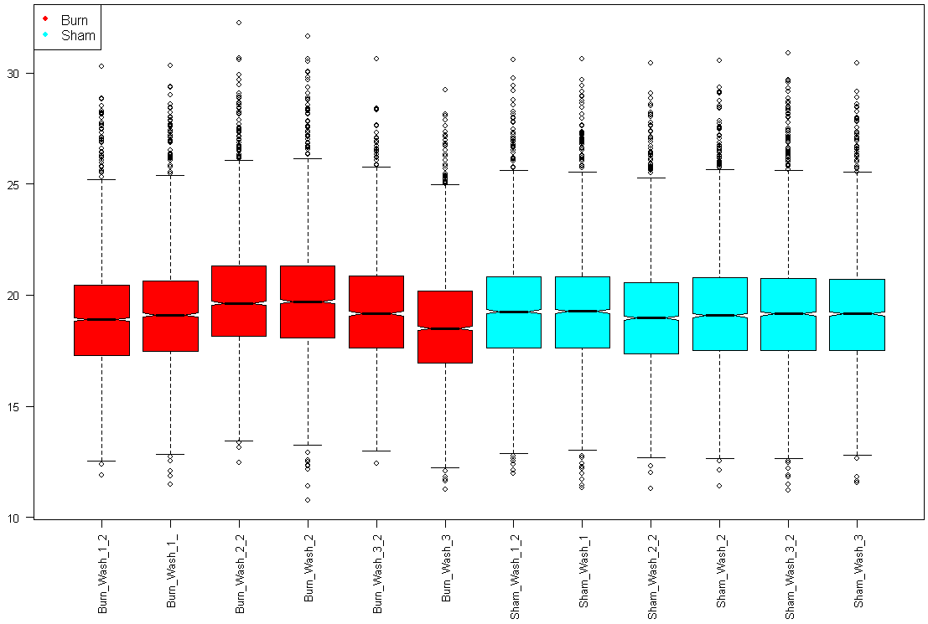
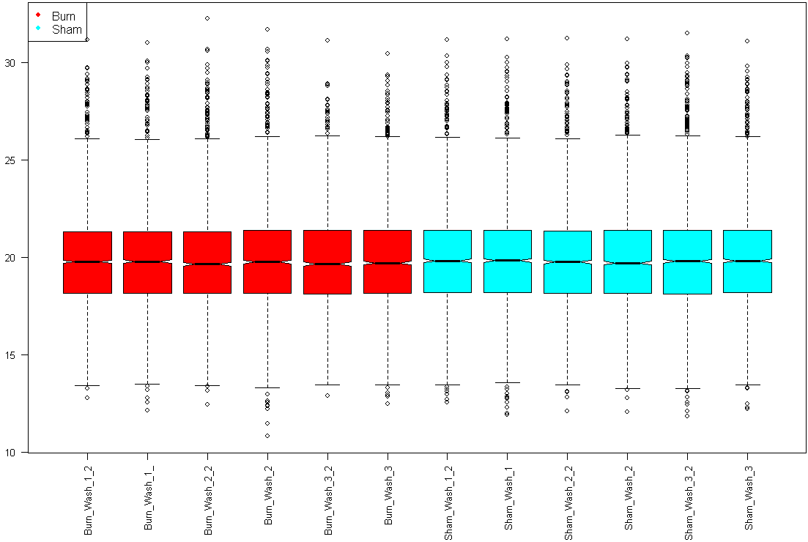
Normalizing - Box Plot Views
Abundance
Raw
Lin. Reg.
Dataset Names
MAD
Mean Center

Slide 15
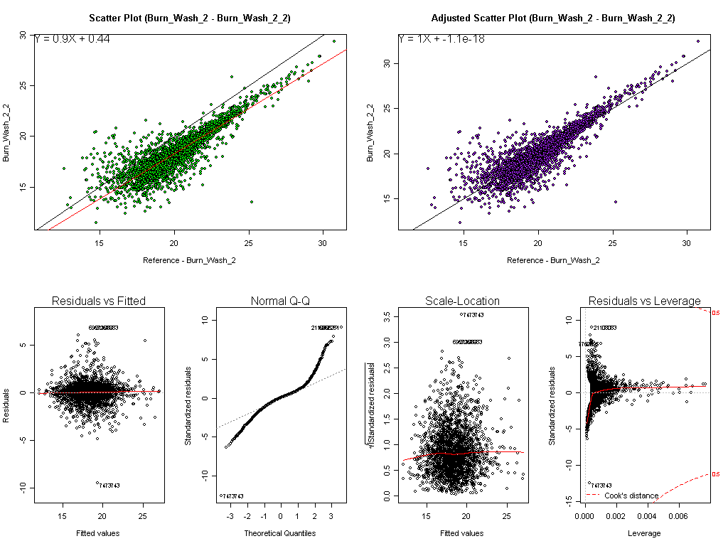
Diagnostic plots for Linear Regression
Raw
After regression
Regressing one dataset vs. second dataset

Slide 16
Rolling Up Peptides to Protein Abundance
Raw peptide abundances vs. dataset (for 1 protein)
Burn
Sham
Scaled peptide abundances for this protein’s 5 peptides
Burn
Sham
Scaled abun., outliers removed with Grubb’s test
Burn
Sham
Median protein abundance (dark black line)

Slide 17
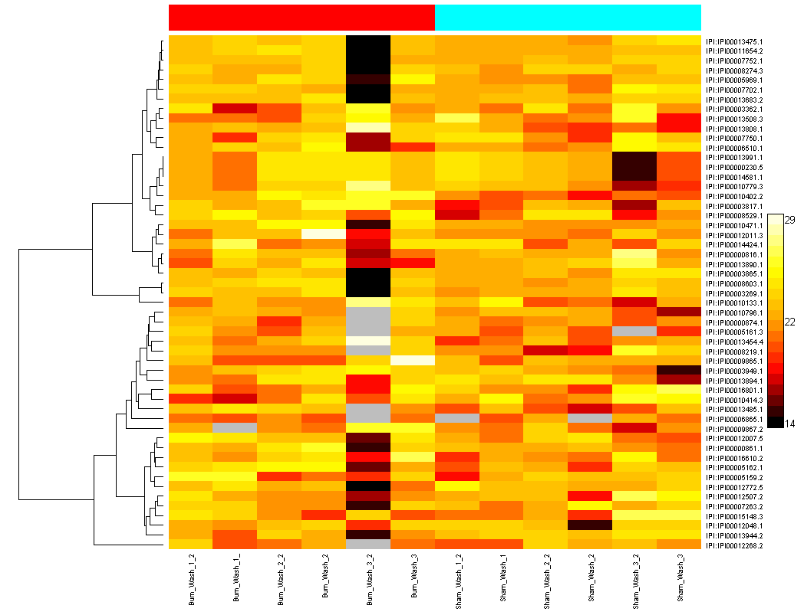
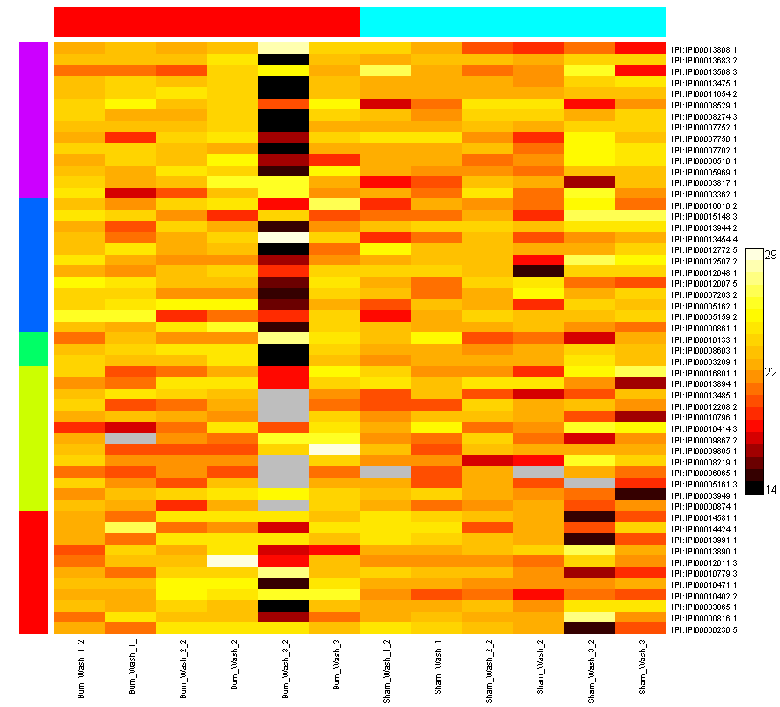
Heatmaps of Protein Abundance
Hierarchical clustering of rows
K-means clustering of rows (using 5 clusters)
Burn
Sham
Burn
Sham
Proteins
Datasets
Datasets

Slide 18
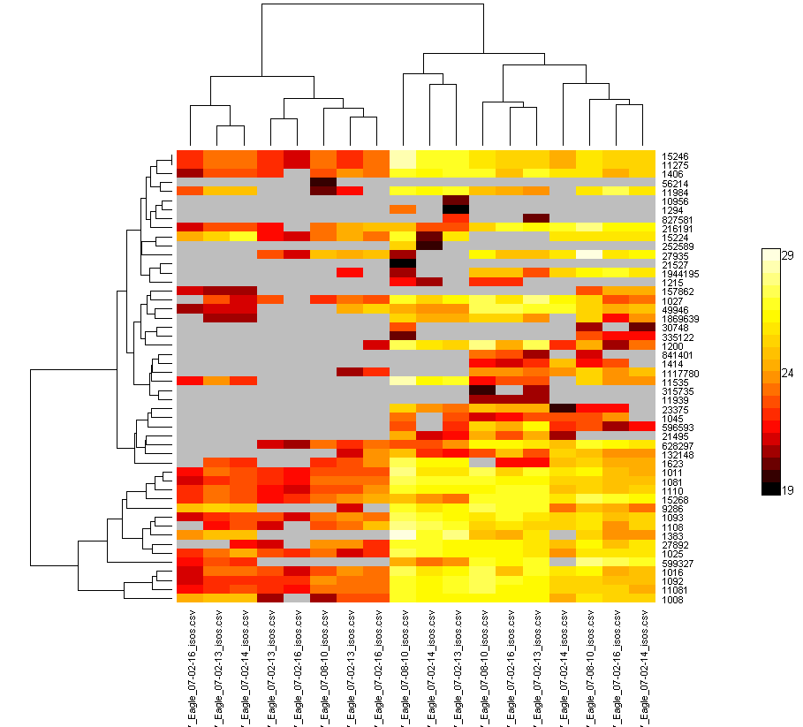
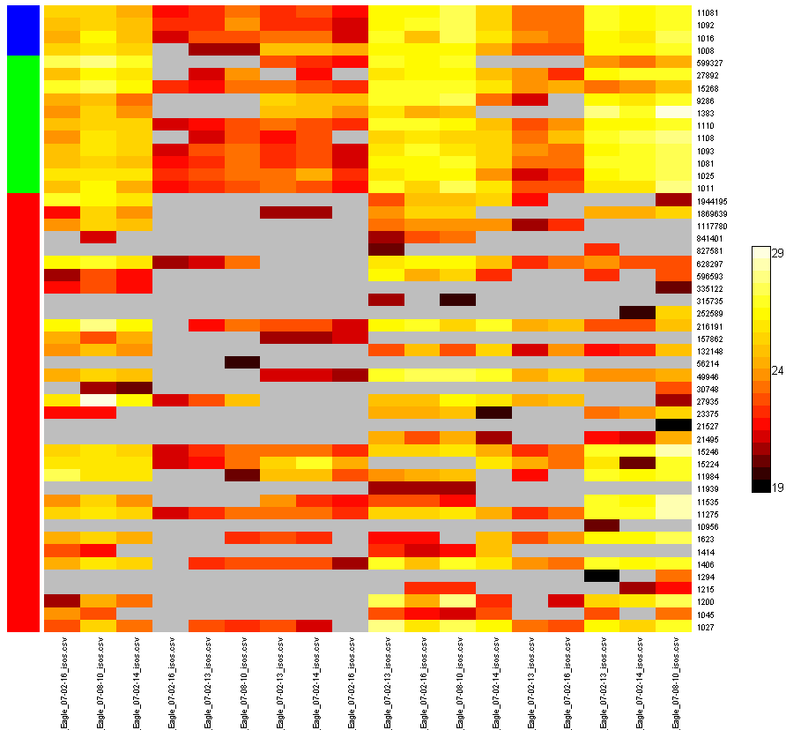
Heatmaps of Peptide Abundance
Hierarchical clustering of rows and columns
Various conditions ??

Slide 19
Complete DAnTE Feature List
Data loading with peptide-protein group information
Log transform
Factor Definitions
Normalization
  Linear Regression
  Loess
  Quantile normalization
  Median Absolute Deviation (MAD) Adj.
  Mean Centering
Missing Value Imputation
  Simple
    mean/median of the sample
    Substitute a constant
  Advance
    Row mean within a factor
    kNN method
    SVDimpute
Save tables / factors / session

Slide 20
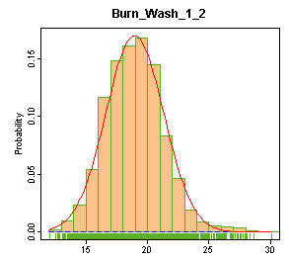
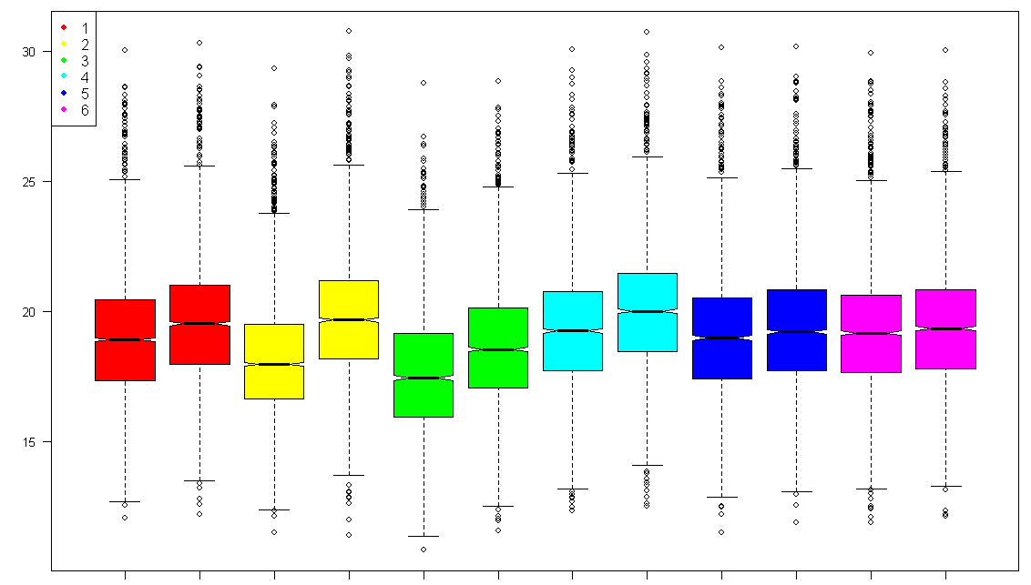
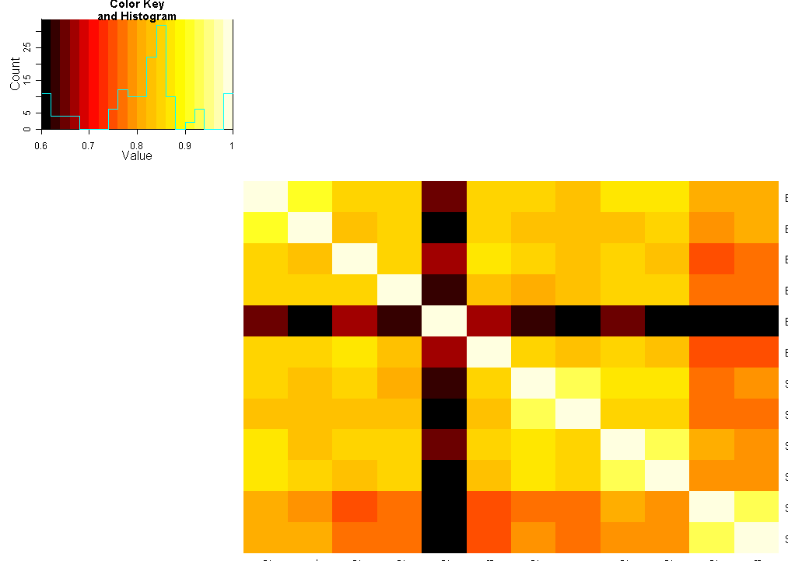
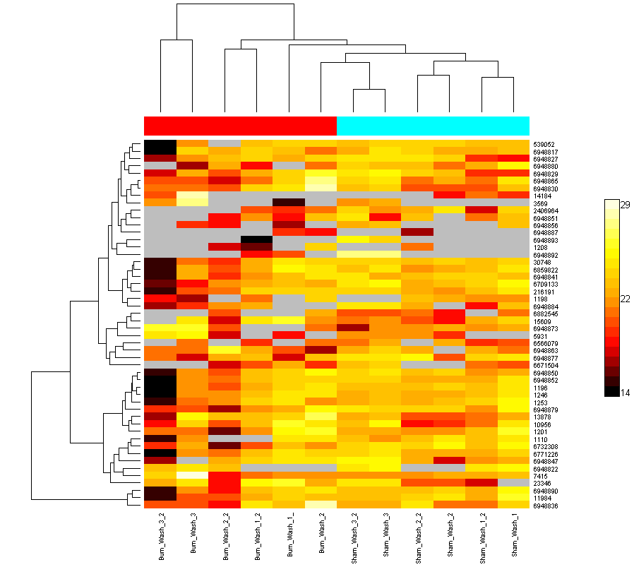
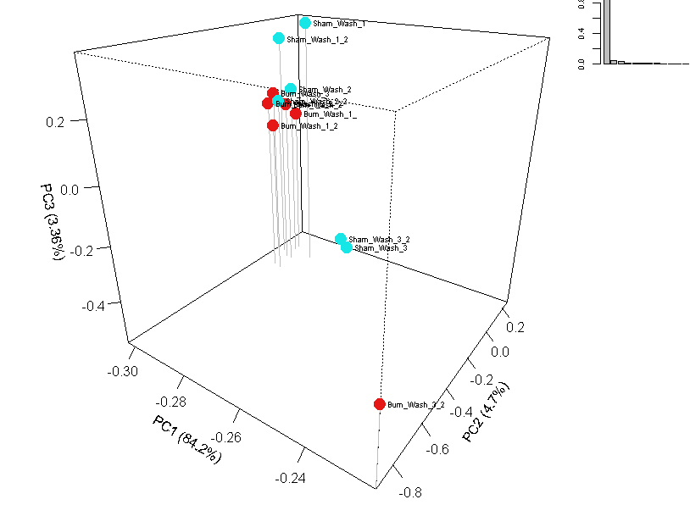
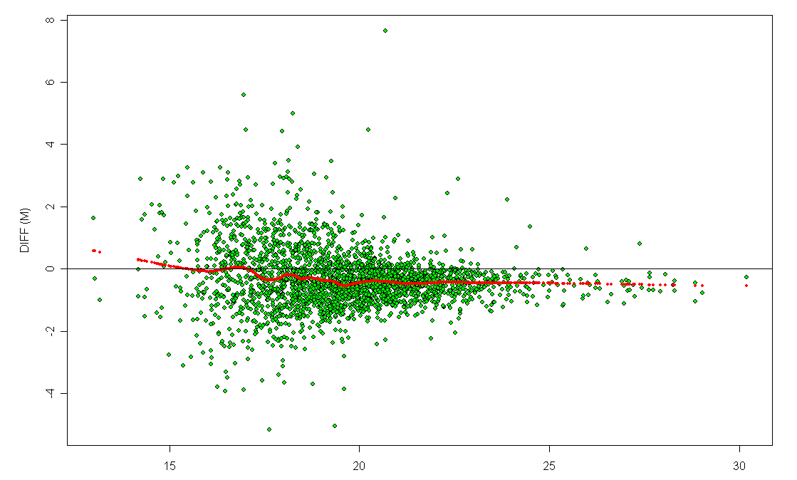
Complete DAnTE Feature List
Plots
  Histograms
  Boxplots
  Correlation plots
  MA plots
  PCA/PLS plots
  Protein rollup plots
  Heatmaps
Rolling up to Proteins
  Reference peptide based scaling (RRollup)
  Z-score averaging (ZRollup)
  QRollup
Statistics
  ANOVA
    Simple 1-way
    N-Way (provisions for unbalanced data)
    Random effects (multi level) models (REML)
  Q-values
  Filters
\\floyd\Software\DAnTE

Slide 21
To be added…
Tests for normality, Nonparametric tests, post-hoc tests
Incorporating an interactive heatmap control
SMART-AMT, peptide prophet
Protein Quality metrics
Improve rollup methods to cluster and differentiate protein isoforms
Alan Dabney’s work
Network algorithms / Cytoscape

Slide 22
Acknowledgements
Weijun Qian
Deep Jaitly
Vlad Petyuk
Josh Adkins
Tom Metz
Stephen Callister
Brian LaMarche
Ken Auberry
Matt Monroe
and the rest of the informatics group
Joel Pounds
Susan Varnum
Bobbie-Jo Webb-Robertson
Active users!
  Kim Hixson
  Josh Turse
  Charles Ansong
  Feng Yang
  Bryan Ham
  Christina Sorensen
  Angela Norbeck
  Sam Purvine
  Nathan Manes
  Jon Jacobs
Gordon Anderson
Dick Smith
… and the group.

