Slide 1
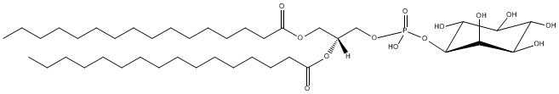
Lipid identification using LIQUID
Jennifer Kyle, PhD
Pacific Northwest National Laboratory
jennifer.kyle@pnnl.gov
Office phone: 5-3679
December 2014

Slide 2
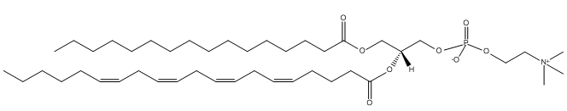
Lipid Identification
Based on diagnostic ions and other fragments
Example - PC(16:0/20:4)
m/z 184
head group
m/z 599
both
fatty acids
m/z 239
individual
fatty acids
m/z 287

Slide 3
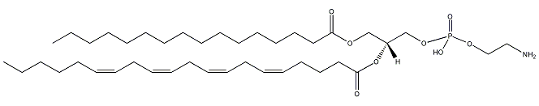
Lipid identification
Based on diagnostic ions
Based on fragments
m/z 184
phosphatidylcholine
(16:0/20:4)
phosphatidylethanolamine
(16:0/20:4)
NL 141
NL 241
phosphatidylinositol
(16:0/16:0)
Notes:
Phospholipids; differ by head group which are used as diagnostic ions to determine the lipid class. NL = neutral loss

Slide 4
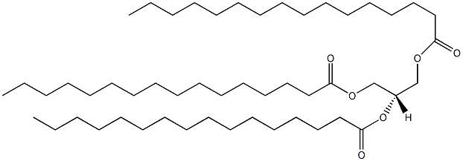
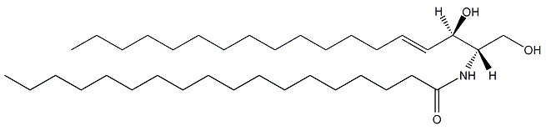
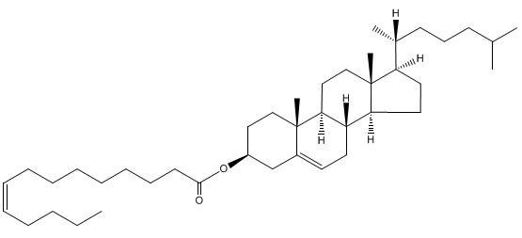
Lipid identification
NL 273
Triacylglycerol
(16:0/16:0/16:0)
NL 273
+NH₄
m/z 264
Ceramide
(d18:1/18:0)
m/z 369
Cholesterol ester
(14:1)
Notes:
Other lipid classes and their diagnostic ions

Slide 5
Positive mode
NL of choline
Diagnostic ion for PC and SM
PC(16:0/20:4)
DAG(36:4)
[M+H-RCH=C=O]
(16:0)
[M+H-RCOOH]
(20:4)
[M+H-RCH=C=O]
(20:4)
[M+H-RCOOH]
(16:0)
[RCOO+58]
(20:4)
[RCO]
(20:4)
Notes:
Example ms/ms spectra for PC(16:0/20:4). You can see the fragments that are formed and the annotations of what the fragment represents.

Slide 6
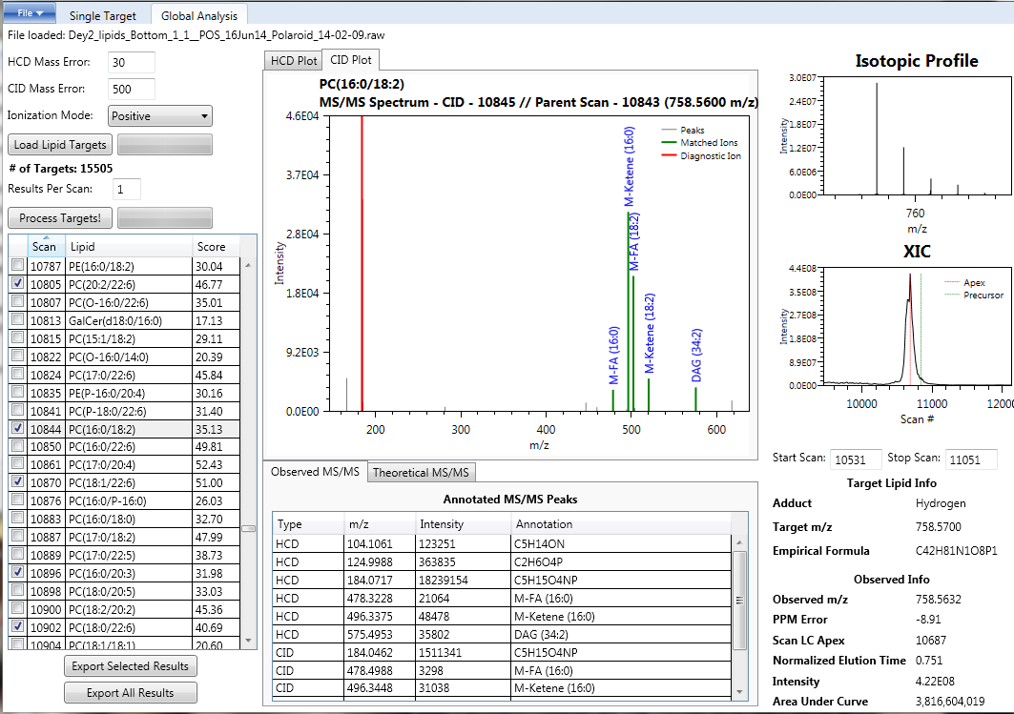
Notes:
Point out number of targets

Slide 7
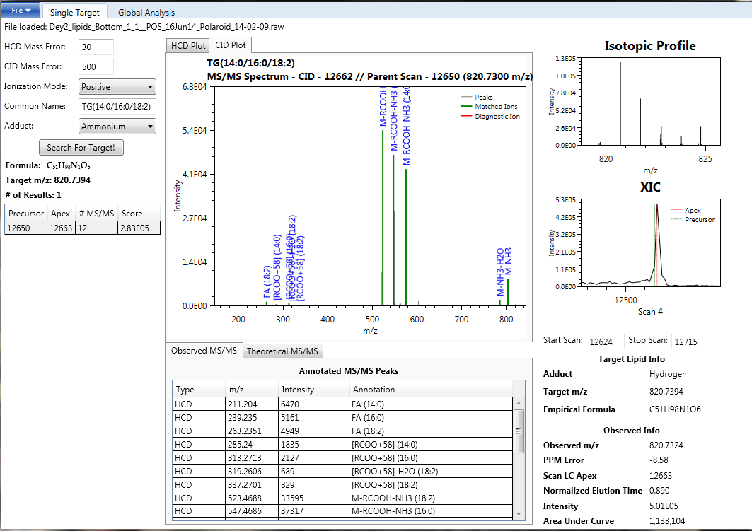

Slide 8
Your data

Slide 9
Things to consider
Is the score for the lipid subclass okay (the higher the better)
Ceramides >25
DGs ~>15
Phospholipids – varies but generally above 30 (>20 for PA)
TGs >35-40
Does your ms/ms spectra look good (has diagnostic ion and not many unmatched (gray peaks)?
Are you seeing fragments you expect to see?
Does the isotopic profile look good?
Does the XIC look good?
Is the parent scan (red line) at the peak apex? This is where your intensity values come from
Does the ppm error match the trend in your data? For your samples…
POS → -7 to -10 ppm
NEG → 8 ppm

Slide 10
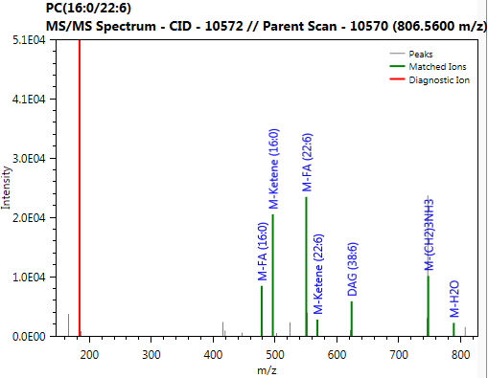
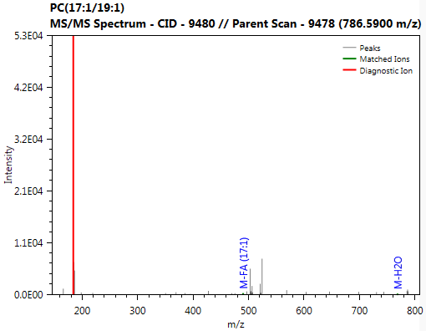
Example of good vs the bad
Good Match
Bad Match

Slide 11
Positive ionization

Slide 12
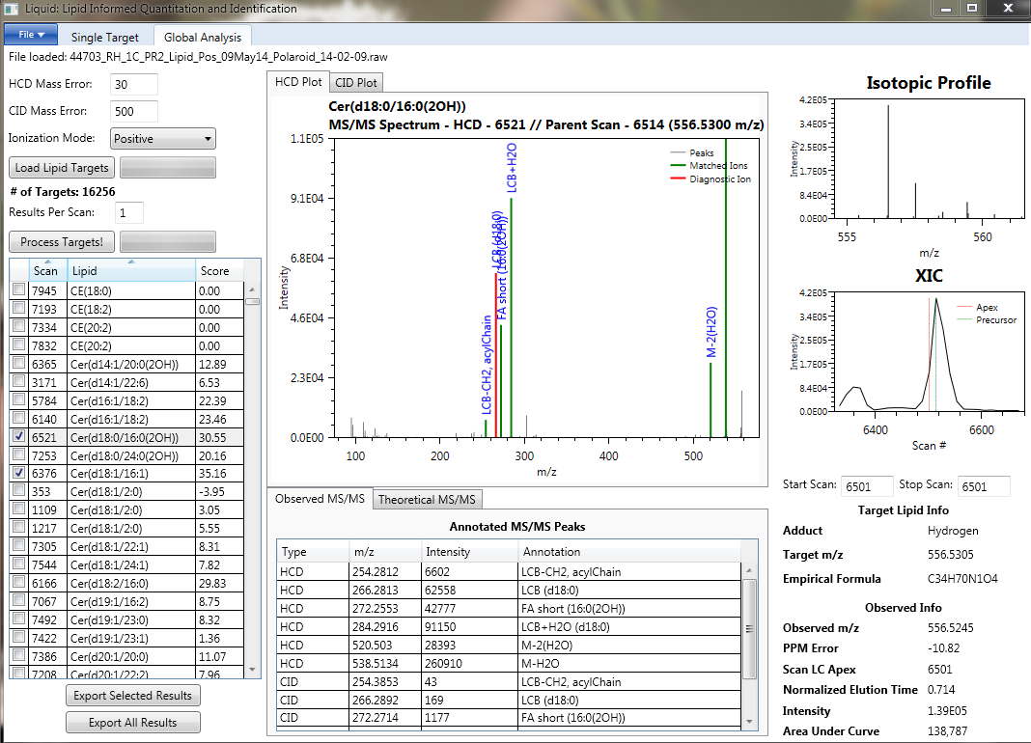
Look at Cer in HCD

Slide 13
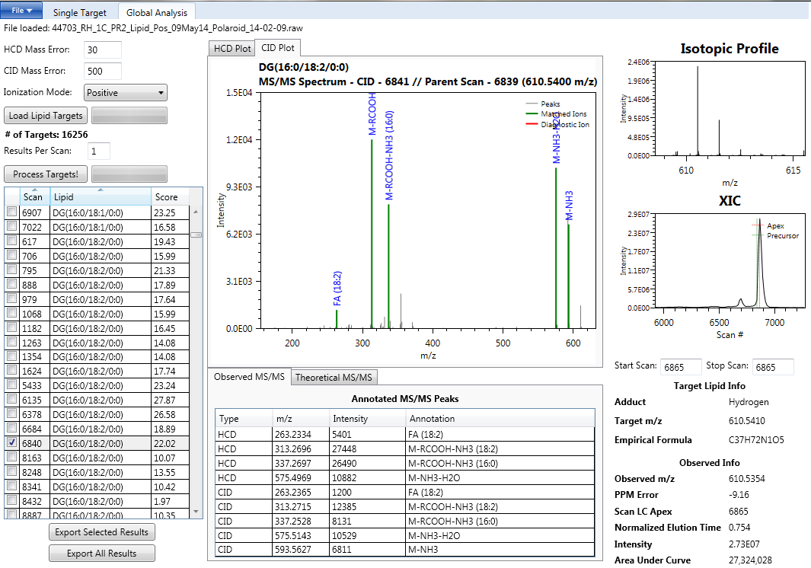
Look at DGs in CID

Slide 14
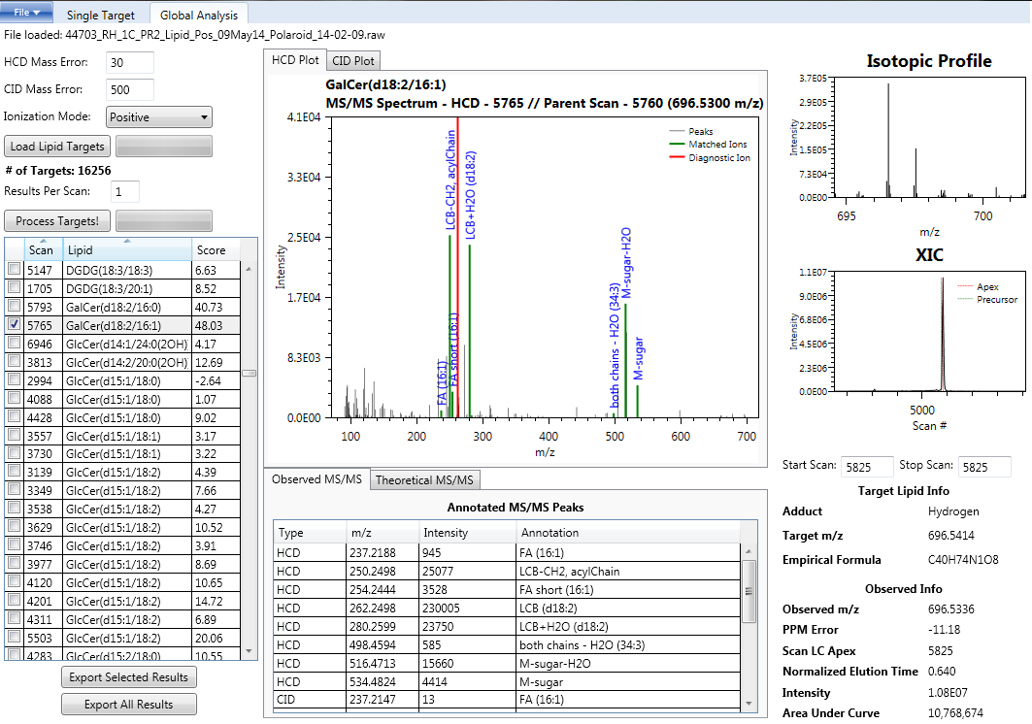

Slide 15
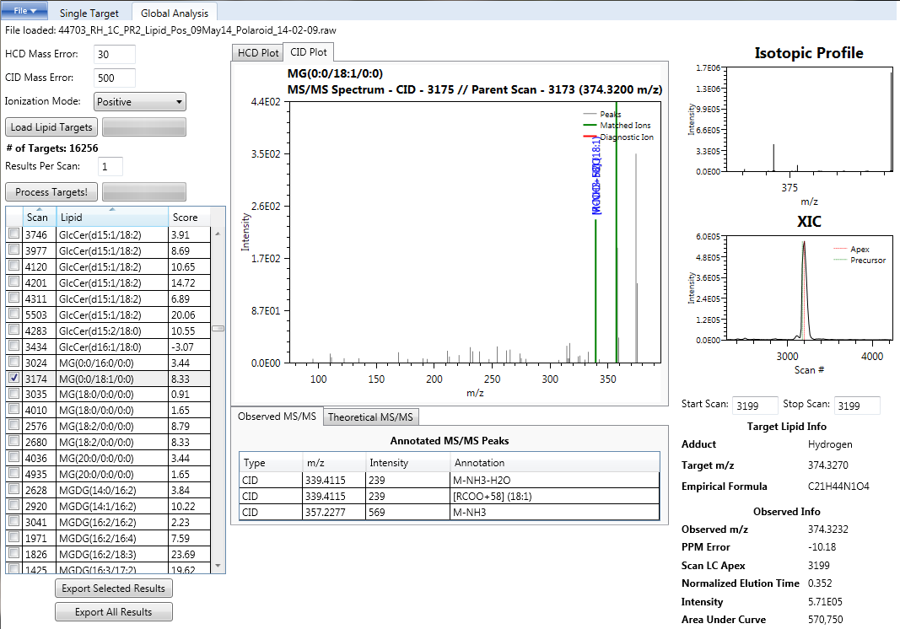
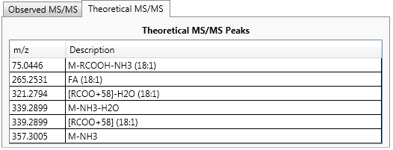
Look at MGs in CID
?

Slide 16
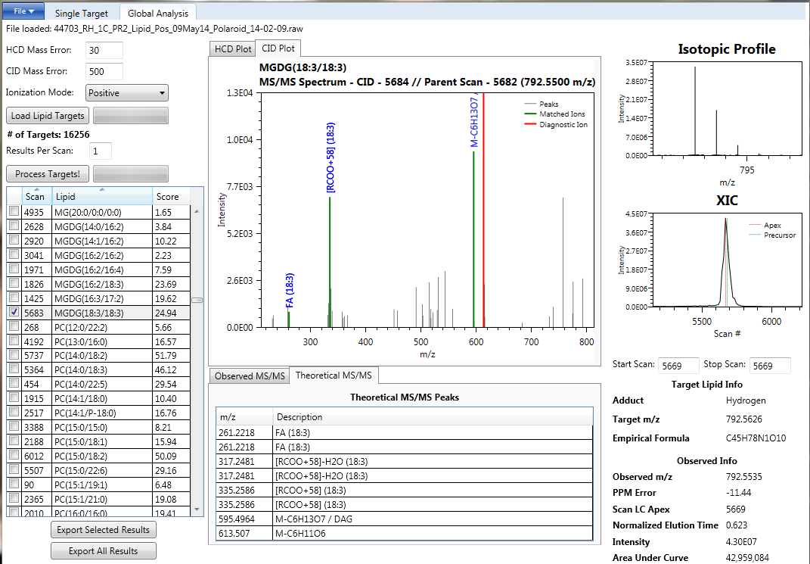
MGDG

Slide 17
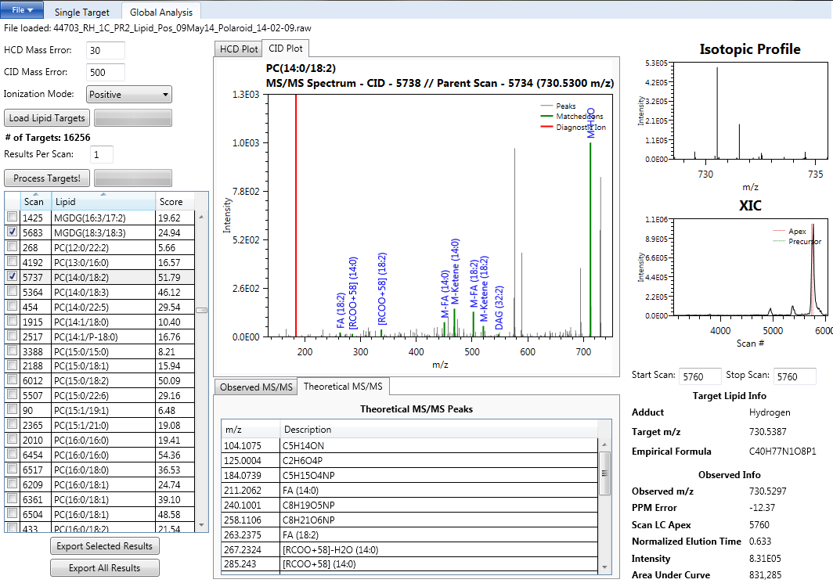
Diacyl-PC
Look at phospholipids in CID
If unclear – look at HCD too → next slide

Slide 18
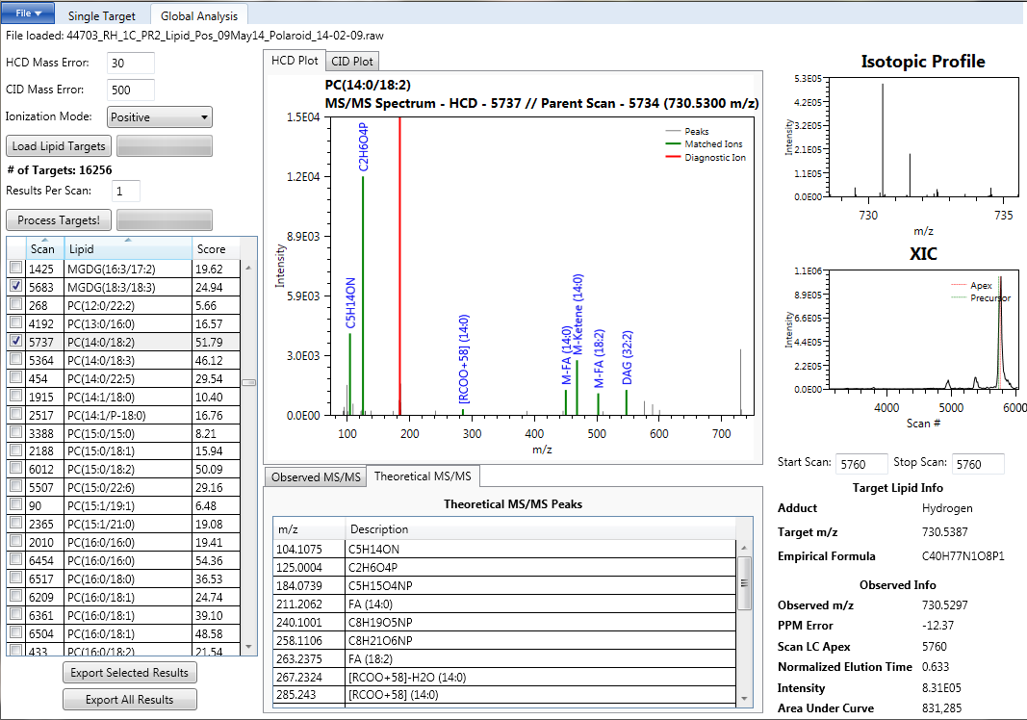
If still unsure – note down scan number and examine again AFTER you have initially gone through your identifications. You will re-examine by changing the ‘results per scan’ from 1 to 4.

Slide 19
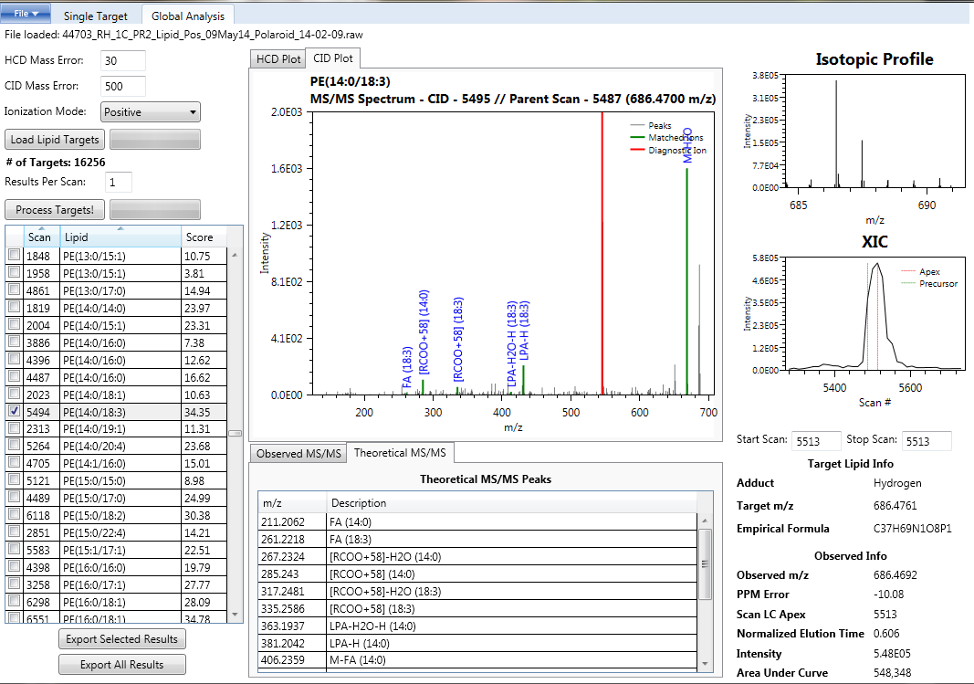
PE
If unclear – look at HCD too → next slide

Slide 20
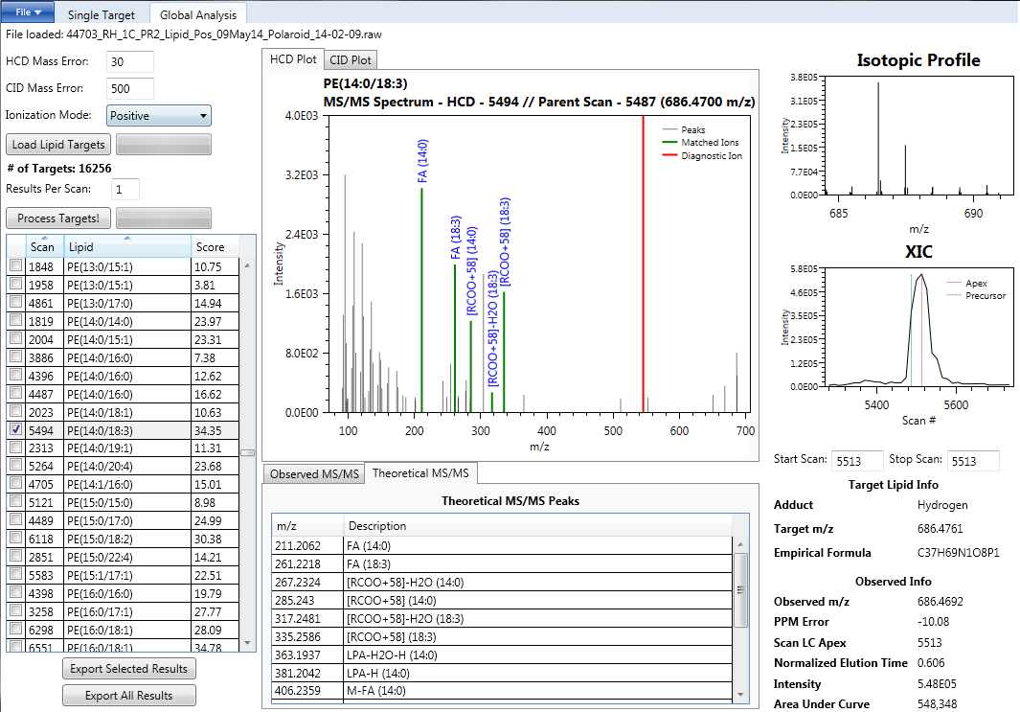

Slide 21
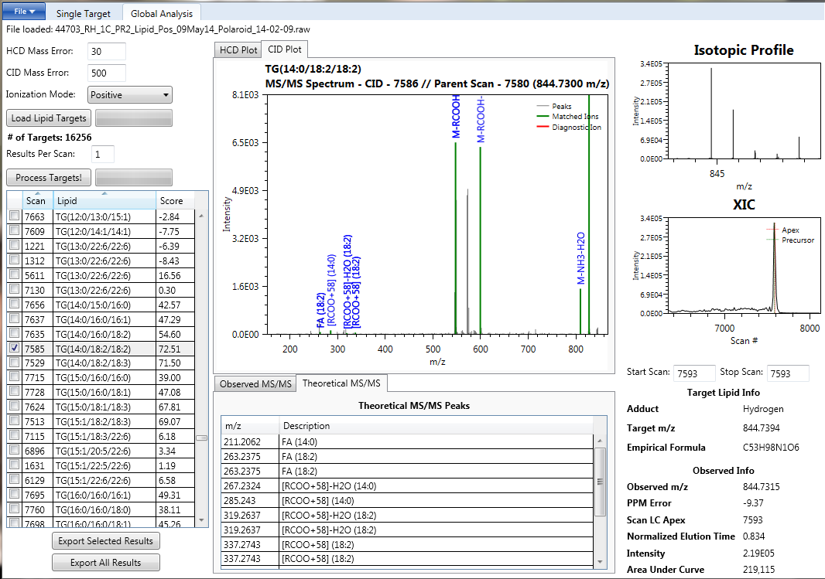
Look at TGs in CID

Slide 22
Now what that you have selected the correct identifications?
Click ‘Export Selected Results’

Slide 23
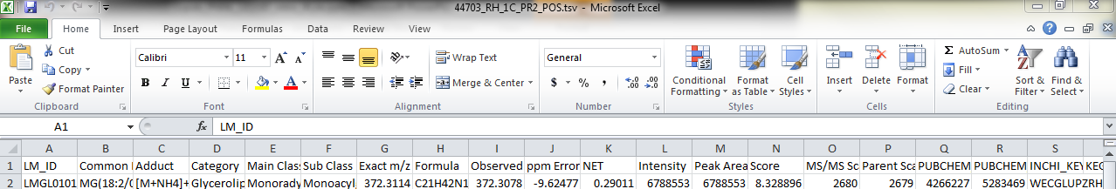
This creates a .tsv file
Drag file into excel and as another file save as .xlsx (do not replace original)

Slide 24
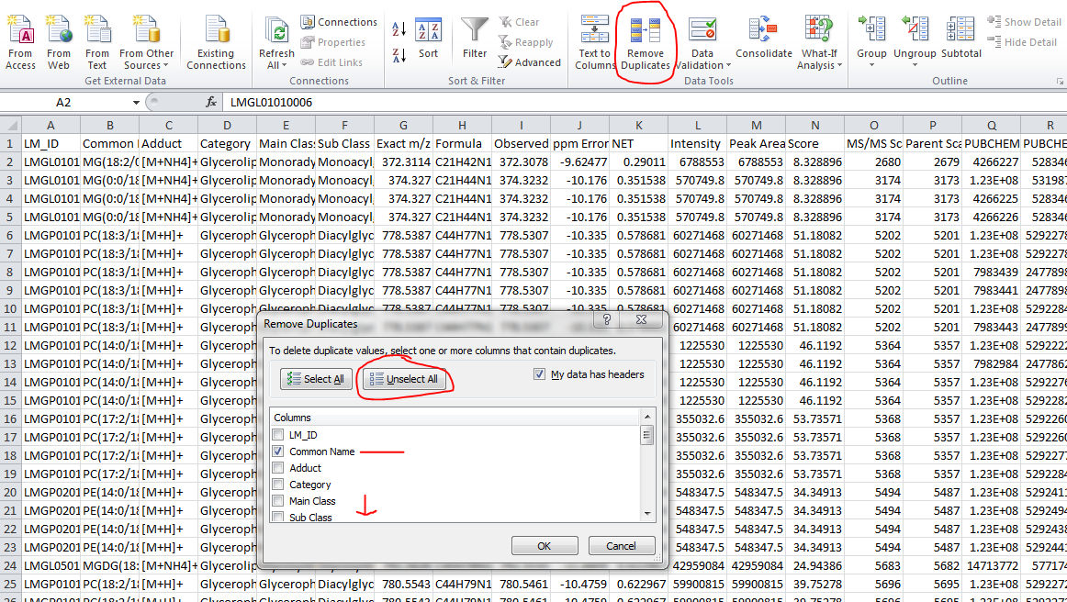
‘select all’
Click “remove duplicates”
Unselect all
Check common name and ms/ms

Slide 25
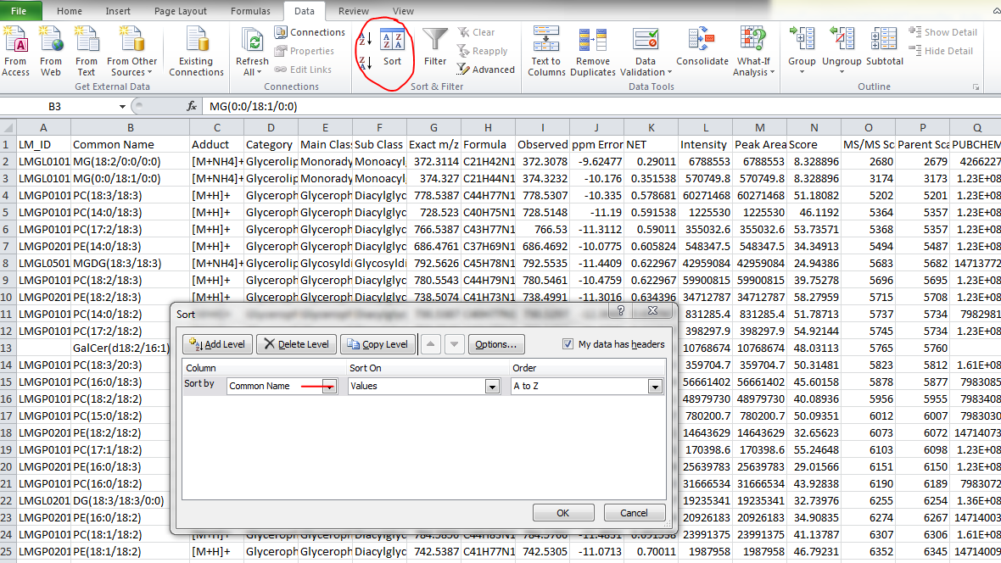
Next, click “sort”
By common name and then Apex RT

Slide 26
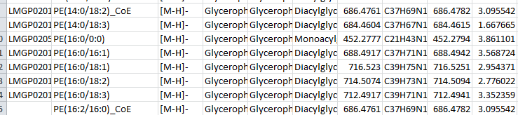
If you have ≥ 2 lipids with the same common name then annotate these as ‘_A’ and ‘_B’. You will be aligning your data at the end and you will need to be able to distinguish the two for correct alignment (and this is a time saver down the road)
Example: PC(0:0/16:1)_A
PC(0:0/16:1)_B
Re-run LIQUID with more ‘results per scan’ if you question the identification or suspect co-elution of another species.
see next slide
Annotate these co-elution species with ‘_CoE’ in your excel file OR combine the identifications so they are on the same row

Slide 27
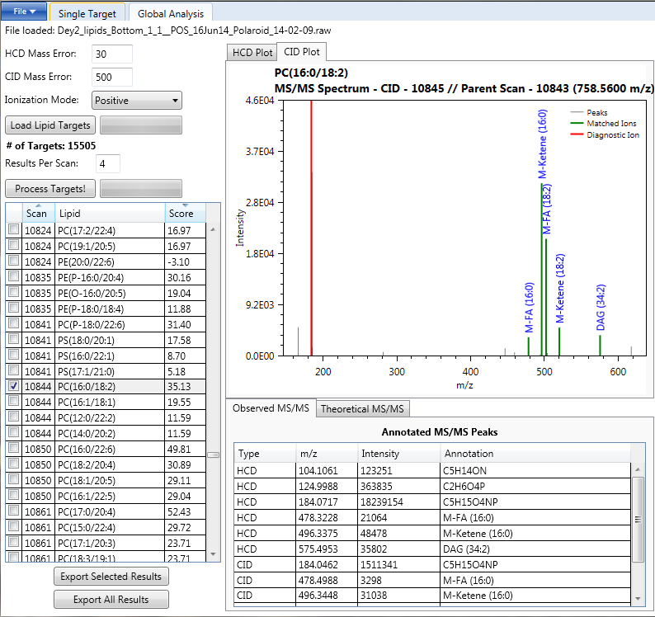

Slide 28
Negative ionization

Slide 29
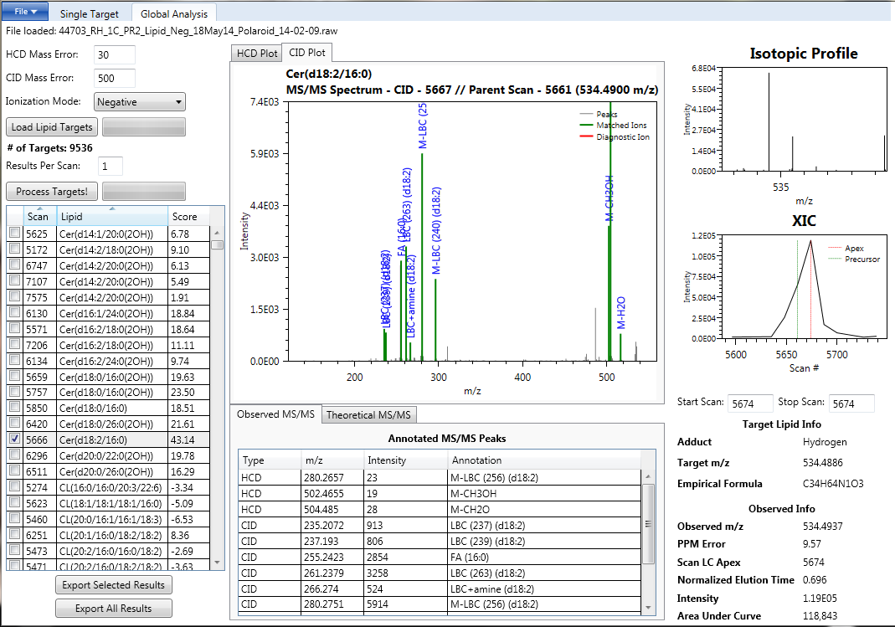
Look at Cer in CID

Slide 30
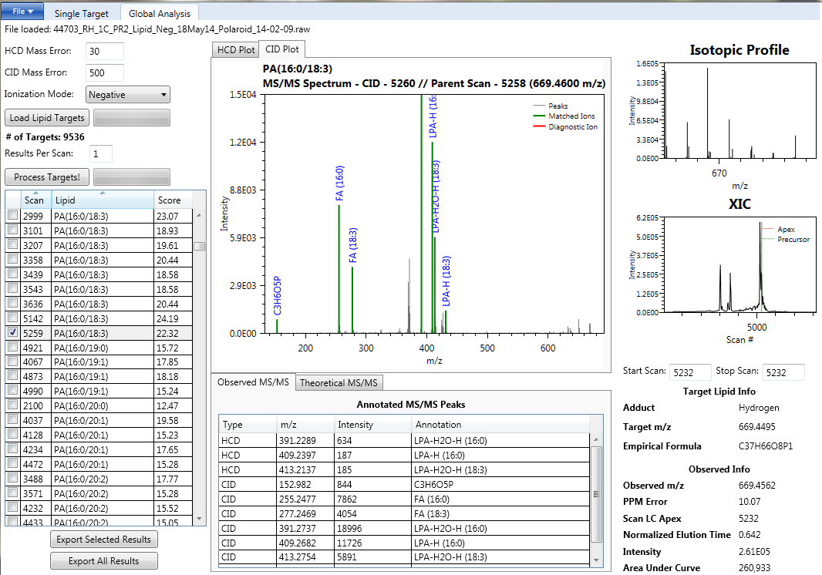
Look at PAs in CID

Slide 31
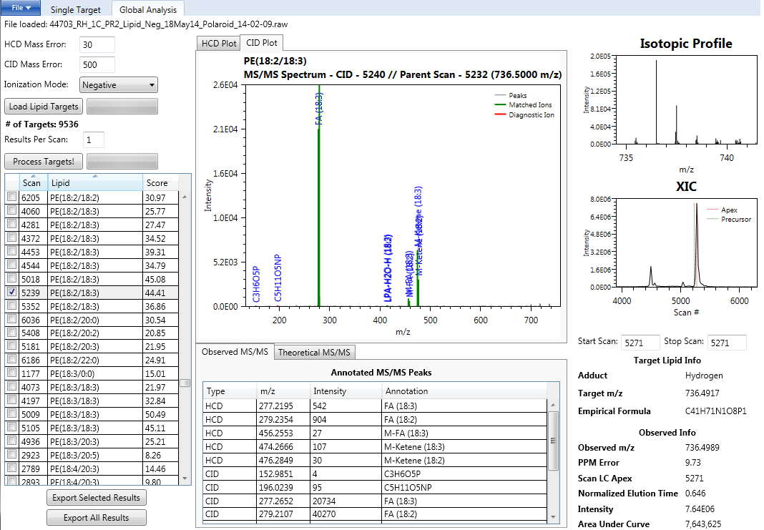
Diacyl-PE
Look at all phospholipids in CID

Slide 32
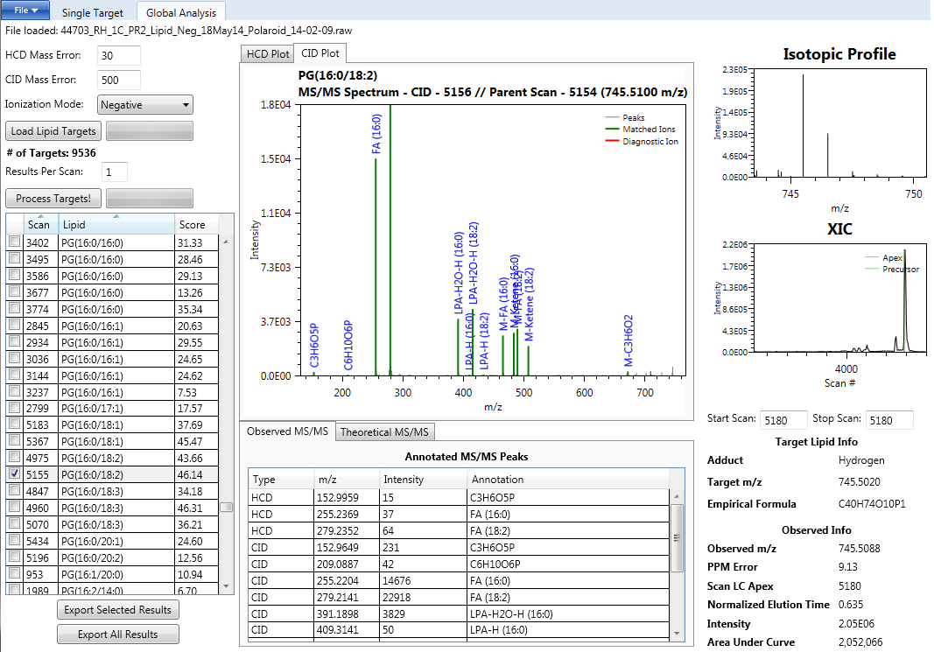
PG (no diagnostic ion)

Slide 33
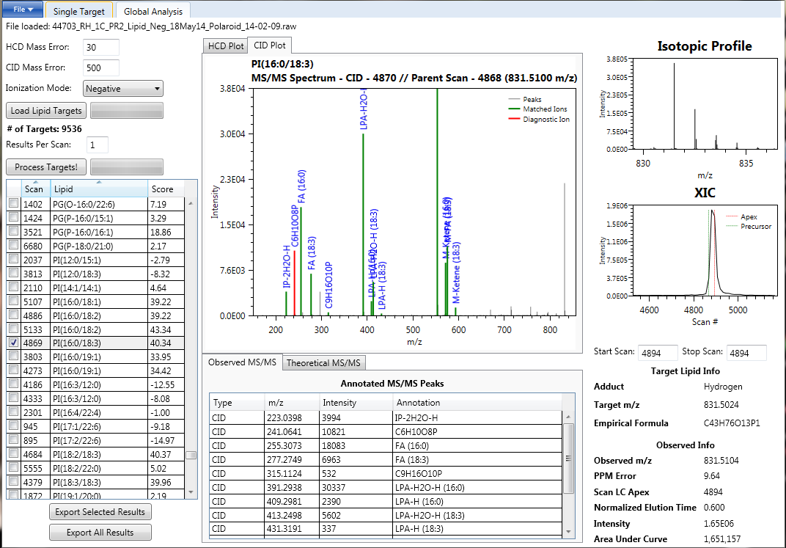
PI

Slide 34
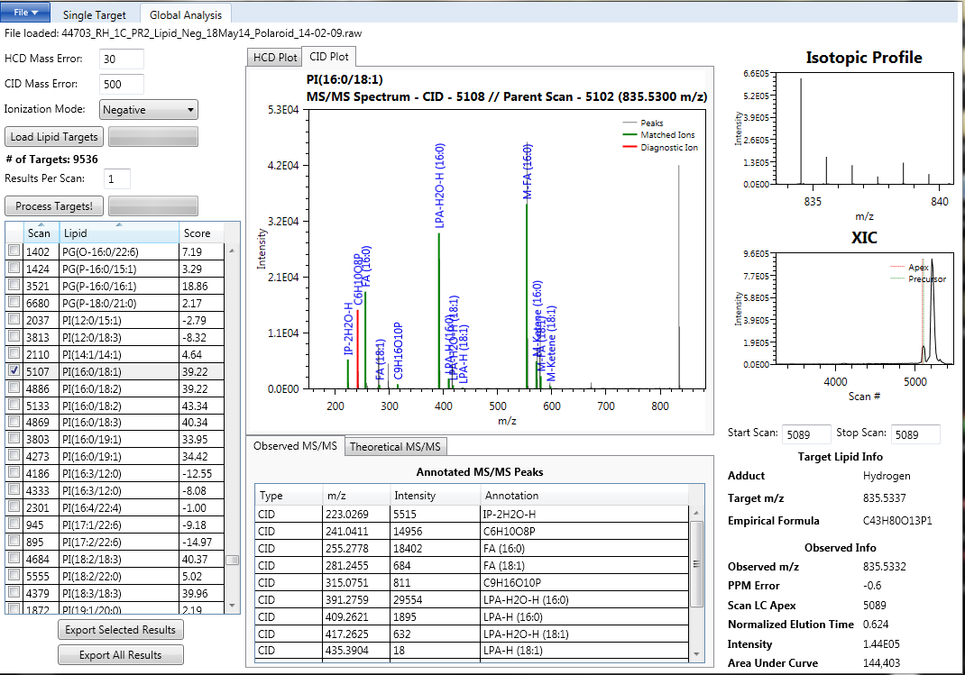
PIs can be tricky as the score and MS2 will look good but the isotopic profile and ppm error will not be correct. This is NOT a correct identification.
X

