Slide 1
MASIC Processing Details
Matthew Monroe
December 2005

Slide 2
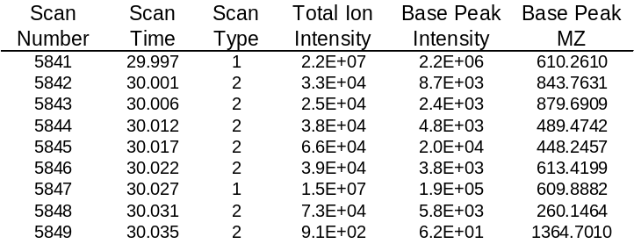
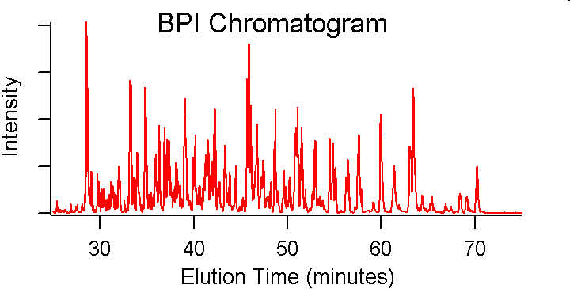
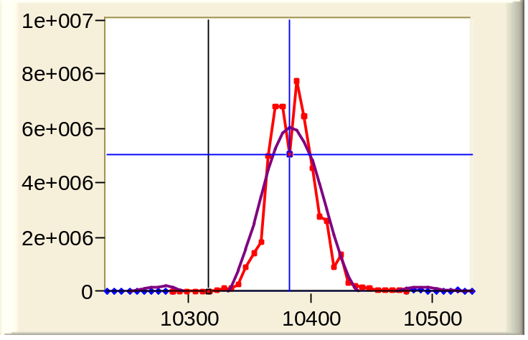
MASIC Overview
Purpose: process LC-MS/MS data
  Generate scan-based statistics
    Scan #, scan type, elution time, etc.
  Generate dataset-wide chromatograms
    TIC & base peak intensity chromatogram
  Summarize chromatographic statistics for m/z values chosen for fragmentation
    Scan # of MS/MS spectrum
    Scan # (and elution time) of chromatographic peak apex
    Chromatographic peak height, width, and area
SIC
Notes:
Data from LTQ analysis of QC standards
D:\MSData\QC_04_1_14Mar05_Earth_1204-05\SIC200503150826_Auto107303
SIC peak is scan 10316 (762.66 m/z), X range at 300 scans, Y range at 10000000 counts
Important note: MASIC does not require Sequest results; only the original raw data

Slide 3
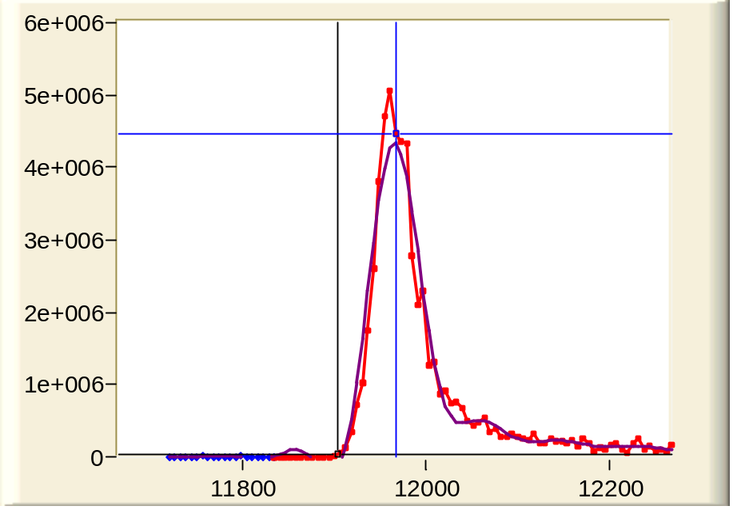
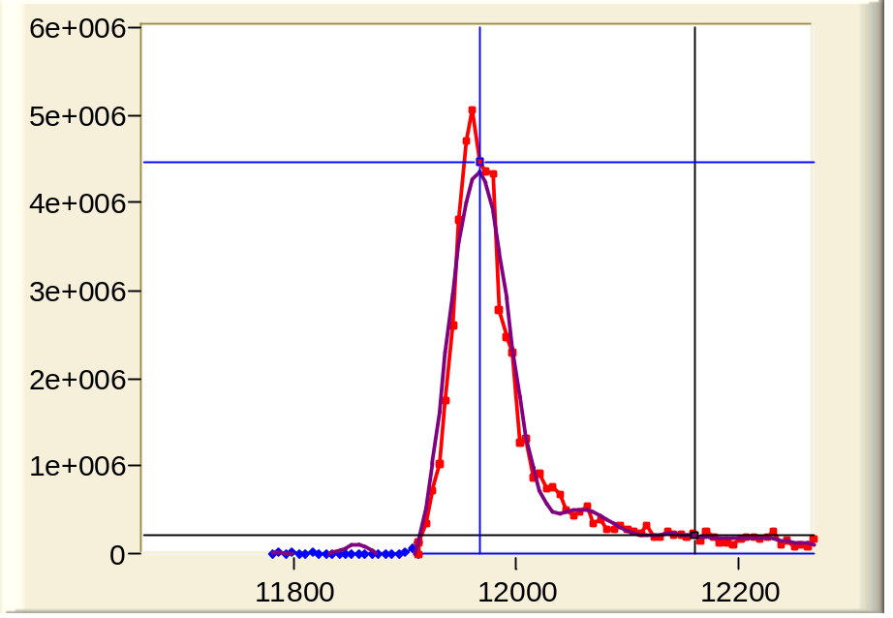
MASIC Overview
Utility: track elution time of peak apex
  Superior to scan number of fragmentation spectrum
  More accurate alignment of LC-MS/MS peptides to accurate mass and time (AMT) tag features observed in LC-MS
Apex
61.39 min.
Apex
61.39 min.
Intensity
821.38 m/z
MS/MS @
62.43 min.
821.59 m/z MS/MS @
61.06 min.
spectrum #
Notes:
Data from LTQ analysis of QC standards
D:\MSData\QC_04_1_14Mar05_Earth_1204-05\SIC200503150826_Auto107303
SIC peak #1 is scan 11904 (821.59 m/z), X range at 600 scans, Y range at 6000000 counts (index 9682)
SIC peak #2 is scan 12160 (821.38 m/z), X range at 600 scans, Y range at 6000000 counts (index 9895)

Slide 4
Related Software
XPRESS & ASAP Ratio
  Han, Eng, Zhou, and Aebersold, Nature Biotech., 2001, 19, 946-951.
  Li, Zhang, Ranish, and Aebersold, Anal. Chem., 2003, 75, 6648-6657.
  C (Linux) application for finding and quantitating isotopically labeled peptide pairs (e.g. ICAT), given peptide identifications from MS/MS
  Utilizes output from INTERACT (SEQUEST results summarizer)
RelEx (EXTRACT-CHRO)
  MacCoss, Wu, Liu, Sadygov, and Yates, Anal. Chem., 2003, 75, 6912-6921.
  VB6 (and C) application for isotopically labeled MS/MS quantitation
  Utilizes output from DTASelect (SEQUEST results summarizer)
MASIC
  Creates selected ion chromatograms for all parent ion m/z values chosen for fragmentation, plus optionally a custom list of m/z values
  VB.NET application (Windows)
Notes:
Software from the Yates Lab?

Slide 5
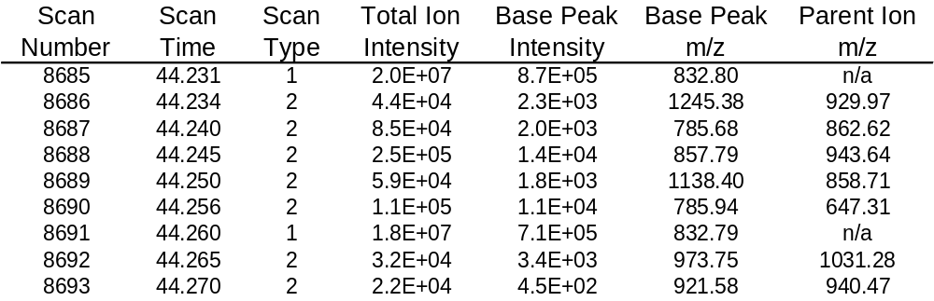
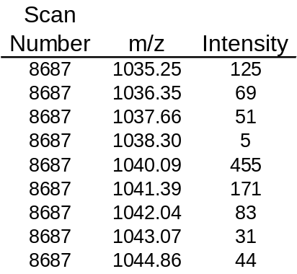
Processing Steps
Load data
  Recognized file formats
    Finnigan RAW file (LCQ, LTQ, and LTQ-FT, using Finnigan XDK)
    CDF and Mascot Generic File (MGF) combo (Agilent Ion Trap)
    mzXML
  Each file format has similar information
Scan information
Mass spectral data
Notes:
Note: must infer Scan Time for MGF data since not present in the file

Slide 6
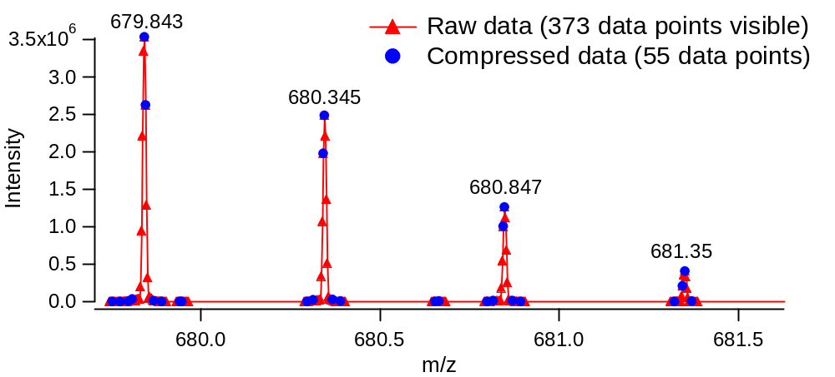
Processing Steps
Compress high resolution data (e.g. LTQ-FT)
  Compress data with >2 consecutive peaks with an intensity of 0
  Bin MS spectra to m/z tolerance 20% of the SIC tolerance
    e.g., for ±0.1 m/z tolerance, bin to 0.02 m/z resolution
  Bin MS/MS spectra to m/z tolerance 20% of the MS/MS binning options bin size
    e.g. 1 m/z bin size, bin to 0.2 m/z resolution
  Reduces memory requirements and improves processing rate
28,660 data points total
17,498 after combining blocks with intensity values of 0
5,311 after binning to 0.02 m/z

Slide 7
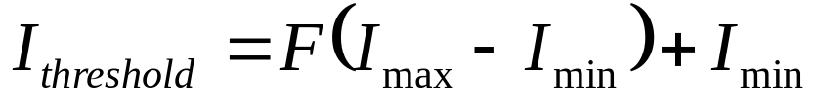
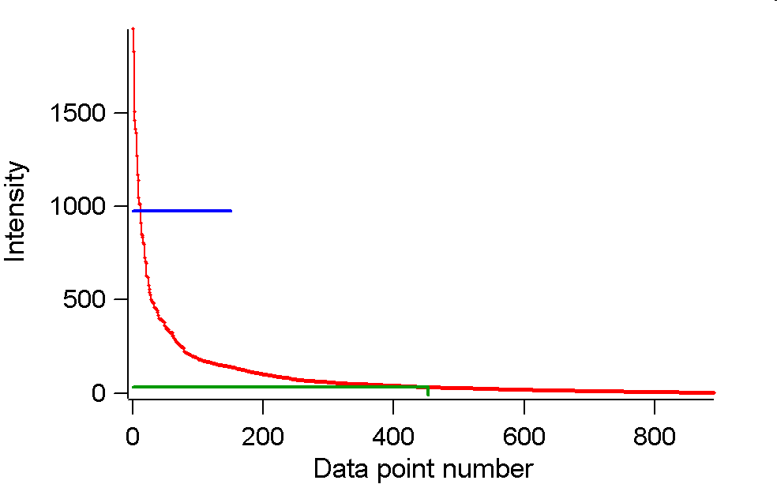
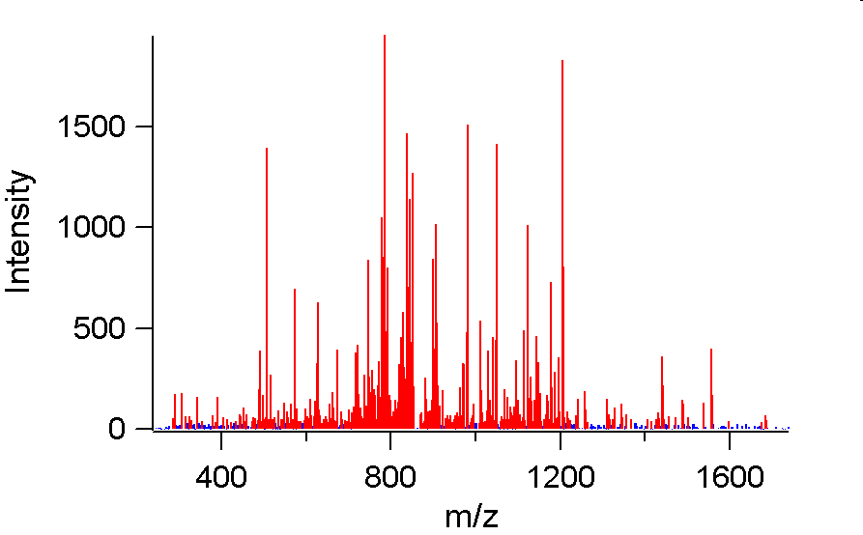
Processing Steps
Compute noise threshold level for each mass spectrum
  Useful for computing S/N ratio for base peaks
  Using trimmed median by abundance
    Find median of low intensity data, i.e. data with I < I_{threshold}
(F = 0.5)
892 data points
I_{threshold} = 977 counts
Trimmed median = 32.1 counts
440 points have
Intensity < 32.1
Notes:
Data is for scan 8687 in file QC_04_1_14Mar05_Earth_1204-05 (MS/MS spectrum)
MASIC discards MS/MS data below S/N = 2, which reduces memory usage and speeds the correlation step slightly
MASIC does not discard MS data, since this makes it harder to find the noise floor in SICs

Slide 8
Processing Steps
Create selected ion chromatograms (SICs)
  Construct list of parent ion m/z values
    Optionally include custom m/z values provided by user
  Sort list by m/z and find groups of m/z values within 50% of the SIC tolerance
    e.g., for ±0.1 m/z tolerance, process in 0.05 m/z groups
  Create one SIC for each m/z group
Frag Scan Number | Elution Time (minutes) | m/z | m/z Group | Median m/z | Diff From Median m/z
2319 | 24.772 | 795.17 | 1 | 795.175 | -0.005
2469 | 25.916 | 795.18 | 1 | 795.175 | 0.005
7175 | 55.674 | 795.37 | 2 | 795.380 | -0.010
3302 | 31.422 | 795.38 | 2 | 795.380 | 0.000
4304 | 37.641 | 795.41 | 2 | 795.380 | 0.030
4484 | 38.738 | 795.44 | 3 | 795.445 | -0.005
5296 | 43.699 | 795.45 | 3 | 795.445 | 0.005
2878 | 28.715 | 795.75 | 4 | 795.750 | 0.000
1400 | 16.721 | 796.12 | 5 | 796.120 | 0.000

Slide 9
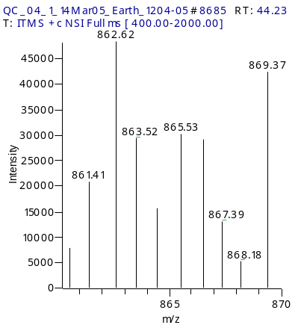
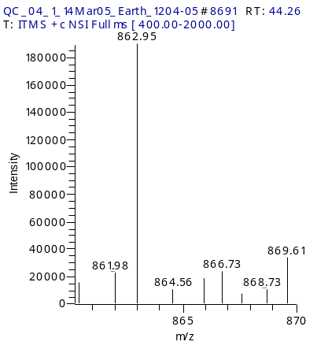
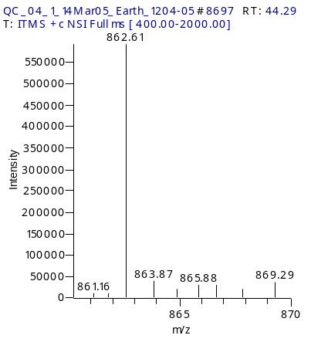
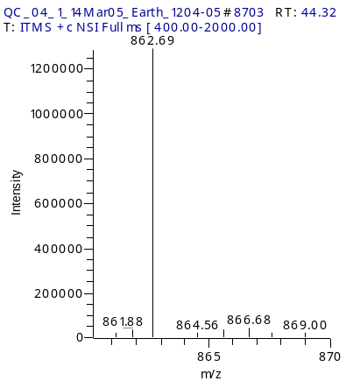
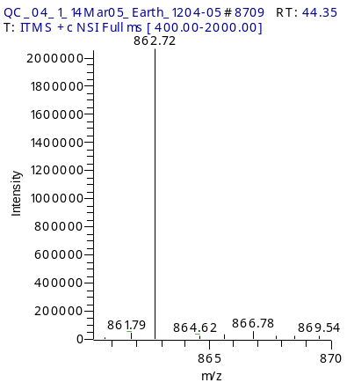
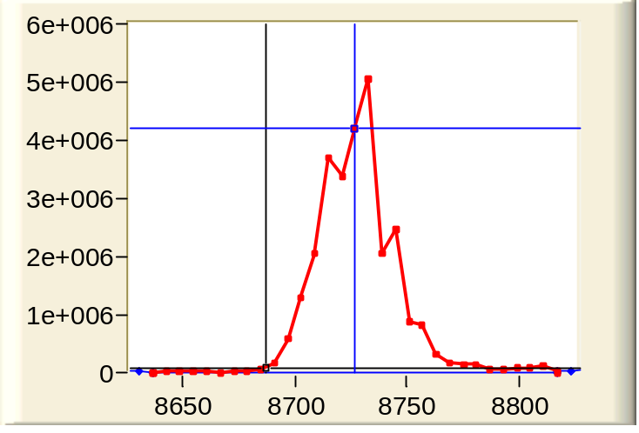
Processing Steps
  Selected ion chromatograms (SIC) creation
    Search the MS1 spectra (survey scans) for data within ± the SIC tolerance of the median m/z of the members of the group
    Perform the search across all scans in the input file
    If a given scan has no data in tolerance, then use the minimum positive intensity across all mass spectral points in that scan
862.62 m/z ±0.6
Intensity
spectrum #

Slide 10
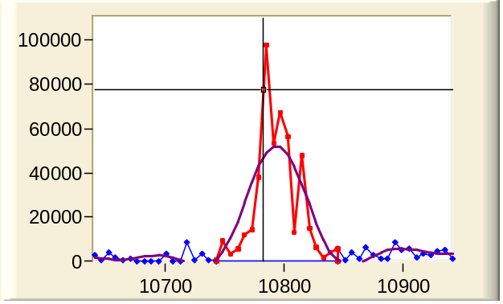
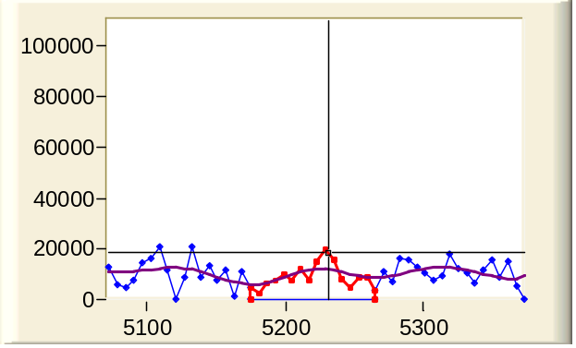
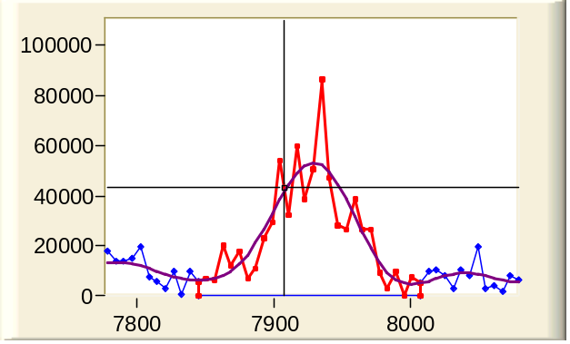
Processing Steps
Selected ion chromatograms (SIC) creation
  MS spectra data access speed is important
    Unlike SEQUEST, not processing one spectrum at a time
  Need to repeatedly look for m/z ranges in adjacent mass spectra
OLD Method
m/z
MS1
MS1
spectrum #
MS2
MS2
MS2
MS2
MS2
MS2
Notes:
Data is for scan 8687 (862.62 m/z) in file QC_04_1_14Mar05_Earth_1204-05 (SIC index 7001)
In particular, displaying data for MS1 scans 8685, 8691, 8697, 8703, & 8709

Slide 11
Processing Steps
  Determine the baseline noise level in the SIC data for each m/z group
    Divide the data into 3 segments
    Compute the noise level in each segment using a dual trimmed mean
      Replace intensity values of 0 in the SIC data with the minimum positive value across all scans in the given SIC
      Compute the average and StDev
      Discard the data above or below 5 StDev units from the average
      Recompute the average and StDev
    Perform a T-Test between adjacent segments to determine if they are significantly different (90% confidence level)
      If not different, then combine the two segments and recompute the noise level
ToDo: Show full file m/z example with baseline noise level by segment highlighted

Slide 12
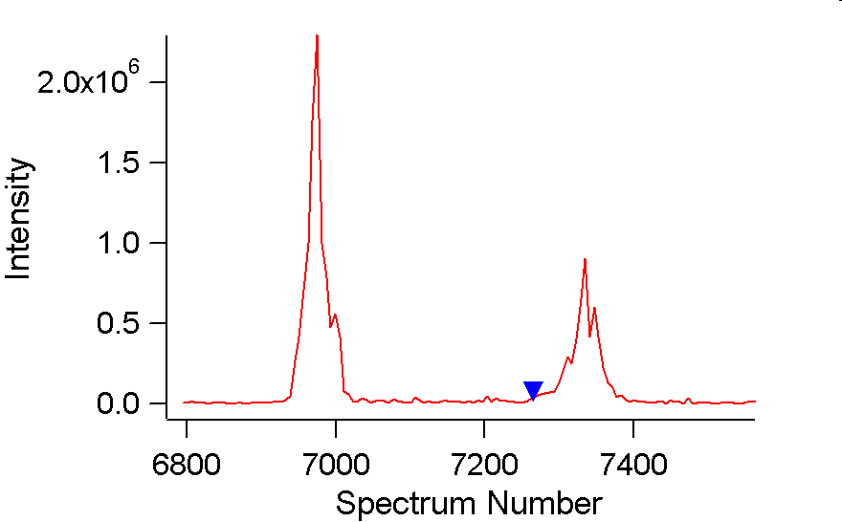
Processing Steps
  Extract the data centered around the highest intensity in the SIC data for each m/z group
  Compute baseline noise level for the extracted SIC data
    Useful for computing S/N ratio of SIC peaks
    Determined using the baseline noise level from the full SIC
      For peaks that reside between the midpoint of one segment and the midpoint of an adjacent segment, the noise values are averaged between the two segments
673.96
SIC of 674.58 m/z ±0.6
674.70
S/N=148
675.64
ToDo: Show an
example of this
MS/MS
674.49
S/N=38
675.55
676.50
Notes:
Data is for scan Scan 7265, 674.58 m/z (Index 5816) in file QC_04_1_14Mar05_Earth_1204-05 (MS/MS spectrum)
MASIC discards MS/MS data below S/N = 2, which reduces memory usage and speeds the correlation step slightly
MASIC does not discard MS data, since this makes it harder to find the noise floor in SICs

Slide 13
Processing Steps
  Find the largest peak in the SIC data for a given m/z group
    Determine the peak's boundaries, apex, and associated stats
  For each parent ion in the m/z group
    If the fragmentation scan number falls within the peak boundaries of the largest peak in the SIC data, then assign the peak stats for the largest peak to the given parent ion
    If the fragmentation scan number does not fall within the peak boundaries, then search for the closest peak in the SIC data for the given m/z group
  For each custom m/z in the m/z group
    ???
Notes:
Data is for scan 8687 (862.62 m/z) in file QC_04_1_14Mar05_Earth_1204-05 (SIC index 7001)
In particular, displaying data for MS1 scans 8685, 8691, 8697, 8703, & 8709

Slide 14
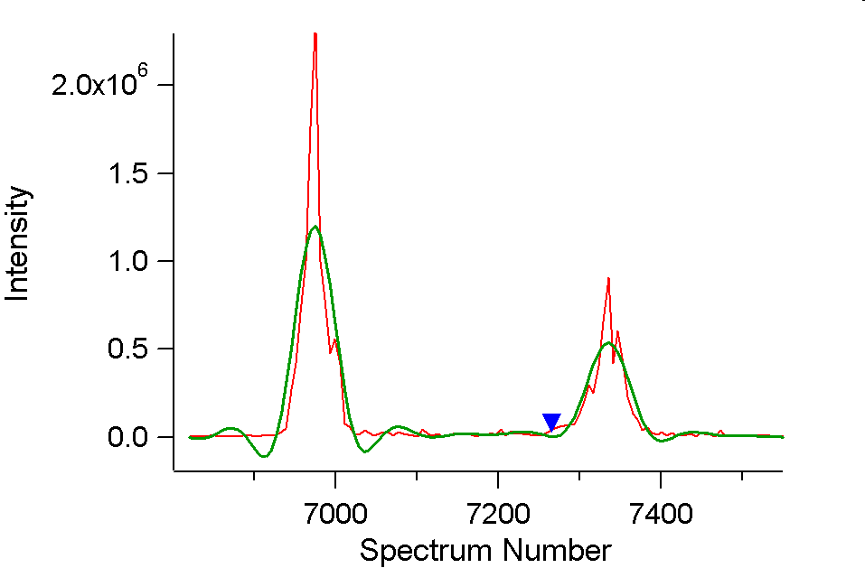
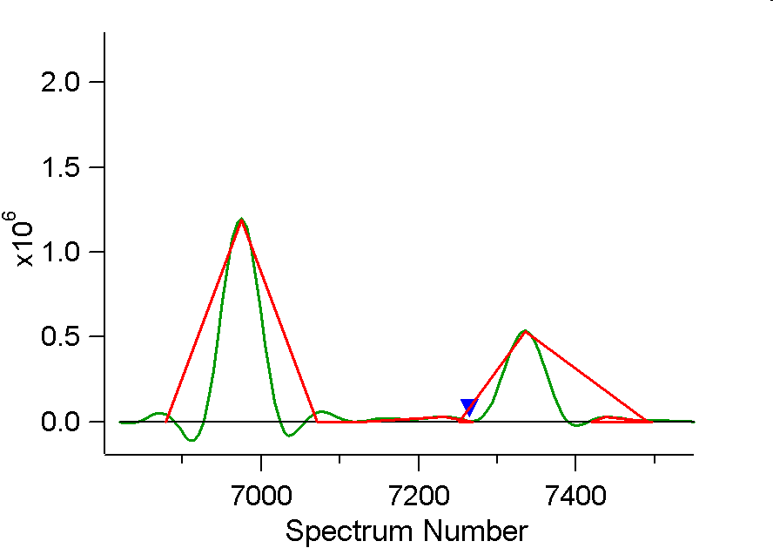
Processing Steps
  Find the largest peak in the SIC data for a given m/z group
    Use Butterworth smoothing (algorithm from XPRESS, by J. Eng)
    Determine the peak's boundaries, apex, and associated stats
  For each parent ion in the m/z group
    If the frag scan falls within largest peak's boundaries, then assign the peak stats for the largest peak to the given parent ion
    If the frag scan does not fall within the boundaries, then search for the closest peak in the SIC data for the given m/z group
Center: 6975
Area: 6.0x10⁷
7335
3.2x10⁷
MS/MS
7233
1.1x10⁶
7437
5.7x10⁵
Notes:
Actually finding peaks using Magnitude-Concativity fitting, which involves fitting 2nd order polynomials to a sliding window of points, then examining the first derivative to find zero-crossings from positive to negative. This is probably a bit more elaborate than needed, but does the job.
Butterworth filters ported from the XPRESS software, written by Jimmy Eng
http://cvs.sourceforge.net/viewcvs.py/sashimi/XPRESS-RAMP/addxpress3.c?rev=1.13&view=markup
Coefficients for various sampling rates obtained using MatLab (courtesy of Deep Jaitly, PNNL)

Slide 15
Processing Steps
Determine the peak stats
  S/N
  Full Width at Half Max
  Area
  Statistical moments
    Use smoothed data above noise threshold centered around peak apex
    Area, center of mass, StDev, and Skew
  Kolmogorov-Smirnov statistic
    Another measure of skew

Slide 16
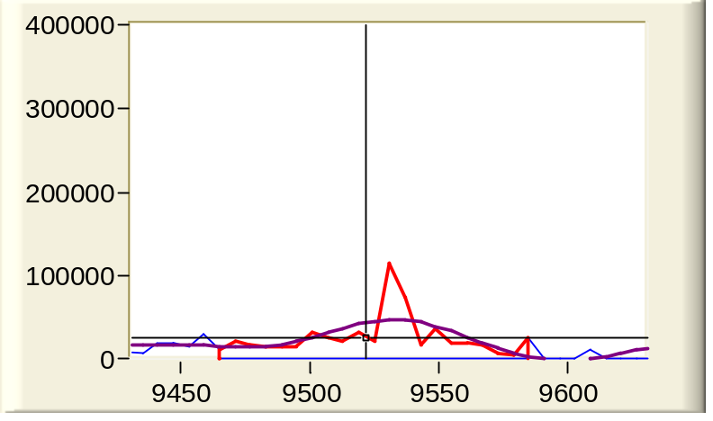
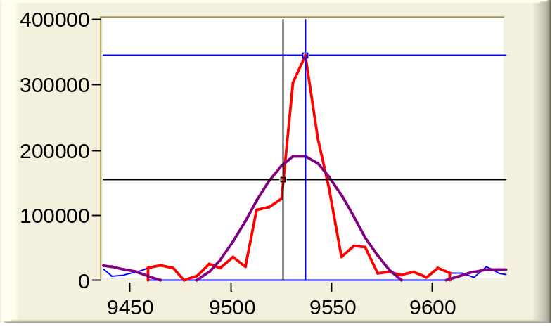
Processing Steps
Look for spectra with similar parent ion m/z values and similar elution time values
  Typical tolerance is ±0.1 m/z units and ±5 minutes
    Also consider M+1, M-1, M+0.5, and M-0.5, all ±0.1 m/z
    If SIC Tolerance <= 0.25 Da, also consider M+0.333, M-0.333, M+0.666, and M-0.666
  Use Pearson correlation (of binned data) to compare MS/MS fragmentation patterns
    Track indices of related spectra
928.36 m/z MS/MS @
48.50 min.
929.38 m/z MS/MS @
48.48 min.
Notes:
Example from D:\MSData\QC_04_1_14Mar05_Earth_1204-05\
SIC Index 7700 (scan 9526) and SIC Index 7697 (scan 9522)

Slide 17
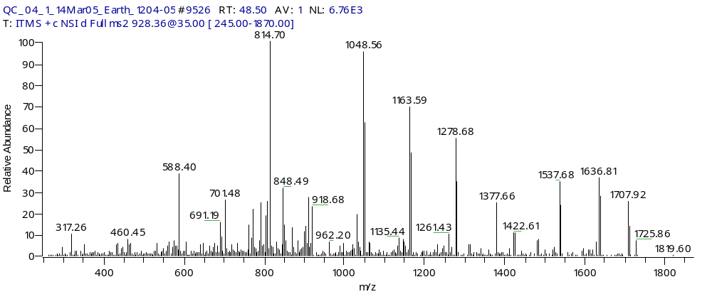
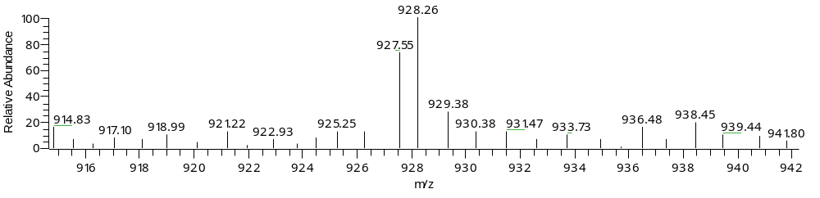
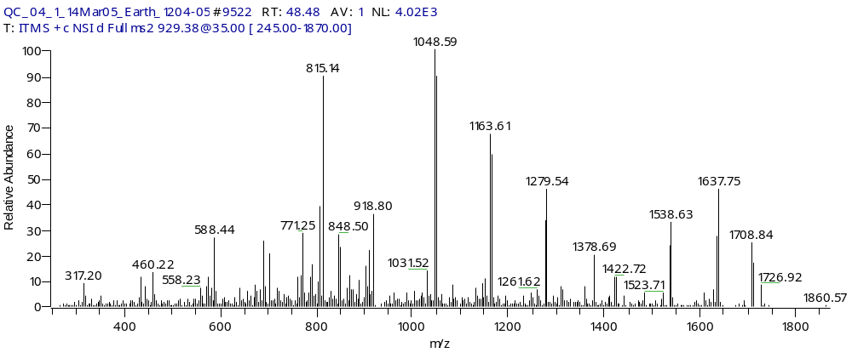
Processing Steps
Spectra similarity example
Binning to 1 m/z resolution, get Pearson correlation of 0.899
MS1
Notes:
Example from D:\MSData\QC_04_1_14Mar05_Earth_1204-05\
SIC Index 7700 (scan 9526) and SIC Index 7697 (scan 9522)

Slide 18
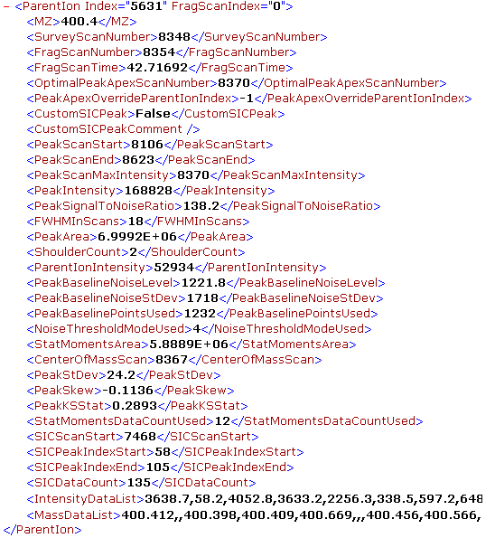
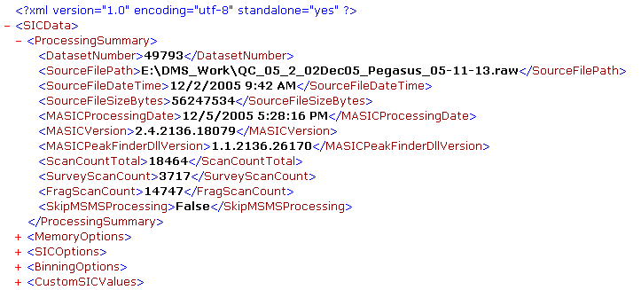
Processing Steps
Write out results
  TIC and BPI files in ICR-2LS binary chromatogram format
  Scan stats (tab delimited)
  SIC stats (tab delimited)
  XML summary file

Slide 19
File Loading Considerations
Four options when loading spectral data
  Pre-load raw data and store all in memory
  Load raw data only when needed, then discard immediately
  Load raw data and cache in memory
    Discard oldest spectra when memory usage is high
    Reload from raw data file if needed again
  Load raw data and cache in memory
    Swap to disk when memory usage is high
    Reload from disk cache if needed again
Requires large amount of memory
Requires fast, random data access to raw data
Requires fast memory allocation/deallocation

Slide 20
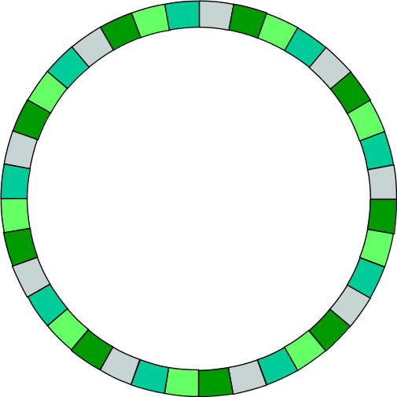
File Loading Considerations
Using a circular buffer to hold active spectra
  Only need to read data from raw data file once
    Different reader for each recognized file format
  Simplifies memory management
    No need to allocate/deallocate memory continuously
    When buffer fills, cache spectrum to disk and load new, either from raw file if first time or from disk cache
  Always retain scan info in memory
  Buffer size of ~2000 spectra allows for fast, in-memory access to sequential spectra when making SICs
spectrum #
Still true, but processing in m/z chunks so not as advantageous
1
2
3
8
1
8
37

Slide 21
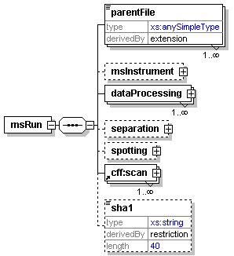
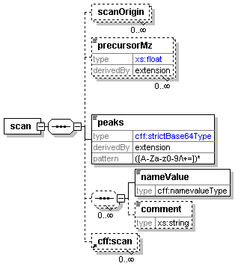
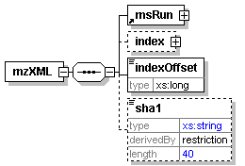
mzXML Considerations
mzXML file schema elements utilized

Slide 22
mzXML Considerations
mzXML file reading options
  1: Standard XML document parser
    Cannot use mzXML spectra index section
    Random access is possible via XML element selection commands
    Memory usage can be very large, since reader pre-loads the entire Document Object Model into memory
  2: Custom random access XML reader, e.g. RAMP
    Can use mzXML index in file, or
    Index file manually on first read
  3: Custom forward-only XML reader
    Read each spectrum sequentially and process or cache to disk
    Does not allow random access to spectra
Notes:
Could use a SAX parser for solution 3

Slide 23
mzXML Considerations
mzXMLDataFileReader VB.NET Interface
  OpenFile – returns True on success
    ByVal mzXMLFilePath as String
  ReadNextSpectrum – returns True on success
    ByRef MZList() As Double
    ByRef IntensityList() As Single
    ByRef SpectrumHeaderInfo As udtSpectrumHeaderInfoType
  CloseFile
  GetScanInfo – returns True on success
    ByVal Scan As Integer
    ByRef SpectrumHeaderInfo As udtSpectrumHeaderInfoType
  GetScanData – returns True on success
    ByVal Scan As Integer
    ByRef MZList() As Double
    ByRef IntensityList() As Single
    ByRef SpectrumHeaderInfo As udtSpectrumHeaderInfoType
SpectrumHeaderInfo
ScanNumber
MSLevel
PeaksCount
Polarity
RetentionTimeMin
CollisionEnergy
LowMZ
HighMZ
BasePeakMZ
BasePeakIntensity
TotalIonCurrent
ParentIonMZ
ParentIonIntensity
NumericPrecisionOfData

Slide 24
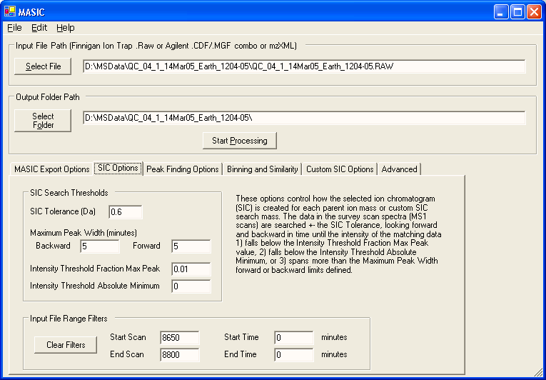
MASIC User Interface
GUI interface, command line automation, and VB.NET DLL

Slide 25
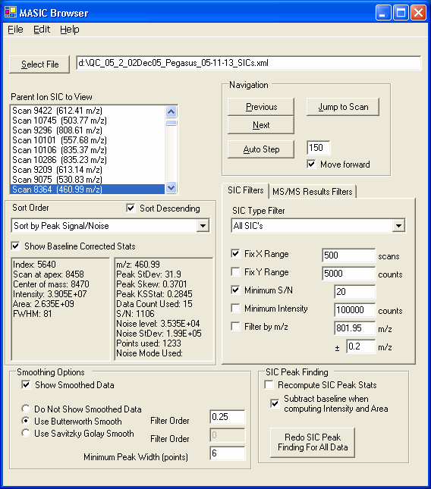
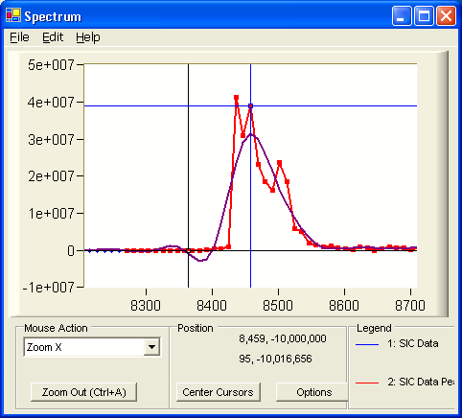
MASIC Browser

Slide 26
Processing Benchmarks
Test datasets
  LC-MS/MS analysis of QC Standards mixture
    Tryptic digest of 12 protein mixture, modeled after protein mixture suggested by Purvine et. al. (OMICS, 2004, 8, 79-92.)
    Analyzed weekly on LCQ, LTQ, and LTQ-FT instruments
  Converted Finnigan .Raw files to mzXML using ReAdW
    http://sashimi.sourceforge.net/software_glossolalia.html
Instrument | Finnigan Raw File Size (MB) | Separation Time (minutes) | Total Spectra | MS/MS Spectra | mzXML File size (MB) | Conversion Time (minutes)
LCQ | 10 | 100 | 2,779 | 1,851 | 13 | 0.06
LTQ | 74 | 100 | 19,298 | 15,845 | 98 | 0.47
LTQ_FT | 534 | 100 | 10,656 | 6,905 | 56 | 3.9
LTQ | 875 | 600 | 133,677 | 93,131 | 1148 | 5.4
LTQ | 1067 | 720 | 150,034 | 110,071 | 1400 | 7.6

Slide 27
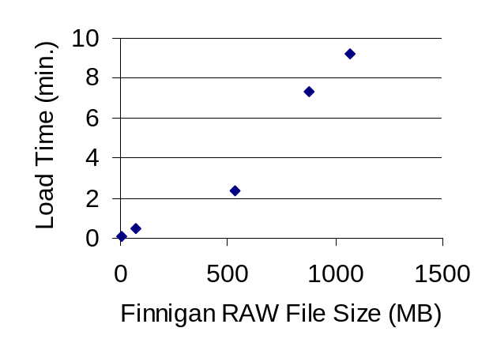
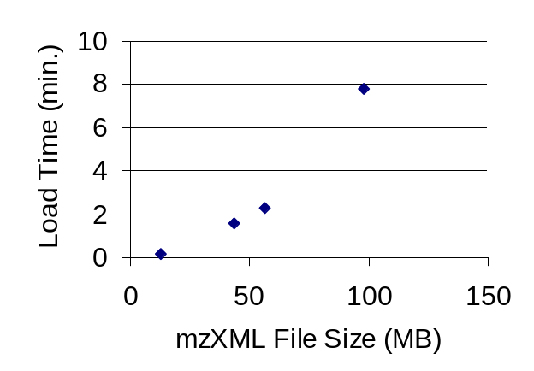
Processing Benchmarks
Processing stats for 3.2 GHz, Pentium 4 with 2 GB RAM
 | Finnigan Raw File Size (MB) | Total Spectra | Finnigan .Raw file |  | mzXML File |  | SIC Processing Time (minutes)
Instrument |  |  | Load time (minutes) | MB Used on Load | Load time (minutes) | MB Used on Load
LCQ | 10 | 2,779 | 0.1 | 52 | 0.2 | 73 | 0.2
LTQ | 74 | 19,298 | 0.5 | 151 | 7.8 | 258 | 2.9
LTQ_FT | 534 | 10,656 | 2.4 | 807 | 2.3 | 176 | 1.7
LTQ | 875 | 133,677 | 7.4 | 365 | mzXML file too large to test with current reader |  | 74
LTQ | 1067 | 150,034 | 9.2 | 413 |  |  | 78
Notes:
Computer has a 7200 RPM SATA drive

Slide 28
Summary
MASIC software creates selected ion chromatograms for LC-MS/MS data
Can read Finnigan RAW files, CDF/MGF, and mzXML
Output files include scan-based statistics, SIC details, and chromatograms
Integration of new data standard requires adding an appropriate data file reader
  Uses localized memory and disk caching of spectra
Procedure to make compiled version and source code available is underway

Slide 29
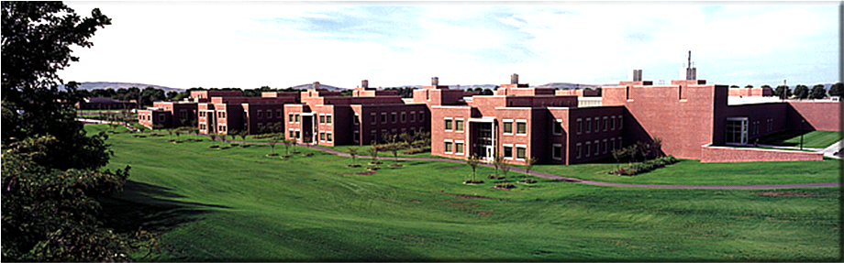
Acknowledgements
Dick Smith
Gordon Anderson
Deep Jaitly
Josh Adkins
Don Daly
Gary Kiebel
Funding
  Biological Sciences Initiative (BSI)
  Department of Energy (DOE)
  Genomes to Life (GtL)
  National Center for Research Resources (NCRR)

