Slide 1
Mage Application Using the Mage Library from Applications
G. R. Kiebel
January 11, 2012
Notes:
Mage is both a software library and a small set of applications that improve the process of extracting database and file data out of PRISM (particularly DMS).
I will talk some about the underlying structure of Mage, but mostly I will talk about one particular application program, Mage File Processor. I will walk through its operation in some detail, but the goal will be to give everyone a feeling for what it can do rather than the specific skill to operate it. For anyone who wishes to learn to use the program, I suggest downloading the program and going back through the presentation individually.

Slide 2
Available:
Installer:
Mage_Installer.msi at \\floyd\software\Mage
Bug reports, feature requests:
http://redmine.pnl.gov/projects/magefileprocessor
Latest Beta:
\\floyd\software\Mage\Beta
Latest Source:
SVN checkout: http://prismsvn.pnl.gov/svn/Infrastructure_Tools/Mage/Trunk

Slide 3
Getting Started
Which DLLs do you need?
Mage.dll (Mage.xml for intellisense)
MageDisplayLib.dll (MageDisplayLib.xml for intellisense)
System.Data.SQLite.dll (System.Data.SQLite.xml for intellisense)
log4net.dll
Where to get them?
Mage\MageFileProcessor\bin\Debug
Mage\MageFileProcessor\bin\Release
For advanced work:
MageUIComponents.dll
MageExtContentFilters.dll
MageExtExtractionFilters

Slide 4

Design Concept: Modular Pipelines
Reusable modules that do simple jobs
Formed into pipelines to perform data access tasks
Data Store
Module
Module
Module
Data Store
Easier to configure for multiple use cases
Easier to adapt to future needs

Slide 5
Complex Pipelines Made of Simple Modules
Modules can be used in multiple pipelines
Import or Copy
File
Reader (file)
Writer
(SQLite)
SQLite DB
Filter Contents
File
Reader
(file)
Filter
“X”
Writer
(file)
File
Modules chain together via their “standard” tabular inputs and outputs to make pipelines
Notes:
Instead of writing monolithic code, …

Slide 6
Modules
Modules handle tabular data
Tabular Data Input
Tabular Data Output
Module operations
Read metadata from DMS
Read data from file
Filter data
Write data to file
Write data to SQLite DB
Read data from SQLite DB
Etc.
Module
Tabular Data
Output
Tabular Data
Input
Filter
Data
Store
File
Database
Notes:
Tabular data

Slide 7
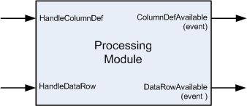
“Standard Tabular Input/Output”
Column definition
One event per pipeline run
Row data
One event for each data row
Module receives column definition event from upstream module
Module fires column definition event to inform downstream modules of what it will be sending them.
Module receives row events from upstream module, one event per row. Data is an array of objects, previously received column definitions are used to understand fields in row data.
Module fires row data events to deliver data to downstream modules, one event per row, terminated by event with “DataAvailable” set false

Slide 8
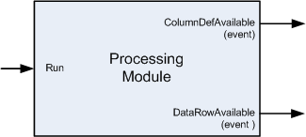
Root Module
Root Module is first module in pipeline
There is no standard tabular input to give it
Starts data stream on standard tabular output when Run() is called.
Data
Store
File
Database

Slide 9
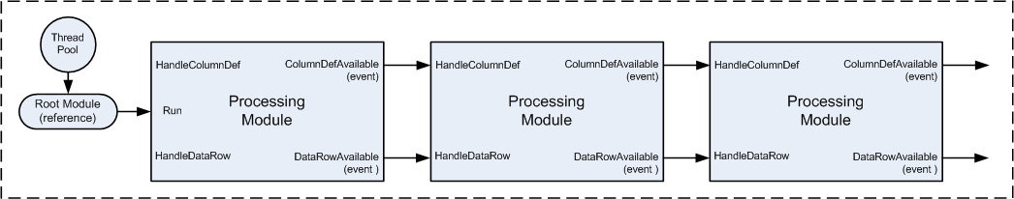
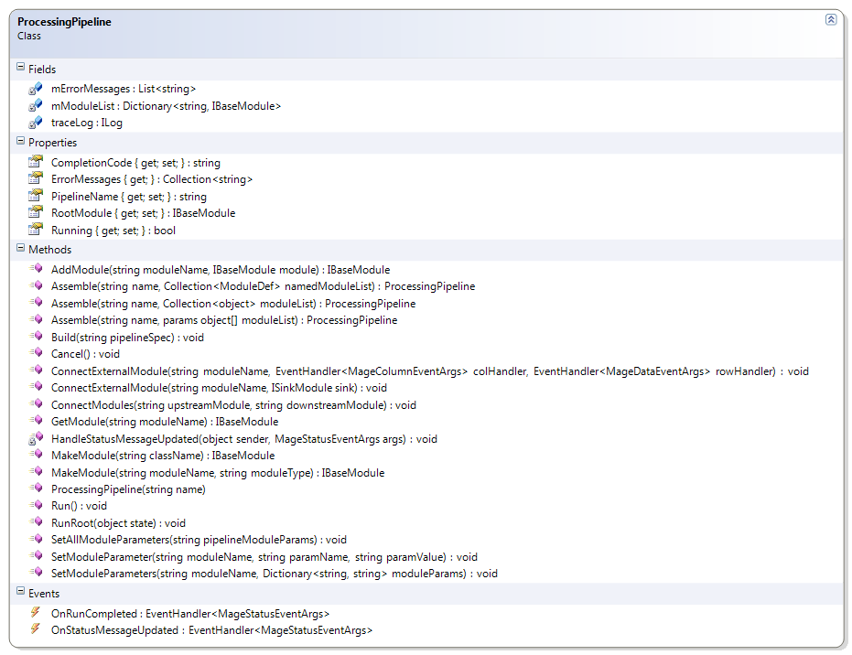
Mage Pipeline Object
Pipeline Contains modules
Downstream modules register their input handlers for upstream module’s output events
First module in chain is “Root Module”. Pipeline will call its “Run” method.

Slide 10
Example Pipeline Code
File
Reader (file)
Writer
(SQLite)
SQLite DB
public static void ImportFileToSQLite(string inputFilePath, string dbFilePath, string dbTableName) {
DelimitedFileReader reader = new DelimitedFileReader();
reader.FilePath = inputFilePath;
SQLiteWriter writer = new SQLiteWriter();
writer.DbPath = dbFilePath;
writer.TableName = tableName;
ProcessingPipeline.Assemble("ImportPipeline", reader, writer).RunRoot(null);
}

Slide 11
Running The Pipeline
Run pipeline in current thread:
Run pipeline in separate thread:
Setting up to receive status updates from pipeline:
Terminating running pipeline:
pipeline.RunRoot(null);
pipeline.Run();
pipeline.OnStatusMessageUpdated += HandleStatusUpdateMessage;
pipeline.OnRunCompleted += HandlePipelineCompletionMessage;
pipeline.Cancel();

Slide 12
Caveat:
Modules and pipelines should be considered one-shots:
Generally, internal state too complicated to clear for re-use
There are a few exceptions

Slide 13
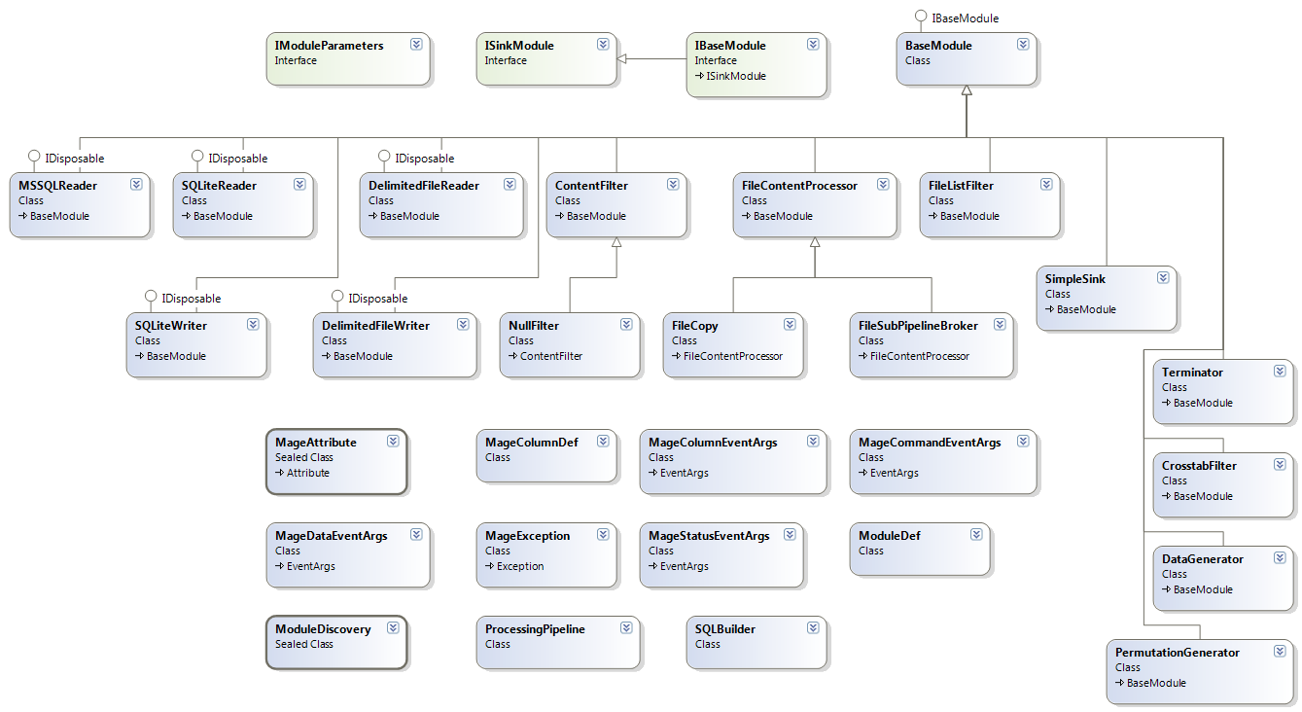
Mage Module And Pipeline Classes

Slide 14
Mage Input and Output Modules

Slide 15
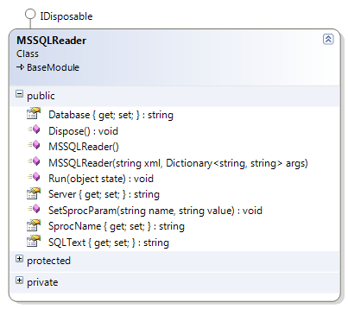

MSSQLReader Module
Get data rows from MS SQL Server via SQL query or stored procedure call and deliver to standard tabular output
MSSQLReader
MS SQLServer

Slide 16
MSSQLReader – Usage
Use straight database query as source of rows:
MSSQLReader reader = new MSSQLReader();
reader.Server = "gigasax";
reader.Database = "DMS5";
reader.SQLText = string.Format("SELECT * FROM V_X WHERE ID IN ({0})", datasetIDList);
Use stored procedure as source of rows:
MSSQLReader reader = new MSSQLReader();
reader.Server = "Porky";
reader.Database = "MT_Shewanella_ProdTest_Formic_P460";
reader.SprocName = "PMExportFeatures";
reader.SetSprocParam("@MDIDs", "5984, 5985, 5986";);
reader.SetSprocParam("@message", "-");

Slide 17
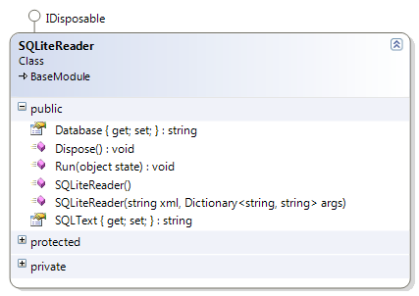
SQLiteReader Module
Get data rows from SQLite3 database via SQL query and deliver to standard tabular output
SQLiteReader
SQLite3
Database

Slide 18
SQLiteReader - Usage
public static SimpleSink ReadSQLiteDB() {
SQLiteReader reader = new SQLiteReader();
SimpleSink sink = new SimpleSink();
reader.Database = "//path/to/sqlite/database/file";
reader.SQLText = "SELECT * FROM …";
ProcessingPipeline.Assemble("SQLite_Reader“, reader, sink).RunRoot(null);
return result;
}

Slide 19
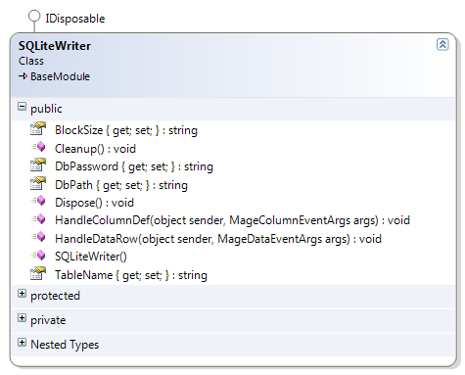
SQLiteWriter Module
Insert data rows from standard tabular input into SQLite3 database table
SQLiteWriter
SQLite3
Database

Slide 20
SQLiteWriter - Usage
public static void ImportFileToSQLite(string inputFilePath) {
DelimitedFileReader reader = new DelimitedFileReader();
reader.FilePath = inputFilePath;
SQLiteWriter writer = new SQLiteWriter();
string tableName = "“;
writer.DbPath = "//path/to/sqlite/database/file";
writer.TableName = “name_of_table”;
ProcessingPipeline.Assemble("ImportToSQLite", reader, writer).RunRoot(null);
}

Slide 21
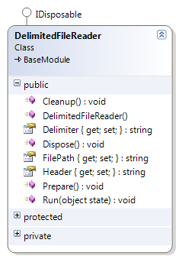

DelimitedFileReader Module
Read data rows from delimited text file and deliver to standard tabular output
DelimitedFile
Reader
Delimited Text File

Slide 22
DelimitedFileReader - Usage
public static void ImportFileToSQLite() {
DelimitedFileReader reader = new DelimitedFileReader();
reader.FilePath = "//path/to/delimited/file";
SQLiteWriter writer = new SQLiteWriter();
string tableName = "“;
writer.DbPath = "//path/to/sqlite/database/file";
writer.TableName = “name_of_table”;
ProcessingPipeline.Assemble("ImportToSQLite", reader, writer).RunRoot(null);
}
Additional properties:
Delimiter:
Set a specific character as delimiter (default will recognize either tab-delimited or comma-delimited files)
Header:
Whether or not input file has a header line ("Yes" or "No")

Slide 23
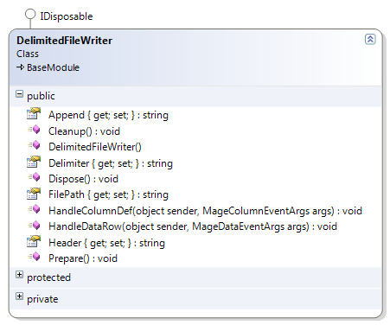
DelimitedFileWriter Module
Write data rows from standard tabular input to delimited text file
DelimitedFile
Writer
Delimited Text File

Slide 24
DelimitedFileWriter - Usage
public static void ExportSQLiteToFile() {
SQLiteReader reader = new SQLiteReader();
reader.Database = "//path/to/sqlite/database/file";
reader.SQLText = "SELECT * FROM ...";
DelimitedFileWriter writer = new DelimitedFileWriter();
writer.FilePath = "//path/to/delimited/output/file";
ProcessingPipeline.Assemble("ExportPipeline", reader, writer).RunRoot(null);
}

Slide 25
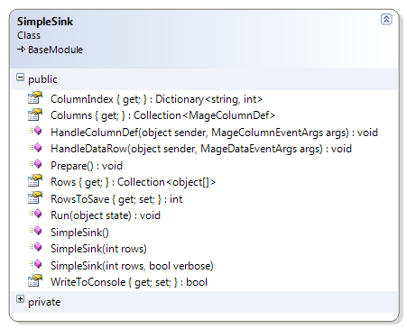
SimpleSink Module
Collects data rows from standard tabular input
Contents accessible via Rows property after pipeline run
Can be used as source module in another pipeline
SimpleSink

Slide 26
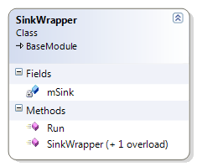
Sink Wrapper Module
Proxy for SimpleSink object that can be source module
Used when single SimpleSink object needs to be source for more than one pipeline
SimpleSink
SinkWrapper
Run()

Slide 27
Mage Filter Modules

Slide 28
Filter Modules
Can produce a different standard tabular output than what they receive on their standard tabular input
Remap columns (rename, reposition, add, or remove)
Decide whether to pass input data rows to output
Reader
Filter
“X”
Writer

Slide 29
Column Mapping
Mage filter modules can remap columns
Output columns can be different than input column
Renamed
Repositioned
Removed
Created (within limits)
Data Type Changed
Controlled by OutputColumnList property
NullFilter module is handy for this

Slide 30
Column Mapping - Example
Column mapping defined by string
OutputColumnList property
Alpha
Beta
Gamma
Delta
OutputColumnList = “George|Gamma, Delta, Bob|+|text, Beta”
Mage
Filter
Module
George
Delta
Bob
Beta

Slide 31
Column Mapping - OutputColumnList
Mapping parameter is string with comma-delimited list of fields
Each field defines an output column
Each output column definition has sections set off by vertical bar:
output column name|input column name|data type|data size
Only columns that are defined in column mapping appear in output
Using “+” for input column name means output column is created new
Using “*” for column def means “include all input columns not already mapped”
Data type and data size are optional (except for new columns)

Slide 32
NullFilter
Passes all input rows to output rows and applies mapping
Convenient to handle column mapping in pipelines (input and output modules don’t always provide the feature)
DelimitedFile
Reader
NullFilter
SQLiteWriter
OutputColumnList
Delimited Text File
SQLite3
Database

Slide 33
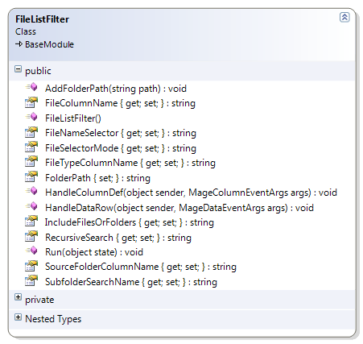

FileListFilter Module
Searches folder paths given by column in standard tabular input
Selects files using name filter
Delivers file list to standard tabular output
List
Of
Folders
To Search
FileListFilter
List
Of
Files
Found
Folders

Slide 34
FileListFilter - Input
Standard tabular input must include a column that contains path to source folder to be searched
The “SourceFolderColumnName” property specifies name of this column
It defaults to “Folder”
FileListFilter
Alpha
Beta
Folder
Folders

Slide 35
FileListFilter - Output
FileListFilter
Item
File
File_Size_KB
Folder
Folders
Module will search each source folder and deliver a description of each file and/or subfolder as a record in standard tabular output
Default output record will have four fields (with names specified by following module properties):
FileTypeColumnName (Default: “Item”)
FileColumnName (Default: “File”)
FileSizeColumnName (Default: “File_Size_KB”)
SourceFolderColumnName (passed through from input )

Slide 36
FileListFilter - Search
File/Folder search is controlled by module properties:
FileSelectorMode
"RegEx“ (Default)
“FileSearch"
IncludeFilesOrFolders
"File“ (Default)
"Folder"
"IncludeFilesOrFolders"
RecursiveSearch
"No“ (Default)
"Yes"

Slide 37
FileListFilter – Column Mapping
Columns from standard tabular input can be included in output record using OutputColumnList property
The four default output column names must then be included explicitly
Alpha
Beta
Folder
OutputColumnList = "Item|+|text, File|+|text, File_Size_KB|+|text, Folder, Alpha, Beta"
FileListFilter
Item
File
File_Size_KB
Folder
Alpha
Beta

Slide 38
FileListFilter – Root Mode
Module can be operated as root module in pipeline
Folder paths to be searched are specified by calling AddFolderPath() for each folder prior to pipeline run
Standard tabular input is ignored
FileListFilter
Folders

Slide 39
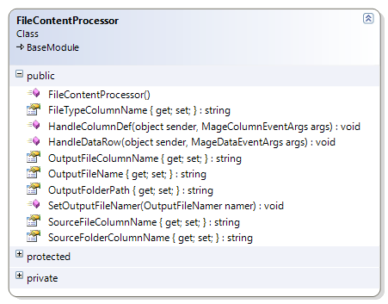
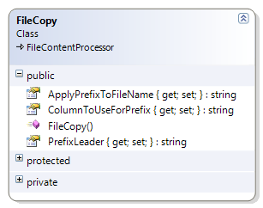

FileCopy Module
Copies given files/folders to specified output folder
Items to copy given by columns in standard tabular input
Delivers file list to standard tabular output
Used for building Manifest
List
Of
Files
And
Subfolders
To Copy
FileCopy
List
Of
Files
And
Subfolders
Copied
Copy

Slide 40
FileCopy - Input
Standard tabular input must contain columns that specify file or folder path to copy:
SourceFileColumnName (Default: "File") - Name of column that contains name of file or subfolder to copy
SourceFolderColumnName: (Default: "Folder") - Name of column that contains path to folder that contains file or subfolder to copy
FileTypeColumnName: (Default: "") (optional) - Name of column that contains indicator of whether item is file or subfolder (if blank) presumed to be a file
Necessary when input records include subfolders
FileCopy
Item
File
Folder

Slide 41
FileCopy - Action
Each file or subfolder given by input will be copied to output folder specified by OutputFolderPath property
Output file name can be (optionally) dynamically changed:
ApplyPrefixToFileName: Apply prefix to input file name if “Yes”
ColumnToUseForPrefix: Prepend contents of given input column (optional)
PrefixLeader: Literal text to apply as first part of prefix (optional)
FileCopy
Copy

Slide 42
FileCopy - Output
Module will output a standard tabular output record for each file copied (useful for creating a manifiest)
By default, there will be two output columns:
SourceFolderName from input record is included in default record
File name (including dynamic modifications, if any) is included in default record in column named “File” (column name can be changed by setting OutputFileColumnName property)
Columns from the input record can be included by setting OutputColumnList property
FileCopy
File
Folder
Alpha
Beta

Slide 43
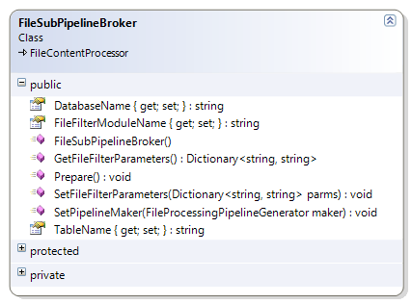
FileSubPipelineBroker Module
Processes contents of files referenced by standard tabular input using sub-pipeline created for each file
Delivers list of files processed to standard tabular output
File
SubPipeline
Broker
Sub-Pipeline
Process

Slide 44
FileSubPipelineBroker - Input
Standard tabular input must contain columns that specify file or folder path to copy:
SourceFileColumnName (Default: "File“) – Name of column that contains name of file or subfolder to copy
SourceFolderColumnName: (Default :"Folder“) – Name of column that contains path to folder that contains file or subfolder to copy
File
SubPipeline
Broker
Item
File
Folder

Slide 45
FileSubPipelineBroker - Action
Inner pipeline will be created and run for each file in input:
Results of inner pipeline will be delivered to folder specified by OutputFolderPath property.
Name of filter module to include in default inner pipeline given by FileFilterModuleName property (or "All Pass“) and parameters for it by the SetFileFilterParameters property (parameters as delimited string "key:value; key:value;”)
If results of inner pipeline are to be delivered to SQLite database, DatabaseName property must be set with file name. TableName property can name a single table to receive all results, or be blank (results will be delivered to multiple tables, one per input file)
If results in inner pipeline are to be concatenated to single file, its name should be set in property OutputFileName (optional) (if blank, results will be delivered to separate files).

Slide 46
FileSubPipelineBroker - Output
Module will output a standard tabular output record for each file copied (useful for creating a manifiest)
By default, there will be two output columns:
SourceFolderName from input record is included in default record
File name (including dynamic modifications, if any) is included in default record in column named “File” (column name can be changed by setting OutputFileColumnName property)
Columns from the input record can be included by setting OutputColumnList property
File
SubPipeline
Broker
File
Folder
Alpha
Beta

Slide 47
DataGenerator
Mage module that can generate a simulated data stream on Mage standard tabular output or accept a set of data that it will stream to ouput

Slide 48
Mage Display-Related Modules

Slide 49
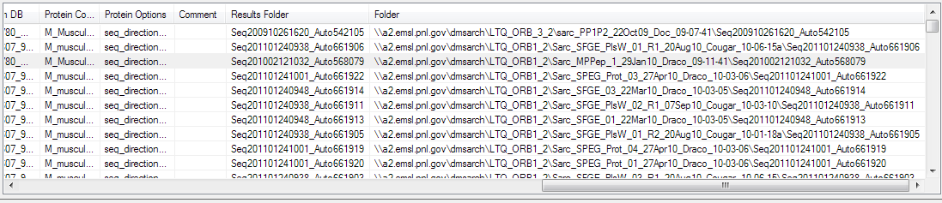
GridViewDisplayControl
Provides grid display for tabular data
Implements standard tabular input
Implements ISinkModule interface
Can be dropped into pipeline (recognized by “Assemble()”)
Can supply contents via standard tabular output
Using instance of GVPipelineSource as adapter:
In MageDisplayLib DLL
BaseModule source = new GVPipelineSource(FileListDisplay, mode);

Slide 50
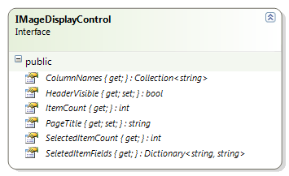
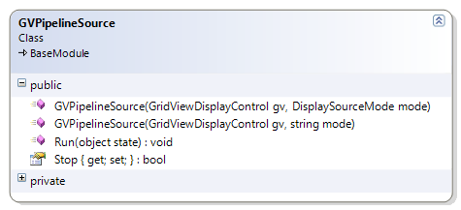
GVPipelineSource
Can serve contents of associated GVDisplayList to standard tabular output and function as root module in pipeline

Slide 51
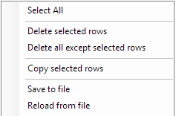
GridViewDisplayList Built-In UI Features
Right-clicking on display lists brings up menu of useful actions…
Remove rows from list
Copy rows to clipboard
Save list to file
Reload list from file

Slide 52
Creating Filter Modules

Slide 53
Creating New File Processing Filters
Mage modular pipeline streamlines adding new filters
Code can focus on algorithm
Can ignore input and output issues
Handled by pipeline
Minimal “housekeeping” requirements
In simplest case, only need to override one inherited function
Easy to install new filters
Can be in separate DLL file and dropped into application folder
Reader
Filter
“X”
Writer
Notes:
The underlying Mage modular pipeline infrastructures minimizes the amount of code that has to be written for a new filter. Filters can be packaged in separate DLLs and dropped into place.

Slide 54
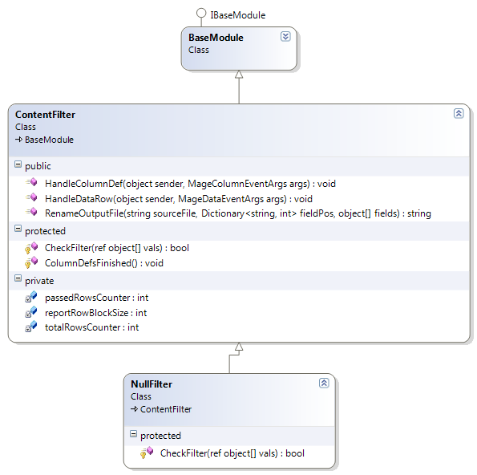
Filter Modules
Usually subclass of ContentFilter class

Slide 55
Creating Your Own Simple Filter
[MageAttribute("Filter", "XCorr", "XCorr Example", "Simple filter for SEQUEST results (XCorr > 2.0)")]
class XCorrExample : ContentFilter {
// Indexes into the row field data array
private int xCorrIdx = 0;
// Precalulate field indexes
protected override void ColumnDefsFinished() {
// set up indexes into fields array
xCorrIdx = this.InputColumnPos["XCorr"];
}
// This is called for each input data row that is being filtered.
// the fields array contains value of each column for the row
protected override bool CheckFilter(ref object[] fields) {
bool accepted = false;
// convert XCorr from text to number
// and accept it if it meets minimum value
double v = 0;
double.TryParse((string)fields[xCorrIdx], out v);
if (v > 2.0) {
accepted = true;
}
// apply output column mapping (if active)
if (accepted && OutputColumnDefs != null) {
fields = MapDataRow(fields);
}
return accepted;
}
}

Slide 56
Pipeline Queue

Slide 57
Pipeline Queue
Execute multiple Mage pipelines in sequence in thread
Used for complex workflows
Pipeline
Pipeline
Queue
Module
Module
Module
Pipeline Ref
Pipeline Ref
Pipeline
Pipeline Ref
Module
Module
Module
Pipeline
Module
Module
Module

Slide 58
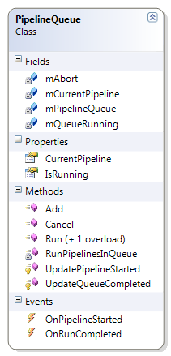
Pipeline Queue
Methods
Add pipelines to queue
Run queue
Properties:
Is queue currently running?
Which pipeline is currently running?
Events:
Next pipeline has been started
All pipelines in queue have been run

Slide 59
Examples of Complex Pipelines

Slide 60
MageExtractor Pipelines
Job Results Folder
“Get Jobs” Pipeline
MSSQL
Reader
GridView
Display
“Search For Files” Pipeline
GVPipeline
Source
1
File List
Filter
2
Add Assoc.
File
3
Simple
Sink
Pipeline Queue
Pipeline Ref
1
Job, Results Folder Path
Pipeline Ref
“Process Files” Pipeline
2
Job, Results Folder Path, Result File Name
Sink Wrapper
3
File Content
Extractor
3
Job, Results Folder Path, Result File Name, MSGF File Name
4
Job, Results
5
Job, Results, MSGF
6
Job, Results, MSGF, Proteins (XT)
“Extract File Contents” Sub-Pipeline
Delimited File Reader
4
MSGF
Filter
5
Extraction
Filter
6
*Writer
ExtractionFilter
SequestExtractionFilter
XTandemExtractionFilter
FilterXTResults
FilterSequestResults
Results File
MSGF File
XT “Merge” Files

Slide 61
MageExtractor Pipelines (Continued)
Dataset_xt.txt
“Extract File Contents” Sub-Pipeline
Delimited File Reader
4
File Content
Extractor
6
*Writer
Dataset_xt_MSGF.txt
“Load MSGF Lookup” Sub-Pipeline
ExtractionFilter
SequestExtractionFilter
XTandemExtractionFilter
FilterXTResults
FilterSequestResults
Delimited File Reader
x
Key/ValueSink
Dataset_xt_ResultToSeqMap.txt
“Load Map Lookup” Sub-Pipeline
Delimited File Reader
x
Key/ValueSink
Dataset_xt_SeqToProteinMap.txt
“Load Map Lookup” Sub-Pipeline
Delimited File Reader
x
Keyed CollectionSink

Slide 62
Advanced SQL Features

Slide 63
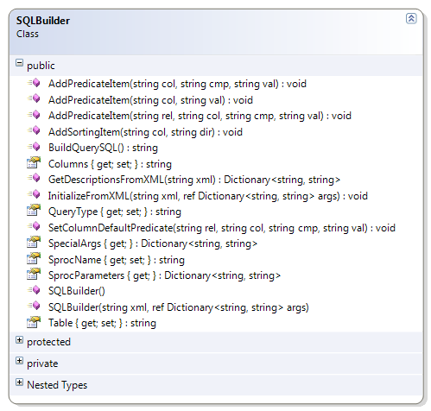
SQLBuilder Class
Helper class for building SQL queries from templates and runtime parameters.

Slide 64
Query Template Definition
QueryDefinitions.xml
<?xml version="1.0" encoding="utf-8" ?>
<queries>
<query name='Mage_Analysis_Jobs'>
<description>Get selected list of analysis jobs</description>
<connection server='gigasax' database='DMS5'/>
<table name='V_Mage_Analysis_Jobs' cols='*'/>
<predicate rel='AND' col='Job' cmp='Equals' val=''>Descriptive text for Job</predicate>
<predicate rel='AND' col='Dataset' cmp='ContainsText' val=''>Descriptive text for Dataset</predicate>
<sort col='Job' dir='ASC'/>
</query>
<query name='GetMassTagsPlusPepProphetStats'>
<description>Get mass tags for given MT database</description>
<connection server='elmer' database='MT_Human_Sarcopenia_QC_P584'/>
<sproc name='GetMassTagsPlusPepProphetStats'/>
<param name="@MassCorrectionIDFilterList" value="" >Descriptive text for MassCorrectionIDFilterList</param>
<param name="@ConfirmedOnly" value="0" >Descriptive text for ConfirmedOnly</param>
<param name="@MinimumHighNormalizedScore" value="0" >Descriptive text for MinimumHighNormalizedScore</param>
<param name="@MinimumPMTQualityScore" value="9" >Descriptive text for MinimumPMTQualityScore</param>
<param name="@NETValueType" value="0" >Descriptive text for NETValueType</param>
<param name="@MinimumHighDiscriminantScore" value="0" />
<param name="@ExperimentFilter" value="" >Descriptive text for ExperimentFilter</param>
<param name="@ExperimentExclusionFilter" value="" >Descriptive text for ExperimentExclusionFilter</param>
<!-- if "val" attribute is missing, parameter definition not automatically included in sproc call -->
<param name="@JobToFilterOnByDataset" >Descriptive text for JobToFilterOnByDataset</param>
<param name="@MinimumPeptideProphetProbability" >Descriptive text for MinimumPeptideProphetProbability</param>
</query>
</queries>

Slide 65
SQLBuilder Class – Example Code
MSSQLReader target = new MSSQLReader();
target.Server = "gigasax";
target.Database = "DMS5";
string[] colList = new string[] { "Dataset", "Dataset_ID", "Factor", "Value" };
string colNames = string.Join(", ", colList);
SQLBuilder builder = new SQLBuilder();
builder.Table = "V_Custom_Factors_List_Report";
builder.Columns = colNames;
builder.AddPredicateItem("Dataset", "sarc");
target.SQLText = builder.BuildQuerySQL();
target.Run(null);

Slide 66
MSSQLReader – Example Code
Set server, database, and query from query template and runtime values:
// runtime parameters for query
Dictionary<string, string> runtimeParameters = new Dictionary<string, string>();
runtimeParameters["@ExperimentFilter"] = "sarc";
// get XML query definition by name
string queryDefXML = ModuleDiscovery.GetQueryXMLDef("GetMassTagsPlusPepProphetStats");
// create MSSQLReader module initialized from XML definition
MSSQLReader target = new MSSQLReader(queryDefXML, runtimeParameters);

Slide 67
Module Loading

Slide 68
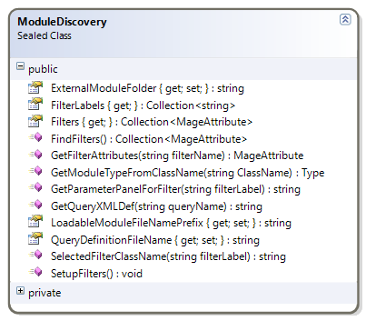
ModuleDiscovery Class
Provides methods for dynamic creation of Mage modules and discovery of Mage components in DLLs.

Slide 69
Create Module Dynamically
Module can be created from class name
Class can be in Mage
Class can be in external DLLs
DLLs must follow naming convention (“MageExt_*.dll”)
IBaseModule mod = ProcessingPipeline.MakeModule(“Name_of_class");
IBaseModule mod = ProcessingPipeline.MakeModule("DelimitedFileReader");
IBaseModule mod = ProcessingPipeline.MakeModule("MSSQLReader");
IBaseModule mod = ProcessingPipeline.MakeModule("SQLiteReader");

Slide 70
Creating Your Own Mage Modules

Slide 71
Creating Your Own Mage Module
using Mage;
namespace MyStuff {
class MyMageModule : BaseModule {
public override void HandleColumnDef(object sender, MageColumnEventArgs args) {
base.HandleColumnDef(sender, args); // need to call base functionality
OnColumnDefAvailable(args); // pass it along to our standard tabular output
// do something with column definitions
//...
}
public override void HandleDataRow(object sender, MageDataEventArgs args) {
if (args.DataAvailable) {
// do something with data row
//...
}
OnDataRowAvailable(args); // pass it along to our standard tabular output
}
}
}

Slide 72
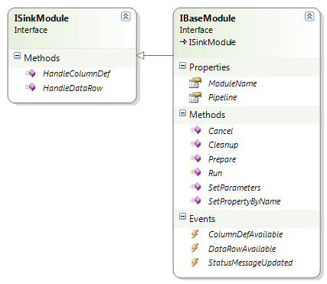
Module Interfaces
Define common connections for all Mage modules
Implementing ISinkModule allows module to receive standard tabular input and be recognized by Assemble method, however, it cannot provide standard tabular output.
Implementing IBaseModule allows module to provide all module functions and be recognized by Assemble method

Slide 73
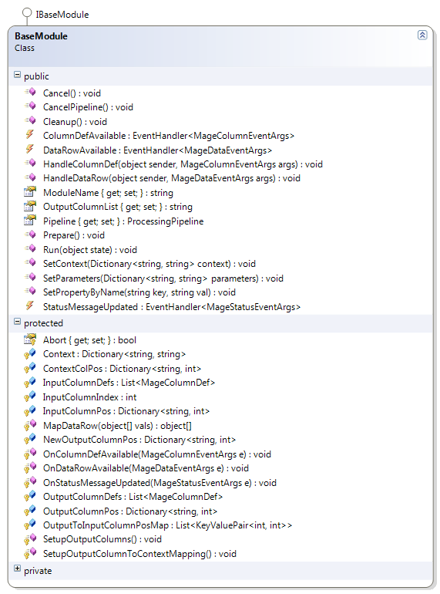
BaseModule Class
Base class for all Mage modules in library
Implements functions defined in IBaseModule interface
Implements necessary or convenient functions that subclasses can use

