Slide 1
Mage Swiss Army Knife™ for PRISM Data Extraction
G. R. Kiebel
February 11, 2011
Notes:
Mage is both a software library and a small set of applications that improve the process of extracting database and file data out of PRISM (particularly DMS).
I will talk some about the underlying structure of Mage, but mostly I will talk about one particular application program, Mage File Processor. I will walk through its operation in some detail, but the goal will be to give everyone a feeling for what it can do rather than the specific skill to operate it. For anyone who wishes to learn to use the program, I suggest downloading the program and going back through the presentation individually.

Slide 2
Mage?
It’s an acronym?
No.
What does it mean?
Nothing, really.
Vaguely related to idea of data “sourcer”, which sounds kind of like “sorcerer”, which is three syllables and eight letters. “Mage” is a way of saying “sorcerer” in four letters and one syllable.
Seriously, there has to be an acronym – right?
Take your pick:
Massively Adaptable Gathering Engine
More Acceptable “Grabber” Epithet
Munge And Grab Everything
…
Notes:
The important stuff out of the way first.

Slide 3


DMS Metadata and File Storage
DMS
Archive (Aurora)
DMS
Tracking
Entities
Campaign
Dataset Folder
Biomaterial
Experiment
Raw Data
Requested
Run
Dataset
Analysis Results Folder
Factors
Analysis
Job
Analysis Results
Metadata
Files
Notes:
To clarify what data and files we are talking about. DMS metadata is mostly centered in the main tracking entities in DMS. Files are of two kinds: Dataset files and analysis results files. Dataset files are mostly raw data files captured from an instrument run, with some additional files produced by the capture process. Dataset files are kept in a dataset folder on the EMSL archive. Each dataset entity in DMS tracks the location of its associated dataset folder. Similarly, results files produced by analysis jobs in the analysis pipeline are kept in analysis results folders. Each analysis job entity in DMS tracks the location of its associated folder. Analysis jobs belong to a particular dataset, and analysis results folders are kept in the associated dataset folders.

Slide 4
Caveat
Access to files may fail.
Too New:
DMS managed files are stored on the EMSL archive (Aurora), and that is where DMS looks to find them. It can take some time for newly acquired datasets to show up there because of the capture process.
Too Old:
Aurora moves files that haven’t been accessed recently from disk to tape. Such files will appear normal in directory lists, but access will time out and fail. Aurora will automatically bring such files back from tape to disk, but it can take up to an hour.

Slide 5
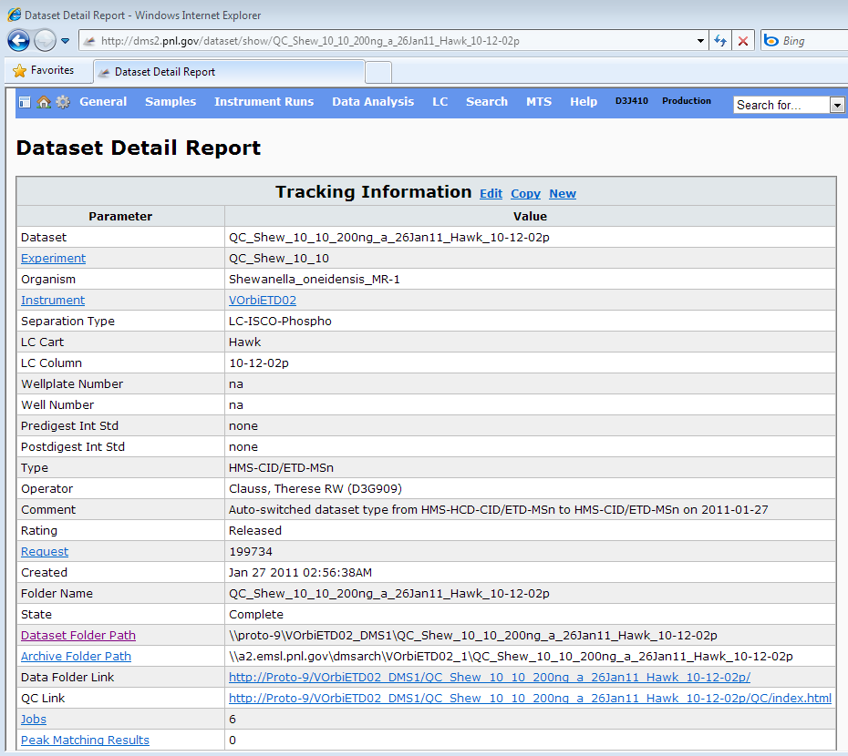
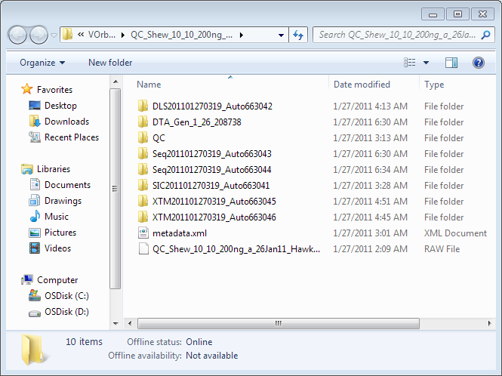
Issues
DMS web interface provides access to one folder at a time
Doesn’t work for multiple datasets or jobs
Analysis tools each have their own DMS access code
Inconsistent
Consumes developer time
Notes:
There are a couple of issues with how we traditionally have accessed that have become more problematic recently. One is that the main DMS web interface only provides access to the file data for one dataset or analysis job at a time. Another is that developers of stand alone tools need to write new code each time.

Slide 6
Opportunity
Shared software for accessing DMS data files and DMS/MTS metadata
Code library for analysis tools to use
One or more applications for researchers to use
Better use of researchers’ and developers’ time
Notes:
This presents us with an opportunity to make better use of researcher’s and developer’s time by providing software to streamline getting data out of DMS.

Slide 7
Outgrowth of MDART Data Import
John Sandoval
Needed to add more data import capabilities to MDART
Gathered the initial requirements
Working name: “Grabber”
Accepted new role as tool development team lead
No time for coding
Gary Kiebel
Felt guilty about helping to talk John into accepting new role
Volunteered to be the developer

Slide 8
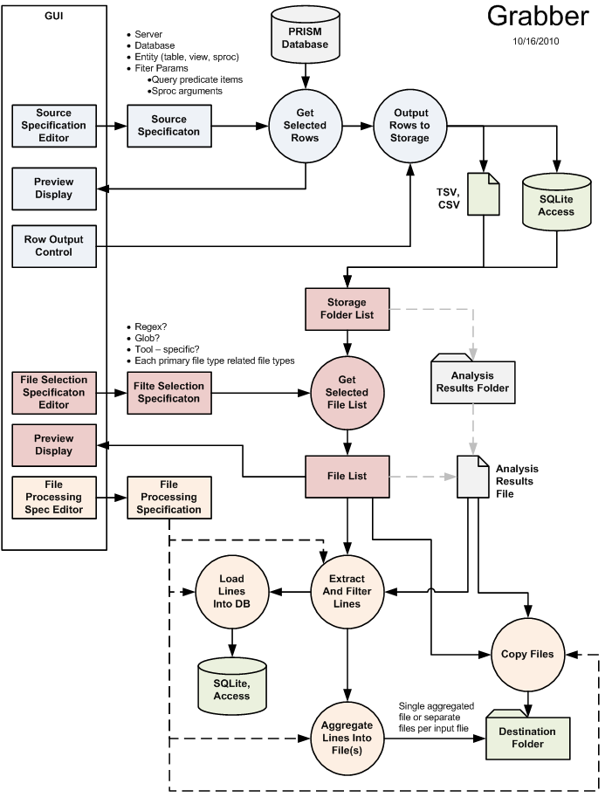
Initial Analysis
Concept was simple
Use cases were diverse
Get lists of DMS jobs
Get lists of DMS datasets
Multiple types of files
Diverse processing:
Copy files
Filter file content
Lots(!) of different filters
Rearrange data structure
Save data to files/databases
Retain DMS metadata
No hope for a simple solution

Slide 9
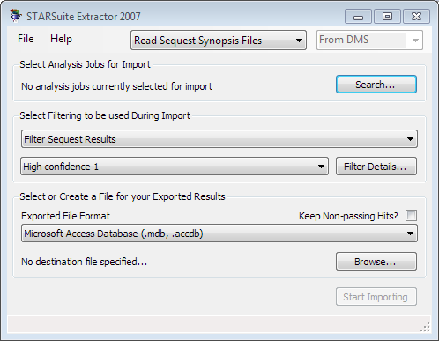

Why Not Extend StarSuite Extractor?
It was designed to be really focused on extracting peptide identifications from Sequest results (later X!Tandem).
Handling other use cases would require a major rewrite.
Doesn’t really provide library for other applications to use.
Not all was lost: SEQUEST and X!Tandem filtering code was ported to Mage

Slide 10
Design Concept: Modular Pipelines
Reusable modules that do simple jobs
Formed into pipelines to perform data access tasks
Data Store
Module
Module
Module
Data Store
Easier to configure for multiple use cases
Easier to adapt to future needs

Slide 11
Modules
Modules handle tabular data
Tabular Data Input
Tabular Data Output
Module operations
Read metadata from DMS
Read data from file
Filter data
Write data to file
Write data to SQLite DB
Read data from SQLite DB
Etc.
Module
Tabular Data
Tabular Data
Data
Store
File
Database
Notes:
Tabular data

Slide 12
Pipelines
Import or Copy File
File
Reader (file)
Writer
(SQLite)
SQLite DB
Filter Contents of File
Modules can be reused in multiple pipelines
File
Reader
(file)
Filter
“X”
Writer
(file)
File
Complex Filtering, Multiple Outputs
Database
Reader
(DMS)
Filter “
X”
Writer
(SQLite)
SQLite DB
Modules chain together via their “standard” tabular inputs and outputs to make pipelines
Filter
“Y”
Writer (file)
File
Notes:
Instead of writing monolithic code, …

Slide 13
Pipelines (Continued)
“Outer” pipeline handles list of files to be processed
Pipelines can be nested
Filter Contents of Multiple Files
Outer Pipeline
Reader
(DMS)
Pipeline
Handler
Writer
(file)
Sub-Pipeline
Reader
(file)
Filter
“X”
Writer
(file)
A “sub-pipeline” is created and run for each file to process its contents

Slide 14
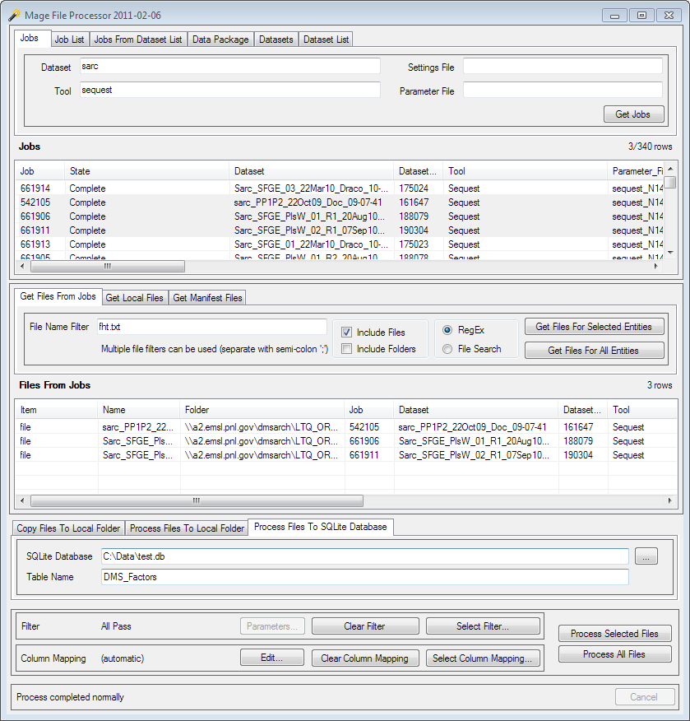
Mage File Processor
Tool for extracting files and file contents from DMS
Mage pipelines do the heavy lifting
It is complicated, but you have to start somewhere…

Slide 15
Strategy Of Operation
If file source is DMS, Choose and perform DMS query to get list of DMS entities having files (Datasets and Analysis Jobs)
List of files can come from different sources:
Query DMS And Search Folders
Local Folder
Local File List (Manifest)
List of Jobs or Datasets will display here.
If file source is local folder…
If file source is local manifest…
Get a list of files to process
(display in this list)
Job or Dataset folders will be searched for files, which will display in this list.
It will be searched for files which will display in this list.
Its contents will be read
and displayed in this list.
Choose and apply processing to the files
Copy to local folder
Extract and filter contents

Slide 16
Example Tasks
Copy files from DMS
Copy folders from DMS
Process file contents

Slide 17
Example Task: Get Files From DMS
Get selected feature files for Sarcopenia Mini-Study
Search DMS for pertinent analysis jobs
Get selected list of feature finder analysis results files for jobs
Copy files to local folder

Slide 18
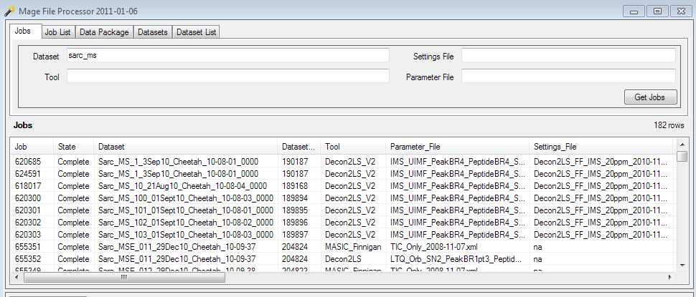
Get List Of Jobs
Choose how you want to search for jobs
Set job search criteria
Click to search DMS for jobs
Jobs that meet search criteria are displayed in list

Slide 19
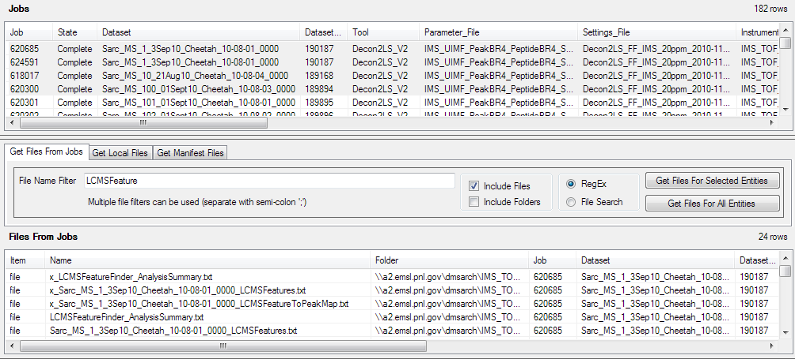
Search Analysis Results Folders For Files
Starting with list of jobs from previous step…
Set Filtering for files / folders
Click to get list of files (all or selected)
Optional: Select specific jobs to search
Analysis Job results folders for Jobs in list will be searched and files that meet search criteria are displayed in list

Slide 20
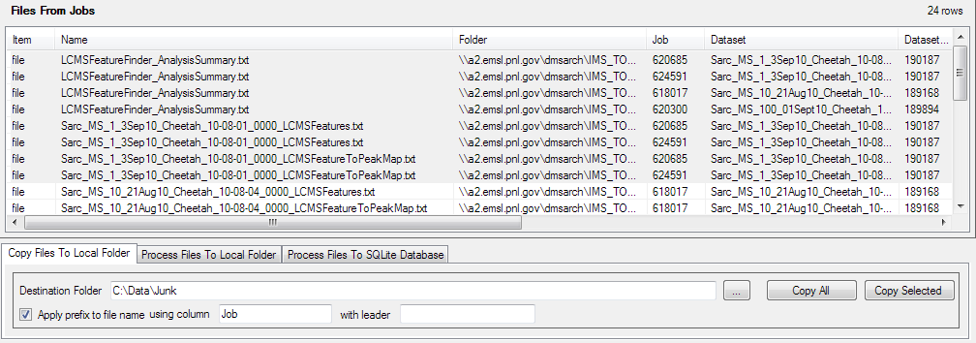
Copy Files To Local Folder
Select “Copy” operation
Starting with list of files from previous step…
Optional: Select specific files to copy
Click to copy files
(all or selected)
Select local folder to receive copies of files

Slide 21
Automatic Prefix Function
An automatic prefix can be optionally applied to the name of each copied file or folder
Useful when files/folders would otherwise have the same name
The value contained in the specified column will be used for prefix
Use of prefix can be turned on or off
The literal text in the leader field (optional) will appear at front of prefix

Slide 22
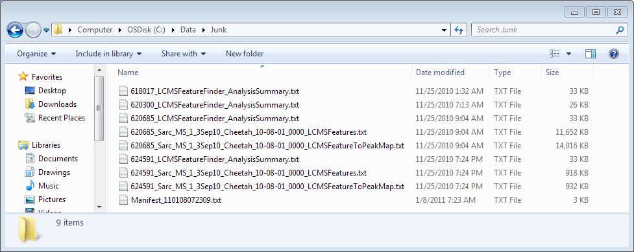
Results:
Prefix was automatically applied to each file name
Manifest file was automatically created

Slide 23
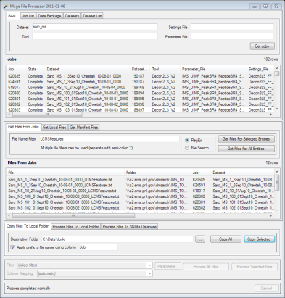
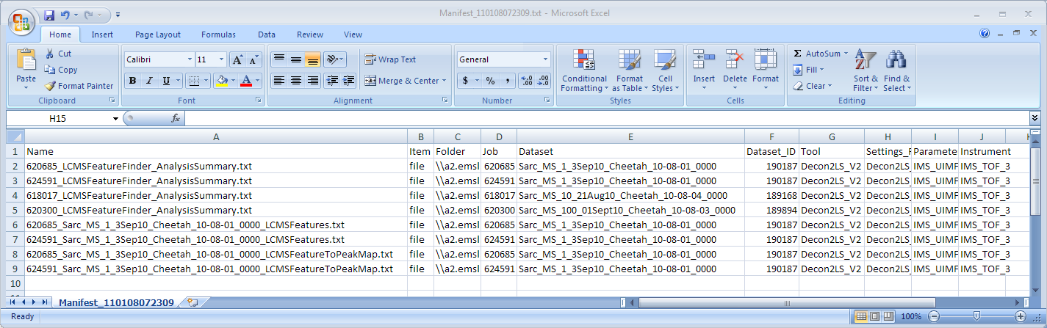
Manifest File
List of files/folders that were copied
Metadata about files that were copied
Stays with files in destination folder
Usually same information as in file list

Slide 24
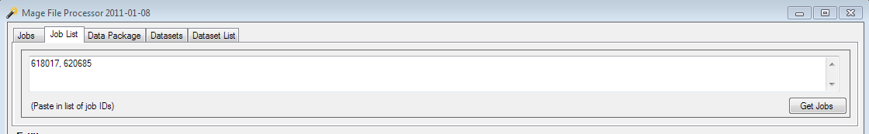
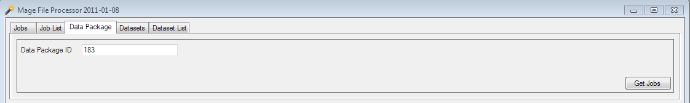
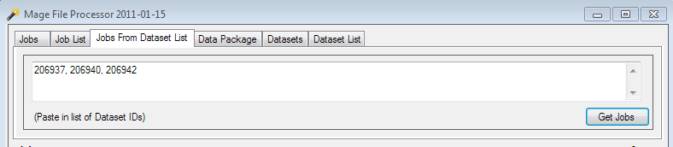
Alternate Job Searches
Paste in list of Job numbers
(for example, from a DMS list report)
Jobs from list of jobs
Specify a data package
(list will show jobs in that data package)
Jobs from data package
Paste in list of Dataset numbers
(for example, from a DMS list report)
Jobs from list of datasets

Slide 25
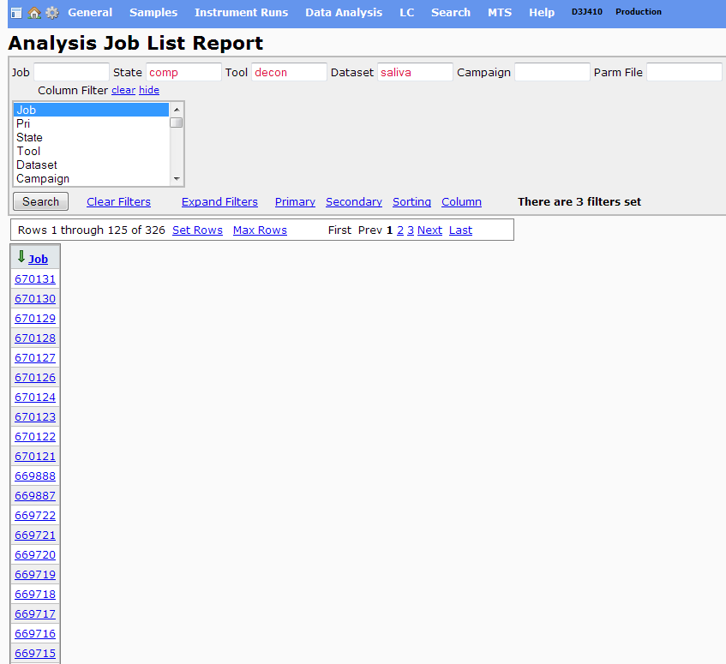
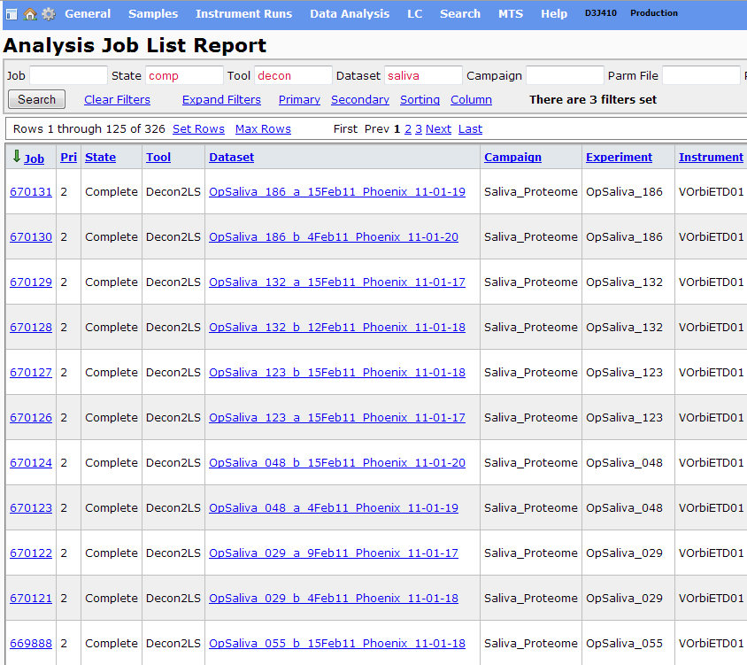
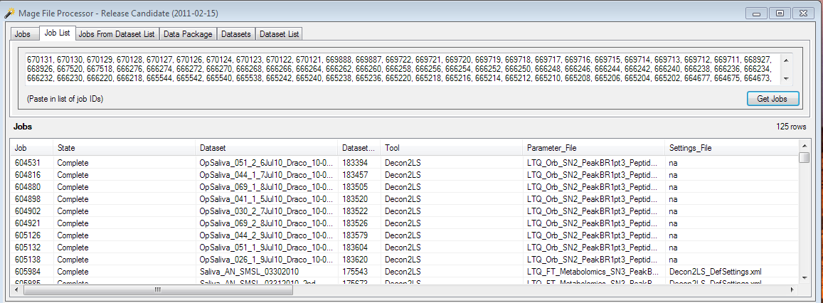
A Handy Technique
Use DMS to find list of jobs
Set column filter for Job column only
…and paste into “Job List” tab on Mage File Processor.
Select list of jobs…
…copy them…

Slide 26
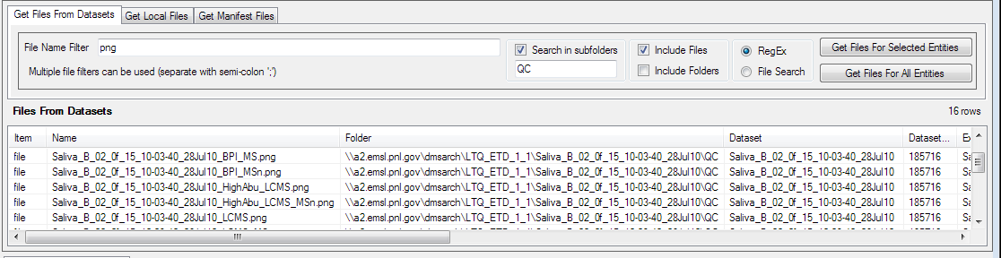
File/Folder Search Controls
Enter search terms to limit results of search to files or folders whose name satisfies them
Choose whether search results will include file or folders or both
Choose whether search terms in File Name Filter will be interpreted as regular expression or classic file search with wildcards

Slide 27
File/Folder Search Controls
You can optionally have the search extend into subfolders
You can specify a name filter to restrict which subfolders will be searched
This is mostly useful at the dataset level looking inside DECON2LS results folders and QC folders

Slide 28
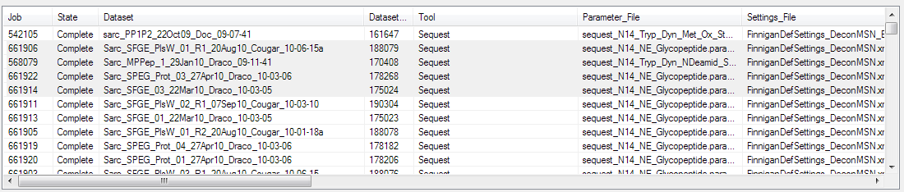
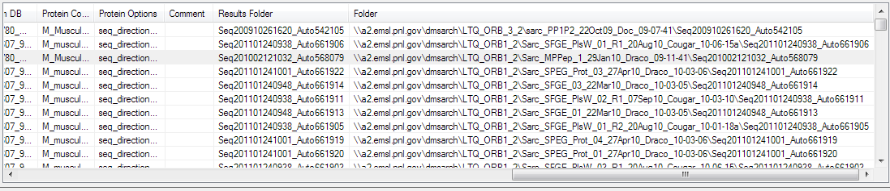
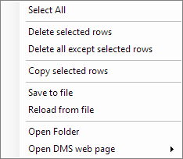
Context Menu For Display Lists
Right-clicking on display lists brings up menu of useful actions…
Remove rows from list
Open folder
(if “Folder” column present)
Copy rows to clipboard
Open DMS web page
(if “Job” or “Dataset” column present)
Save list to file
Reload list from file

Slide 29
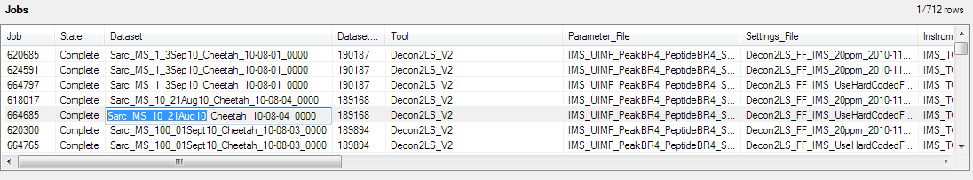
Cell Contents
Double clicking on a particular field on any list…
…opens a text box over it…
…that lets you copy all or part of the contents to the clipboard.

Slide 30
Example Task: Get Folders From DMS
Get Dataset QC folders for Sarcopaenia Mini-Study
Search DMS for pertinent datasets
Get selected list of QC folders for selected datasets
Copy folders to local folder

Slide 31
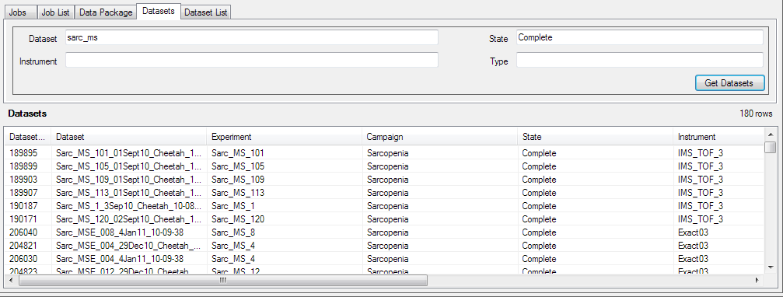
Get List of Datasets
Choose how you want to search for Datasets
Set Dataset search criteria
Click to search for Datasets
Datasets that meet search criteria are displayed in list

Slide 32
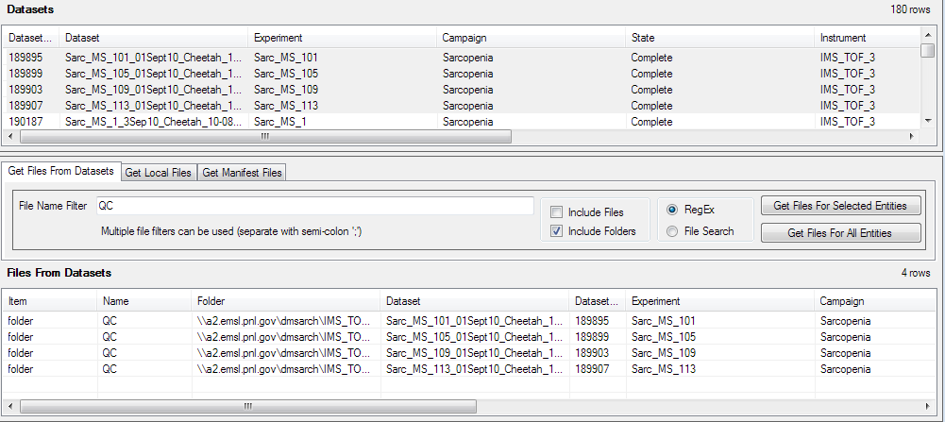
Get Folders For Datasets
Set file name search pattern
Set up to look only for folders
Starting with list of datasets from previous step…
Optional: Select specific datasets to search
Click to get
list of folders
(all or selected)
Dataset folders are searched and contained folders that meet search criteria are displayed in list

Slide 33
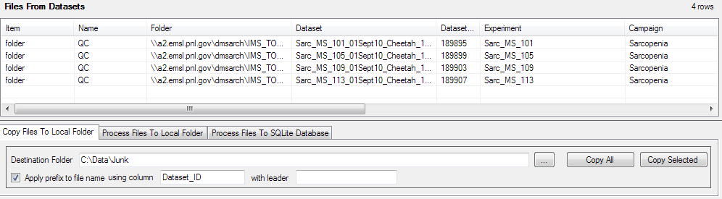
Copy Folders To Local Folder
Select “Copy” operation
Starting with list of folders from previous step…
Click “All” or “Selected” to copy folders
Optional: Select specific folders to copy
Optional: Automatically apply prefix to each file name
Select local folder to receive copies of files

Slide 34
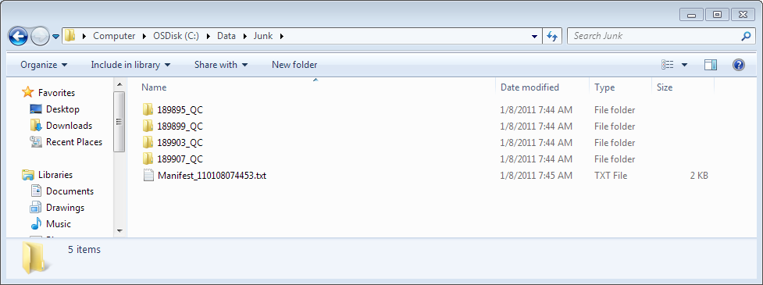
Results:
Automatic prefix applied to each folder name
Manifest file automatically created

Slide 35
Example Task: Process Files
Get Sequest first hits results into SQLite DB table
Get list of jobs
Get list of first hits results files for jobs
Process contents of files to SQLite DB

Slide 36
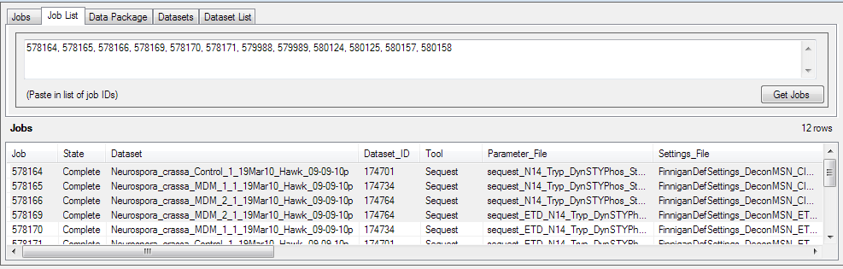
Get List Of Jobs
Select method to search for jobs
Set search criteria
Click to perform search
List of Jobs will appear in the display

Slide 37
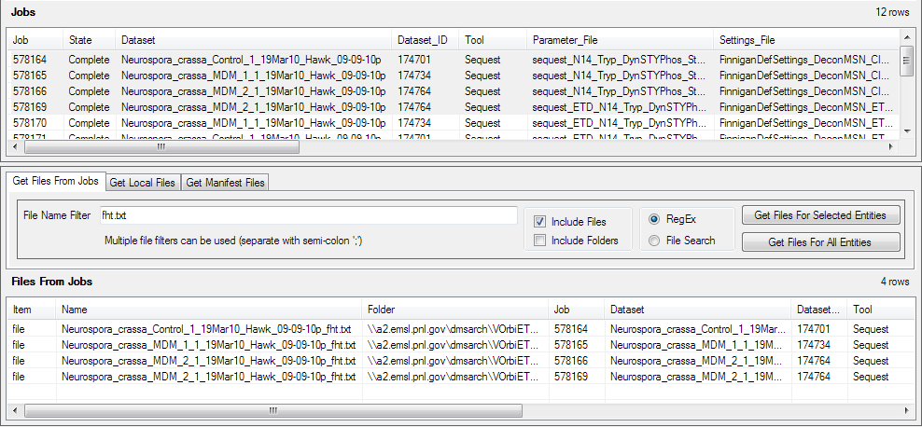
Get List Of First Hits Files For Jobs
Set file name search pattern for first hits files
Starting with list of jobs from previous step…
Click to get list of files
(all or selected)
Optional: Select specific jobs to search
Analysis Job results folders for Jobs in list will be searched and files that meet search criteria are displayed in list

Slide 38
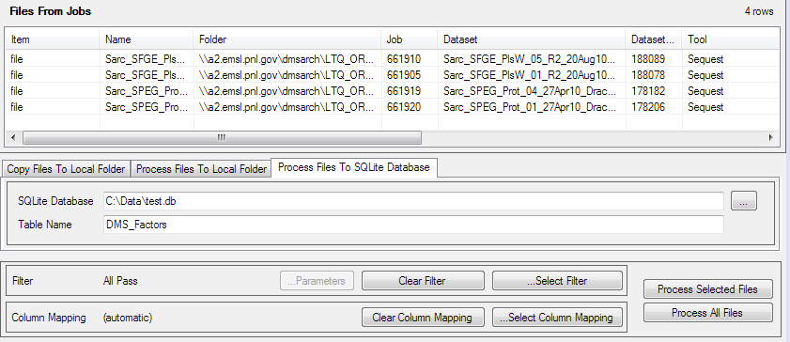
Process Files To SQLite Database
Select SQLite DB process panel
Optional: Select specific files to process
Starting with list of files from previous step…
Specify SQLite Database file and table (new or existing) to receive results
Click to process files
(all or selected)
Select processing filter
(in this case, we left default “All Pass” filter that passes all contents)

Slide 39
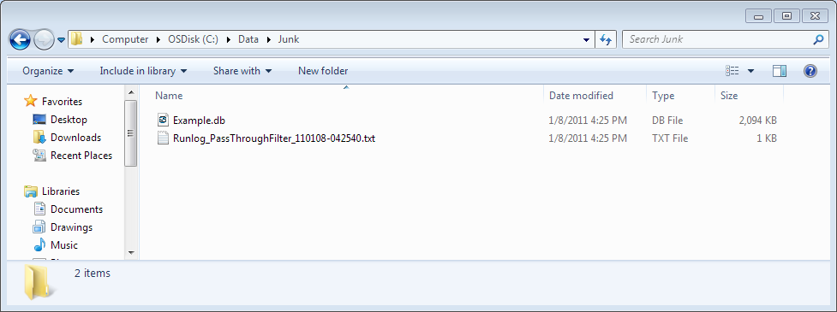
Results
Database file is created (if it did not exist)
Run log file is created

Slide 40
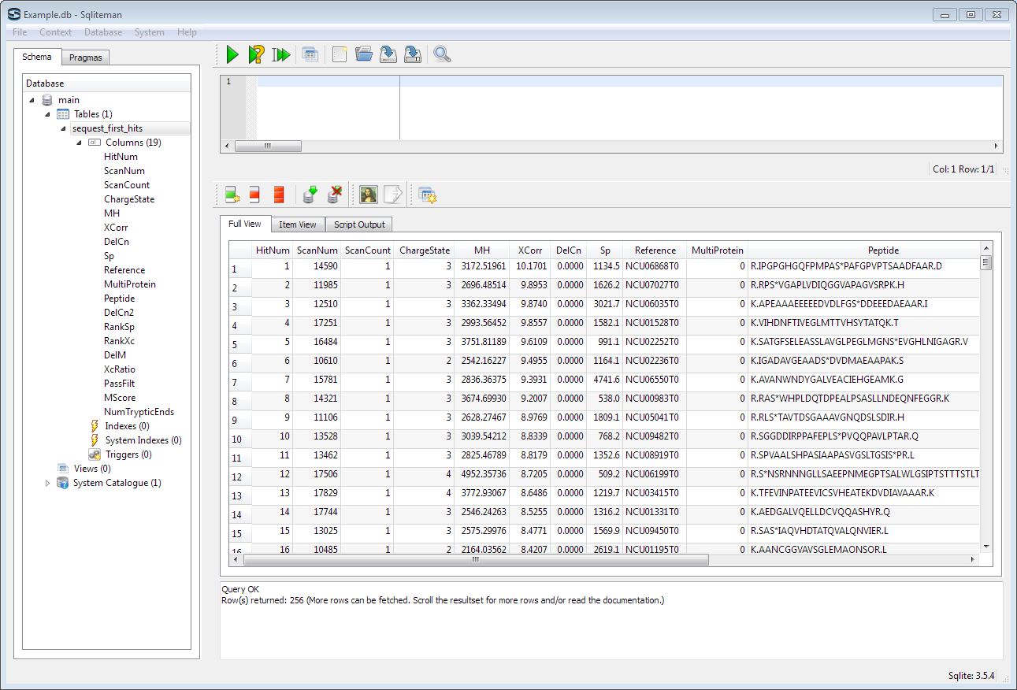
Database Results
Table is created
(if it did not exist)
Results from all files are concatenated into table

Slide 41
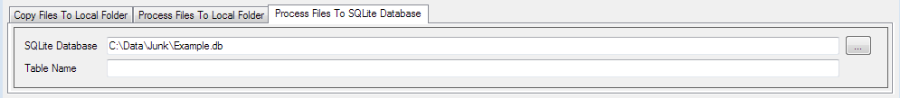
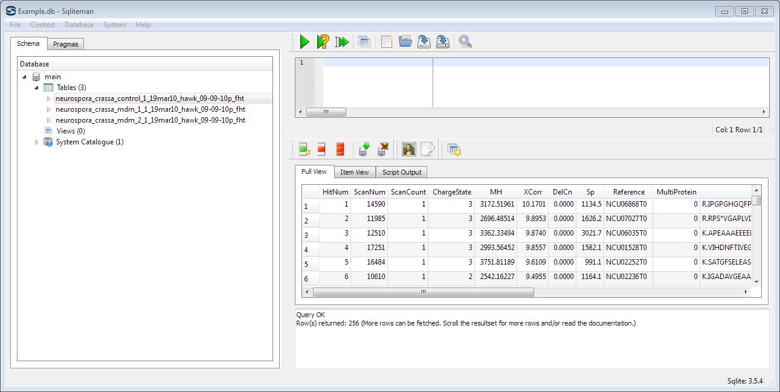
Option: Results In Separate Tables
If table name is blank
…
results for each input file goes into a separate table

Slide 42
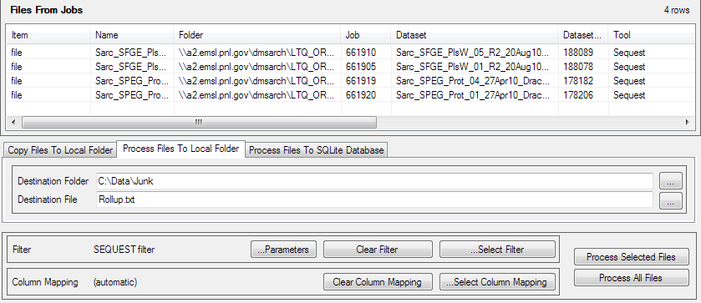
Process Results To Local Folder
Identical to “Process File to SQLite Database”, except results for each input file go into one or more files in a local folder
Select file processing panel
Select local folder to receive results
Click to process files
(all or selected)
Starting with list of files from previous step…
Optional: Select specific files to process
Choose file name to concatenate all results, or leave blank for separate files

Slide 43
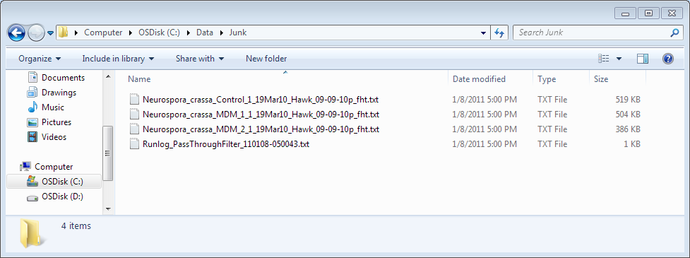
Results
Results are contained in individual files (as shown here) or a concatenated file
Run log file is created

Slide 44
MSGF Files
Search for the desired jobs
Can use DMS to identify the jobs and paste them into the Job List pane
Change the File Name Filter to "*_fht_msgf.txt" or "*_syn_msgf.txt"
Use the fht file if you loaded (plan to load) data from first hits files
Use the syn file if you loaded (plan to load) data from synopsis files
Click "Get Files for All Entries" or "Get Files for Selected Entries"
You should now see the list of matching _msgf.txt files
Choose tab "Process Files to Local Folder"
Define the destination folder path and destination file name
Click "Clear Filter" so that the Filter Name shown is "All Pass"
Click "Select Column Mapping", choose "Add Job Column", click OK
Click "Process All Files

Slide 45
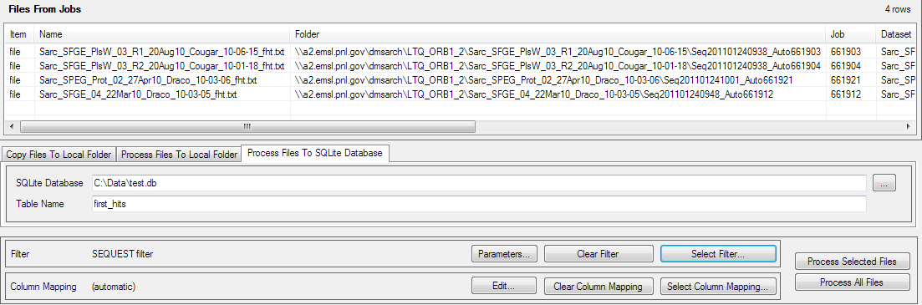
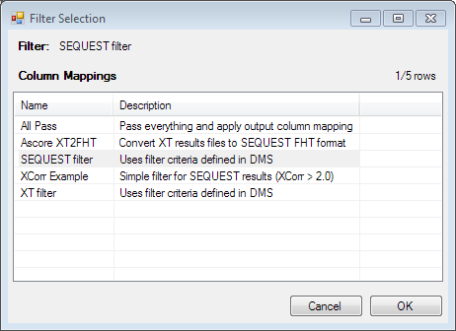
Filter Selection
Filter may be chosen by clicking the
“Select Filter” button
Clicking it brings up a dialog that allows filter to be chosen

Slide 46
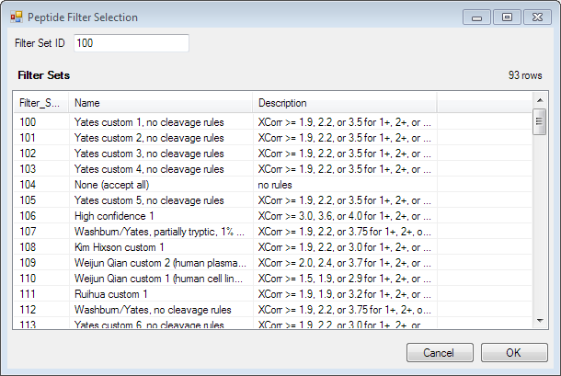
Filter Parameters
Some filters have user-selectable parameters
When one is chosen, the “Parameters” button is enabled
Clicking it brings up a dialog that allows parameters to be set
SEQUEST Filter Uses code ported from StarSuite Extractor

Slide 47
File Processing Filters
Mage File Processor has basic filter set installed
Mage modular pipeline streamlines adding new filters
Code can focus on algorithm
Can ignore input and output issues
Handled by pipeline
Minimal “housekeeping” requirements
In simplest case, only need to override one inherited function
Easy to install new filters
Can be in separate DLL file and dropped into application folder
Reader
Filter
“X”
Writer
Notes:
The underlying Mage modular pipeline infrastructures minimizes the amount of code that has to be written for a new filter. Filters can be packaged in separate DLLs and dropped into place.

Slide 48
Code For Simple Filter
[MageAttribute("Filter", "XCorr", "XCorr Example", "Simple filter for SEQUEST results (XCorr > 2.0)")]
class XCorrExample : ContentFilter {
// Indexes into the row field data array
private int xCorrIdx = 0;
// Precalulate field indexes
protected override void ColumnDefsFinished() {
// set up indexes into fields array
xCorrIdx = this.InputColumnPos["XCorr"];
}
// This is called for each input data row that is being filtered.
// the fields array contains value of each column for the row
protected override bool CheckFilter(ref object[] fields) {
bool accepted = false;
// convert XCorr from text to number
// and accept it if it meets minimum value
double v = 0;
double.TryParse((string)fields[xCorrIdx], out v);
if (v > 2.0) {
accepted = true;
}
// apply output column mapping (if active)
if (accepted && OutputColumnDefs != null) {
fields = MapDataRow(fields);
}
return accepted;
}
}

Slide 49
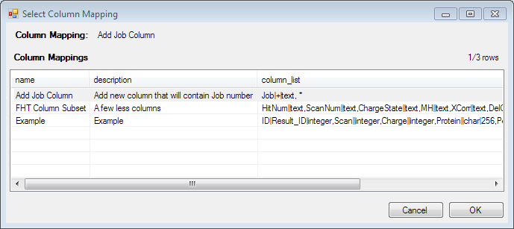
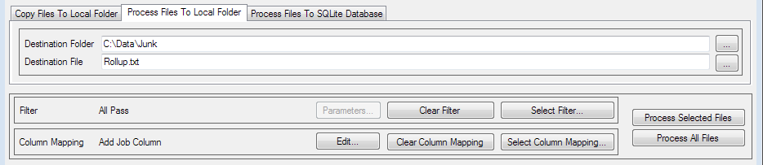
Column Mapping
Mage File Processor provides use of this feature
Mage library allows filters to remap columns
Output columns can be different than input columns
Renamed
Repositioned
Removed
Created (within limits)
Data Type Changed
Brings up a dialog that allows a predefined column mapping to be selected.
Clicking “Select Column Mapping”…

Slide 50
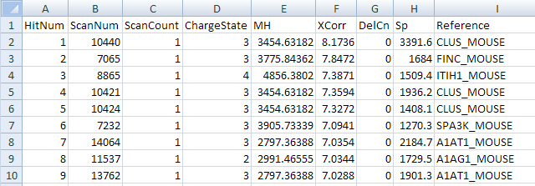
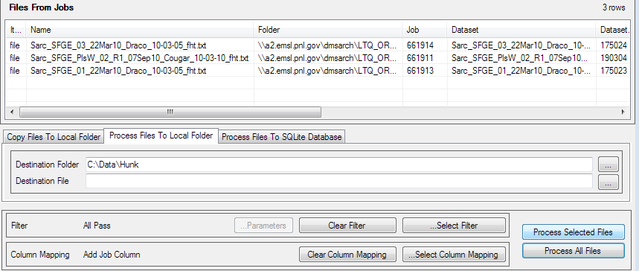
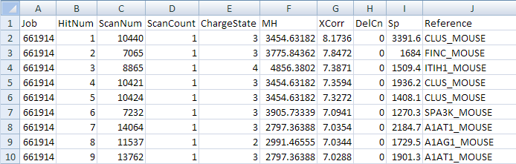
Example Column Mapping: Add Job Column
Input: Sequest First Hits File
When contents of input files are extracted to output…
Job column will be added to output.
Output:
Values will be taken from Job column in file list
(if present)

Slide 51
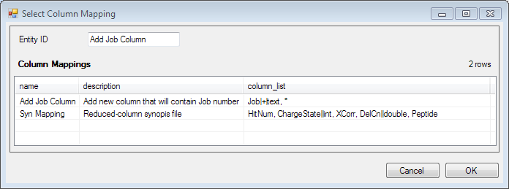
Column Mapping Configuration
Column mapping defined by comma-delimited list of fields
Each field defines an output column
Each column definition has name and optional sections set off by vertical bar:
output column name|input column name|data type|data size
This mapping adds a new output column named “Job” and then include all input columns.
This mapping simply lists a subset of input columns.
Only columns that are defined in column mapping will appear in output
Input column name only required if different than output column name
Using “+” for input column name means output column is created new
Using “*” for output column def means “include” all input columns not already mapped”
Data type and data size are optional (except for new columns)

Slide 52
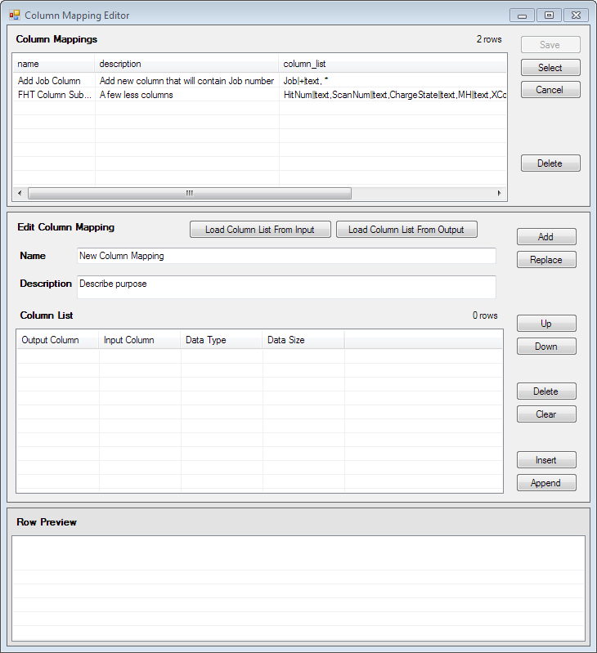
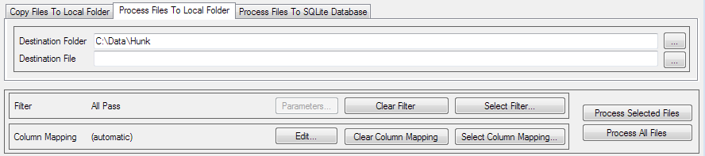
Column Mapping Definition
Clicking the “Edit” button brings up column mapping editor dialog
Column mappings can be created, edited, and saved

Slide 53
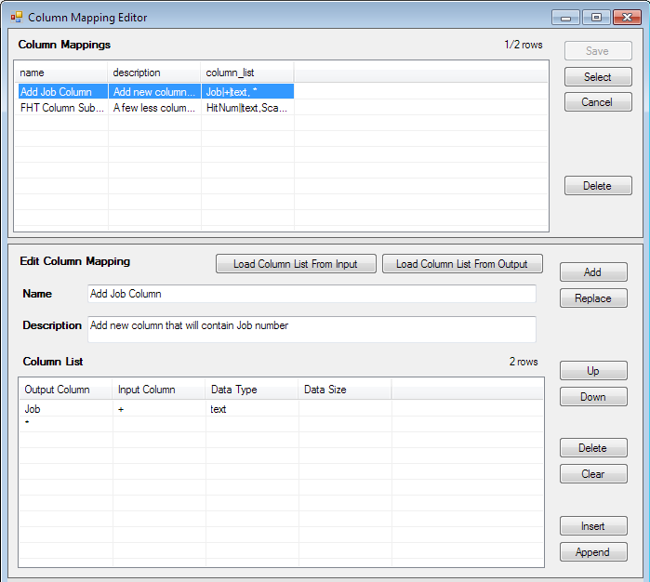
Column Mapping Editor – Edit Existing
When existing column mapping is selected…
…its details appear in the editing panel…
Modified column mapping list can be saved.
…where they can be examined or changed…
…and replaced in the column mapping list.

Slide 54
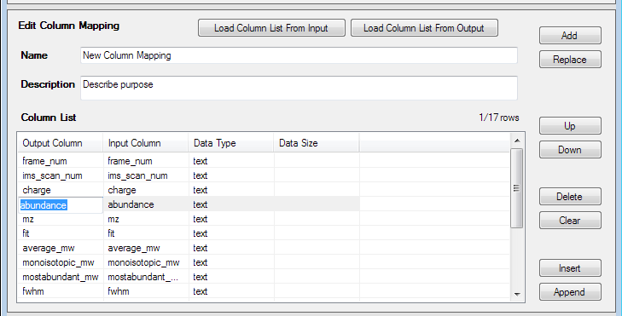
Column Mapping Editor – Editing Columns
Double-clicking on a field makes it editable
A selected column specification…
..can be moved up or down in the list
..or deleted.
A new column can be inserted ahead of the selected row…
…or appended to the end of the list.

Slide 55
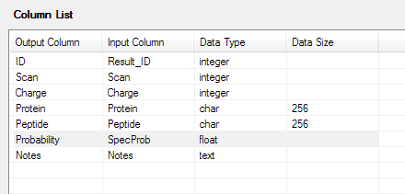
Column Mapping Editor – Column List
Output columns in order that they will appear in processed results.
Input column from which output column will take its data.
Data type of column – only meaningful when results go to SQLite database.
Character data types require a size parameter.

Slide 56
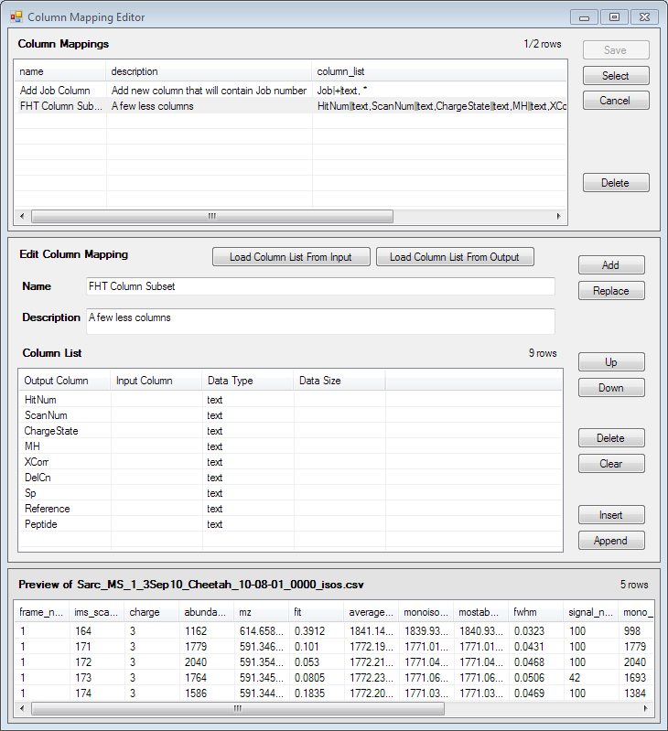

Column Mapping Editor – Start From Input
If file is selected in file list…
This approach is useful when you are processing input files to new output files or database tables and you want to rearrange eliminate, rename, or change the data type of the input columns.
…its column information can be imported into the editing panel…
…and a preview of its first few rows displayed.

Slide 57


Column Mapping Editor – Start From Output
This approach is useful when you are trying to add input data to an existing output database table, and you need to match up input columns to already existing output columns.
If an output file or database is set…
…a starting column definition can be imported from it.
Input columns with names that match output columns will be automatically added.
The input column cell editor is a pick list of columns imported from input file.

Slide 58


One More Thing…
Well, two, actually.
Mage Metadata Processor
Ranger

Slide 59
Mage Metadata Processor
Extract metadata from PRISM
Export to SQLite database
Can do crosstab of dataset factors
Helper to MDART
Still in early development

Slide 60

Ranger
Generate all combinations of several parameters over selected ranges
Save results to file or SQLite database
MDART can do iterative process over parameter set
Example: Calculate FDR for each set of parameters

Slide 61

Ranger Results
Permutations of selected parameters over ranges specified

Slide 62
Path Forward…
Mage is work in progress
Additional applications needed?
More focused on specific tasks?
Use of Mage library by analysis tools
MDART (incorporating Mage pipelines into MDART workflows)
MultiAlign
Basis of next generation of some data handling tools:
StarSuite Extractor
MTDB Creator
Data extraction filters
I can haz more?

Slide 63
Available:
Installer:
Mage_Installer.msi at \\floyd\software\Mage
Bug reports, feature requests:
http://redmine.pnl.gov/projects/magefileprocessor

Slide 64
Players
Development
Beta Testers / Early Adopters
Gary Kiebel
John Sandoval
Brian LaMarche
Anuj Shah
Matt Monroe
Roslyn Brown
Kevin Crowell
Joe Brown
Kristin Burnum
Paul Piehowski
Sam Payne
Da Meng
…and others

