Slide 1
Definitions
Linear velocity
Reduced linear velocity
Reynolds number
Darcy’s Law
Kozeny-Carman/Kozeny-Blake
Diffusion coefficient

Slide 2
Linear velocity
Definition: The distance an analyte travels per unit time (units: Length/time)
Linear velocity u can be defined in several different ways:
  Superficial linear velocity, u_{s} = F/A
  Interstitial linear velocity, u_{i} = u_{s}/ε_{i}
  Chromatographic linear velocity, u_{c}=L/t_{o}=u_{s}/ε_{t}

Slide 3
Linear velocity animation
Superficial
Interstitial
Chromatographic

Slide 4
Superficial LinearVelocity
Superficial linear velocity (a.k.a. velocity in an empty tube): An empty cylinder has a known volume (πr²L). If liquid flows through the tube at a given flow rate, it will take a certain amount of time (t) for a tracer molecule to pass through the tube. The linear velocity is the tube length (L) divided by this time. It is also the flow rate divided by the cross-sectional area of the tube:
u_{s}= F/A=F/πr²
If there are particles in the tube, this velocity has no physical meaning. However, if nothing is known about the interstitial spaces, it is easy to calculate this value. This is the linear velocity term used in Darcy’s Law.

Slide 5
Interstitial Linear Velocity, u
Interstitial linear velocity - If particles are added to the tube, the total volume of the tube will decrease accordingly. A tracer molecule will thus pass through the tube faster than if the tube were empty. The interstitial linear velocity increases as the interstitial volume fraction decreases.
u = u_{s}/ε_{i}
When particles are in the tube, the interstitial linear velocity has more physical meaning than the superficial linear velocity.

Slide 6
Chromatographic Linear Velocity
Chromatographic linear velocity - If the particles in the tube are porous, then the total volume in the tube that a tracer will access is equal to the sum of the interstitial volume plus the volume of pore space in the particles. However, when a tracer enters the pores, it does not “flow”. Rather it diffuses into the pores, and then diffuses back out. The chromatographic linear velocity has no physical meaning (unless the chromatographic tracer is too large to enter the pores).
u_{c}=L/t_{o}=u_{s}/ε_{t}

Slide 7
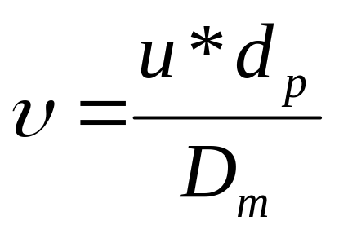
Reduced linear velocity
u=linear velocity (interstitial)
d_{p}=particle diameter
D_{m}=diffusion coefficient
The reduced linear velocity is also known as the Peclet number. It is a dimensionless number that is a ratio of the convection of a liquid stream to the diffusion of an analyte. It is a useful term for chemical engineers because it allows comparison of many different types of fluids that can vary greatly in diffusivity (e.g. gases and liquids), or different particle sizes.

Slide 8
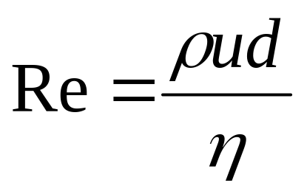
Reynolds Number
ρ = density of fluid
u=linear velocity (interstitial)
d=characteristic length. In a packed bed,
d is the particle diameter
η=viscosity of fluid
Reynolds number is a ratio of the inertial to viscous forces. Flow is laminar at low Re, turbulent at high Re. In an empty tube, turbulence usually id found at Re>2300. In a packed column, it is not clear at what Reynolds number the onset of turbulence occurs. It may occur at Re of 10.

Slide 9
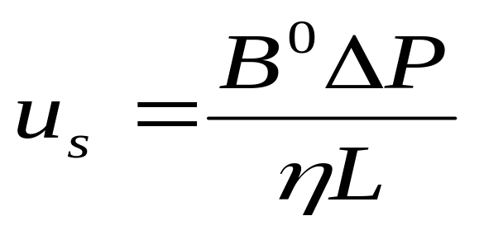
Darcy’s Law
Darcy’s law - superficial velocity is proportional to the pressure
u_{s}=superficial linear velocity
B⁰=specific permeability
ΔP=pressure drop across a
packed bed
η=viscosity of fluid
L=length of bed

Slide 10
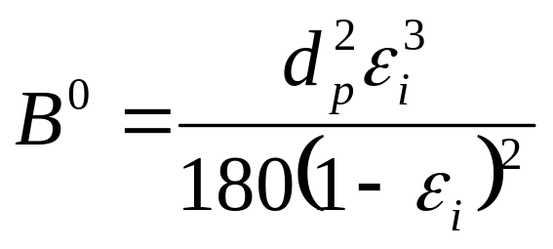
Kozeny-Carman
The Kozeny-Carman equation (anticipated by Blake) is an empirical equation that determines the permeability of a packed bed. The constant in this equation ranges from 150-180. Valid for ε_{i} <0.5 and for laminar flow where d_{p}ρu_{s}/μ(1-ε_{i})<10. (NOTE:For Oasis extn col, =4.25)
B⁰=specific permeability
ε_{i}=interstitial volume fraction

Slide 11
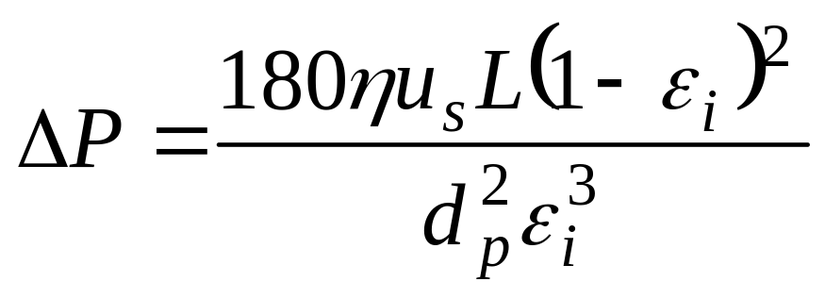
Darcy’s Law and Kozeny-Carman

Slide 12
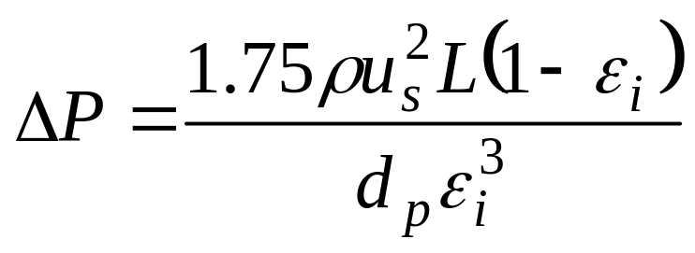
Burke-Plummer Equation
Analogous to Kozeny-Carman, but valid for highly turbulent flow, where d_{p}ρu_{s}/μ(1-ε_{i})>1000

Slide 13
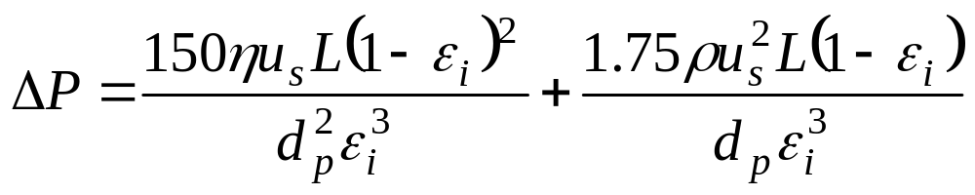
Ergun Equation
Combination of Kozeny-Carman and Burke-Plummer equations:
For low flow rates, 2nd term drops out.
For high flow rates, 1st term drops out.

Slide 14
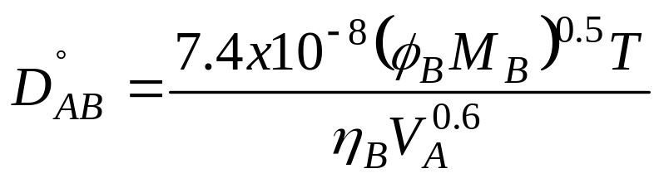
Molecular diffusivity (diffusion coefficient)
Ratio of flux to concentration gradient. Many empirical estimations for estimating diffusivity. Wilke-Chang Equation is one of the more popular. Not very accurate with water as the solvent.
D°_{AB}=diffusion coefficient of
solute A in solvent B
φ_{B}=association factor (2.26 for water)
M_{B}=molecular wt.
T=temperature, K
η_{B}=viscosity
V_{A}=volume of solute molecule

Slide 15
References
P.C. Carman, Flow of Gases through porous media, Academic, NY
Cs. Horváth and W.R. Melander, J. Chromatogr Library 22A (1983) A92-A94.
J.C. Giddings, Dynamics of chromatography, Part I: Principals and Theory, Marcel Dekker, NY, 1965, pp.204-209.
R.B. Bird, W.E. Stewart and E.N. Lightfoot, Transport Phenomena, Wiley, NY.

