Slide 1
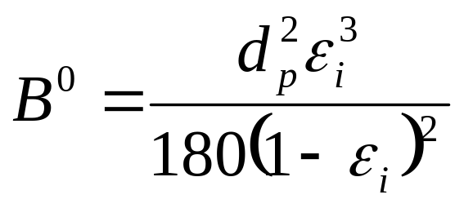
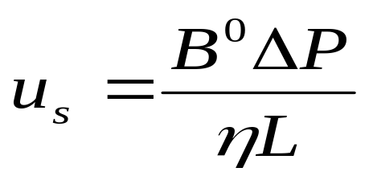
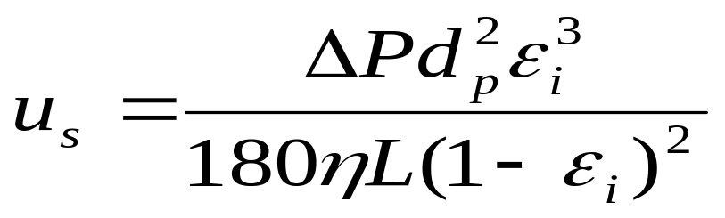
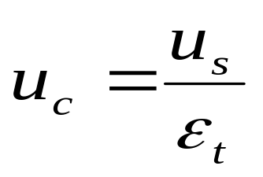

Eq. 1
Eq. 2
Eq. 3:
Subst. eq. 1 into eq. 2
Eq. 4
Eq. 5:
Subst. eq. 3 into eq. 4

Slide 2
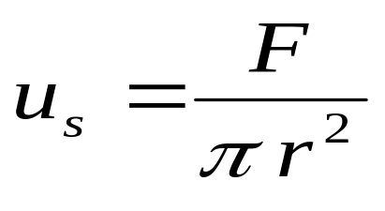
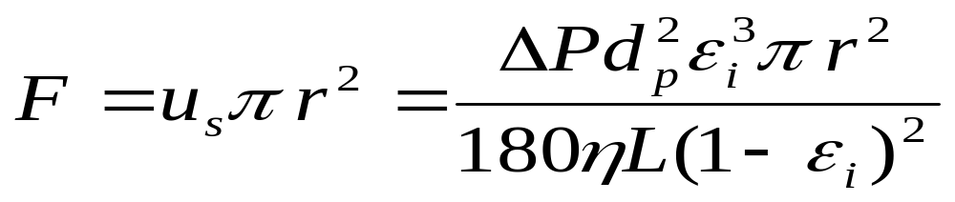
Eq. 3
Eq. 6
Eq. 7
Equate eq. 3 and eq. 6
and solve for F
The way I see it, my software is using u_{c} for the linear velocity and the above for F. If anything, F is wrong since it is based on u_{s} and possibly should be based on F=u_{c}πr² instead.

