Slide 1
ICR-2LS Tutorial
Gordon Anderson
Pacific Northwest National Laboratory
http://ncrr.pnl.gov/software/

Slide 2

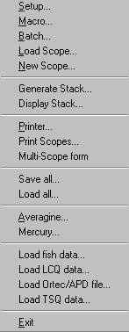
Loading files into ICR-2LS
You can press this icon of a scope to see a file
selection dialog box, this allows you to search
for the files you want to load,
You can drag and drop files from explorer
and drop them into ICR-2LS tool bar. If you select
multiple files you will be asked if you want to
load each into a scope or sum them
You can select this menu option and then you will see this popup menu. This will give you additional file load options.
Select this option to load ICR files. This option will also allow you to define the file type you wish to load. Lots of options for unsupported file types
This option allows you to load LCQ data files
This option allows you to load TSQ files

Slide 3
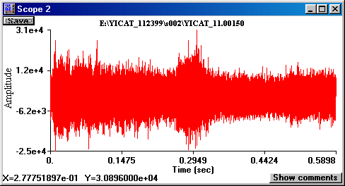
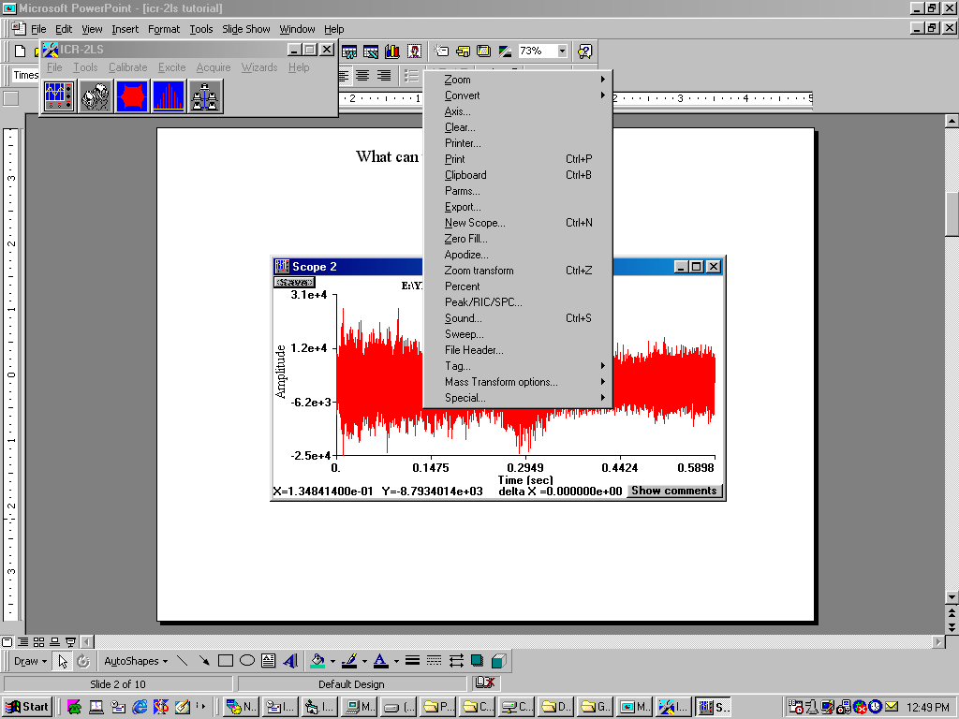
What can you do with a Scope?
A scope is selected when this bar is highlighted
Many options are available for a scope. To view these options, place your mouse pointer anywhere inside the scope a double click. This will cause the popup menu to appear.
You can use explorer to drag-n-drop files into this scope.
This will cause the new file to replace the data in this
scope. If you drop multiple files into this scope, the first one will replace this scope and the other files will be loaded into new scopes.
Many of the common options have control key options can allow fast selection.

Slide 4
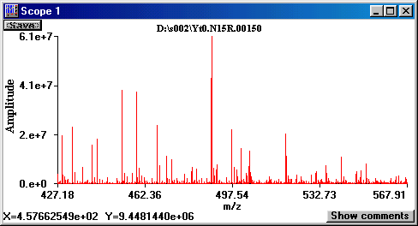
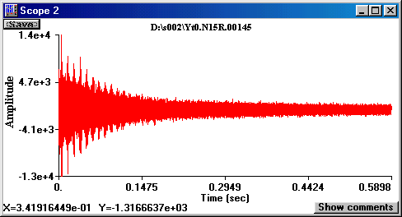
What can you do with a Scope?
Select this scope and press control c, then press the second scope and press control v. This will cause scope to to convert to mass and zoom to the same range as scope 1. You can also add subtract multiple and divide scopes using the same procedure.

Slide 5
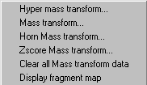
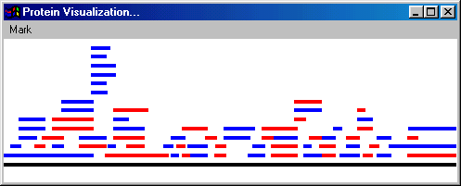
How to mass transform a single spectrum
Double click here and you will see this
Select this and you will see
Select this option to perform a mass transform on this scope. The processing results will be saved in the scopes comment area. After the process is complete press view comments to see the results. If you save the scope the comments are saved with the scope data.
This option will clear all of the data from the comments and remove and tags displayed on the scope.
If the mass transform data includes tryptic fragments os MS/MS fragments, selecting this option will result in the display of a fragment map.

Slide 6
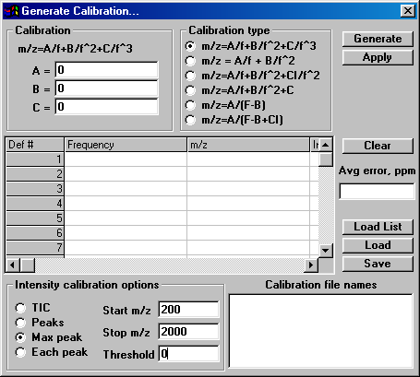
Finnigan Intensity Calibration
If you wish to load finnigan ftms data file using type 2 intensity calibration you must first open the
calibration -> generation dialog box and fill in the field defined below.
Press this radio button
Enter 0
Enter the m/z range
for your spectra

Slide 7
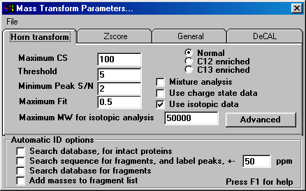
Mass Transform Parameters
The threshold determines the minimum amplitude distribution that will be analyzed. The parameter represent a global signal to noise values used to find all of the peaks in a spectrum. These peaks are then used to flag the location of distributions to analyze.
Maximum CS to be tested when analyzing a spectrum.
Medium type upon witch the bug was grown. Make sure and select Normal for all mixture analysis.
This is an individual peaks minimum signal to noise. This is calculated by following the peak amplitude until an inflection point is detect, on each side of the peak. The amplitude of the inflection points determine this local peak signal to noise.
Check this box if you are analyzing a mixture of normal and C12 enriched.
Check if you will to perform mass transform of charge state data. No not select this option if you are analyzing peptides, use it for proteins only.
The maximum fit is only used in isotopic analysis and it’s the least square error of the raw data's fit to a theoretical distribution. A fit of 0 is perfect and a fit of 1 is the worse possible. Generally fits of .2 or smaller you can be very confident of.
Check this box if you wist to mass transform spectra with isotopic resolution.
This ID option is the most useful and the only you documented here. Selecting this option will cause ICR-2LS to use the protein fragment tool to search a sequence and label peaks in your spectrum. This supports MS/MS fragments as well as enzymatic fragments. The protein fragment toll must be setup before the analysis is started.
This value determine the maximum molecular weight that an isotopic analysis will be attempted.

Slide 8
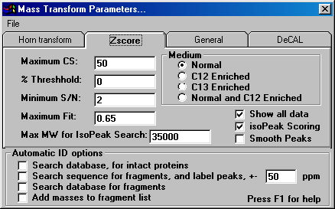
Mass Transform Parameters, Zscore
The threshold determines the minimum amplitude distribution that will be analyzed. The parameter represent a global signal to noise values used to find all of the peaks in a spectrum. These peaks are then used to flag the location of distributions to analyze.
Maximum CS to be tested when analyzing a spectrum.
Medium type upon witch the bug was grown. Make sure and select Normal for all mixture analysis.
This is an individual peaks minimum signal to noise. This is calculated by following the peak amplitude until an inflection point is detect, on each side of the peak. The amplitude of the inflection points determine this local peak signal to noise.
Selecting this option will cause the zscore algorithm to report all results.
Selecting this option will cause zscore to report the isotopic peak data.
The maximum fit is only used in isotopic analysis and it’s the least square error of the raw data's fit to a theoretical distribution. A fit of 0 is perfect and a fit of 1 is the worse possible. Generally fits of .2 or smaller you can be very confident of.
This option will result in raw data smoothing before the zscore algorithm is performed
This value determine the maximum molecular weight that an isotopic analysis will be attempted.

Slide 9
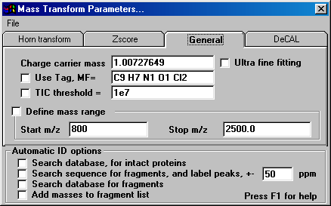
Mass Transform Parameters, General options
This is the charge carrier mass by default it’s the mass of a proton. If you wish to do negative ion analysis, change the sign of this value to negative.
The ultra fine fitting option is used only for isotopic analysis. When this mode is selected the fitting routine aligns the theoretical and measured distribution using a step size of 0.0001 m/z units.
If the use tag check box is selected then the tag mass formula is used to calculate the tags mass and subtract it from the neutral mass value of detected isotopic distributions. The tag show is the IDENT formula. This formula represents the mass change when it is attached to the peptide. Isotopic pattern is detectable by setting the fit threshold to a low value, 0.1 or lass. This is how the IDENT peptide detection is performed and it works well up to about peptide m/z of 1500.
Check this box if you are processing a large set of files and you with to process files with a total ion intensity greater that this user definable value. This option makes sense only when processing a group file files using the wizard.
This check box allows the user to define the m/z rage over witch to perform the analysis. If you do not check this box ICR-2LS will analyze over the range shown in the scope when the analysis is started. If the scope contains time domain data, it will first be converted to mass domain and then analyzed from the lowest m/z in the file to m/z 2000.

Slide 10
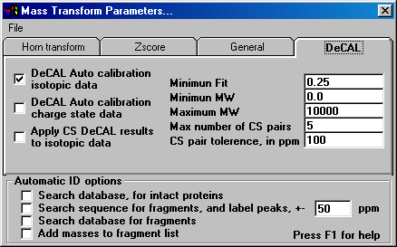
Mass Transform Parameters, DeCAL options
All of the following parameters apply to isotopic DeCAL analysis.
The option sets the maximum fit value that will be accepted for a isotopic distribution. If an isotopic distributions fit is higher that this value it will not be used by the DeCAL procedure.
This check box enables the DeCAL procedure on isotopic distributions.
This check box enables the DeCAL procedure on charge state data.
These two options define the range of masses that will be accepted by the DeCAL procedure. 10,000 is a recommended maximum.
This sets the maximum number of charge state pairs that will be used.
This value is used by the DeCAL procedure to detect CS pairs. If the m/z of two isotopic distribution define a neutral mass within 100 ppm (the 100 is user definable in this text box) then they are considered a pair.
If this option is select charge state DeCAL adjustments will be applied to the isotopic distributions is no isotopic DeCAL can be done or if its not enabled. This us useful in protein analysis when isotopic data is present by the MW is over about 10,000. DeCAL does not work for isotopic data about about 10,000.

Slide 11
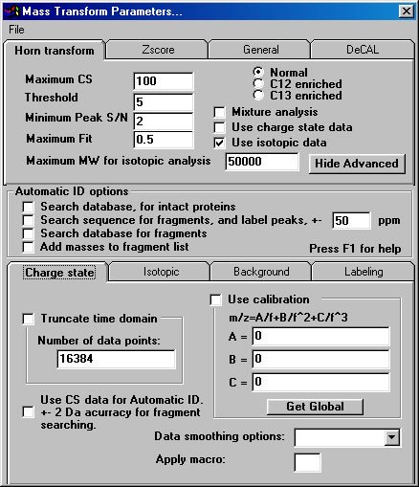
Mass Transform Advanced Parameters, Charge state
Select this option to limit the number of data points used in the analysis. Time domain data must be available for this option to work.
Select this option to use calibration data that you can define in the text boxes available.
If you press this button ICR-2LS will load the text boxes with its default calibration parameters. These parameters are available from the calibrate option on ICR-2LS’s tool bar.
If this box is checked it will have the same effect as this check box, except it will be applied to CS results with a 2 Da tolerance.
This option allow you to smooth the data before the analysis is preformed. This combo box list several options.
If you define a macro in this box, the macro will be applied to the scope before the analysis is performed. This allows you to perform complex processing prior to the analysis.

Slide 12
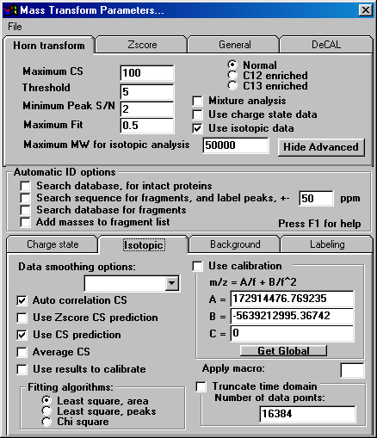
Mass Transform Advanced Parameters, Isotopic
For isotopic analysis the first step involves predicting the distributions charge state. Three option are available:
Auto correlation
Zscore
and if both of the boxes are unchecked then a third default option is used. This option used template files with used to select the most likely charge state.
This option allow you to smooth the data before the analysis is preformed. This combo box list several options.
Select this option to use calibration data that you can define in the text boxes available.
The isotopic distribution analysis will use the CS prediction and look at CS above and below the prediction to see what fits the best. You can disable this searching by selecting this option. For peptides we recommend you select this option.
If you press this button ICR-2LS will load the text boxes with its default calibration parameters. These parameters are available from the calibrate option on ICR-2LS’s tool bar.
If you define a macro in this box, the macro will be applied to the scope before the analysis is performed. This allows you to perform complex processing prior to the analysis.
Average CS is an option you only want to select for proteins or higher MW analysis. When enabled, multiple CS are summed before the analysis is performed thus increasing the S/N and the results.
The measured isotopic distribution are fit to theoretical distributions. This least square error is used to detect distributions. This fit can be calculated using one of these options. We recommend Least square area.
Select this option to limit the number of data points used in the analysis. Time domain data must be available for this option to work.
Use results to calibrate we be selected as part of the automated calibration procedure explained in the calibration section.

Slide 13
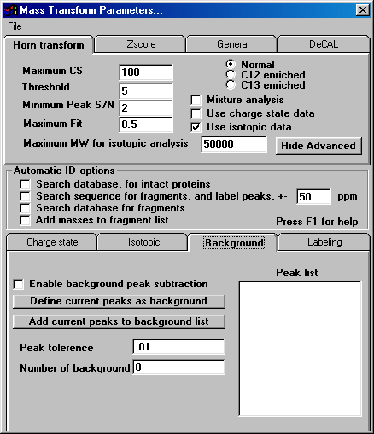
Mass Transform Advanced Parameters, Background
This check box will enable the background noise peak subtraction mod.
Press this button to define the current peaks as background and place them in the peak list. The current peaks must first be selected from any scope using the peak pick menu option. If any peaks are in the peak list box, they will first be deleted before the new ones are entered.
The button is provides the same function as the “Define current peaks as background “ except the peak list is not cleared. This allows you to add to your list.
List of defined peaks
When the background peaks are subtracted, this values defines how close a peaks needs to be to one of the peaks in the peak list before it will be removed.
This text box defines how many peaks are in the peak list.

Slide 14
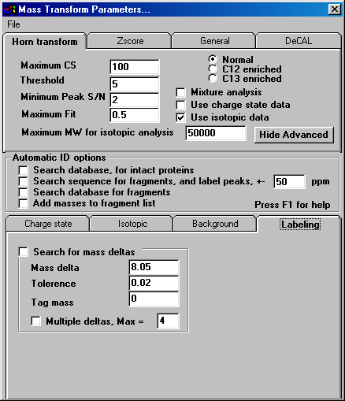
Mass Transform Advanced Parameters, Labeling
If this box is checked the isotopic mass transform results will be searched for pairs of isotopic distributions that differ by the mass definable on this form. This mode is designed for detection of ICAT labeled samples.
Mass delta to search for, in Da
Mass delta tolerance, in Da. Values outside of this tolerance will not be reported.
The mass entered in this box will be subtracted from the lower lower mass pair’s neutral mass value thus yielding the peptides untagged mass.
If this box is checked then multiple deltas are allowed up to a maximum number defined in the text box.

Slide 15

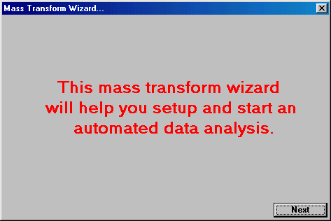
Automated mass transformation of large datasets
Select this option to start the mass transform setup. Pressing this option will result in this dialog box.
Press the next button to progress through the mass transform setup

Slide 16
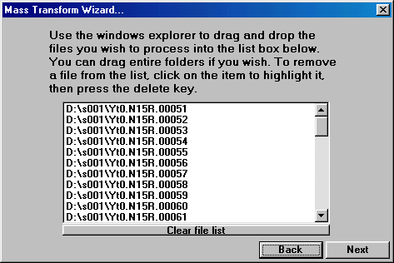
Automated mass transformation of large datasets
Use windows explorer to drag and drop files into this list box. If you drag a folder into this list box the files in the folder will be placed in this box. Any file with the extension of .log will not be loaded into this list, this is to prevent ftp log files from infecting the list. If you want to remove a file, select it with your mouse cursor and press delete.
Press here to clear the entire list.
Returns you to the previous step
Press to advance to the next step

Slide 17
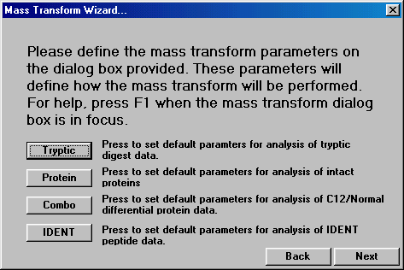
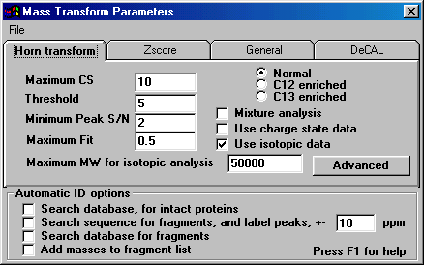
Automated mass transformation of large datasets
See the Mass transform parameter section of this document for a full discussion of the options available in this dialog box.
Returns you to the previous step
Press to advance to the next step
Several options are available to set common mass transform parameters. These buttons will define most of the parameters in the dialog box show. If you want to define more option or look at the details use the Mass Transform Parameters dialog box. When you press back or next the Mass Transform parameters dialog box will disappear but the values are not lost.

Slide 18
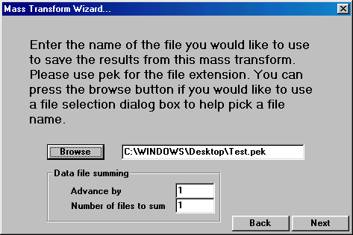
Automated mass transformation of large datasets
This text box defines the file that will hold the mass transform results. You can manually enter this file name or you can press the browse button to use a file dialog box to select or define a file. If you select a file that is already present, the new results from this analysis will be appended to the existing file, the original file contents will not be lost.
Data file summing allows several scans to be summed together and then processed. After this summed set of scans are processed the processing advances by the user definable option. Use the default values of 1 and 1 for normal processing.
Returns you to the previous step
Press to advance to the next step

Slide 19
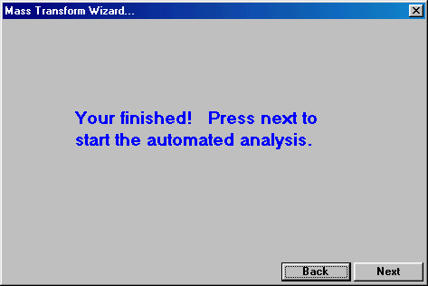
Automated mass transformation of large datasets
OK, this screen does not to exist, there is nothing to do, all you need to do is press next….

Slide 20
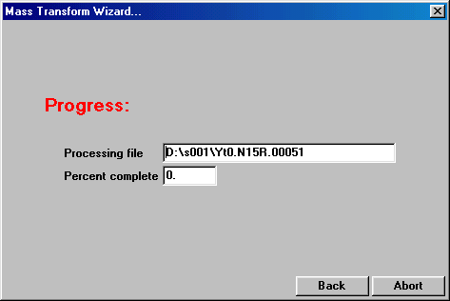
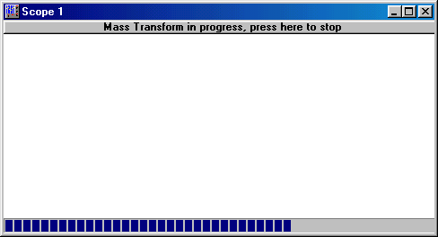
Automated mass transformation of large datasets
Now the processing start, this can take a while, up to a day, it all depends on the number of files and how complex they are, so you might want to start the processing before you go home or to the lab for a busy day. You may not want to use your PC during this processing phase, most of the resources are used my this process.
This gauge tells you the status of the file being processed.
Tells you the file you are processing.
Press to abort the processing.
Tells you the status of the entire processing.
Never press this button, it should not even be shown!
When the processing finishes these dialog boxes will disappear and the ICR-2LS bar is all that will remain.

Slide 21
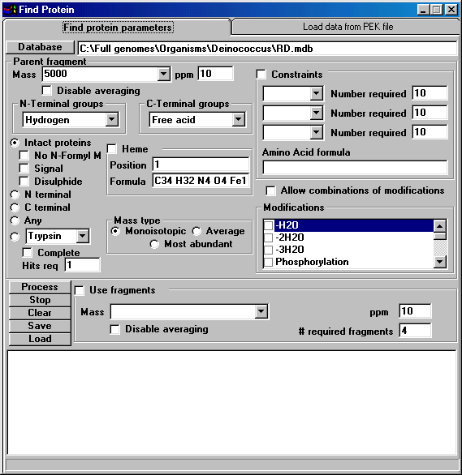
Searching a Database and Identifying proteins…
This box contains the parent mass or masses you will be searching for. You can past a column of number from a text editor or excel into this box.
Press this button to use a file selection dialog box to find a database.
Parent mass measurement accuracy.
Name of the database to search.
Terminal group options.

Slide 22
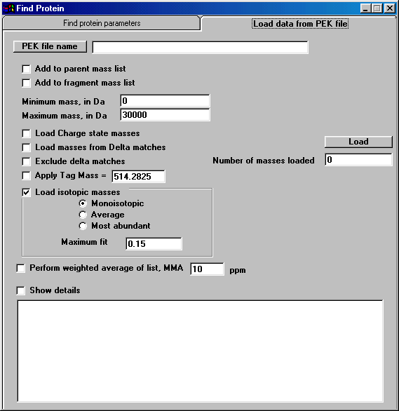

Slide 23
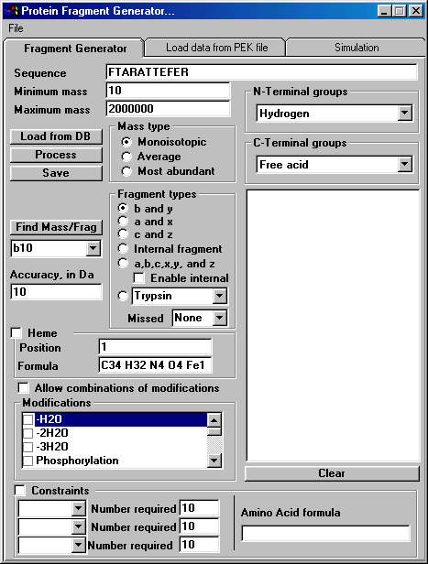

Slide 24
