Slide 1
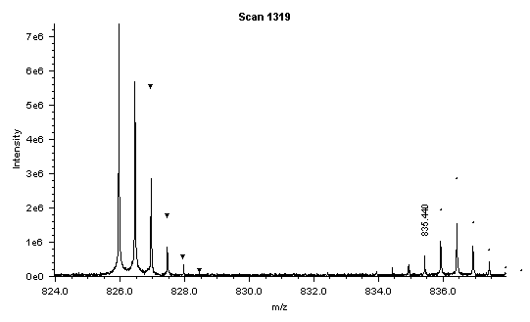
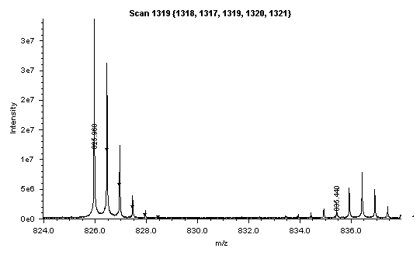
No summing
Sum5

Slide 2
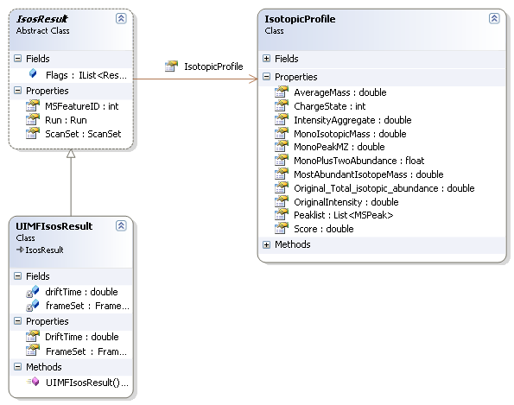
Currently in DeconTools:
Definition of an MSFeature (?):
a group of peaks from one or more scans from a single dataset

