Slide 1
VIPER Parameter Mapping

Slide 2
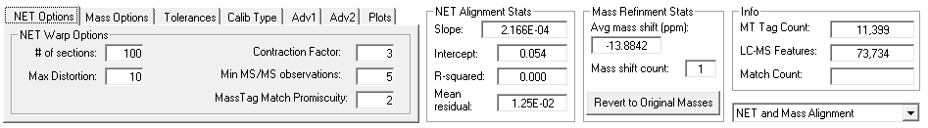
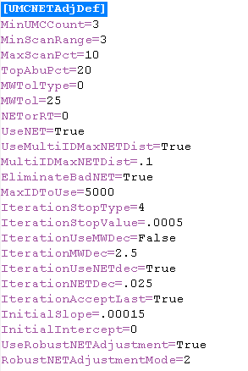
True means to use LCMSWarp
2 means NET and Mass Alignment
1 means NET alignment only

Slide 3
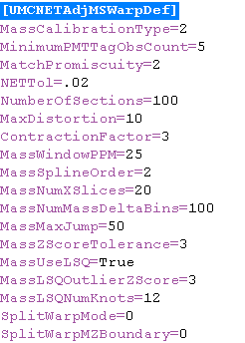

Slide 4
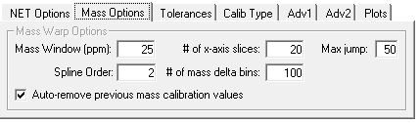

Slide 5
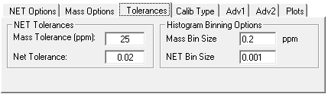

Slide 6
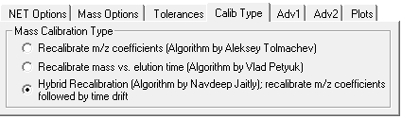
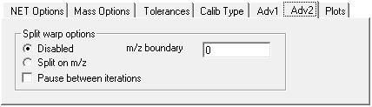
0 means recalibrate vs. m/z
1 means recalibrate vs. elution time
2 means hybrid recalibration

Slide 7
