Slide 1
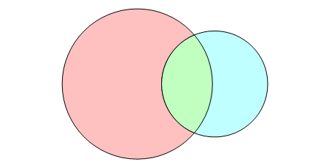
Two Groups
Theoretical
301
9T Peptides
150
241
60
90

Slide 2
Three Groups
Theoretical
301
11
20
9T Peptides
150
239
49
70
11T Peptides
130
2
9

Slide 3
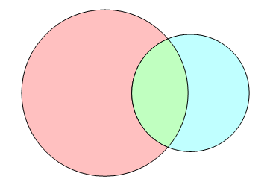
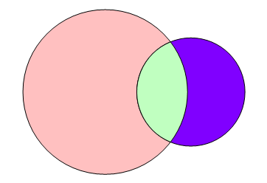
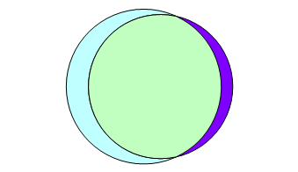
How-To Make Three Group Overlaps
1. Create three pair-wise overlaps
2. Draw three pairs of circles
3. Overlap two of the pair-wise overlaps
Theoretical
301
9T Peptides
150
60
Theoretical
301
11T Peptides
130
4. Now rotate the second pair relative to the first pair until the overlap of the third pair matches the expected overlap
51
Theoretical
301
11
20
9T Peptides
150
9T Peptides
150
11T Peptides
130
239
49
70
119
11T Peptides
130
2
9

Slide 4
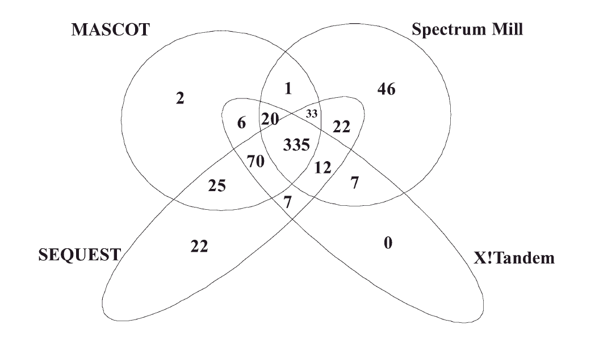
Four Groups
From: Kapp E.A., Schutz F., Connolly L.M. et. al., Proteomics 2005, 5, 3475-3490.

