Slide 1
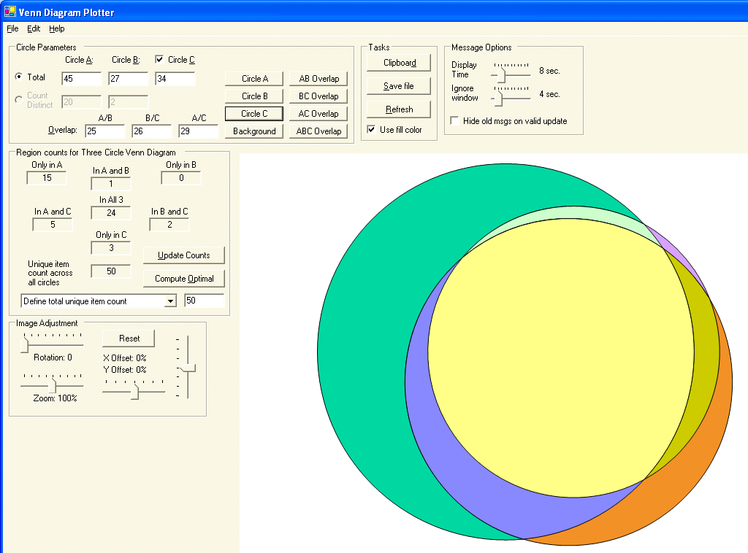
Should be 0
1
15
24
2
5
3

Slide 2
A
15 A only
1 A/B
B
24 in all 3
0 B only
5 A/C
C
2 B/C
3 C only

