Slide 1
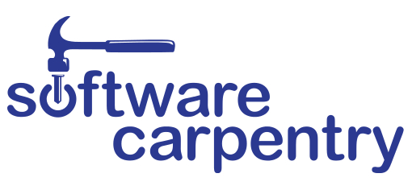
Software Carpentry Workshop
Celebrate Fall with a hands-on introduction to Python, Git, and Unix Shell!
Participants will gain a working knowledge of the common tools for scripting, task automation, testing, debugging and version control while applying these new skills to their own research problems.
9am-4:30pm April 9-10, 2020
Vista Room, Discovery Hall
Limited class size: provide a work package to self-enroll at https://elm.pnl.gov today!

