Slide 1
Comparing spectra in D2O and DMSO solvents
Samples DOC-008, 011, 012, 022 were run in 70 % D2O
Then they were lyophilized
And then run in DMSO-d6
Feb 2021
TES-Drydown

Slide 2
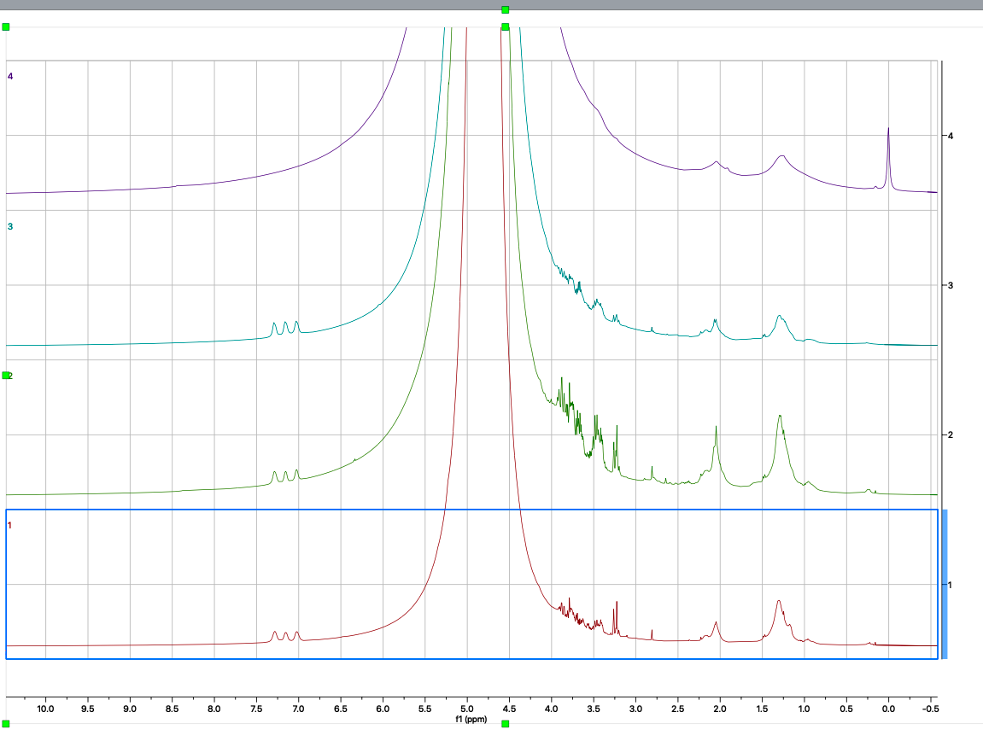
D2O
water
DOC-008 had DSS/phosphate buffer
The other samples did not
DOC-008:
C-150d-CW-5cmtoend
DSS standard
DOC-011:
C-150d-FAD-5cmtoend
DOC-012:
C-150d-FAD-5cmtoend
DOC-022:
C-30d-FAD-5cmtoend
conjugated
(aromatic, amide, phenolic)
heteroatom
(carb, ether, alcohol)
unsaturated
aliphatic

Slide 3
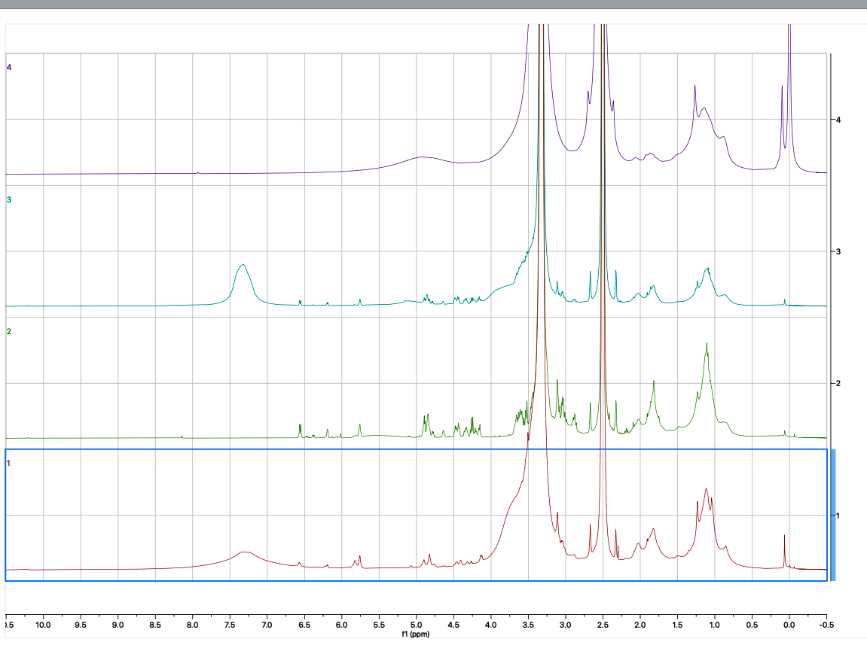
DMSO
water
DMSO
DOC-008 had DSS/phosphate buffer
The other samples did not
DSS standard
DOC-008:
C-150d-CW-5cmtoend
DOC-011:
C-150d-FAD-5cmtoend
DOC-012:
C-150d-FAD-5cmtoend
DOC-022:
C-30d-FAD-5cmtoend
amide
aromatic
carb
α-H
(protein)
O-alkyl
(carb)
aliphatic

Slide 4
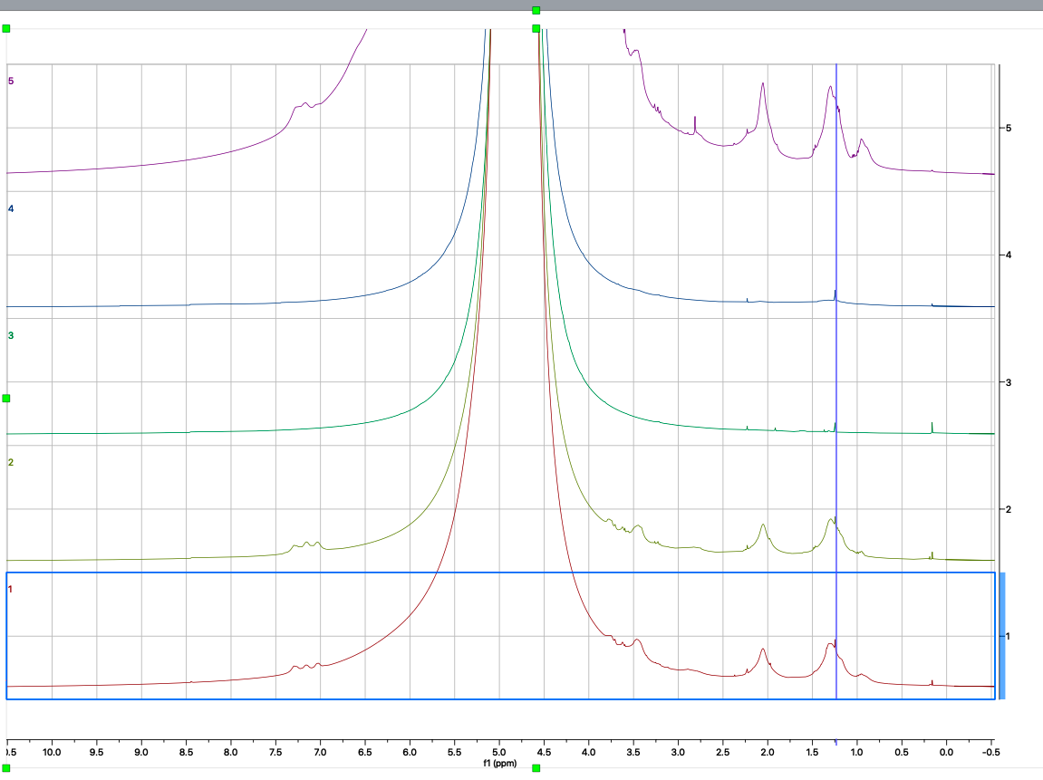
Additional samples run in D2O
DOC-004:
C-150d-FAD-5cmtoend
DOC-014:
C-30d-CW-5cmtoend
DOC-015:
C-30d-CW-5cmtoend
DOC-016:
C-30d-FAD-5cmtoend
DOC-018:
C-30d-FAD-5cmtoend
conjugated
(aromatic, amide, phenolic)
heteroatom
(carb, ether, alcohol)
unsaturated
aliphatic

