Slide 1
Alzhemer_Classification

Slide 2

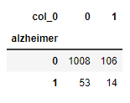
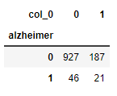
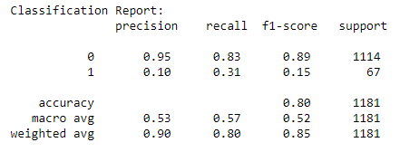
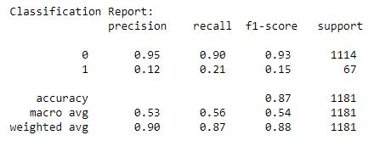
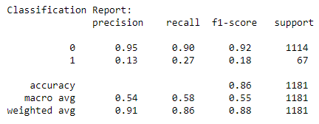
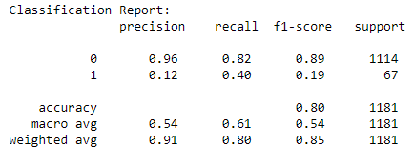
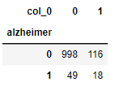
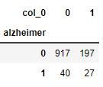
Decision Tree
Default
Best Parameter
Best: 0.8736641221374046 using {'criterion': 'gini', 'max_depth': 10, 'max_features': 'sqrt', 'min_samples_leaf': 2, 'min_samples_split': 2}
เลือก Feature importances 4 + Default
feature_importances Top 4 + Best param

