Slide 1
Body Contents
Body Text
HTML truncates spaces in your text.
Use <br> to insert new lines.
Use <p> tag to create paragraphs.
Other Elements of Body Section:
<table> tags are used to create tables.
<img> tags are used to insert images.

Slide 2

HTML Basics

Slide 3
Objectives
Understand the structure of an HTML page.
Learn to apply physical/logical character effects.
Learn to manage document spacing.
New semantic elements in HTML 5.
Understanding static web page creation.
Creating static web page.

Slide 4

What is HTML?
HTML is a markup language and these documents describe web pages.
Any HTML document contains HTML tags and plain text.
HTML documents are also called web pages.

Slide 5
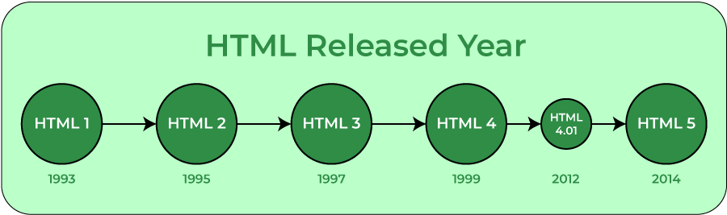
HTML Versions & HTML5
HTML – 5
Good support on modern mobile devices (iOS, Android)
Simpler, more intuitive syntax
Video and Audio can be included without requiring a plug-in
Incremental improvements to previous HTML challenges
Much needed next step in HTML evolution
Creative enhancements: Rounded corners, gradients, text layout
Promising support of Mobile JS Frameworks (Sencha, jQTouch)

Slide 6
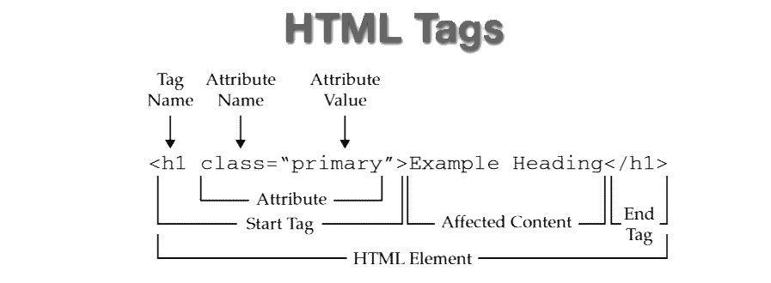
HTML Elements
Most Web documents are created using HTML.
Documents are saved with extension.html or.htm.
Tags are strings in the language surrounded by a less-than (<) and a greater-than > sign.
Opening tag: <html> Ending tag: </html>
Can have Attributes
Attributes are Name-Value pairs added to HTML start tags.

Slide 7
Rules Applicable for HTML5 Tags
Rules for HTML5 Tags are:
The document must included with an HTML5 DOCTYPE.
Tags and attributes are case-insensitive.
Attributes do not need to be quoted.
End tags are not required for every element.
Some attributes may be empty such as checked and disabled.
For example, <input type=checkbox checked>
Only void elements such as br, img and link may be "self-closed" with />.

Slide 8
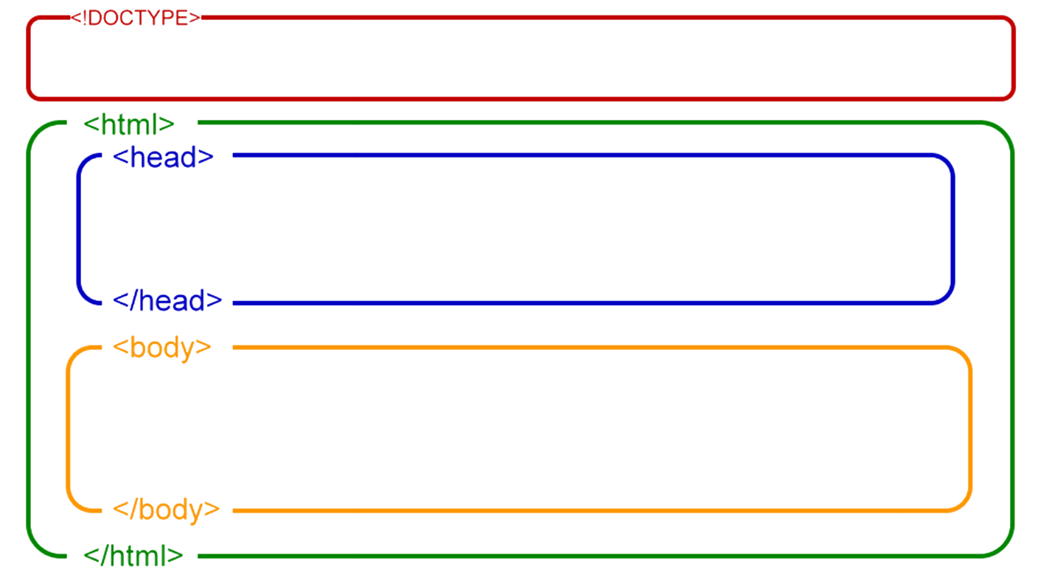
Basic HTML Document
HTML Head Section
<head>…</head>
Page Title, Base URL, Meta Information
HTML Body Section
<body>…</body>
Text, Images, Table, Color, etc.

Slide 9
HTML HEAD SECTION – Title
<TITLE> element does not have any visible effect within a browser’s client area; however, the enclosed title appears in the title bar of the browser window.
<head>
<title>
My First Page
</title>
</head>
01_headTitle.html

Slide 10
HTML HEAD SECTION – Base Href
Base element specifies a base URL for all the links in a page.
<head>
<base href="http://www.example.com/images/" />
</head>
02_baseRef.html

Slide 11
HTML HEAD SECTION – Meta Information
Metadata will not be displayed on the page, but will be machine parsable.
Define keywords for search engines:
<meta name="keywords" content="HTML, DHTML, CSS, XML, XHTML, JavaScript, VBScript" />
Provide a description of your web page:
<meta name="description" content=“This is HTML Training" />
Define the last revision of your page:
<meta name="revised" content=“Yash Patel, 6/10/99" />
Refresh page every 5 seconds:
<meta http‐equiv="refresh" content="5" />
03_metaTags.html
04_metaRefresh.html

Slide 12
HTML Body Section
<body> Element:
Represents information content.
Each document can have at most one <body> element.
Body element is placed between </head> and </html> elements.
Attributes supported in <body> element are:
Event Handler attributes like ononline, onoffline, onunload, onpagehide, onpageshow, etc.
Global attributes like id, style, class, hidden, etc.
05_bodyTag.html

Slide 13
Comments in HTML
Increase code readability.
Ignored by the browser.
Example of HTML comment:
<!-- This is a sample HTML Comment -->

