Slide 1

HTML Basics

Slide 2
Objectives
Understand the structure of an HTML page.
Learn to apply physical/logical character effects.
Learn to manage document spacing.
New semantic elements in HTML 5.
Understanding static web page creation.
Creating static web page.

Slide 3
Body Contents
Body Text
HTML truncates spaces in your text.
Use <br> to insert new lines.
Use <p> tag to create paragraphs.
Other Elements of Body Section:
<table> tags are used to create tables.
<img> tags are used to insert images.

Slide 4
Physical Character Effect
Some tag used are:
<b>
<s>
<sub>
<sup>

Slide 5
Logical Character Effect
Some tag used are:
<strong>
<em>
<kbd>
<var>

Slide 6
Character Entities
&lt; or &#60; (<)
&gt or #62; (>)

Slide 7
Heading Elements
HTML uses 6 kind of heading elements from <h1> up to <h6>.

Slide 8
Document Space
For Horizontal Spacing :
<hr>
For Vertical Spacing
<p>
<br>

Slide 9
Preformatted Text
<PRE>…</PRE> will not change the formatting of text and will display same formatting as in source code.

Slide 10
Working With Styles
Setting the style of an HTML element, can be done with the style attribute.
The HTML style attribute has the following syntax:
<tagname style="property:value;">
The property is a CSS property. The value is a CSS value.
Eg :-
background-color, color, font-family, font-size, text-align, text-transform, text-indent, text-decoration & many more.

Slide 11
Divisions in HTML Document
The <div> tag defines a division or a section in an HTML document.
This is used to group block-element to format them with CSS.

Slide 12
<span> in hTML Document
The <span> tag is used for grouping and applying styles to inline elements.
Inline & Block Elements.

Slide 13
CSS - Simple Selectors
Element Selectors
The element selector selects HTML elements based on the element name.
h1 {
text-align: center;
color: blue;
}

Slide 14
CSS - Simple Selectors
Id Selectors
The id selector selects HTML elements based on the id name.
#table1 {
text-align: center;
color: red;
}

Slide 15
CSS - Simple Selectors
Class Selectors
The class selector selects HTML elements based on the class name.
.red {
color: red;
}

Slide 16
CSS - Simple Selectors
Class Selectors
The class selector selects HTML elements based on the class name.
.red {
color: red;
}
OR
p.red {
color: blue;
}
***Note*** :- A class or id name cannot start with a number.

Slide 17
CSS - Simple Selectors
Universal Selectors
The universal selector (*) selects all HTML elements on the page.
* {
color: red;
}

Slide 18
CSS - Simple Selectors
Grouping Selectors
The grouping selector selects all the HTML elements with the same style definitions.
.red p h1 {
color: red;
}

Slide 19
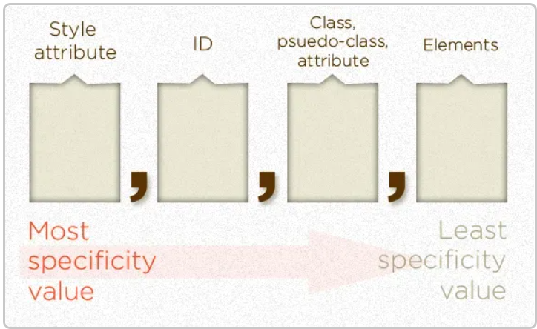
CSS Specificity Value
If there are two or more CSS rules that point to the same element, the selector with the highest specificity value will "win", and its style declaration will be applied to that HTML element.
There are four categories which define the specificity level of a selector:
Inline styles - Example: <p style="color: green;">
IDs - Example: #top
Classes, pseudo-classes, attribute selectors - Example: .red, :hover, [href]
Elements and pseudo-elements - Example: h1, :before
1000 100 10 1

Slide 20
Unordered Html List
An unordered list starts with the <ul> tag. Each list item starts with the <li> tag.

Slide 21
Ordered HTML List
An ordered list starts with the <ol> tag. Each list item starts with the <li> tag.
Ordered List has 2 attributes :-
type attribute
A‐Uppercase letters: <OL TYPE=A>
a‐Lowercase letters: <OL TYPE=a>
I‐Uppercase Roman letters: <OL TYPE=I>
i‐Lowercase Roman letters: <OL TYPE=i>
1‐Standard numbers: <OL TYPE=1>
Start attribute
To start an ordered list at a number other than 1 (<ol start =“2”>)

Slide 22
CSS For List
The list-style-type property specifies the type of list item marker. (circle, square, upper-roman, lower alpha)
The list-style-position property specifies the position of the list-item markers (bullet points). (inside, outside)
The list-style-image property specifies an image as the list item marker:
With using simple tags like background, padding, color, etc.

Slide 23
List - Shorthand property
The list-style property is a shorthand property. It is used to set all the list properties in one declaration:
list-style: square inside url(“Pizza.gif");
When using the shorthand property, the order of the property values are:
list-style-type (if a list-style-image is specified, the value of this property will be displayed if the image for some reason cannot be displayed)
list-style-position (specifies whether the list-item markers should appear inside or outside the content flow)
list-style-image (specifies an image as the list item marker)

Slide 24
LINKS
HTML links are hyperlinks.
You can click on a link and jump to another document or another section.
<a href="url">Text for Link</a>
<a href=“Firstpage.html">Visit My First Page</a>
You can have both Absolute URLs & Relative URLs.

Slide 25
LINKS – Target Attribute
The target attribute specifies where to open the linked document.
The target attribute can have 4 values:
_self (Default) - Opens the document in the same window/tab as it was clicked
_blank - Opens the document in a new window or tab
_parent - Opens the document in the parent frame
_top - Opens the document in the full body of the window
<a href="https://www.example.com/" target="_blank">Visit Web!</a>

Slide 26
Links – CSS Pseudo-Classes
:link – selects unvisited links.
:visited – selects visited links.
:hover – the state that happens when the user places their mouse pointer on top of a link.
:active – the state that happens when the user clicks on a link.
:focus – the state that occurs when the user focuses on the link. This state can be seen when you tab to a link, or after you click on a link.

Slide 27
Internal Links
<h1 id="anchor-name">The name where you want to jump</h1>
<a href="#anchor-name">Jump to the part of the page with the “anchor-name” id </a>

Slide 28
Images
The HTML <img> tag is used to embed an image in a web page.
Images are not technically inserted into a web page; images are linked to web pages.
The <img> tag creates a holding space for the referenced image.
The <img> tag is empty, it contains attributes only, and does not have a closing tag.
The <img> tag has two required attributes:
src - Specifies the path to the image
alt - Specifies an alternate text for the image
<img src="url" alt="alternatetext">

Slide 29
Images - Styling
Width & Height
<img src=“url" alt=“Text" style="width:100px;height:100px;">
<img src=“url" alt=“Text" width=“100" height=“100">
You can use absolute, relative or internet links for images.
Image as link
<a href=“orderedList.html">
<img src=“html5.png" alt="HTML tutorial" style="width:50px;height:50px;">
</a>

Slide 30
Background Image
Background Image
<p style="background-image: url(‘html5.png’);">
Background Image Attribute
To avoid the background image from repeating itself, set the background-repeat property to no-repeat.
If you want the background image to cover the entire element, you can set the background-size property to cover.
For fix size you can do manually (eg :- background-size: 50px 50px;).
Also, to make sure the entire element is always covered, set the background-attachment property to fixed:

Slide 31
Background Image
Background Image
<p style="background-image: url(‘html5.png’);">
Background Image Attribute
To avoid the background image from repeating itself, set the background-repeat property to no-repeat.
If you want the background image to cover the entire element, you can set the background-size property to cover.
For fix size you can do manually (eg :- background-size: 50px 50px;).
Also, to make sure the entire element is always covered, set the background-attachment property to fixed:

Slide 32
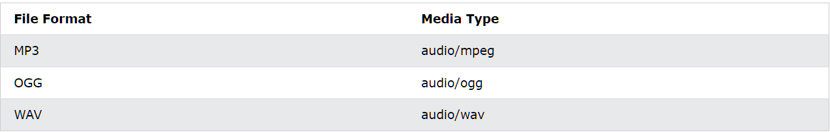
HTML5 – Audio Element
Syntax
<audio controls>
<source src=“megh.mp3" type="audio/mpeg">
<source src=“megh.wav" type="audio/wav">
Your browser does not support the audio element.
</audio>
The controls attribute adds audio controls, like play, pause, and volume.
The <source> element allows you to specify alternative audio files which the browser may choose from.
The text between the <audio> and </audio> tags will only be displayed in browsers that do not support the <audio> element.

Slide 33
HTML5 – Audio Element
To start an audio file automatically, use the autoplay attribute.
<audio controls autoplay>
Add muted after autoplay to let your audio file start playing automatically (but muted):
<audio controls autoplay muted>

Slide 34
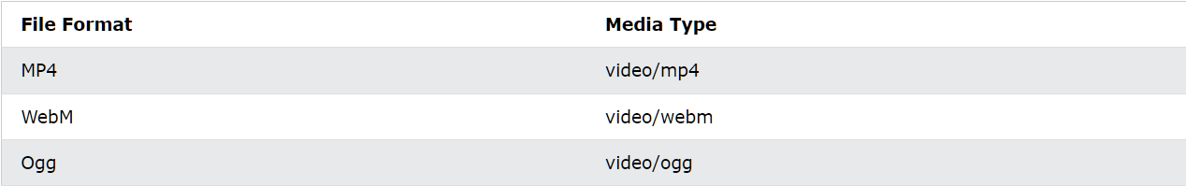
HTML5 – Video Element
Syntax
<video width="320" height="240" autoplay> <source src="movie.mp4" type="video/mp4"> <source src="movie.ogg" type="video/ogg"> Your browser does not support the video tag. </video>
The controls attribute adds video controls, like play, pause, and volume.
If height and width are not set, the page might flicker while the video loads.
Source & Text between tag works same as audio element.

Slide 35
HTML5 – Video Element
To start an video file automatically, use the autoplay attribute.
<video controls autoplay>
Add muted after autoplay to let your video file start playing automatically (but muted):
<video controls autoplay muted>

Slide 36
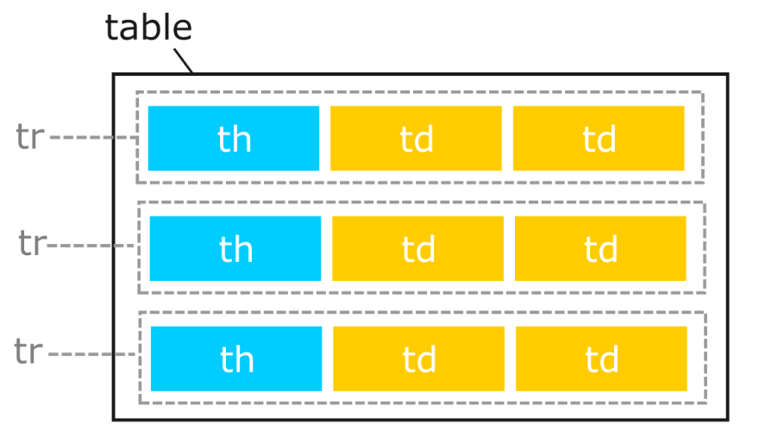
Tables
HTML tables are used for displaying data that make sense in spreadsheet software. They consist of rows and columns and are often used on websites for the effective displaying of tabular data.
A Simple Table Syntax
<table>
<tr>
<th>Headings</th>
</tr>
<tr>
<td>Data</td>
</tr>
</table>

Slide 37
Table - Border
To add border to you table we use border style property of CSS.
border: 1px solid black;
Here a single attribute border ha 3 values
1px – First value defines the size of border
Solid – This defines the style of border
Black – This defines the color of border
There are variety of border style which can also be applied through border-style property. Some of them are :- dotted, double, inset etc.
For Collapsing the border applied to multiple table element you can use border-collapse.
For Rounded border you can use border-radius property of CSS.

Slide 38
Table - Size
style attribute with the width or height properties is used to specify the size of a table, row or column.

Slide 39
Table – Spacing & Padding
Cell padding is the space between the cell edges and the cell content.
Uses padding, padding-left, etc. attributes
Cell spacing is the space between each cell.
Use border-spacing attribute.

Slide 40
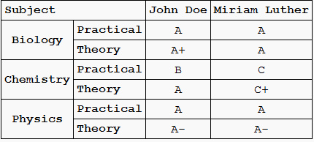
Table – Rowspan & Colspan
HTML tables can have cells that spans over multiple rows and/or columns.

Slide 41
Table – Colgroup
The <colgroup> element is used to style specific columns of a table.
Syntax :-
<colgroup>
<col span=“3" style=“color: #FFEF00">
</colgroup>
You can have multiple <colgroup> also.
You can also Hide the column using visibility attribute.

Slide 42
HTML Forms
For data collection a form is required.
Form is created using the <form> element.
<input> element is the most used element inside form element.
There are various kind of input element which we will learn further.
For labelling the form input we use <label> tag.

Slide 43
Forms – Radio Button
Radio buttons let a user select ONE of a limited number of choices.
Syntax :-
<input type="radio">
Radio Buttons belonging to same group must have same name attribute.
Checked attribute is used to have a pre-checked radio button.

Slide 44
Forms – Checkbox
Checkbox let a user select ZERO or MORE of a limited number of choices.
Syntax :-
<input type=“checkbox">
Checkbox belonging to same group must have same name attribute.
Checked attribute is used to have a pre-checked checkboxes.

Slide 45
Forms – Submit Button
The <input type="submit"> defines a button for submitting the form data to a form-handler.
The form-handler is specified in the form's action attribute.

Slide 46
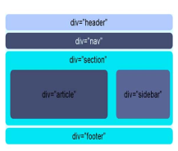
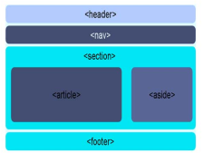
Laying Out Page in HTML
Most HTML 4 pages include a variety of common structures, such as headers, footers, and columns.
It's common to mark them up using div elements, giving each a descriptive id or class.
HTML 5 addresses this issue by introducing new elements for representing each of these different sections.
Elements that make it much easier to structure pages.

Slide 47
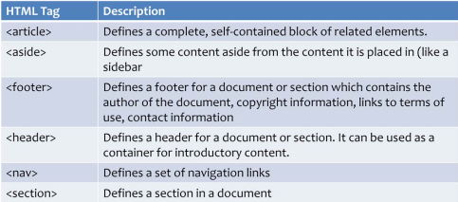
New Semantics in HTML5

