Slide 1
Module 02
CSS Basics

Slide 2
CSS
CSS stands for Cascading Style Sheets
CSS describes how HTML elements are to be displayed on screen, paper, or in other media
CSS saves a lot of work. It can control the layout of multiple web pages all at once
External stylesheets are stored in CSS files

Slide 3
How to Add CSS?
There are three ways of inserting a style sheet:
External CSS
With this type, you can change the look of an entire website by changing just one file.
Each HTML page must include a reference to the external style sheet file inside the <link> element, inside the head section. (<link rel="stylesheet" href=“firstPageStyle.css">)
Internal CSS
An internal style sheet may be used if one single HTML page has a unique style.
The internal style is defined inside the <style> element, inside the head section.
Inline CSS
An inline style may be used to apply a unique style for a single element.
To use inline styles, add the style attribute to the relevant element. The style attribute can contain any CSS property.

Slide 4
CSS Color
There are 6 different ways for applying color in CSS
Using 140 Standard Color Name (red, lime, cyan)
RGB (rgb(52, 199, 71))
HSL (hsl(52, 30%, 60%))
HEX (#FFFF00)
RGBA (rgb(25, 79, 91, 0.8))
HSLA (hsl(55, 9%, 14%, 0.4))

Slide 5
CSS Color
CSS Background Color
background-color:#00bb99;
CSS Text Color
color:blue;
CSS Border Color
border-color: rgb(214,147,21);

Slide 6
CSS Background
The following properties are used to add background effects for elements.
background-color (specifies the background color of an element)
background-image (specifies an image to use as the background of an element)
background-repeat (helps to control the repetition of image vertically & horizontally)
background-attachment (specifies whether the background image should scroll or be fixed)
background-position (specify the position of the background image)
Background-size (specifies the size of the background images)
background (shorthand property)

Slide 7
CSS Borders
The following properties are used to add border effects for elements.
border-width
border-style
border -color
border-radius
border (shorthand property)

Slide 8
CSS Border Side
In CSS, there are also properties for specifying each of the borders (top, right, bottom, and left):
If the border-style property has four values:
border-style: dotted solid double dashed;
top border is dotted, right border is solid, bottom border is double, left border is dashed
If the border-style property has three values:
border-style: dotted solid double;
top border is dotted, right and left borders are solid, bottom border is double
If the border-style property has two values:
border-style: dotted solid;
top and bottom borders are dotted, right and left borders are solid
If the border-style property has one value:
border-style: dotted;
all four borders are dotted
This is applicable to border-width & color also.

Slide 9
CSS Text
Text Color
background-color, color
Text Alignment
text-align, text-align-last, direction, unicode-bidi, vertical-align
Text Decoration
text-decoration-line, text-decoration-color, text-decoration-style, text-decoration-thickness, text-decoration
Text Transformation
text-transform
Text Spacing
text-indent, letter-spacing, line-height, word-spacing, white-space
Text Shadow
text-shadow

Slide 10
CSS Font
Font Family
font-family
Font Style
font-style
Font Weight
font-weight
Font Size
font-size
Font-variant
Font-varient

Slide 11
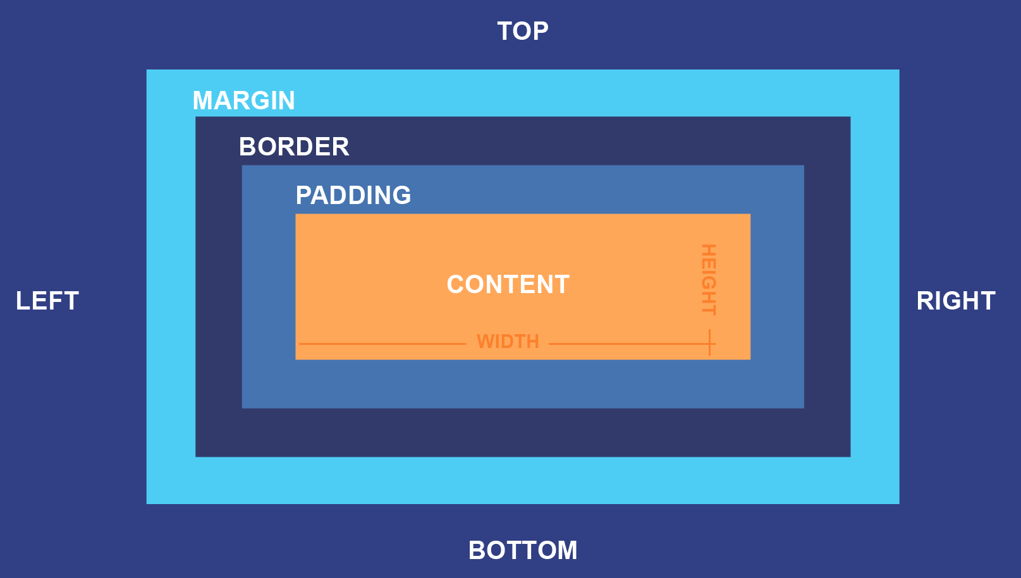
CSS Box Model
The CSS box model is essentially a box that wraps around every HTML element.
Basically 4 element are there
Content
Padding
Border
Margin
How width & height are calculated?

Slide 12
CSS Combinators Selectors
A CSS selector can contain more than one simple selector. Between the simple selectors, we can include a combinator.
There are four different combinators in CSS:
descendant selector (space) (Selects all 2nd elements inside 1st element)
child selector (>) (Selects all 2nd elements where the parent is 1st element)
adjacent sibling selector (+) (Selects the 2nd element that is placed immediately after 1st element)
general sibling selector (~) (selects all 2nd elements that are next siblings of 1st element.)

Slide 13
CSS Pseudo Class Selectors
There are different pseudo classes in CSS, some are:
:hover (Selects elements on mouse over)
:first-child (Selects every element that is the first child of its parent)
:nth-child(n) (Selects every element that is the nth child of its parent)
:visited (Selects all visited links)
:last-child (Selects every element that is the last child of its parent)

Slide 14
CSS Pseudo Element Selectors
There are different pseudo classes in CSS, some are:
::after (Insert something after the content of each given element)
::before (Insert something before the content of each given element)
::first-letter (Selects the first letter of each given element)
::first-line (Selects the first line of each given element)
::marker (Selects the markers of list items)
::selection (Selects the portion of an element that is selected by a user)

Slide 15
CSS Attribute Selectors
There are different pseudo classes in CSS, some are:
[attribute] (Select all element with the given attribute)
[attribute=value] (Select all element having attribute with given value)
[attribute~=value] (Select all element having attribute containing a word with given value)
[attribute|=value] (Select element having attribute having given value or have value-something)
[attribute^=value] (Selects every element whose attribute value begins with given value)
[attribute$=value] (Selects every element whose attribute value ends with given value)
[attribute*=value] (Selects every element whose attribute value contains the given value)
Note :- Selectors 3 & 4 works with whole word not with letters.

Slide 16
CSS Position
The position property specifies the type of positioning method used for an element
Basically 5 types are there
Static
Relative
Fixed
Absolute
Sticky

Slide 17
CSS Static Position
HTML elements are positioned static by default.
Static positioned elements are not affected by the top, bottom, left, and right properties.

Slide 18
CSS Relative Position
An element with position: relative; is positioned relative to its normal position.
Setting the top, right, bottom, and left properties of a relatively-positioned element will cause it to be adjusted away from its normal position. Other content will not be adjusted to fit into any gap left by the element.

Slide 19
CSS Fixed Position
An element with position: fixed; is positioned relative to the viewport, which means it always stays in the same place even if the page is scrolled. The top, right, bottom, and left properties are used to position the element.
A fixed element does not leave a gap in the page where it would normally have been located.

Slide 20
CSS Absolute Position
An element with position: absolute; is positioned relative to the nearest positioned ancestor (instead of positioned relative to the viewport, like fixed).
However; if an absolute positioned element has no positioned ancestors, it uses the document body, and moves along with page scrolling.

Slide 21
CSS Sticky Position
An element with position: sticky; is positioned based on the user's scroll position.
A sticky element toggles between relative and fixed, depending on the scroll position. It is positioned relative until a given offset position is met in the viewport - then it "sticks" in place (like position:fixed).

Slide 22
CSS Display
The display property is the most important CSS property for controlling layout.
The display property specifies if/how an element is displayed.
Every HTML element has a default display value depending on what type of element it is. The default display value for most elements is block or inline.
Some block level element are :- div, h1, p
Some inline elements are :- span, a, img

Slide 23
CSS Float & Clear
The float property is used for positioning and formatting content.
The float property can have one of the following values:
left - The element floats to the left of its container
right - The element floats to the right of its container
none - The element does not float (will be displayed just where it occurs in the text). This is default
inherit - The element inherits the float value of its parent
The clear property specifies what should happen with the element that is next to a floating element.
The clear property can have one of the following values:
none - The element is not pushed below left or right floated elements. This is default
left - The element is pushed below left floated elements
right - The element is pushed below right floated elements
both - The element is pushed below both left and right floated elements
inherit - The element inherits the clear value from its parent

Slide 24
CSS Box Sizing
The CSS box-sizing property allows us to include the padding and border in an element's total width and height.
This property is used when you want to clearly define perfect width & height for your elements.

Slide 25
CSS Media Query
Media queries in CSS3 extended the CSS2 media types idea: Instead of looking for a type of device, they look at the capability of the device.
Media queries can be used to check many things, such as:
width and height of the viewport
width and height of the device
orientation (is the tablet/phone in landscape or portrait mode?)
resolution
Using media queries are a popular technique for delivering a tailored style sheet to desktops, laptops, tablets, and mobile phones

Slide 26
CSS Media Query Syntax
The result of the query is true if the specified media type matches the type of device the document is being displayed on and all expressions in the media query are true. When a media query is true, the corresponding style sheet or style rules are applied, following the normal cascading rules.
Unless you use the not or only operators, the media type is optional and the all type will be implied.
@media not|only mediatype and (expressions) { CSS-Code; }
You can also have different stylesheets for different media:
<link rel="stylesheet" media="mediatype and|not|only (expressions)" href="print.css">

