Slide 1
Module – 03
JavaScript

Slide 2
Basic Concept of JavaScript
Web pages made using only HTML are somewhat static with no interactivity and negligible user involvement.
HTML tags are just instructions on document and the display of the document is dependent on the browser.
Interactive pages cannot be built with only HTML, we need a programming language. So Netscape came out with a client‐side language called as JavaScript.

Slide 3
What is JavaScript?
JavaScript is the scripting language of the Web.
JavaScript is used in Web pages to add functionality, validate forms, detect browsers, and much more.
JavaScript is the most popular scripting language on the internet and works on all major browsers available like IE, Firefox, Chrome etc..

Slide 4
What is Need of JavaScript?
For putting dynamic content into an HTML Page.
For client side Validation.
For storing and retrieving client's information in the form of Cookies.

Slide 5
How does JavaScript works?
When a JavaScript is inserted into an HTML document, the Internet browser will read the HTML and interpret the JavaScript.
The JavaScript can be executed immediately, or at a later event.

Slide 6
Embedding JS in HTML
In HTML you can use script tag for embedding javascript.
<SCRIPT>……</SCRIPT>
Attributes for script tag
src :- Specifies the url of external script file
type :- Specifies the media type of the script
async, reffererpolicy & many more…
Use the <NOSCRIPT> tag to specify alternate content for browsers that do not support JavaScript.

Slide 7
Where to write JS?
Head Section
If you want the Scripts to be executed when they are called, or whenever a user action happens, put script tag in the head section.
Body Section
If you want the Scripts to be executed when the page loads then put script tag in the body section
External File
If you want to run the same JavaScript on several pages, without having to write the same script on every page, you can write a JavaScript in an external file.

Slide 8
Where to write JS?
Head Section
If you want the Scripts to be executed when they are called, or whenever a user action happens, put script tag in the head section.
Body Section
If you want the Scripts to be executed when the page loads then put script tag in the body section
External File
If you want to run the same JavaScript on several pages, without having to write the same script on every page, you can write a JavaScript in an external file.

Slide 9
Hello World Using JS
Let’s implement the hello world program using JavaScript.

Slide 10
Statement, Semicolon & Comments
Statements are syntax constructs and commands that perform actions.
alert('Hello to the'); alert(‘JS World');
A semicolon may be omitted in most cases when a line break exists.
alert(“Hello”)
alert(“World”)
Comments
//Single Line Comment
/* Multi Line Comment */

Slide 11
Variables In JS
Why Variables?
A variable is a “named storage” for data.
A variable should be declared only once, repeated declaration cause an error (Exception :- var).
Variables are case-sensitive.
Variable name can’t be a reserved keyword. Eg:- let, break, if, function etc.
There are two limitations on variable names in JavaScript:
The name must contain only letters, digits, or the symbols $ and _.
The first character must not be a digit.
Types of Variable
let
var
const

Slide 12
Let Keyword
Variable Declaration
let name;
Variable Assignment
name = “Neelkanth”;
Variable Declaration with Assignment
let surname = “Patel”;
Multiple Variables
let name = “Neelkanth”, surname=“Patel”;

Slide 13
Var Keyword
The var keyword is used in all JavaScript code from 1995 to 2015.
There are subtle differences between let and var, we’ll cover them in detail later.
Variable Declaration
var name;
Variable Assignment
var = “Neelkanth”;
Both Declaration & Assignment
var age = 27

Slide 14
Const Keyword
To declare a constant (unchanging) variable, use const instead of let.
const myBirthday = '18.04.1995;
There is a widespread practice to use constants as aliases for difficult-to-remember values that are known prior to execution.
Such constants are named using capital letters and underscores.

Slide 15
Datatypes
A value in JavaScript is always of a certain type. For example, a string or a number.
There are eight basic data types in JavaScript.
We can put any type in a variable.
For example, a variable can at one moment be a string and then store a number:

Slide 16
Number
The number type represents both integer and floating point numbers.
There are many operations for numbers, e.g. multiplication *, division /, addition +, subtraction -, etc.
Besides regular numbers, there are so-called “special numeric values” which also belong to this data type: Infinity, -Infinity and NaN.

Slide 17
Bigint
In JavaScript, the “number” type cannot safely represent integer values larger than (253-1) (that’s 9007199254740991), or less than -(253-1) for negatives.
BigInt type was recently added to the language to represent integers of arbitrary length.
A BigInt value is created by appending n to the end of an integer:

Slide 18
String
A string in JavaScript must be surrounded by quotes.
In JavaScript, there are 3 types of quotes.
Double quotes: "Hello".
Single quotes: 'Hello'.
Backticks: `Hello`.
Double and single quotes are “simple” quotes. There’s practically no difference between them in JavaScript.
Backticks are “extended functionality” quotes. They allow you to embed variables and expressions into a string by wrapping them in ${…}.

Slide 19
Boolean
The boolean type has only two values: true and false.
This type is commonly used to store yes/no values: true means “yes, correct”, and false means “no, incorrect”.

Slide 20
Null
The special null value does not belong to any of the types described above.
It forms a separate type of its own which contains only the null value.
It’s just a special value which represents “nothing”, “empty” or “value unknown”.

Slide 21
Undefined
The special value undefined also stands apart. It makes a type of its own, just like null.
The meaning of undefined is “value is not assigned”.
If a variable is declared, but not assigned, then its value is undefined:

Slide 22
Objects
The object type is special.
All other types are called “primitive” because their values can contain only a single thing (be it a string or a number or whatever).
In contrast, objects are used to store collections of data and more complex entities.

Slide 23
TypeOF
The typeof operator returns the type of the argument. It’s useful when we want to process values of different types differently or just want to do a quick check.
A call to typeof x returns a string with the type name:

Slide 24
Operators

Slide 25
Conditionals
If statement
The if(...) statement evaluates a condition in parentheses and, if the result is true, executes a block of code.
Else statement
The if statement may contain an optional “else” block. It executes when the condition is falsy.
Else if Ladder
Sometimes, we’d like to test several variants of a condition. The else if clause lets us do that.

Slide 26
Dialogs
There are basically three types of dialogs that we will use in JavaScript, namely :-
Alert
It shows a message and waits for the user to press “OK”.
alert(“You are directing to Website");
Confirm
The function confirm shows a modal window with a question and two buttons: OK and Cancel.
The result is true if OK is pressed and false otherwise.
confirm(“Are you 18 years old”);
Prompt
prompt(“Enter your age”, [default]);
It shows a modal window with a text message, an input field for the visitor, and the buttons OK/Cancel.

Slide 27
Loops
Loops are a way to repeat the same code multiple times.
There are 3 basic loops :-
While
while (condition) {
// code }
Do…while
do {
// loop body
} while (condition);
For
for (begin; condition; step) {
// ... loop body ... }

Slide 28
Loops – Continue & Break
Normally, a loop exits when its condition becomes falsy.
But we can force the exit at any time using the special break directive.
The continue directive is a “lighter version” of break. It doesn’t stop the whole loop. Instead, it stops the current iteration and forces the loop to start a new one (if the condition allows).

Slide 29
Function
Functions are the main “building blocks” of the program. They allow the code to be called many times without repetition.
To create a function we can use a function declaration.
function name(parameter1, parameter2, ... parameterN) {
...body...
}

Slide 30
Function Variables
Local variables
A variable declared inside a function is only visible inside that function.
Outer Variables or Global Variables
Variables declared outside of any function.
Global variables are visible from any function.
If a same-named variable is declared inside the function then it shadows the outer one.

Slide 31
Function Parameters
We can pass arbitrary data to functions using parameters.
When a value is passed as a function parameter, it’s also called an argument.
function name(parameter1, parameter2, ... parameterN) {
...body...
}
name(2,”String”,true)
Default Parameters
If a function is called, but an argument is not provided, then the corresponding value becomes undefined.
To avoid this we use default parameter for function.
function getName(name=“No name Provided”) {….}

Slide 32
Function Return Value
A function can return a value back into the calling code as the result.
There may be many occurrences of return in a single function.
Syntax:-
function name(….){
return “Hello”;
}

Slide 33
Arrays
To store ordered collections in javascript, we use special data structure named Array.
There are two syntaxes for creating an empty array:
let arr = new Array();
let arr = [];
For array initialization we use
Colors = [“Red", “Green", “Blue"];
Array elements are numbered, starting with zero.
We can get an element by its number in square brackets.

Slide 34
Arrays Functions
The total count of the elements in the array is its length.
Color.length
Array Loops
For of loop
The for..of give access to the value of the current element.
For In loop
The for..of give access to the index of the current element.

Slide 35
Arrays Functions
at keyword is used for retrieving values from particular array.
In other words, arr.at(i):
is exactly the same as arr[i], if i >= 0.
for negative values of i, it steps back from the end of the array.
There are some other common methods namely push, pop, shift, unshift

Slide 36
Arrays For Each
The arr.forEach method allows to run a function for every element of the array.
arr.forEach(function(item, index, array) {
// ... code
});

Slide 37
Strings
In JavaScript, the textual data is stored as strings. There is no separate type for a single character.
String with backtics are special. They allow multiline spaning.

Slide 38
Strings - Special characters
There are some special character used in string. Some of them are:-
\n
\t
\”
\’
\\

Slide 39
Strings - Function
String length
The length property gives the string length.
String chatAt
To get a character at certain index, use square brackets [index] or call the method str.charAt(index).
Changing the case
Methods toLowerCase() and toUpperCase() change the case.
Get Substring
String.substring(start, end) between start and end indexes

Slide 40
Strings
Strings are immutable
Strings can’t be changed in JavaScript. It is impossible to change a character.
Comparing strings
strings are compared character-by-character in alphabetical order.
But, a lowercase letter is always greater than the uppercase.

Slide 41
Hash Table

Slide 42
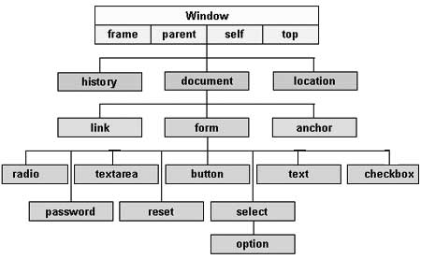
Document Object Model
The Document Object Model, or DOM for short, represents all page content as objects that can be modified.
The document object is the main “entry point” to the page. We can change or create anything on the page using it.

Slide 43
DOM Tree
The backbone of an HTML document is tags.
According to the Document Object Model (DOM), every HTML tag is an object. Nested tags are “children” of the enclosing one. The text inside a tag is an object as well.
All these objects are accessible using JavaScript, and we can use them to modify the page.
Comments & whitespaces are also part of DOM.

Slide 44
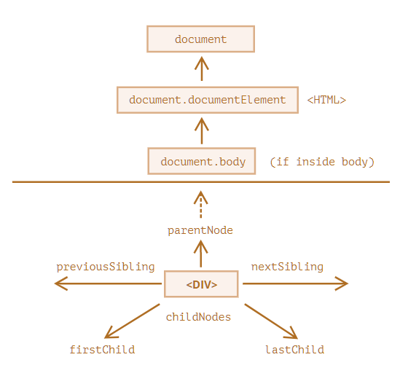
DOM Traversal
The topmost tree nodes are available directly as document properties.
The topmost document node is document.documentElement. That’s the DOM node of the <html> tag.
Another widely used DOM node is the <body> element – document.body.
The <head> tag is available as document.head.

Slide 45
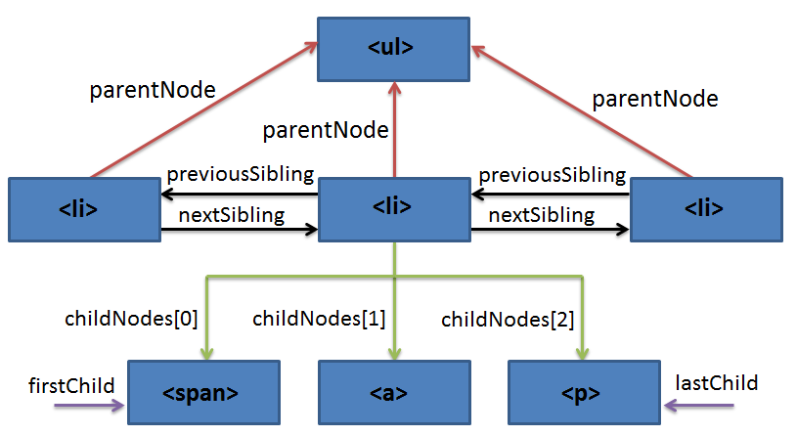
DOM Traversal

Slide 46
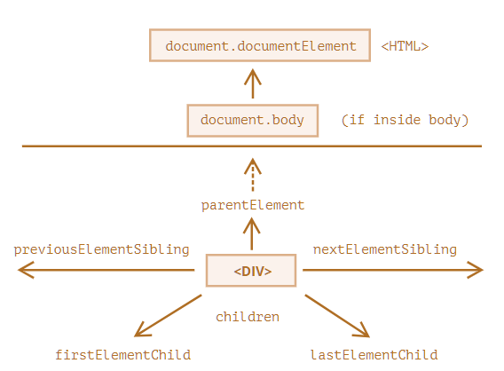
DOM Element Traversal
Navigation properties listed till now refer to all nodes. For instance, in childNodes we can see both text nodes, element nodes, and even comment nodes if they exist.
The links are similar to those given above, just with Element word inside:
children – only those children that are element nodes.
firstElementChild, lastElementChild – first and last element children.
previousElementSibling, nextElementSibling – neighbor elements.
parentElement – parent element.

Slide 47
Searching Dom: getElement*
document.getElementById
If an element has the id attribute, we can get the element using the method document.getElementById(id), no matter where it is in the page.
getElementsByTagName(tag)
getElementsByTagName(tag) looks for elements with the given tag and returns the collection of them. The tag parameter can also be a star "*" for “any tags”.
getElementsByClassName(className)
getElementsByClassName(className) returns elements that have the given CSS class.
getElementsByName(name)
getElementsByName(name) returns elements with the given name attribute, document-wide. Very rarely used.

Slide 48
Searching Dom: querySelector*
querySelectorAll(css)
querySelectorAll(css) returns all elements inside elem matching the given CSS selector.
querySelector(css)
querySelector(css) returns the first element for the given CSS selector.
matches(css)
matches(css) does not look for anything, it merely checks if elem matches the given CSS-selector. It returns true or false.
closest(css)
closest(css) looks for the nearest ancestor that matches the CSS-selector. The element itself is also included in the search.

Slide 49
Remember
Only document.getElement*/querySelector*, or anyElem.getElement*/querySelector*
The method getElementById can be called only on document object. It looks for the given id in the whole document.
Other all can be on any element.

Slide 50
Dom Inner & Outer HTML
The innerHTML property allows to get the HTML inside the element as a string.
We can also modify it. So it’s one of the most powerful ways to change the page.
The outerHTML property contains the full HTML of the element. That’s like innerHTML plus the element itself.
unlike innerHTML, writing to outerHTML does not change the element. Instead, it replaces it in the DOM.

