Slide 1
Node.jS

Slide 2
Learning Objectives
What is Node.js?
Features of Node.js
Node.js background
Download and install Node.js
Comparing blocking vs non-blocking
Node Package Manager (NPM)
Callback concept
Node.js Modules
HTTP module

Slide 3
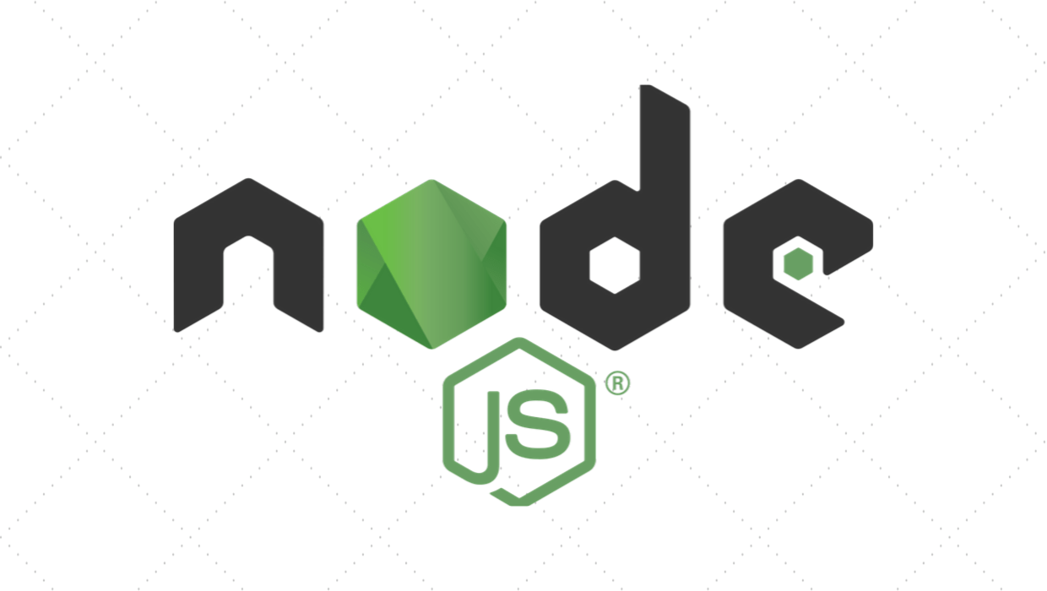

Slide 4
What is Node.js?
Node.js provides a non-blocking architecture using event loop processing based on single threaded JavaScript model and built on top of Google’s V8 JavaScript Engine.

Slide 5
Features of Node.js: Non-blocking
Non-blocking execution means asynchronous execution.
All APIs of Node.js library are asynchronous and non-blocking.
Node.js server never waits for an API to return data. Server moves to next API after calling it and a notification mechanism of Events of Node.js helps server to get response from the previous API call.

Slide 6
Features of Node.js: Event loop processing
Event loop processing in Node.js is a programming style where the flow of execution is determined by events.
Events are handled by event handlers or event callbacks.
An event callback is a function that is invoked when something significant happens such as when the result of a database query is available.

Slide 7
Features of Node.js: Single Threaded
Node is a single-threaded environment. At most, only one line of your code will ever be executing at any time.
Note: event loop in Node.js is just one thread running inside one process, which means that, when an event happens, the event handler can run without interruption.

Slide 8
Node.js Background
Node.js was invented in 2009 by Ryan Dahl along with other developers while working at Joyent.
The Node.js’ Package Manager (NPM) was introduced in 2011, allowing publishing and sharing node.js source code by the community.
Node.js was originally developed for the Linux environment.
The first node.js to support Windows was released in July 2011.
Node.js went through several technical changes including internal conflict over Joyent’s governance, resulting Fedor Indutny (Node.js core team developer) in December 2014 starting io.js, a fork of Node.js.

Slide 9
Node.js Background
In February 2015, the Node.js foundation was announced, providing the opportunity of merging Node.js and io.js communities together under the Node.js foundation.
On Oct12, 2015, Node 4.2.0 (LTS) was announced, the first release covered under the new LTS plan (Long Term Support).
Node’s core functionalities are kept to a minimum.
There are many third-party modules supporting Node.js and can be downloaded, installed, and managed using Node Package Manager (NPM) to expand node’s functionalities.

Slide 10
Structures of Node.js
Console Module
Buffer Module
dns Module
Core Node.js
express Module
fs Module
net Module
http Module

Slide 11
Download and Install Node.js
Download and install latest version of Node.js
Instruction for windows O/S click here.
Instruction for Mac O/S click here.
Create a working folder (c:\nodejs_workspace).
Check the Node.js version that just installed.
Go to cmd terminal, enter:
node --version (or node –v)

Slide 12
Compare Blocking vs Non-blocking
Blocking methods execute synchronously and non-blocking methods executes asynchronously.
Using the File System modules, this is a synchronous file read:
const fs = require("fs");
const data = fs.readFileSync("./test.txt");
console.log(data.toString());
console.log("This statement runs after read file!");

Slide 13
Compare Blocking vs Non-blocking
Here is an equivalent asynchronous example:
const fs = require("fs");
fs.readFile("./test.txt", (err, data) => {
if(err) console.log("Read error!!");
console.log(data.toString());
});
console.log("This statement runs after read statement?");

Slide 14
Node.js – Node Package Manager (NPM)
Node Package Manager (NPM) provides two main functionalities:
Online repositories for Node.js packages/modules.
Command line utility to install packages, do version management and dependency management of Node.js packages.
NOTE: NPM comes bundled with Node.js after v0.6.3 version.
To verify the NPM version, go to cmd terminal, enter:
npm --version (or npm –v)

Slide 15
NPM Global vs Local Installation
By default, npm installs any dependency (modules or packages) in the local mode. Locally deployed packages are accessible via require.
Install express, a popular web framework using local installation (go to cmd terminal).
c:\nodejs_workspace> npm install express
Once npm completes the download, you can verify by looking at the content of c:\nodejs_workspace\node_modules
Or type the following command:
c:\nodejs_workspace> npm ls

Slide 16
NPM Global vs Local Installation
Globally installed packages/dependencies are stored in <user-directory>/npm directory. Such dependencies can be used in CLI (Command Line Interface) function of any Node.js but can not be imported using require in Node application directly.
Install express, a popular web framework using global installation.
c:\nodejs_workspace> npm install express –g
Once npm completes the download, you can verify by looking at the content of <user-directory>/npm/node_modules.
NOTE: <user-directory> = c:\Users\my_uid\AppData\Roaming
Or type the following command:
c:\nodejs_workspace> npm ls -g

Slide 17
Callbacks Concept
Callback is an asynchronous equivalent for a function.
A callback function is called at the completion of a given task.
Node.js makes heavy use of callbacks.
API_function("data_here", callback_function(var_data){
// cunction content
});
OR (No name function)
API_function("data_here", (var_data) => {
// function content
});

Slide 18
Callback sample
For example (non-blocking) readFile(), a function to read a file may start reading file and return the control to execution environment immediately so that next instruction can be executed.
Once file I/O is complete, it will call the callback function while passing the callback function, the content of the file as parameter. So there is no blocking or wait for file I/O.
fs.readFile(“location/file_name", callback_function());
console.log("This statement runs after read statement?");

Slide 19
Node.js – Sync vs Async Write
var fs = require('fs');
var out_data = 'Outdata line 1. \r\nOutdata last line.';
// Asynchronous write
fs.writeFile('./output_async.txt', out_data, function (err) {
if (err) console.log(err);
console.log('Output Async file content: ' + out_data);
});
// Synchronous write
fs.writeFileSync('./output_sync.txt', out_data);
console.log('Output Sync file content: ' + out_data);
console.log('Program Ended.');

Slide 20
Node.js - Modules
Module Name | Description
buffer | buffer module can be used to create Buffer class.
console | console module is used to print information on stdout and stderr.
dns | dns module is used to do actual DNS lookup and underlying o/s name resolution functionalities.
domain | domain module provides way to handle multiple different I/O operations as a single group.
fs | fs module is used for File I/O.
http | to make Node.js act as an HTTP server
https | to make Node.js act as an HTTPS server

Slide 21
Node.js - Modules
Module Name | Description
net | net module provides servers and clients as streams. Acts as a network wrapper.
os | os module provides basic o/s related utility functions.
path | path module provides utilities for handling and transforming file paths.
process | process module is used to get information on current process.
querystring | to handle URL query string
url | to parse URL strings

Slide 22
Node.js – HTTP Module
Node.js has a built-in module called HTTP, which allows Node.js to transfer data over the Hyper Text Transfer Protocol (HTTP).
Set up node.js as a Web Server:
The HTTP module can create an HTTP server that listens to server ports and gives a response back to the client.
Use the createServer() method to create an HTTP server.
The function passed into the http.createServer() method, will be executed when someone tries to access the computer on port 8081.

Slide 23
http_server.js
var http = require('http');
http.createServer(function (request, response) {
response.writeHead(200, {'Content-Type' : 'text/html'});
response.write('Hello World!');
response.end();
}).listen(8081);
console.log('Server running at http://127.0.0.1:8081/ or http://localhost:8081');
console.log('Server Program Ended.');

Slide 24
Test your web server
From cmd terminal, enter:
c:\nodejs_workspace> node http_server.js
From browser, enter:
http://localhost:8081
To terminate the web server, from cmd terminal, enter:
c:\nodejs_workspace> CTRL C

Slide 25
Create http_client.js
var http = require('http');
var options = {
host: 'localhost',
port: '8081',
path: '/'
};
var callback = function (response) {
var body = '';
response.on('data', function (data) {
body += data;
});

Slide 26
http_client.js
response.on('end', function () {
console.log(body);
});
response.on('error', function (error) {
console.error(error)
});
};
var req = http.request(options, callback);
req.end();
console.log('Client Program Ended.');

Slide 27
Test your http_client.js (API)
Start the http_server.js
From cmd terminal, enter:
c:\nodejs_workspace> node http_server.js
Open another cmd terminal, enter:
c:\nodejs_workspace> node http_client.js

Slide 28
Use of curl (API to API)
Start the http_server.js
From cmd terminal, enter:
c:\nodejs_workspace> node http_server.js
Open another cmd terminal, enter:
c:\nodejs_workspace> curl http://localhost:8081

