Slide 1
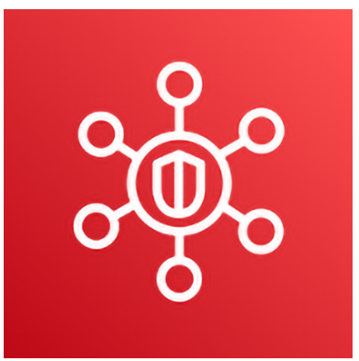
CLOUD SECURITY POSTURE MANAGEMENT
AWS SECURITY HUB

Slide 2
Agenda
01. Introduction
02. AWS Security Hub
03. AWS Security Hub Automated Response and Remediation
04. Demo
05. Limitation

Slide 3
INTRODUCTION

Slide 4
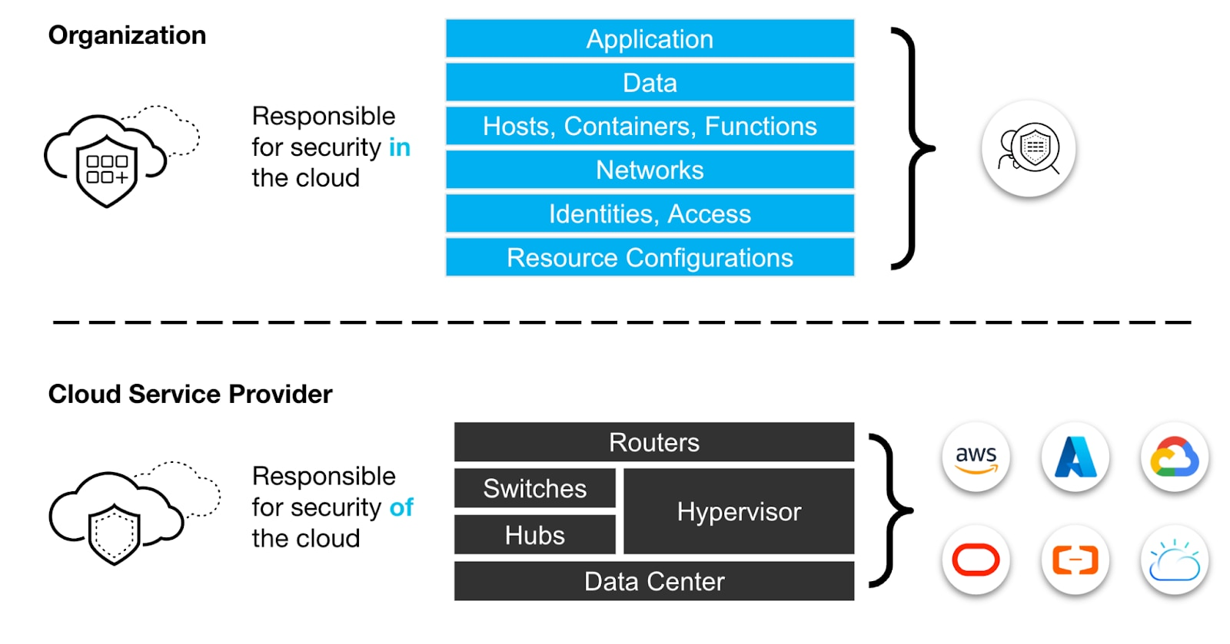
CSPM explained
Adopt CSPM as a standard security practice

Slide 5
CSPM explained
Identify, remediate risks by:
visibility
uninterrupted monitoring
threat detection
remediation workflows
misconfigs in
cloud environments/infrastructure
search for
IaaS
PaaS
SaaS

Slide 6



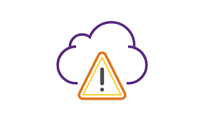

Why is CSPM important?
Data leak
More Cloud Users
More Apps
More misconfigs
Fine
Notes:
What is CSPM? | Microsoft Security
What Is CSPM? - Palo Alto Networks

Slide 7
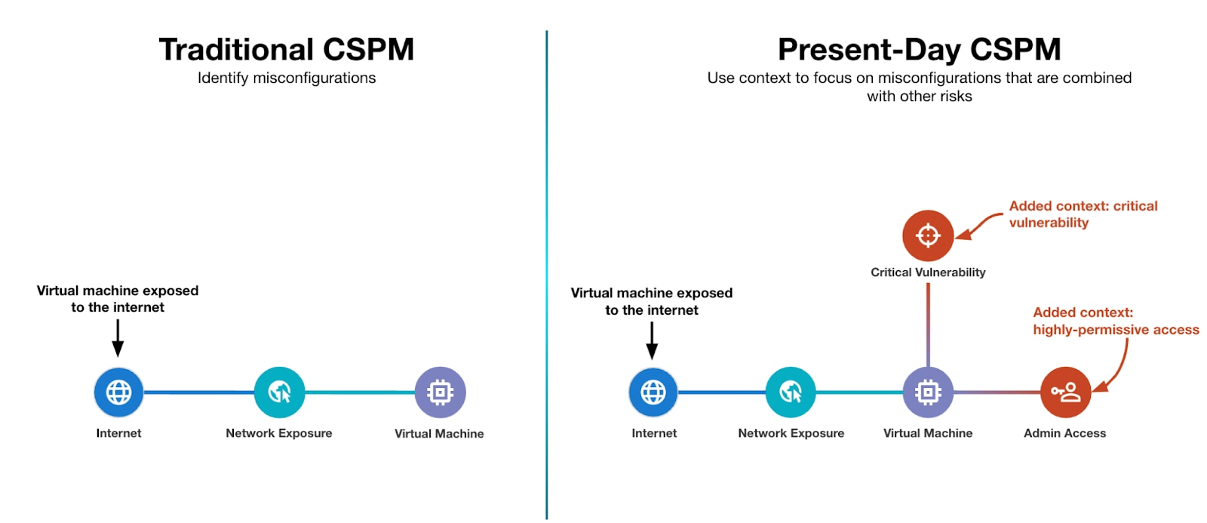
Example of CSPM’s context

Slide 8
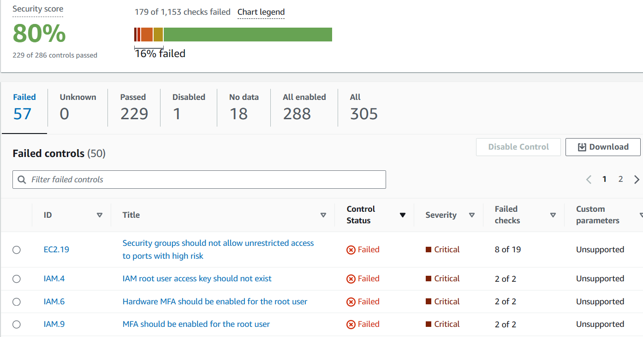
Example of CSPM’s monitoring

Slide 9
CSPM vs Other solutions
vs SIEM
SIEM:
- aggregates security events from several infrastructure (cloud, network, etc.) to detect and mitigate threats
CSPM can export findings to SIEM for further analysis

Slide 10
AWS SECURITY HUB

Slide 11
Scope of work
Boundary: Deploy features of AWS Security Hub related to CSPM, aimining to enhance security in AWS and AWS only by security check for misconfig in AWS resources and remediations for findings.

Slide 12
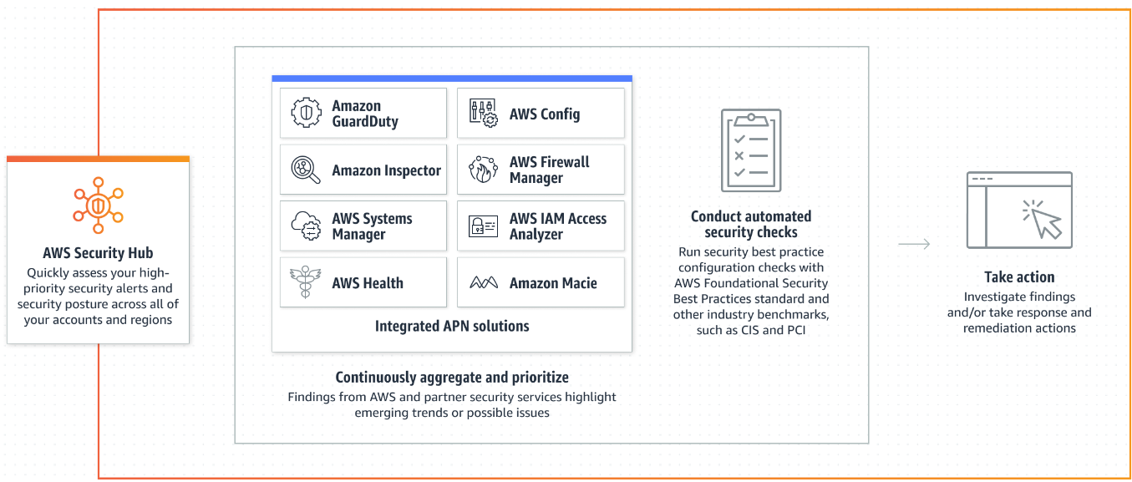






AWS Security Hub - A CSPM tool
Continuously central, aggregate findings
Loggings
Security standard check
Automatically remediate findings across multiple accounts
Notice remediation actions and results

Slide 13
Terminology
AWS Config rule: an ideal config setting
Scurity control: a representation of a rule -> in one or more security standards
Finding: a potential security issue generated after security check
Playbook: a set of remediation
Runbook: defines actions that SSM performs on resources when an automation runs.

Slide 14
Security Control example
[EC2.13] Security groups should not allow ingress from 0.0.0.0/0 or ::/0 to port 22
Related requirements:
Category: Protect > Secure network configuration
Severity: High
Resource type: AWS::EC2::SecurityGroup
AWS Config rule: restricted-ssh
Parameters: None
This control checks whether an Amazon EC2 security group allows ingress from 0.0.0.0/0 or ::/0 to port 22. The control fails if the security group allows ingress from 0.0.0.0/0 or ::/0 to port 22.
Security groups provide stateful filtering of ingress and egress network traffic to AWS resources. We recommend that no security group allow unrestricted ingress access to port 22. Removing unfettered connectivity to remote console services, such as SSH, reduces a server's exposure to risk.
Remediation
To prohibit ingress to port 22, remove the rule that allows such access for each security group associated with a VPC.

Slide 15
AWS Config rule: restricted-ssh
For this rule, the rule identifier (INCOMING_SSH_DISABLED) and rule name (restricted-ssh) are different.
Checks if the incoming SSH traffic for the security groups is accessible. The rule is COMPLIANT if the IP addresses of the incoming SSH traffic in the security groups are restricted (CIDR other than 0.0.0.0/0 or ::/0). Otherwise, NON_COMPLIANT.
Identifier: INCOMING_SSH_DISABLED
Resource Types: AWS::EC2::SecurityGroup
Trigger type: Configuration changes and Periodic
AWS Region: All supported AWS regions except Africa (Cape Town), Europe (Milan) Region
Parameters: None

Slide 16
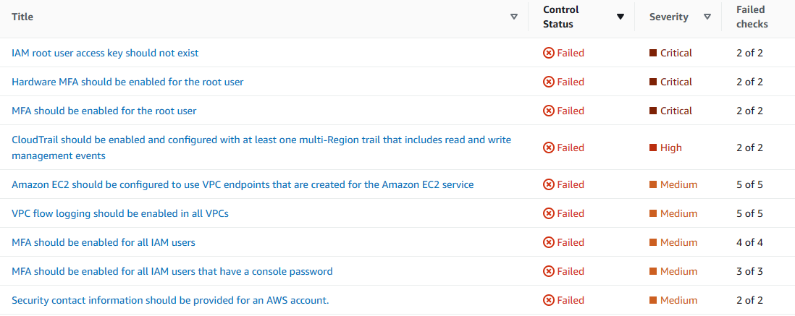
Security control list

Slide 17
Standalone Findings

Slide 18
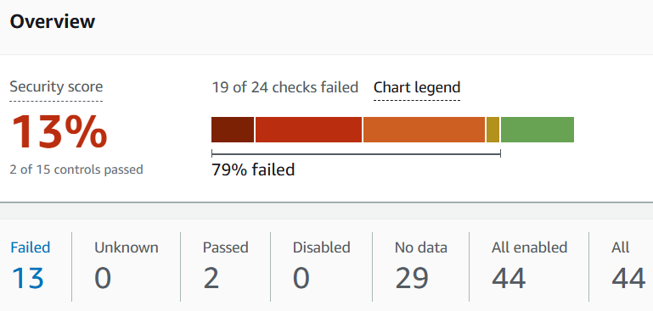
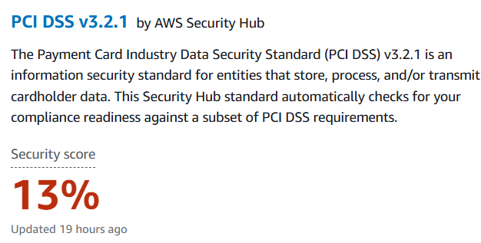
Security Standard Check

Slide 19
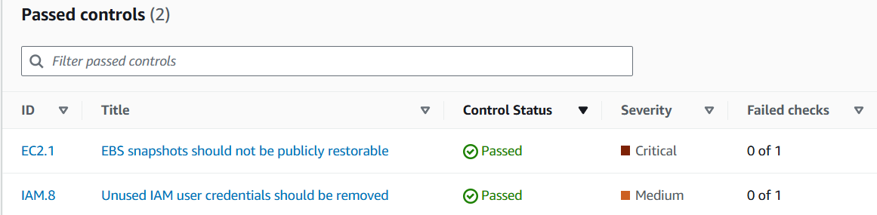
Security Standard Check
PCI DSS v3.2.1

Slide 20
Security Standard Check

Slide 21
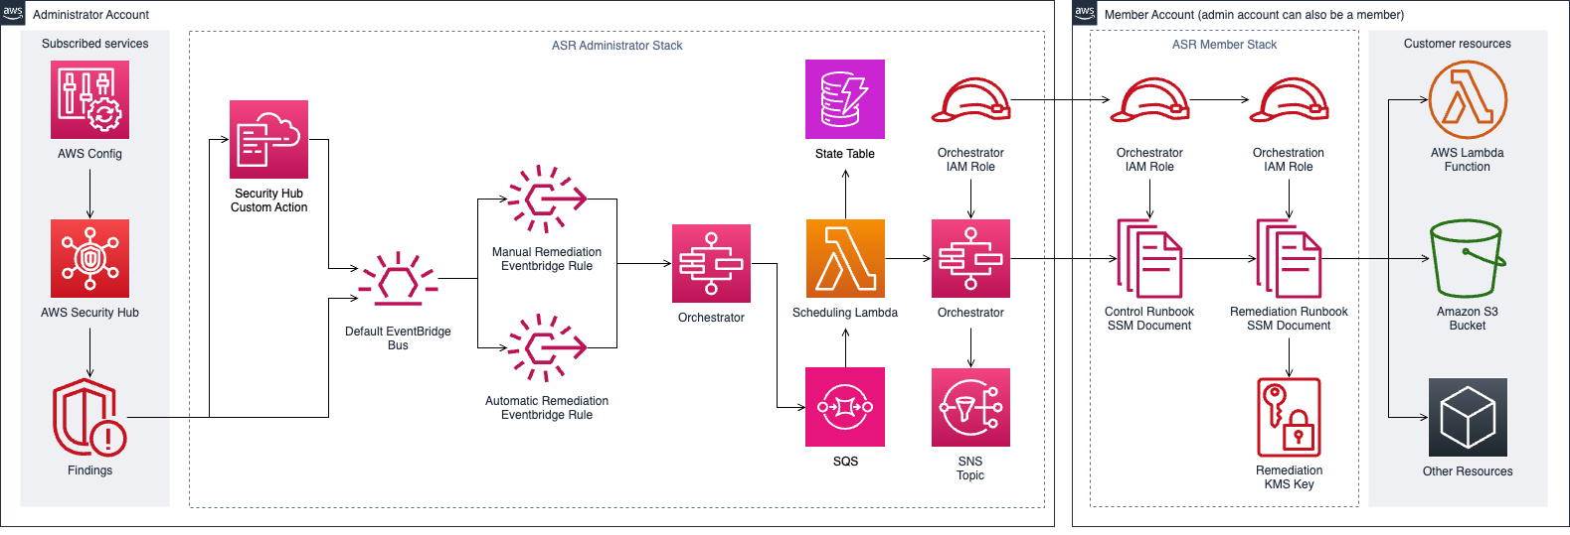

Architecture Diagram
(Execute the
remediation)

Slide 22
DEMO

Slide 23
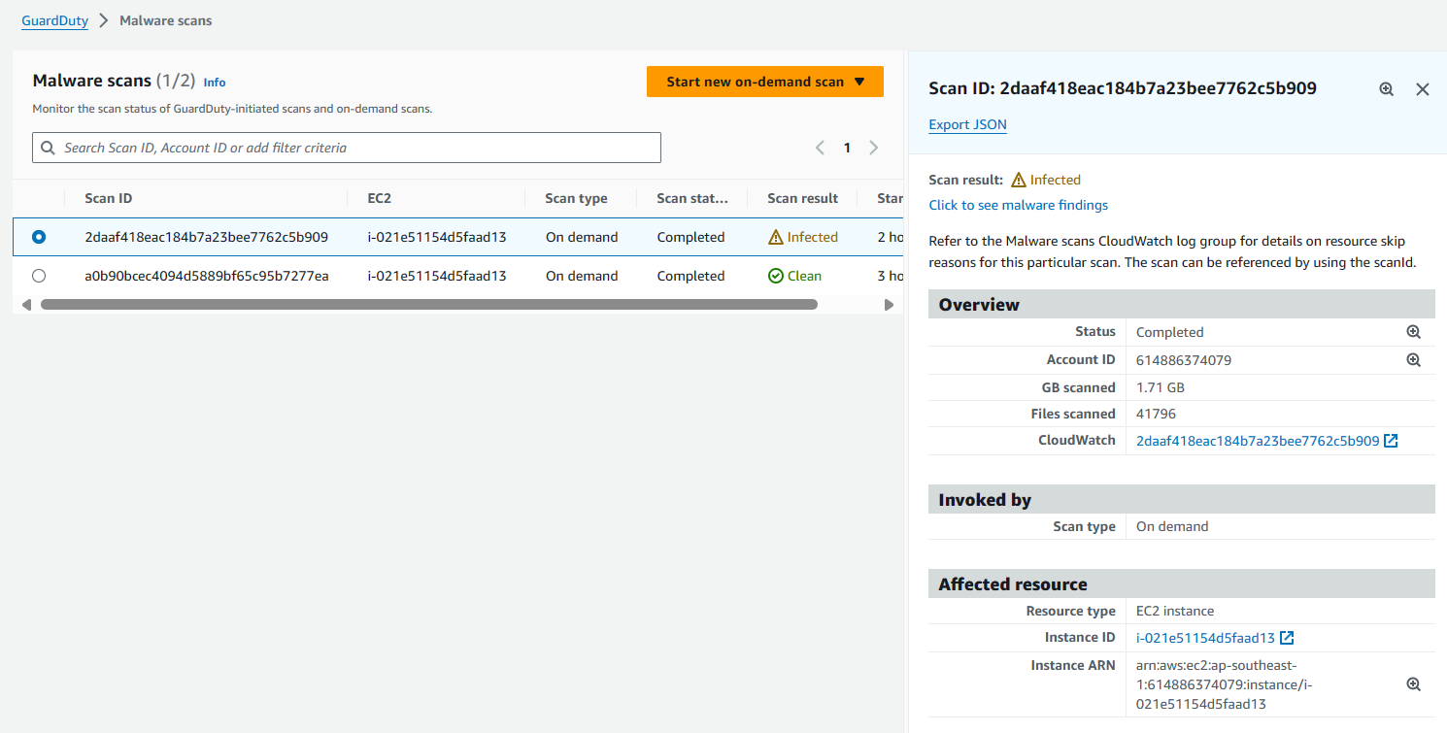
Detect virus

Slide 24
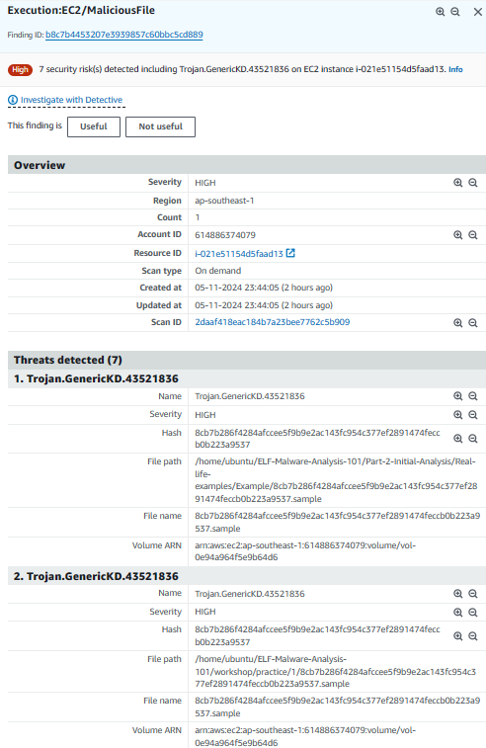
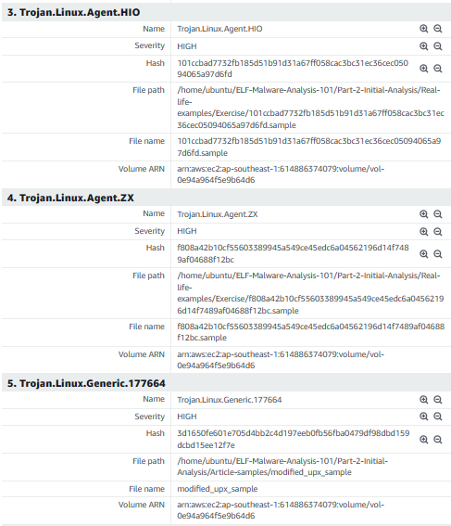
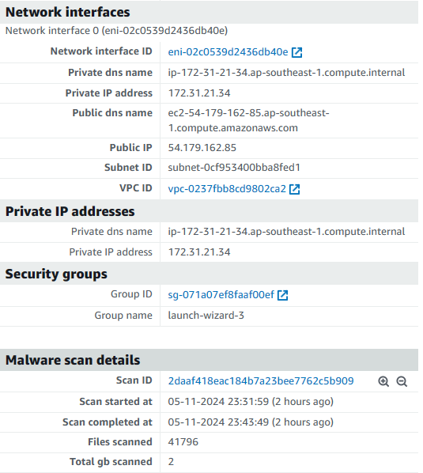
GuardDuty – Detailed report

Slide 25
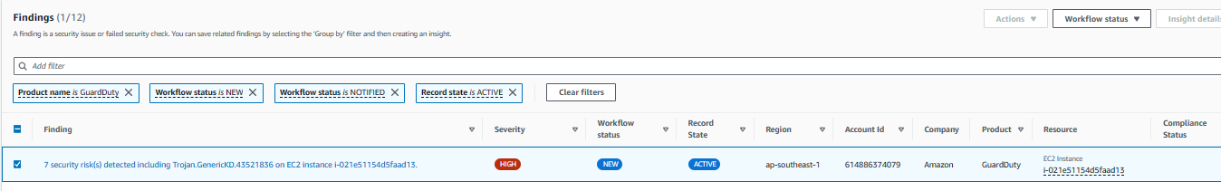
Security Hub aggregates finding from GuardDuy

Slide 26
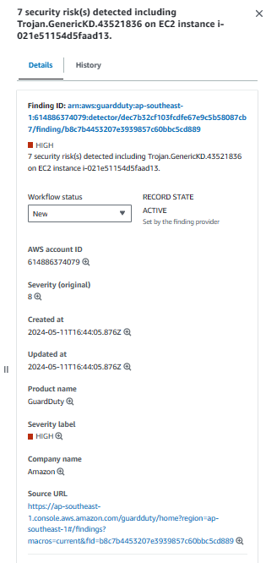
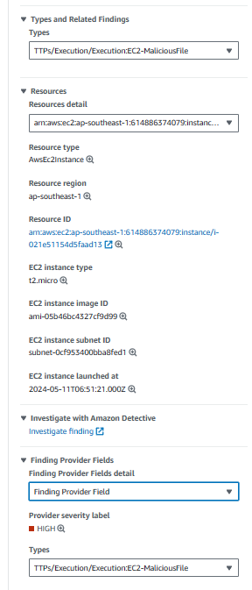
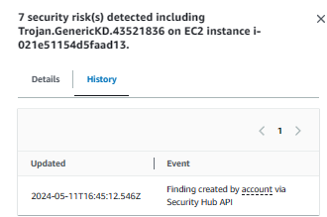
Security Hub

Slide 27
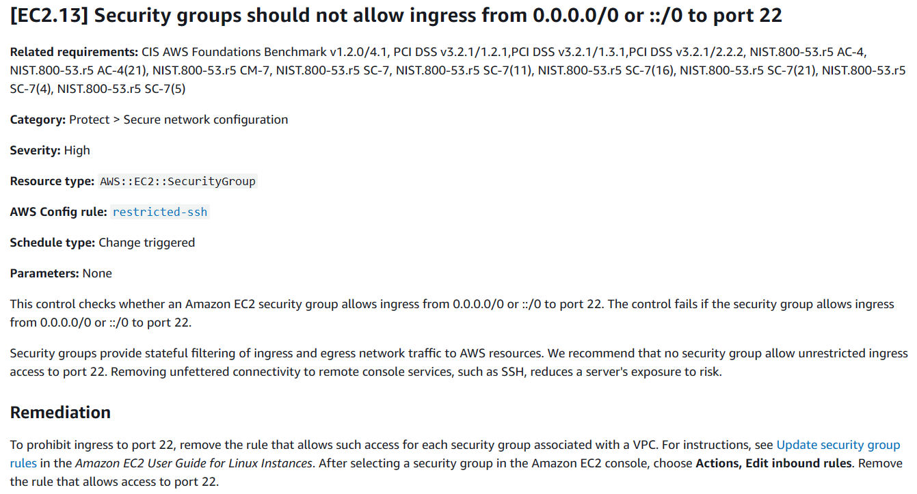
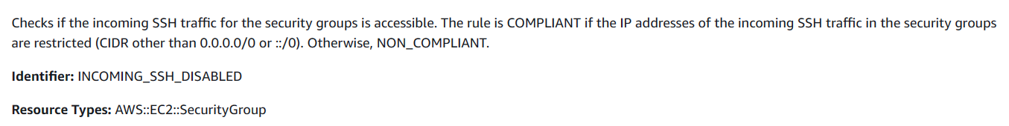

Slide 28
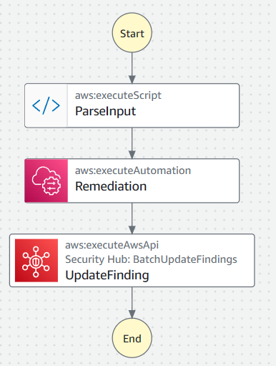
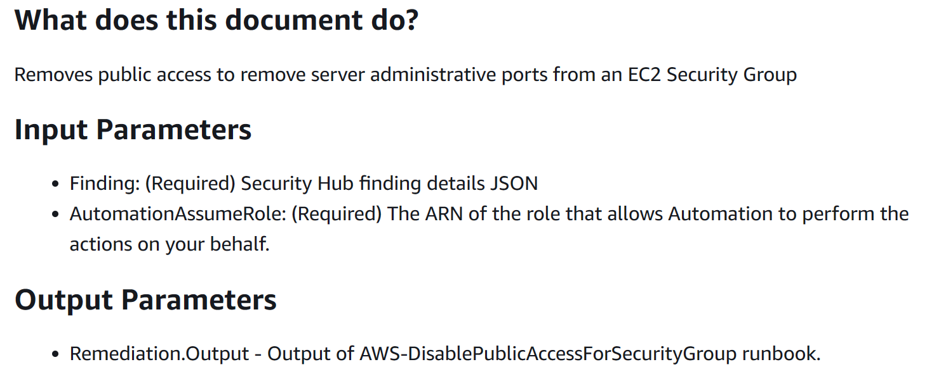
Runbook EC2.13

Slide 29
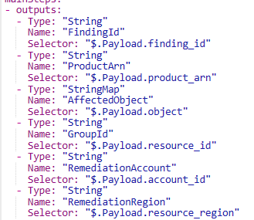
expected_control_id:
- EC2.13
- EC2.14
parse_id_pattern: ^arn:(?:aws|aws-cn|aws-us-gov):ec2:(?:[a-z]{2}(?:-gov)?-[a-z]+-\d):\d{12}:security-group\/(sg-[a-f\d]{8,17})$
Finding: '{{ Finding }}'

Slide 30
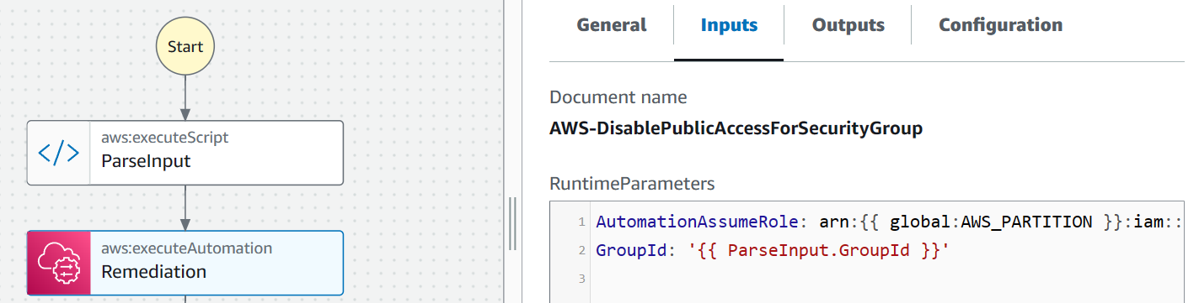
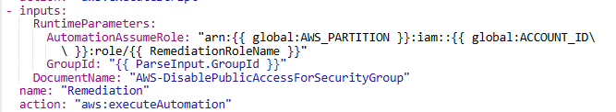

Slide 31
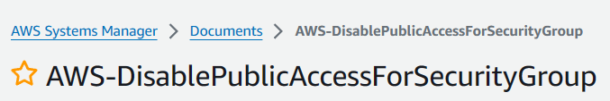
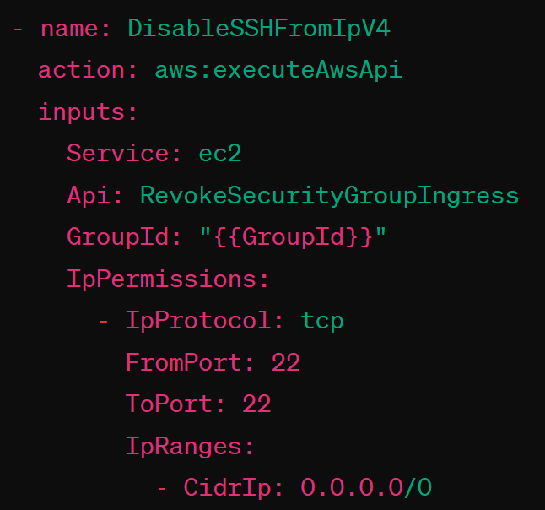
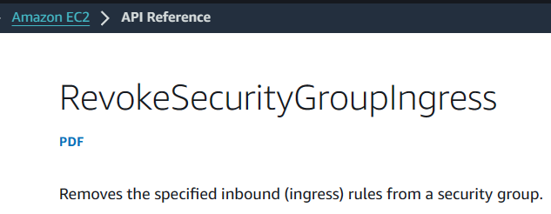

Slide 32

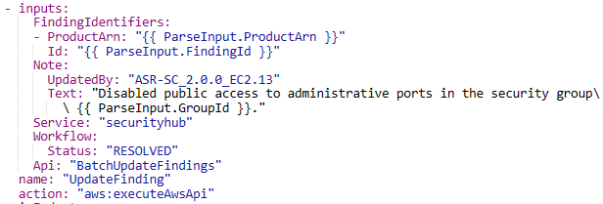

Slide 33
Prerequisite
AWS Organization
Adminstrator account: Pham Nguyen Hai Anh
Member account: Anh Pham
Enable:
Required: AWS Security Hub, AWS Config
Optional: AWS GuardDuty, AWS WAF, Amazon Macie

Slide 34
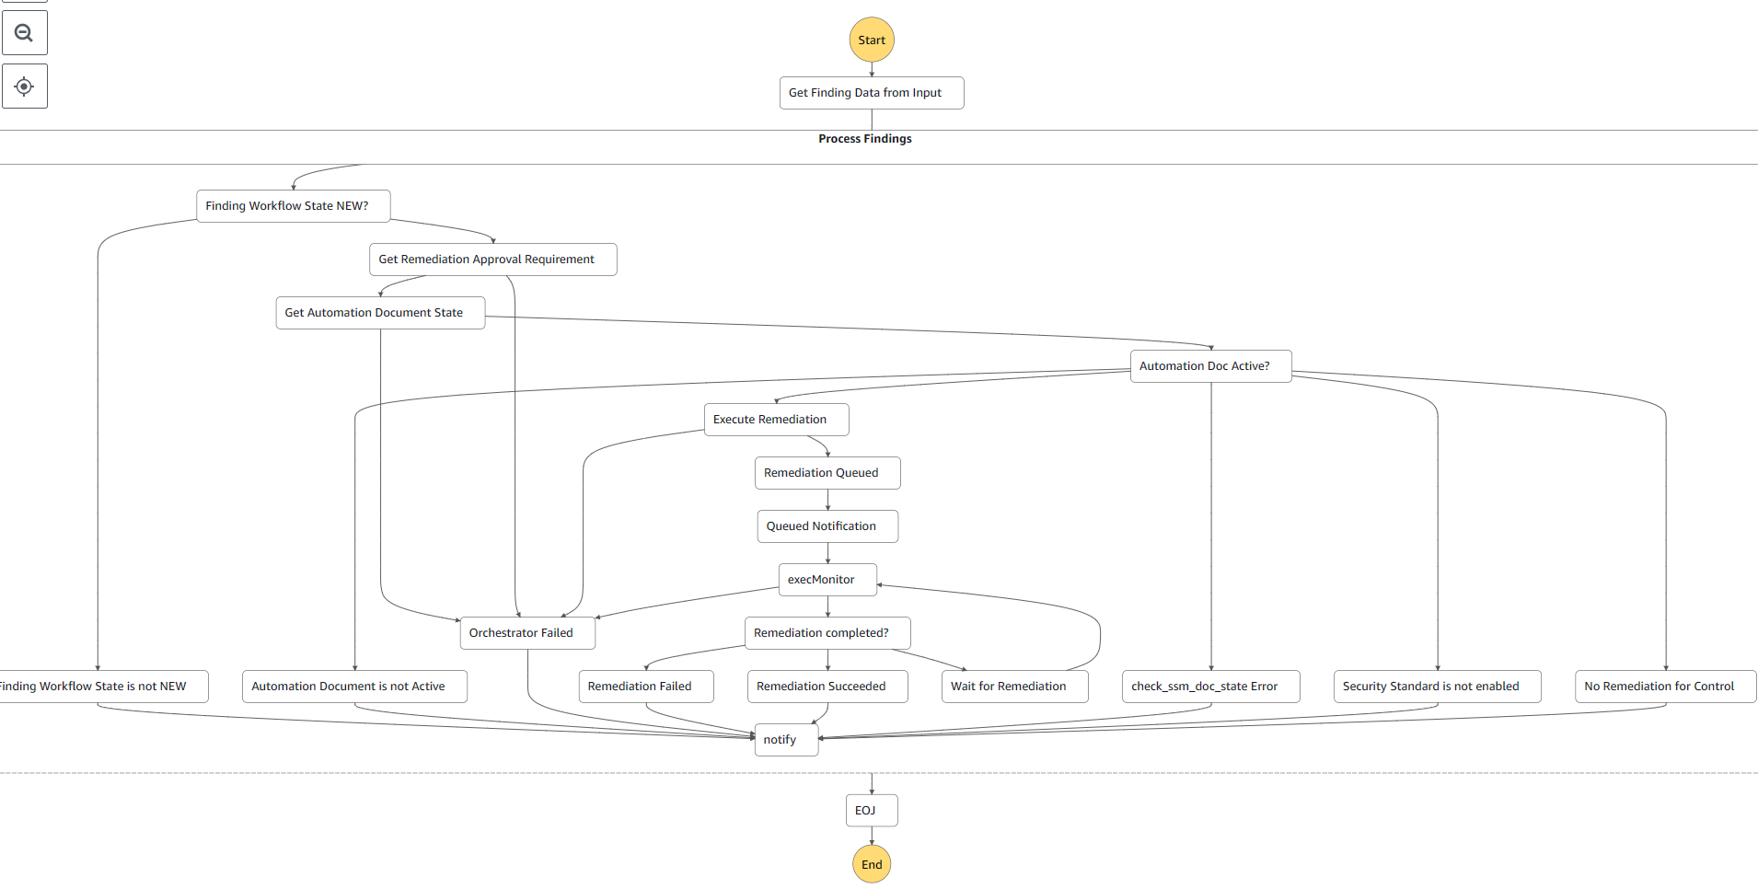
Behind the scene - Orchestrator

Slide 35
Scenario 1.1: Security groups should not allow ingress from 0.0.0.0/0 to port 22 – in member
Input: Member creates a security group that opens port 22 for all IPv4
=> violate control EC2.13
Acion: Monitor & remediate
Output:
Findings generated in admin-member AWS Security Hub
Remediation status notification to mail
Successfull automated remediation

Slide 37
Scenario 1.2 – Deploy in admin
Input: Admin creates a security group that opens port 22 for all IPv4
=> Fail control EC2.13
Acion: Monitor & remediate
Output:
Findings generated in admin AWS Security Hub
Remediation status notification to admin mail
Successfull automated remediation

Slide 39
Scenario 1.2: Behind the scene

Slide 42
Scenario 2: Ensure IAM password policy requires at least one number
Input: Member configs weak IAM password policies
=> Fail control IAM.14
Acion: Monitor & remediate
Output:
Findings generated in admin AWS Security Hub
Remediation status notification to admin mail
Successfull automated remediation

Slide 44
Scenario 3: RDS DB clusters should be configured for multiple AZs
Input: Admin has a RDS DB instance in only one Availablity Zone.
=> Fail control RDS.5
Acion: Monitor & remediate
Output:
Findings generated in admin AWS Security Hub
Remediation status notification to admin mail
Successfull automated remediation

Slide 46
Scenario 4: EBS default encryption should be enabled
Input: Member has an unencrypted EBS volume.
=> Fail control EC2.7
Acion: Monitor & remediate
Output:
Findings generated in admin AWS Security Hub
Remediation status notification to admin-member mail
Successfull automated remediation

Slide 48
Scenario 5: S3 general purpose buckets should have block public access settings enabled
Input: Member has a S3 bucket with public acces.
=> Fail control S3.1
Acion: Monitor & remediate
Output:
Findings generated in admin AWS Security Hub
Remediation status notification to admin-member mail
Successfull automated remediation

Slide 50
Scenario 5: Behind the scene

Slide 53
Project limitation
Slow generating findings (~ 1m 30s)
Only for AWS services

Slide 54
Thank you!
Phạm Nguyễn Hải Anh 21520586
Nguyễn Nhật Quân
21522497
Phan Hoàng Tuấn
20520847
Nguyễn Đăng Nguyên
20520256

Slide 55
Appendices

Slide 56
Appredix 1: Related work to EC2.13
CIS AWS Foundations Benchmark v1.2.0/4.1:
The Center for Internet Security (CIS) AWS Foundations Benchmark provides security best practices for AWS. Section 4.1 specifically addresses restricting public access to port 22.
PCI DSS v3.2.1/1.2.1, PCI DSS v3.2.1/1.3.1, PCI DSS v3.2.1/2.2.2:
The Payment Card Industry Data Security Standard (PCI DSS) sets requirements for protecting cardholder data. These specific sections deal with firewall and router configurations (1.2.1), restrictions on inbound and outbound traffic (1.3.1), and securing all system components (2.2.2).
NIST.800-53.r5:
The National Institute of Standards and Technology (NIST) Special Publication 800-53 provides a catalog of security and privacy controls for federal information systems and organizations.
AC-4: Information Flow Enforcement.
AC-4(21): Information Flow Enforcement | Network Segregation.
CM-7: Least Functionality.
SC-7: Boundary Protection.
SC-7(11): Boundary Protection | Restricting Information System Services.
SC-7(16): Boundary Protection | Transmission Points.
SC-7(21): Boundary Protection | External Telecommunication Services.
SC-7(4): Boundary Protection | External Telecommunication Services.
SC-7(5): Boundary Protection | Deny by Default / Allow by Exception.

Slide 57
Benefits of CSPM
Greater Visibility
Centralized visibility across (multi)cloud
Normalizing data sources
Real-time
Reduced Cloud Security Risk
Prioritize risks with highest impact
Help of remediation guidance and automation
Improved Regulatory Compliance

Slide 58
Why is CSPM important?
Without CSPM tools:
Each provider’s service: unique nuance
Multicloud Complexity
New services -> hard to keep up
What services used?
Security Blind Spots
Who, When, What - resources changed?
Where misconfig?
Challenges
Compliance Obligations
Human mistake -> noncompliance
Poor Developer Experience
Sec team coop with DevOps team
-> slow down the operation
Notes:
What is CSPM? | Microsoft Security
What Is CSPM? - Palo Alto Networks

Slide 59
Why is CSPM important?
With CSPM tools:
Multicloud Complexity
Detect, centralize and normalize
Visibility into resources, config changes, risks, compliance violations, etc
Security Blind Spots
Solve to Challenges
Auto compare config vs controls
Compliance Obligations
Report, remediation guidance
Poor Developer Experience
Add context + remediation steps
Notes:
What is CSPM? | Microsoft Security
What Is CSPM? - Palo Alto Networks

Slide 60
How CSPM works
Connect to the Cloud Environments
Get Visibility
Identify Misconfig & Compliance Violations
CSPM tools
Detect Threats
Contextualize Risks
Monitor and Report
Remediate Issues

Slide 61
Introduction
Context: In cloud security shared responsibility model, cloud service providers are in charge of cloud security, including infrastructure (routers, switches, data centers). Users (organizers) are responsible for security in the cloud => Adopt CSPM as a standard security practice when migrating applications to cloud.
Result: Automatically address security threats with predefined remediation actions in AWS Security Hub
Tech:
AWS Config, AWS Security Hub: For security check and findings
AWS Cloudformation: Deploy the solution in IaC
AWS Systems Manager: Deploys System Manager Documents (link to doc) that contain the remediation logic
AWS Step function: Orchestrator invokes the remediation documents with AWS Systems Manager API calls
AWS EventBridge: Deploy events that will initiate the orchestator step function when a finding is being remediated
AWS Lambda: Used by the step function orchestator to remediate issues
AWS IAM: Deploys roles to remediation
Amazon CloudWatch: Log groups
AWS SQS: Allows parallel remediations
AWS SNS: Notify users
Learn new: CSPM concepts + All tech above + AWS Cross-account

Slide 62
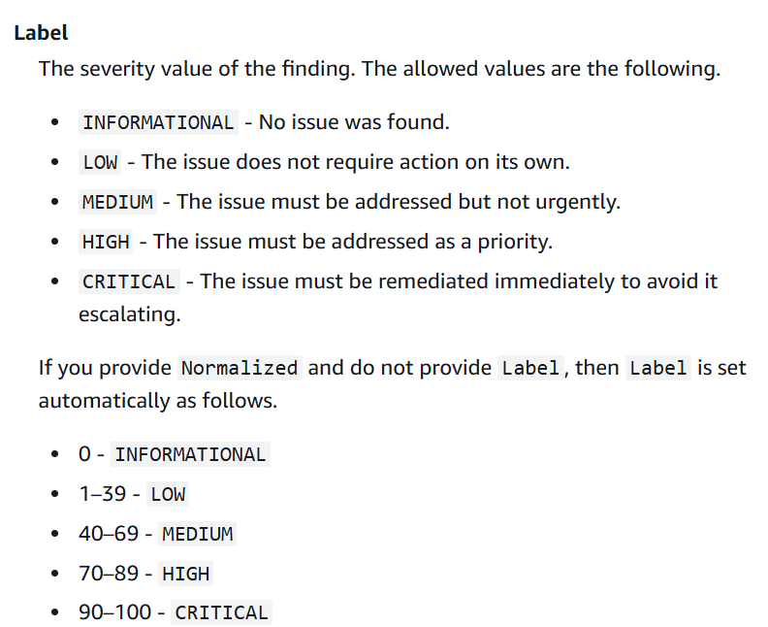
Appredix 2: Finding severity

