Slide 1

ANALYSIS OF COMPANIES DATA
By
P.Nithya Sri
K.Pavani

Slide 2
Contents
Introduction
Problem Statement and Objectives
Web Scraping
Summary Of Data
Data Cleaning
Exploratory Data Analysis
Univariate and Bivariate Analysis
Conclusions
Challenges
Steps to overcome the challenges

Slide 3
Introduction
We chose a website called ambitionbox.com.
It is India’s largest platform for company reviews, salary insights and interview advice.
It also awards companies on different categories every year based on the analysis.
To read companies related data like:
>Read companies reviews
>Interview questions
>Advice
>Discover companies
>Get salary insights
>Ratings
>Benefits

Slide 4
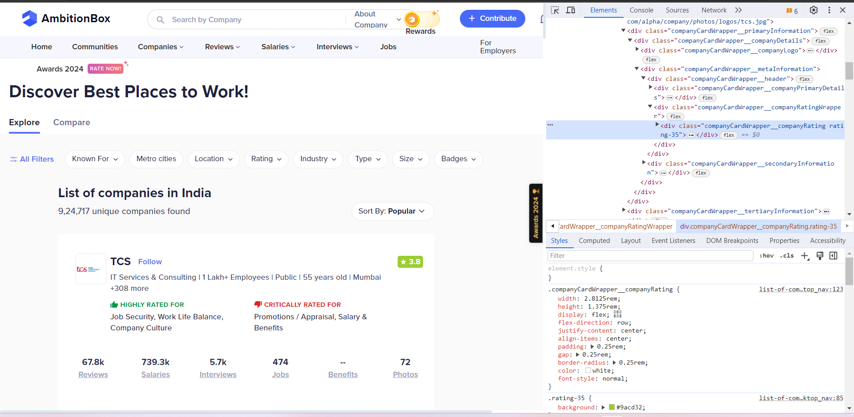
Website: ambitionbox.com
A snapshot of the website and its contents:

Slide 5
Problem Statement
To give suggestions(or)advice to job seekers about different companies by analyzing them based on their performance and ratings.
Objectives:
To find the company ratings and reviews.
To find the factors that affect the ratings of the company.
To understand the salary insights.

Slide 6
Web scraping
Process of extracting data from websites automatically.
Libraries used:
Requests
BeautifulSoup
Steps involved:
Inspecting the website
Downloading the website contents using code
Formatting the content into readable format
Collected a sample of 500 random companies from 9lakh+ companies as raw data.

Slide 7
Summary of Data The extracted data contains the following variables/ features: 1. Name 2. Rating 3. Highly Rated for 4. Critically Rated for 5. Reviews 6. Salaries 7. Interviews 8. Jobs

Slide 8
Data Cleaning
We need to clean the data before we do any analysis.
The important data cleaning steps include
- Missing value treatment
- Dropping the duplicates
- Converting the data to a more readable format
- Type conversion for required parameters

Slide 9
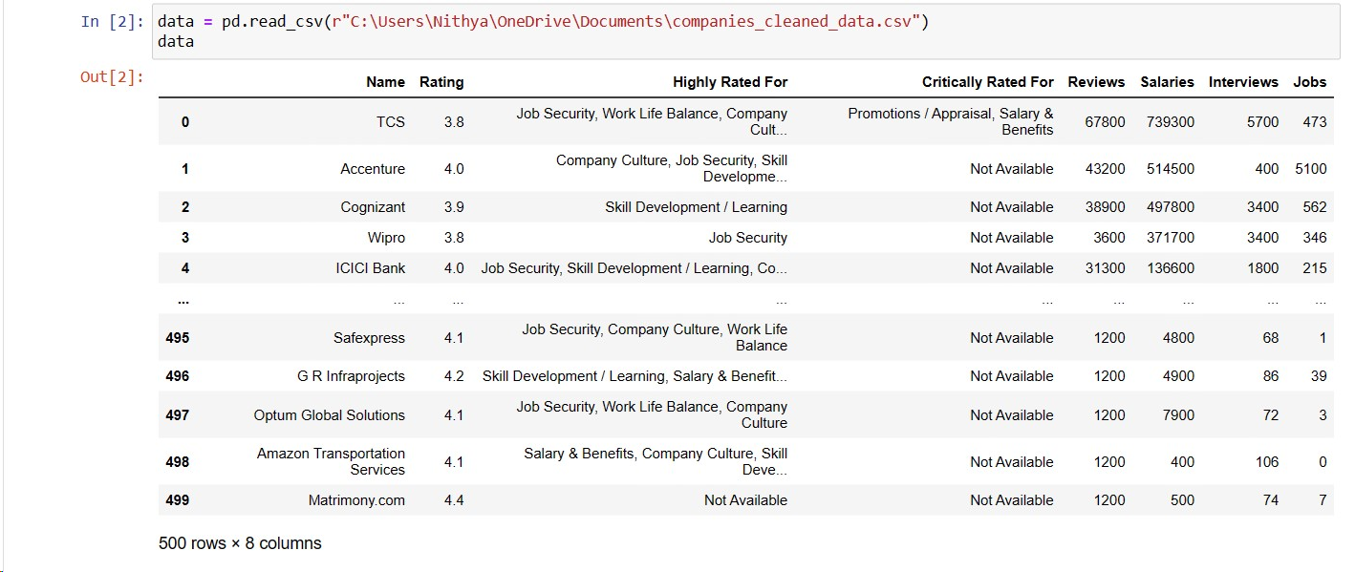
Clean and formatted data

Slide 10
Exploratory Data Analysis
Analysing data sets to summarize the main characteristics
Uses statistical methods and data visualization techniques
Python libraries used –
Pandas
Numpy
Matplotlib
Seaborn

Slide 11
Exploratory Data Analysis
Univariate Analysis
- Explores each variable in the data set.
- Describes patterns found in univariate data.
- Two types of data:
Categorical
Discrete
Bivariate Analysis
- Analysis of two variables in the data set to describe how these variables are related.
Categorical vs Numerical
Numerical vs Numerical

Slide 12
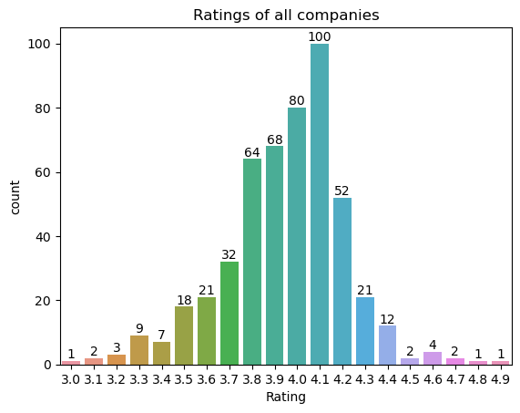
Insights drawn: Here in this count plot we see the count of companies that have certain ratings.

Slide 13
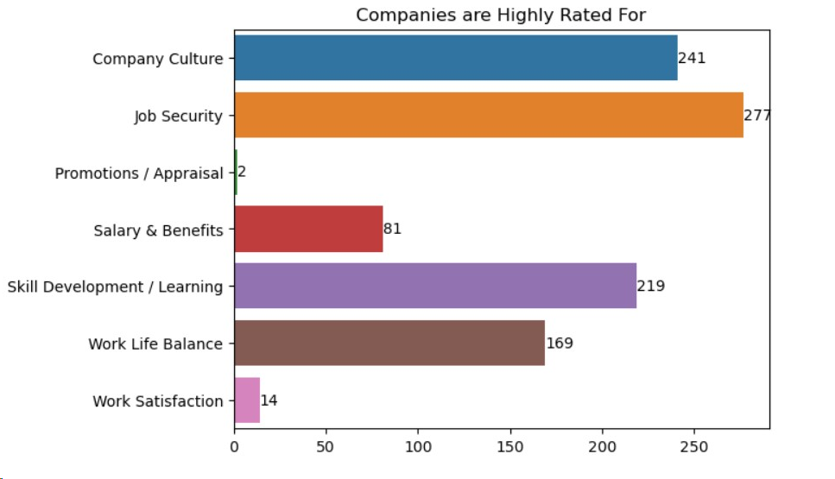
Insights drawn: Most of the companies are positively rated for Job Security, Company Culture, Skill Development/Learning

Slide 14
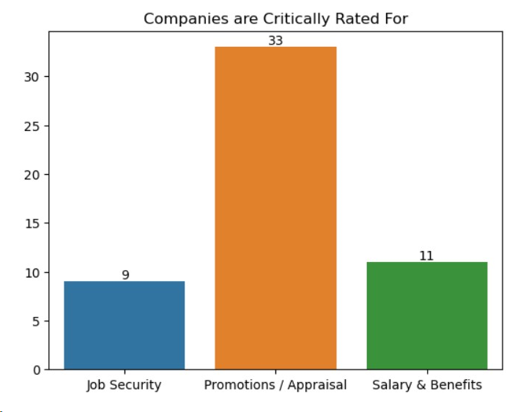
Insights drawn: Most of the companies are negatively/critically rated for Promotions/Appraisal

Slide 15
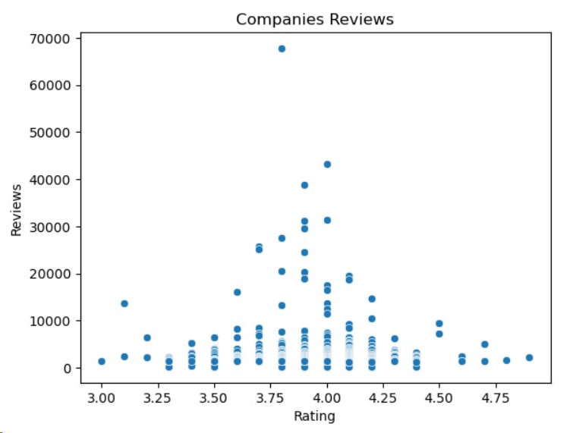
Insights drawn: From this scatter plot we can understand that most of the reviews are given for ratings between 3.7-4.2, whereas lowest ratings and highest ratings like 3.0-3.2, 4.5-4.7 have very less reviews.

Slide 16
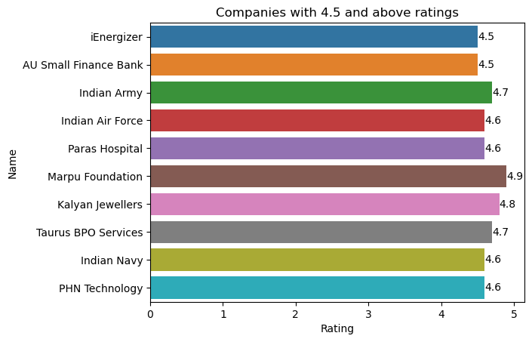
The above plot provides list of companies with 4.5 and above ratings

Slide 17
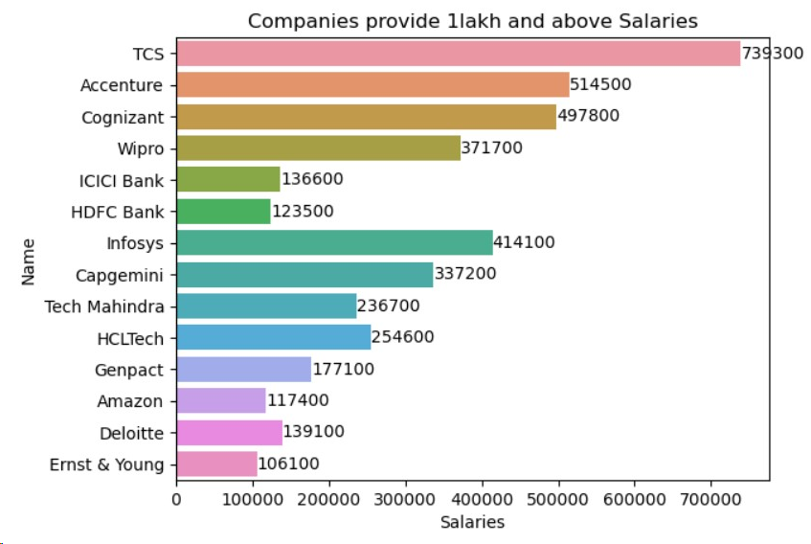
Insights drawn: TCS company provides the highest salary(7 lakh plus) compared to other companies Ernst & Young company has the least compared to other

Slide 18
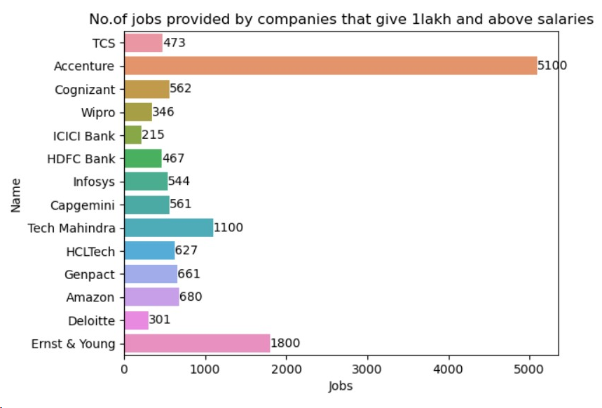
Insight drawn: The number of jobs provided by companies that give 1 lakh and above salaries is seen in this plot.
Accenture provides highest no.of jobs and pay highest salaries to employees.

Slide 19
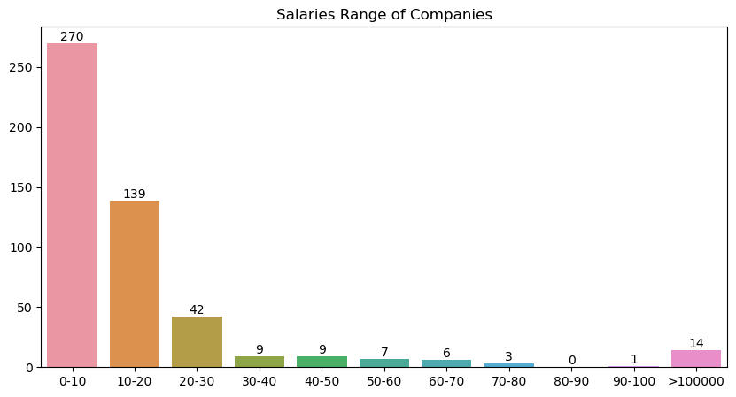
From the above plot we can understand that highest number of companies provide salaries less than 10,000 and very less companies provide salaries between 60k-100k

Slide 20
Conclusion
In this website we observed that mostly all companies have the 4 plus rating.
Most of the companies are highly rated for job security and critically rated for promotions/appraisal. So, if companies want to increase their ratings they have to increase promotions/appraisal for employees satisfaction.
From the randomly selected sample of 500 companies from website we found that 14 companies provide more than 1lakh salaries and highest number of companies provide salaries less than 10k.

Slide 21
Challenges
Scrapping multiple pages at the same time was difficult and the website was not responding many times.
Sometimes we got a 403 response on this website, in other words the server has understood the requests, but it won’t fulfil it due to insufficient permissions.
It implies that the client does not have the necessary credentials or the required permissions to access the requested resource.

Slide 22

THANK YOU

