Slide 1
SECTION 2
Use Cases of Cognitive Services

Slide 2
OBJECTIVE
Select appropriate combination of cognitive technologies based on use-case and data format.
Explain the uses of the Watson services in the Application Starter Kits.
Describe the Watson Conversational Agent.
Explain use cases for integrating external systems (such as Twitter, Weather API).

Slide 3
Cognitive technologies based on use-case and data format.
Agent-assist for email-based customer call center
Data: customer emails
Services: Q&A, Text classification, entity extraction and, keyword extraction
Watson-specific: NLC, R&R, Alchemy Language

Slide 4
Agent-assist for phone-based customer call center
Data: customer voice recordings
Services: Q&A, Speech recognition, text-to-speech, text classification, entity extraction, keyword extraction
Watson-specific: NLC, R&R, Alchemy Language

Slide 5
Expert advisor use case for physicians
Data: natural language intents
Services: Q&A, Text classification, entity extraction and keyword extraction
Watson-specific: NLC, R&R, Alchemy Language

Slide 6
Data insights for Instagram images
Data: images
Services: Image classification and natural OCR
Watson-specific: Visual Insights

Slide 7
Data insights for Twitter
Data: tweets
Services: Text classification, entity extraction, keyword extraction
Watson-specific: NLC and Alchemy Language

Slide 8
Uses of the Watson services in the Application Starter Kits.
List of Watson Starter Kits
Chatbot with Long Tail Search
News Intelligence
Social Customer Care
Text Message Chatbot
Voice of the Customer
Knowledge Base Search
Answer Retrieval

Slide 9
Chatbot with Long Tail Search
Use a conversational interface to answer both simple, common questions and complex, less common questions by adding search capability to a chatbot application.
Services Used
Discovery
Conversation

Slide 10
News Intelligence
Build applications that uncover insights from pre- enriched news content. Use a dashboard to visualize the latest connections and trends for companies mentioned in the news.
Services Used
Discovery

Slide 11
Social Customer Care
Social Customer Care monitors social media, understands brand customer needs or requests and responds proactively
Services Used
Personality Insights
Natural Language Classifier
Tone Analyzer

Slide 12
Text Message Chatbot
This starter kit uses Watson Conversation, Watson Natural Language Understanding, and the Weather API to demonstrate how to create an intuitive natural language conversation chatbot that connects to other services.
Services Used
Conversation
Natural Language Understanding

Slide 13
Voice of the Customer
Analyze consumer reviews and extract valuable insights
Services Used
Discovery

Slide 14
Knowledge Base Search
Use cognitive search to uncover the best answers to natural language questions by taking advantage of the Discovery Service's embedded natural language processing and powerful query language.
Services Used
Discovery

Slide 15
Answer Retrieval
Find and surface the most relevant responses to natural language queries from a large set of unstructured data.
Services Used
Retrieve and Rank

Slide 16
Starter Kit Demo
https://www.ibm.com/watson/developercloud/starter-kits.html

Slide 17
Watson services
Natural Language Classifier
uses machine learning algorithms to return the top matching predefined classes for short text inputs
The service interprets the intent behind text and returns a corresponding classification with associated confidence levels
The return value can then be used to trigger a corresponding action, such as redirecting the request or answering a question.

Slide 18
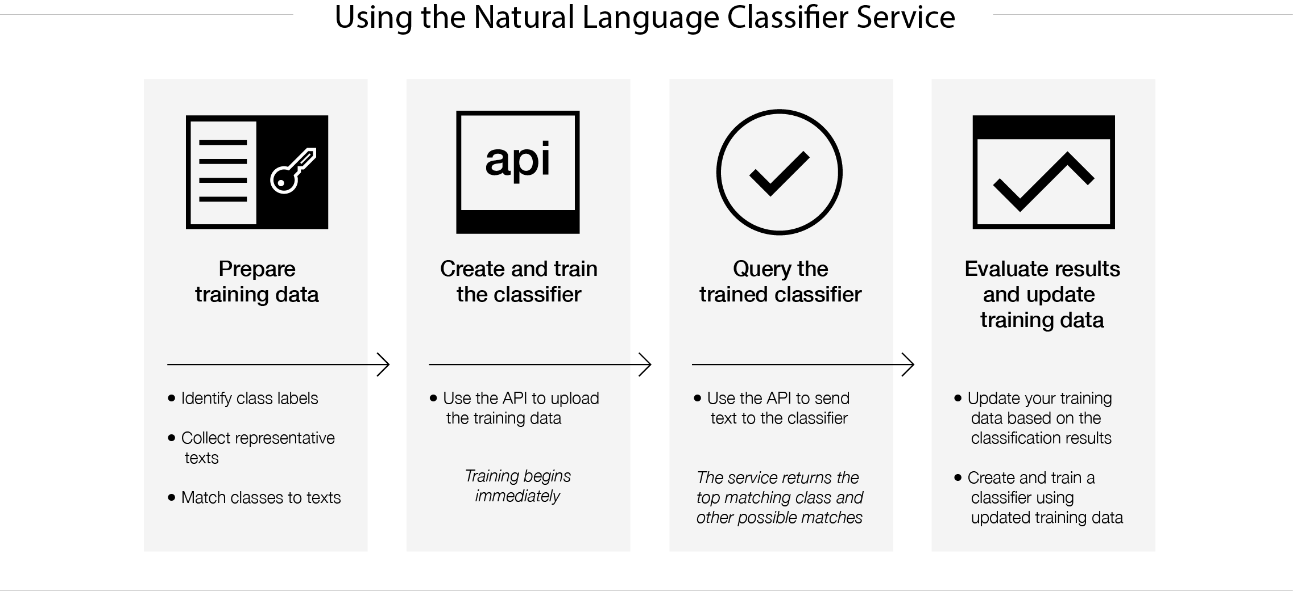
Natural Language Classifier

Slide 19
Natural Language Classifier
Intended Use
The Natural Language Classifier is tuned and tailored to short text (1000 characters or less)
Tackle common questions from your users that are typically handled by a live agent.
Classify SMS texts as personal, work, or promotional
Classify tweets into a set of classes, such as events, news, or opinions.
Based on the response from the service, an application can control the outcome to the user. For example, you can start another application, respond with an answer, begin a dialog, or any number of other possible outcomes.

Slide 20
Natural Language Classifier
Examples:
Twitter, SMS, and other text messages
Classify tweets into a set of classes, such as events, news, or opinions.
Analyze text messages into categories, such as Personal, Work, or Promotions.
Sentiment analysis
Analyze text from social media or other sources and identify whether it relates positively or negatively to an offering or service.

Slide 21
Natural Language Classifier
User input
Text to a pre-trained model
Service output
Classes ordered by confidence

Slide 22
Natural Language Classifier
Guidelines for good training
The training data must have at least five records (rows) and no more than 15,000 records.
The maximum total length of a text value is 1024 characters.
Limit the length of input text to fewer than 60 words.
Limit the number of classes to several hundred classes. Support for larger numbers of classes might be included in later versions of the service.
When each text record has only one class, make sure that each class is matched with at least 5 - 10 records to provide enough training on that class.

Slide 23
It can be difficult to decide whether to include multiple classes for a text. Two common reasons drive multiple classes:
When the text is vague, identifying a single class is not always clear.
When experts interpret the text in different ways, multiple classes support those interpretations.
However, if many texts in your training data include multiple classes, or if some texts have more than three classes, you might need to refine the classes. For example, review whether the classes are hierarchical. If they are hierarchical, include the leaf node as the class.

Slide 24
Natural Language Classifier
Supported languages
supports English (en), Arabic (ar), French (fr), German (de), Japanese (ja), Italian (it), Portuguese (pt), and Spanish (es).
The language of the training data must match the language of the text that you intend to classify
Specify the language when you create the classifier.

Slide 25
AlchemyLanguage
collection of APIs that offer text analysis through natural language processing. The AlchemyLanguage APIs can analyze text and help you to understand its sentiment, keywords, entities, high-level concepts and more
You can input text, HTML, or a public URL and leverage sophisticated natural language processing techniques to get a quick high-level understanding of your content and obtain detailed insights such as directional sentiment from entity to object.

Slide 26
AlchemyLanguage
Intended Use
Entity Extraction
Sentiment Analysis
Emotion Analysis
Keyword Extraction
Concept Tagging
Relation Extraction
Taxonomy Classification
Author Extraction
Language Detection
Text Extraction
Microformats Parsing
Feed Detection
Linked Data Support

Slide 27
AlchemyLanguage
User input
Any publicly-accessible webpage or posted HTML/text document.
Service output
Extracted meta-data including, entities, sentiment, keywords, concepts, relations, authors, and more, returned in XML, JSON, and RDF formats

Slide 28
AlchemyData News
AlchemyData provides news and blog content enriched with natural language processing to allow for highly targeted search and trend analysis.
you can query the world's news sources and blogs like a database.
AlchemyData News indexes 250k to 300k English language news and blog articles every day with historical search available for the past 60 days
You can query the News API directly with no need to acquire, enrich and store the data yourself - enabling you to go beyond simple keyword-based searches

Slide 29
AlchemyData News
Intended Use
Highly targeted search, time series and counts for trend analysis and pattern mapping, and historical access to news and blog content.
User input
Build a query with natural language processing to search both the text in indexed content and the concepts that are associated with it.
Service output
News and blog content enriched with our full suite of NLP services. Keywords, Entities, Concepts, Relations, Sentiment, Taxonomy

Slide 30
Tone Analyzer
uses linguistic analysis to detect three types of tones from text: emotion, social tendencies, and language style
Emotions identified include things like anger, fear, joy, sadness, and disgust
Identified social tendencies include things from the Big Five personality traits used by some psychologists. These include openness, conscientiousness, extroversion, agreeableness, and emotional range. Identified language styles include confident, analytical, and tentative.

Slide 31
Tone Analyzer
User input
JSON, plain text, or HTML input that contains your written content to the service
Service output
JSON that provides a hierarchical representation of the analysis of the terms in the input message

Slide 32
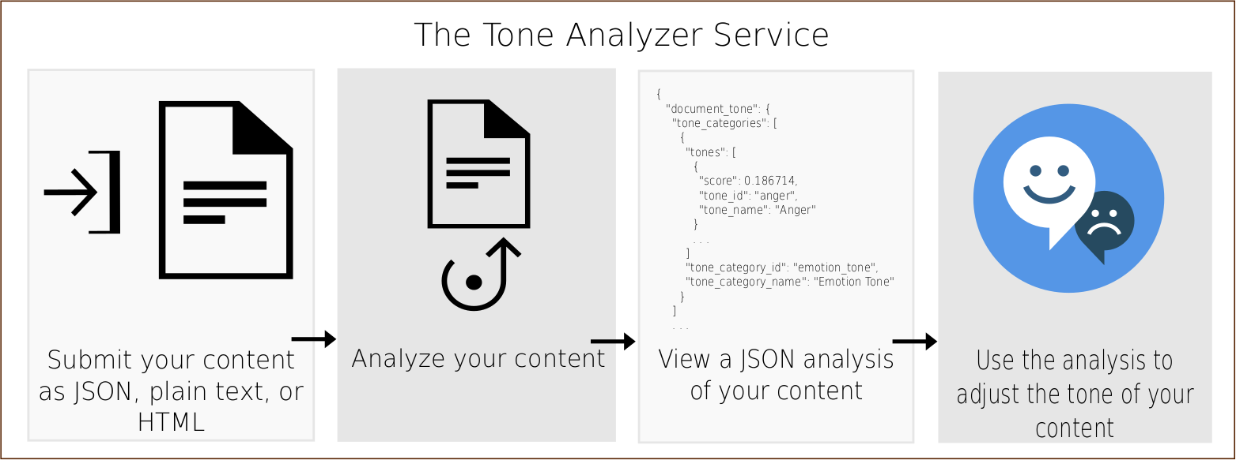
Tone Analyzer

Slide 33
Tone Analyzer
Intended Use
Personal and business communications - Anyone could use the Tone Analyzer service to get feedback about their communications, which could improve the effectiveness of the messages and how they are received.
Message resonance - optimize the tones in your communication to increase the impact on your audience
Digital Virtual Agent for customer care - If a human client is interacting with an automated digital agent, and the client is agitated or angry, it is likely reflected in the choice of words they use to explain their problem. An automated agent could use the Tone Analyzer Service to detect those tones, and be programmed to respond appropriately to them.
Self-branding - Bloggers and journalists could use the Tone Analyzer Service to get feedback on their tone and fine-tune their writing to reflect a specific personality or style.

Slide 34
Watson Dialog
The Dialog service provides a comprehensive, robust, platform for managing conversations between virtual agents and users through an application programming interface (API). These conversations are commonly referred to as dialogs.
Enables a developer to automate branching conversations between a user and your application.
The Dialog service enables your applications to use natural language to automatically respond to user questions, cross-sell and up-sell, walk users through processes or applications, or even hand-hold users through difficult tasks.
The Dialog service can track and store user profile information to learn more about end users, guide them through processes based on their unique situation, or pass their information to a back-end system to help them take action and get the help they need.

Slide 35
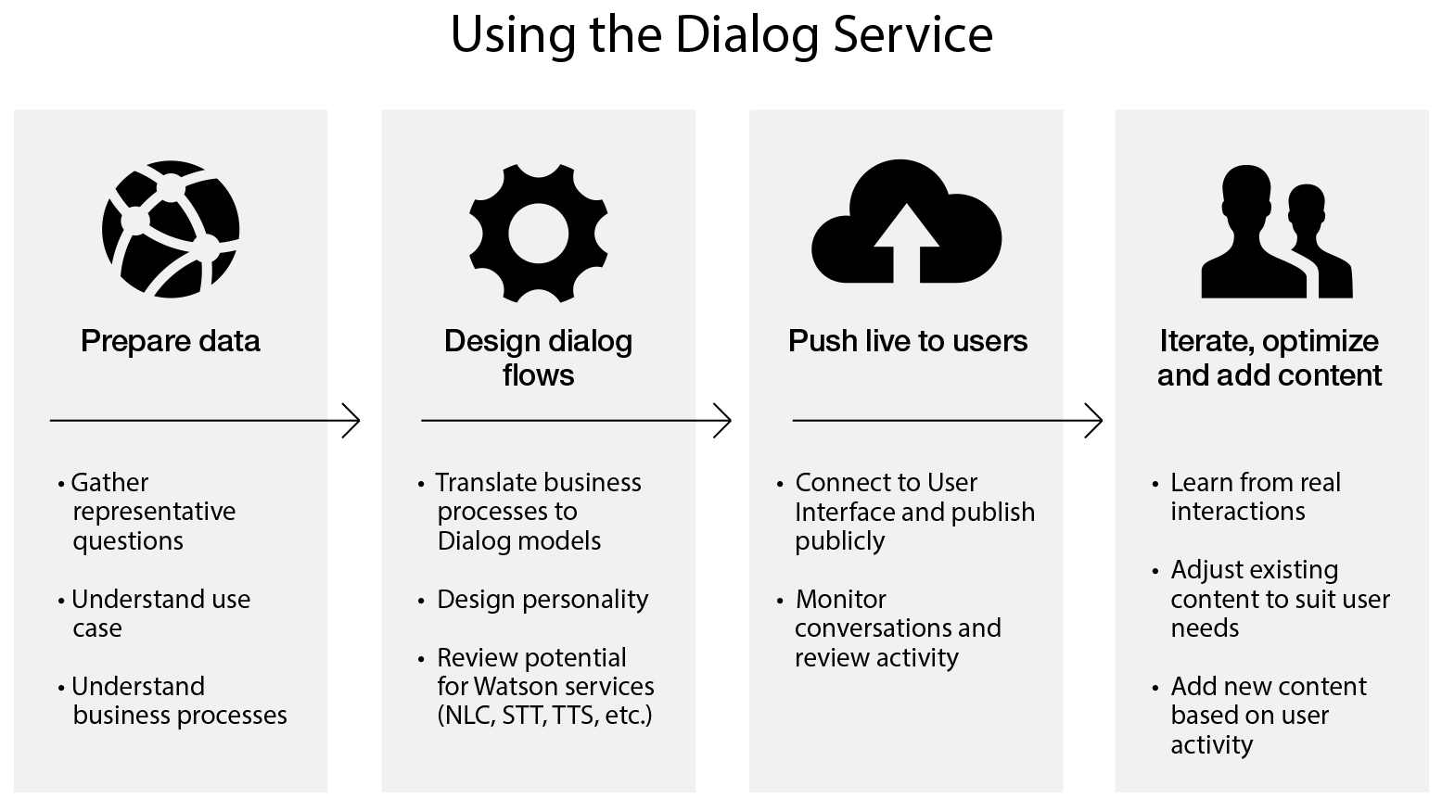
Watson Dialog

Slide 36
Watson Dialog
User input
Script conversations based on your expert knowledge of the domain.
Service output
End users can chat with your application using natural language and get the pre-written responses you created.

Slide 37
Watson Dialog
Intended Use
Engage in personalized, context-aware interactions
Answer questions
Provide product suggestions and decision support
Perform tasks and make transactions
Drive a user through a step-by-step process
Disambiguate inquiries
Connect with external systems
Show personality and have humanized interaction
Navigate users through websites and provide links
Provide interactive problem resolution

Slide 38
Tradeoff Analytics
Service that helps people make decisions when balancing multiple objectives
The service uses a mathematical filtering technique called “Pareto Optimization,” that enables users to explore tradeoffs when considering multiple criteria for a single decision.

Slide 39
Tradeoff Analytics
User input
A decision problem with objectives and options (for example, what is the best car when my goals are type, price, and fuel economy?)
Service output
JSON objects that represent the optimal options and highlight the trade-offs between them. The service recommends using a provided client-side library to consume its JSON output.

Slide 40
Tradeoff Analytics
Intended Use
Tradeoff Analytics can help bank analysts or wealth managers select the best investment strategy based on performance attributes, risk, and cost
It can help consumers purchase the product that best matches their preferences based on attributes like features, price, or warranties
Tradeoff Analytics can help physicians find the most suitable treatment based on multiple criteria such as success rate, effectiveness, or adverse effects

Slide 41
Watson Conversation
With the IBM Watson Conversation service, you can build a solution that understands natural-language input and uses machine learning to respond to customers in a way that simulates a conversation between humans
combines a number of cognitive techniques to help you build and train a bot - defining intents and entities and crafting dialog to simulate conversation

Slide 42
Watson Conversation
Use cases:
Add a chatbot to your website that automatically responds to customers’ most frequently asked questions.
Build Twitter, Slack, Facebook Messenger, and other messaging platform chatbots that interact instantly with channel users.
Allow customers to control your mobile app using natural language virtual agents.

Slide 43
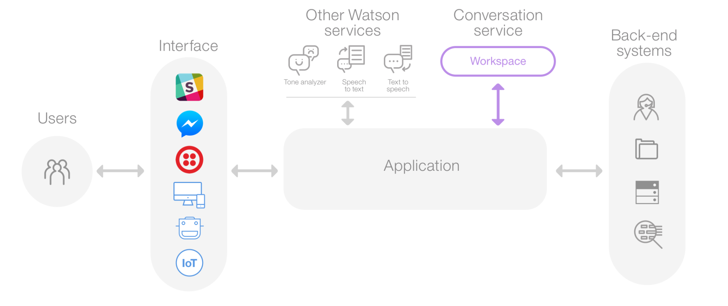
Watson Conversation

Slide 44
Watson Conversation
Users interact with your application through the user interface that you implement. For example, A simple chat window or a mobile app, or even a robot with a voice interface.
The application sends the user input to the Conversation service.
The application connects to a workspace, which is a container for your dialog flow and training data.
The service interprets the user input, directs the flow of the conversation and gathers information that it needs.
You can connect additional Watson services to analyze user input, such as Tone Analyzer or Speech to Text.
The application can interact with your back-end systems based on the user’s intent and additional information. For example, answer question, open tickets, update account information, or place orders. There is no limit to what you can do.

Slide 45
Watson Conversation
User input
Your domain expertise in the form of intents, entities and crafted conversation
Service output
A trained model that enables natural conversations with end users

Slide 46
Language Translator
You can create an application that identifies the language of input text and uses a domain-specific linguistic model to translate the text into another language.
To translate industry-specific jargon or other types of specialized terminology, you can customize the linguistic model to optimize it for your needs.

Slide 47
Language Translator
Intended use
An English-speaking help desk representative can assist a Spanish-speaking customer through chat (using the conversational translation model)
A West African news website can curate English news from across the globe and present it in French to its constituents (using the news translation model)
A patent attorney in the US can effectively discover prior art (to invalidate a patent claims litigation from a competitor) based on invention disclosures made in Korean with the Korean Patent Office
A bank can translate all of their product descriptions from English to Arabic using a custom model tailored to that bank's product names and terminology

Slide 48
Language Translator
User input
Plain text in one of the supported input languages and domains.
Service output
Plain text in the target language selected.

Slide 49
Language Translator
Supported languages
News:
Targeted at news articles and transcripts. Translate English to and from Arabic, Brazilian Portuguese, French, German, Italian, Japanese, Korean, and Spanish. You can also translate Spanish to and from French.
Conversational:
Targeted at conversational colloquialisms. Translate English to and from Arabic, Brazilian Portuguese, French, Italian, and Spanish.
Patents:
Targeted at technical and legal terminology. Translate Brazilian Portuguese, Chinese, Korean, and Spanish to English.

Slide 50
Personality Insights
Service provides an Application Programming Interface (API) that enables applications to derive insights from social media, enterprise data, or other digital communications
The service outputs personality characteristics that are divided into three dimensions:
The Big 5, Values, and Needs

Slide 51
Personality Insights
Big Five personality characteristics represent the most widely used model for generally describing how a person engages with the world. The model includes five primary dimensions:
Agreeableness is a person's tendency to be compassionate and cooperative toward others.
Conscientiousness is a person's tendency to act in an organized or thoughtful way.
Extraversion is a person's tendency to seek stimulation in the company of others.
Emotional Range, also referred to as Neuroticism or Natural Reactions, is the extent to which a person's emotions are sensitive to the person's environment.
Openness is the extent to which a person is open to experiencing a variety of activities.
Each of these top-level dimensions has six facets that further characterize an individual according to the dimension.
Needs describe which aspects of a product will resonate with a person. The model includes twelve characteristic needs: Excitement, Harmony, Curiosity, Ideal, Closeness, Self-expression, Liberty, Love, Practicality, Stability, Challenge, and Structure.
Values describe motivating factors that influence a person's decision making. The model includes five values:
Self-transcendence / Helping others, Conservation / Tradition, Hedonism / Taking pleasure in life, Self-enhancement / Achieving success, and Open to change / Excitement.

Slide 52
Personality Insights
Intended Use
Understand their customers at a deeper level by learning their clients' preferences, improving customer satisfaction, and strengthening client relations.
Improve client acquisition, retention, and engagement.
Guide highly personalized engagements and interactions to better tailor their products, services, campaigns, and communications for individual clients.

Slide 53
Personality Insights
User input
JSON, or Text or HTML (such as social media, emails, blogs, or other communication) written by one individual
Service output
A tree of cognitive and social characteristics in JSON or CSV format

Slide 54
Natural Langauage Understanding
Analyze various features of text content at scale.
Provide text, raw HTML, or a public URL, and IBM Watson Natural Language Understanding will give you results for the features you request.
The service cleans HTML content before analysis by default, so the results can ignore most advertisements and other unwanted content.

Slide 55
NLU
Concepts
Identify general concepts that are referenced or alluded to in your content. Concepts that are detected typically have an associated link to a DBpedia resource.
Entities
Detect important people, places, geopolitical entities and other types of entities in your content. Entity detection recognizes consecutive coreferences of each entity. For example, analysis of the following text would count "Barack Obama" and "He" as the same entity:
"Barack Obama was the 44th President of the United States. He took office in January 2009."
Keywords
Determine the most important keywords in your content. Keyword phrases are organized by relevance in the results.
Categories
Categorize your content into a hierarchical 5-level taxonomy. For example, "Leonardo DiCaprio won an Oscar" returns "/art and entertainment/movies and tv/movies" as the most confident classification.
Sentiment
Determine whether your content conveys postive or negative sentiment. Sentiment information can be returned for detected entities, keywords, or user-specified target phrases found in the text.

Slide 56
NLU
Emotion
Detect anger, disgust, fear, joy, or sadness that is conveyed by your content. Emotion information can be returned for detected entities, keywords, or user-specified target phrases found in the text.
Relations
Recognize when two entities are related, and identify the type of relation. For example, you can identify an "awardedTo" relation between an award and its recipient.
Semantic Roles
Parse sentences into subject-action-object form, and identify entities and keywords that are subjects or objects of an action.
Metadata
Get author information, publication date, and the title of your text/HTML content.

Slide 57
IBM Watson Discovery
IBM Watson™ Discovery makes it possible to rapidly build cognitive, cloud-based exploration applications that unlock actionable insights hidden in unstructured data — including your own proprietary data, as well as public and third-party data.
With Discovery, it only takes a few steps to prepare your unstructured data, create a query that will pinpoint the information you need, and then integrate those insights into your new application or existing solution.

Slide 58
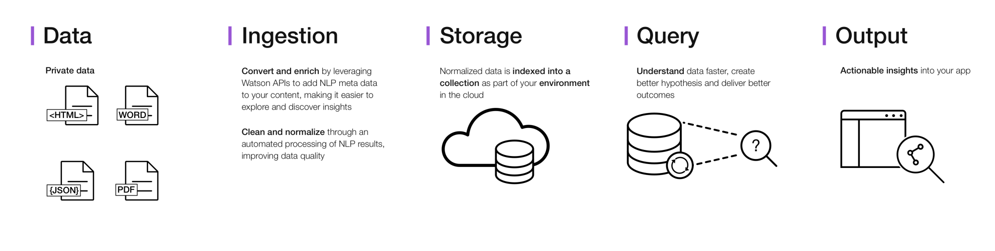
DISCOVERY

Slide 59
DISCOVERY
How does Discovery do it?
By using data analysis combined with cognitive intuition to take your unstructured data and enrich it so you can discover the information you need.
IBM Watson™ Discovery brings together a functionally rich set of integrated, automated Watson APIs to:
Crawl, convert, enrich and normalize data.
Securely explore your proprietary content as well as free and licensed public content.
Apply additional enrichments such as concepts, relations, and sentiment through natural language processing.
Simplify development while still providing direct access to APIs.

Slide 60
DISCOVERY NEWS
Discovery News, a public data set that has been pre-enriched with cognitive insights, is also included with Discovery. You can use this public, unstructured data set to query for insights that you can integrate into your applications

Slide 61
Retrieve and Rank
This service helps users find the most relevant information for their query by using a combination of search and machine learning algorithms to detect "signals" in the data.
Retrieve: Retrieve is based on Apache Solr. It supports nearly all of the default Solr APIs and improves error handling and resilience. You can start your solution by first using only the retrieve features and then add the ranking component.
Rank: The rank component (ranker) creates a machine-learning model that is trained on your data. You call the ranker in your runtime queries to use this model to boost the relevance of your results with queries that the model has not previously seen.

Slide 62
Retrieve and Rank
Apache Solr
An open source enterprise search platform, written in Java, from the Apache Lucene project.
Its major features include
full-text search
hit highlighting
faceted search
real-time indexing
dynamic clustering
database integration

Slide 63
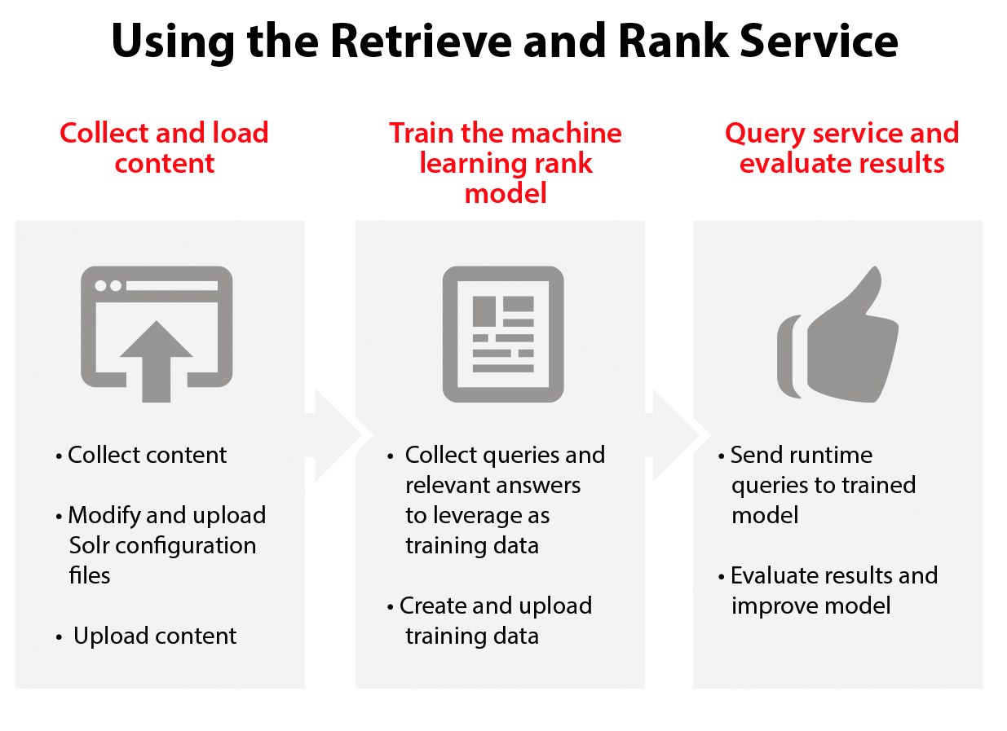
Retrieve and Rank

Slide 64
Retrieve and Rank
User input
Your documents Queries (questions) associated with your documents Service Runtime: User questions and queries
Service output
Indexed documents for retrieval Machine learning model (Rank) Service Runtime: A list of relevant documents and metadata

Slide 65
Retrieve and Rank
Intended use:
The core users of the Retrieve and Rank service are customer-facing professionals, such as support staff, contact center agents, field technicians, and other professionals.
Customer support: Find quick answers for customers from your growing set of answer documents
Field technicians: Resolve technical issues onsite
Professional services: Find the right people with the right skills for key engagements

Slide 66
Speech to Text
Watson Speech to Text can be used anywhere there is a need to bridge the gap between the spoken word and its written form.
This easy-to-use service uses machine intelligence to combine information about grammar and language structure with knowledge of the composition of an audio signal to generate an accurate transcription.
It uses IBM's speech recognition capabilities to convert speech in multiple languages into text.
The service is accessed via a WebSocket connection or REST API.

Slide 67
Speech to Text
Intended Use
The Speech to Text service can be used anywhere voice-interactivity is needed.
The service is great for mobile experiences, transcribing media files, call center transcriptions, voice control of embedded systems, or converting sound to text to then make data searchable.
Supported languages include US English, UK English, Japanese, Spanish, Brazilian Portuguese, Modern Standard Arabic, and Mandarin.
The Speech to Text service now provides the ability to detect the presence of specific keywords or key phrases in the input stream.

Slide 68
Speech to Text
User input
Streamed audio with Intelligible Speech Recorded audio with Intelligible Speech
Service output
Text transcriptions of the audio with recognized words

Slide 69
Speech to Text
Continuous transmission
By default, the service stops transcription at the first end-of-speech (EOS) incident, which is denoted by a half-second of non-speech (typically silence) or when the stream terminates
Set the continuous parameter to true to instruct the service to transcribe the entire audio stream until the stream terminates

Slide 70
Use cases for integrating external systems (such as Twitter, Weather API)
When systems communicate with each other, this is considered Internet of Things
IBM Watson IoT Platform for Bluemix gives you a versatile toolkit that includes gateway devices, device management, and powerful application access.
By using Watson IoT Platform, you can collect connected device data and perform analytics on real-time data from your organization

Slide 71
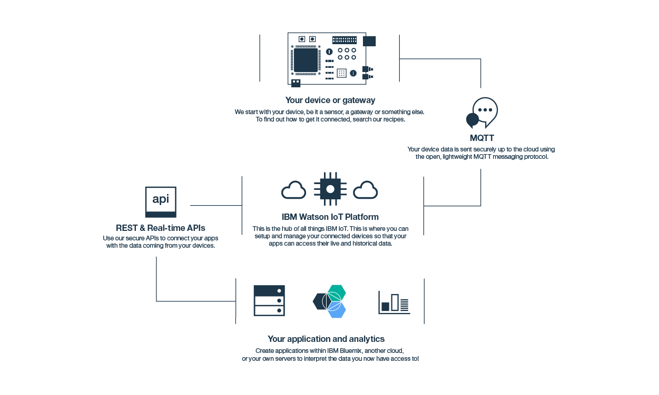
Watson IoT

Slide 72
Components of systems communicating with one another
Step 1: Connect your devices
Step 2: Analyze your device data
Step 3: Create applications to consume your device data
Before connecting devices and utilizing data, register for a Bluemix account and create an instance of the Watson IoT Platform service in your Bluemix organization

Slide 73
Sentiment Analysis API
Sentiment analysis
API used to process text and gives polarity of text weather it is positive, negative or neutral with associated score around it
Trained using Twitter data, web data for positive and negative words
partnership between IBM and Twitter, you don’t need to be a specialist or data scientist to extract business insights from Twitter
Recurrent neural, Operated on sentences rather than word

Slide 74
The Weather APIs
Weather is perhaps the single largest external swing factor in business performance across many industries and is responsible for significant economic impact worldwide,
IBM and The Weather Company announced their new strategic partnership to bring unmatched capabilities of weather data to its clients, joining The Weather Company’s weather data, forecasting and analytical models together with IBM’s deep expertise in combining weather data and analytics to bring real value to the market.

Slide 75
IBM Insights for Weather
IBM Insights for Weather for Bluemix enables you to easily incorporate weather data into your application, allowing you to retrieve daily observed weather data and forecasts for a specified time range, based on postal code or geolocation with worldwide coverage
The APIs include:
Real-time weather updates for current weather conditions, including temperature, wind direction and speed, humidity, pressure, visibility and more! Updates include a sensible weather phrase and a matching weather icon.
Hourly forecasts for the next 24 hours, including descriptive forecast text.
Daily forecasts for the next 10 day period, including forecast narrative text string of up to 256 characters with appropriate units of measure for the location and in the language requested.
Historical weather data for the previous 24 hours, based on weather data from site-based observation stations.
Insights for Weather for Bluemix supports a set of REST APIs and provides weather data in JSON format, which means any cloud developer can embed weather data with worldwide coverage with ease, without the hassle of setup, maintenance and operation

